Slide 1
CSSE 304 Day 2
More Recursive Procedures
Submit your Assignment 0 hand-in sheet to the drop box on Moodle

Slide 2
Finding today’s starting code
Go to the Live-in-class folder. Two ways to find it:
Schedule page, Session 1 Resources, sixth bulleted item.
Moodle page, Important External links, the last link.
Click the Day 02 in-class link.
Get the code for your section.

Slide 3
Day 2 things to do
Your non-Scheme questions
Your Scheme Questions
Run the A1 offline test code
More recursive procedures (together)
Still more recursive procedures (in breakout rooms)

Slide 4
Students Questions
Questions about the syllabus or course policies?
Questions about installation, tool use, etc.?
Questions about Scheme?

Slide 5
Running my test code on your own computer
I will demonstrate this in SWL (now) and Emacs (when we do the live coding).
Notes:
The first one is true. And according to the evaluations from the 13 or so times I have taught this, most of the students like it too!
On Senior exit surveys, one question we ask is "What is your favorite CSSE course?" Every year, this one gets the most votes.
Full dusclosure: It usually also gets one or two votes for least favorite course
The second one is true only if you don't keep up!
In Spring of 2009, 61 students. 28 A's and 10 B+'s
Unfortunately, every time I teach the course a few students get behind and can never catch up.
Decide now that this will not be you!
On most assignments, you will spend a lot of time writing a little bit of code, and you will learn a lot. The assignments are key. They are cumulative. Do not miss any,

Slide 6
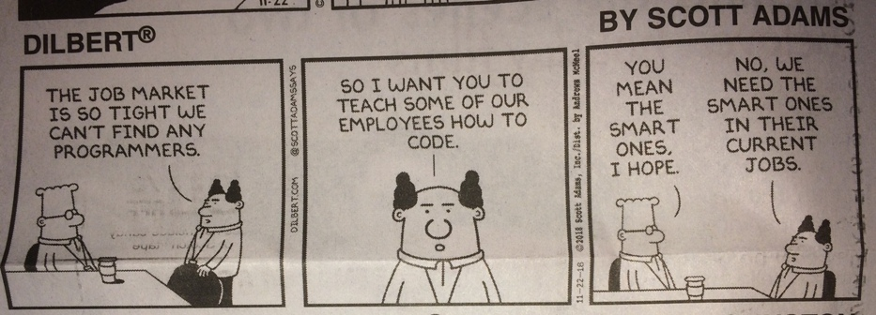
Interlude

Slide 7
Interlude
Tom Swifties (most from Wikipedia):
"Who left the toilet seat down?" Tom asked peevishly.
"I'll never again put my arm in a lion's mouth," Tom said off-handedly.
"Can I go looking for the Holy Grail again?" Tom requested.
"I unclogged the drain with a vacuum cleaner," Tom said succinctly.
"We just struck oil!" Tom gushed.
"They had to amputate them both at the ankles," Tom said defeatedly.
"Who discovered radium?" asked Marie curiously.
"Hurry up and get to the back of the ship," Tom said sternly.
"Who put the moss in the bog again?" asked Tom repeatedly.
"A word that contains all five vowels? And I suppose you want those vowels to appear in alphabetical order!?" asked Tom facetiously.
"The robber is coming down the stairs", Tom said condescendingly.
"Nnnn", Tom murmured forensically.
Notes:
Hidden for 200930

Slide 8
Write these recursive procedures
Write procedures to
Find the median of three numbers
Given a list of numbers lon and a number n, return a new list of numbers where each element is n more than the corresponding element of lon.
Count how many times the number n occurs in the list lon.
* "…if any time remains," Tom schemed parenthetically.

Slide 9
More recursive procedures
Go to your assigned breakout room.
The student whose birthday is soonest should drive.
(square-sum n) returns the sum of the squares of the first n positive integers.
(square-all lon) returns a list of the squares of the numbers in lon.
(make-list n obj) returns a list of n "copies" of obj. [If obj is a "by-reference" object, such as a list, make-list makes n copies of the reference].
Notes:
On the board, like the previous one:
(define square-sum
(lambda (n)
(if (zero? n)
0
(+ (* n n) (square-sum (- n 1))))))
This one is on the quiz. Let them have about 3 minutes to work on it. Ask if everyone has it. If so, then move on, and don't go over it.
(define square-all
(lambda (ls)
(if (null? ls)
'()
(cons (* (car ls) (car ls))
(square-all (cdr ls))))))
On the board, like the previous one:
(define make-list
(lambda (n obj)
(if (zero? n)
'()
(cons obj (make-list (- n 1))))))

