Slide 1
CSSE 304 Day 11
Short quiz (10 20 points) 7 minutes
List-recur follow-up
reverse and reverse!
Make our own objects
compose
Your questions?
Notes:
When posting for students, originally do not include slides that have answers. Put them in after class.

Slide 2
CSSE304 assignments are not research projects!
You might find solutions to some of the homework problems on the internet
Using them short-circuits the learning process, and it is an Academic irregularity.
This is intended to be a "from first principles" course

Slide 3
For reference: list-recur
A procedure that returns a procedure that recurs down a list.
(define list-recur
(lambda (base-value list-proc)
(letrec
([helper
(lambda (ls)
(if (null? ls)
base-value
(list-proc (car ls) (helper (cdr ls)))))])
helper)))
)
Notes:
Look at the ones online
Then do reverse
(define reverse (list-recur '() (lambda (x y) (append y (list x)))))
Talk about snoc

Slide 4
list-recur abstracts list recursion
Assignment from last time:
Try to come up with at least one other procedure that is easy to write using list-recur. Hopefully something that is not a clone of one that we wrote.
And write it!
(define list-sum (list-recur 0 +)
(define list-prod (list-recur 1 *)
(define apply-to-all
(lambda (proc)
(list-recur ′()
(lambda (x y)
(cons (proc x) y)))))
(define member?-c
(lambda (item)
(list-recur #f (lambda (x y)
(or (equal? item x)
y)))))
(define length (list-recur 0 (lambda (x y) (+ 1 y))))
Your examples?
One of these may be a bad idea!
Notes:
My new example:
For next time: (define reverse (list-recur '() (lambda (x y) (append y (list x)))))
Bad idea: member?-c, because we can no longer short-circuit. Ask them why that is.
It's because arguments to procedures are evaluated before the procedure is applied.

Slide 5
HW 9 Preview
You will write a procedure, snlist-recur that produces procedures that recur over s-lists and n-lists, similar to how list-recur produces procedures that recur over lists. (An n-list is like an s-list, but contains numbers instead of symbols).
Use that procedure to create several s-list procedures.
Then write bt-recur. Produces procedures that recur over binary trees.
Also, you will do an OO example.

Slide 6
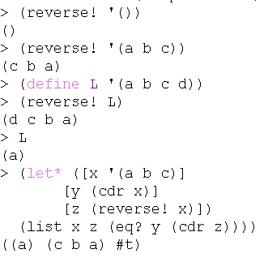
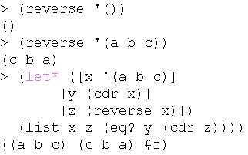
In-class exercise
write reverse and reverse! procedures
For reverse!, you will need to use set-cdr!
Both should be O(n).
These transcripts might help you to distinguish between them.
Do this with another person.
Notes:
Suggestion for 2011: Email a link to the Exam slides to students on Wednesday, so there is no need to spend much time on them in class.

Slide 7
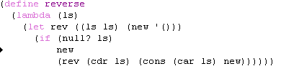
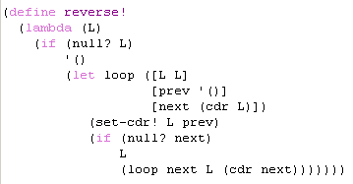
Solutions

Slide 8
Interlude
Assaf Razon wrote:
>
> A few of my friends and I attended a wedding. Being from Israel, this
> is naturally a Jewish wedding, and one of my friends is an ex combat
> officer in the Army.
>
> So we were talking about throwing the bouquet, and I said (being the
> insistent wedding-basher) that if one were thrown at me, I'd dodge it.
> So my friend said: "I'll just throw it at you like the Palestinians
> throw rocks and bombs at us", > and I answered "you mean a 'Mazeltov Cocktail'?"
http://groups.google.com/group/rec.humor.funny/tree/browse_frm/month/1997-09/9746604786b8c274?rnum=31&lnk=ol

Slide 9
How we could do OOP IN SCHEME using only things we have seen so far?
Constructing objects
"fields"
"methods"
method arguments

Slide 10
OO Programming in Scheme
We need to find a way to encapsulate "fields" and "methods", so that fields can only be accessed/changed by using the methods.
We can represent an object by a _____.
"Fields" are persistent local variables.
A "method name" is the first argument to the "object" procedure; "method arguments" are the other arguments to the procedure.

Slide 11
> (define s1 (make-stack))
> (define s2 (make-stack)))
> (s1 'push 'a)
> (s2 'push 'z)
> (s1 'push 'b)
> (s1 'pop)
b
(s1 'empty?)
#f
> (s2 'push (s1 'pop))
> (s1 'empty?)
#t
> (s2 'pop)
a
> (s2 'pop)
z
> (s2 'pop)
Exception in car: () is not a pair
>
Transcript for the stack class

Slide 12
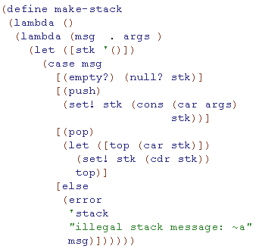
Encapsulation: Creating "objects" in a mostly functional language
The car of the list contains the top of the stack
What is the problem with this code? How to fix it?
This code contains a subtle error. Can you see what it is?
Notes:
The problem is that it recreates stk every time you call a method.
FIX: Move the let outside the inner lambda
ASK: What goes wrong if we move the let outside the outer lambda?
ANSWER: There is only one stack, shared by all "stack objects"

Slide 13
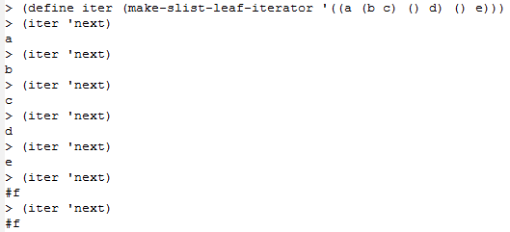
HW 8a Preview
You will implement another class, slist-leaf-iterator. Your procedure, given an s-list s, will make an iterator "object" for s.
What is an easy way to implement this?

Slide 14
HW 8 Preview
You will use this stack "class" implementation as a helper procedure when you implement another class, slist-leaf-iterator. Your procedure, make-slist-leaf-iterator, given an s-list s, will make an iterator "object" for s.
Why is the "easy" approach from the last slide inefficient? Think of an slist with tens of thousands of symbols.
In the HW problem, your iterator procedures are not allowed to traverse more of the tree than is required for the 'next calls that happen.
That's where a stack object cones in.
Can be similar to the preorder iteratror in Weiss, Chapter 18.

Slide 15
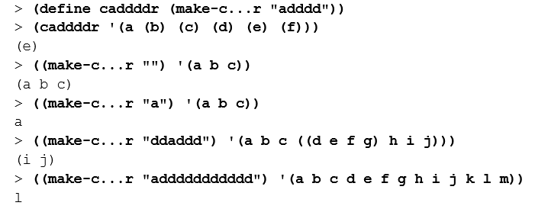
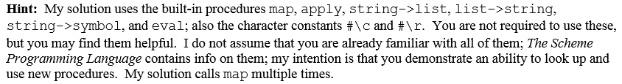
HW 9 Preview
Use compose as a helper procedure when you implement, make-c…r in a functional style.

Slide 16
Quick Programming Practice
Write compose, which creates the composition of any number of one-argument procedures.
> (define caddddddr (compose car cdr cdr cdr cdr cdr cdr)) > (define id (compose)) > (caddddddr '(1 2 3 4 5 6 7 8)) 7 > (id '(a b c)) (a b c)
Notes:
A likely solution, but not a good one:
(define compose
(lambda fn-list
(lambda (x)
(if (null? fn-list)
x
((car fn-list)
((apply compose (cdr fn-list))
x))))))
See later slides for better version.

