Slide 1
CSSE 304 Day 11
Your list-recur examples
Lambda Calculus syntax
Free and Bound Variables
(if time) Lexical address
Student Questions?
Notes:
Make a handout of slides 14-17. Take it to class.

Slide 2
list-recur abstracts list recursion
From last time: Try to come up with at least one other procedure that is easy to write using list-recur. Hopefully something that is not a clone of one that we wrote.
And write it!
(define list-sum (list-recur 0 +)
(define list-prod (list-recur 1 *)
(define apply-to-all
(lambda (proc)
(list-recur ′()
(lambda (x y)
(cons (proc x) y)))))
(define member?-c
(lambda (item)
(list-recur #f (lambda (x y)
(or (equal? item x)
y)))))
(define length (list-recur 0 (lambda (x y)
(+ 1 y))))
Notes:
My new example:
For next time: (define reverse (list-recur '() (lambda (x y) (append y (list x)))))
Bad idea: member?-c, because we can no longer short-circuit. Ask them why that is.
It's because arguments to procedures are evaluated before the procedure is applied.

Slide 3
Exam 1: Monday, Dec 21 6:30-9:00 PM
Exam Resources allowed:
Written part: writing implement (pencil or pen). It is a Moodle quiz, but on some of the questions, you will be allowed to write/draw something and photograph it for submission.
Computer part: TSPL, CSUG, EoPL, EOPL-1, course web pages, an editor and a Scheme interpreter on your laptop, notes/code that you write before the exam, no other sources (such as code from previous terms or other students).
Exam material: through Day 12 class and A9plus reading assignments through day 10. Nothing on free and bound variables, lexical address.
If you are allowed extra time, today is the last day to tell me.
List of built-in procedures and syntax to know for written part of the exam is on the next slide.
Also some old exams are linked from Day 13

Slide 4
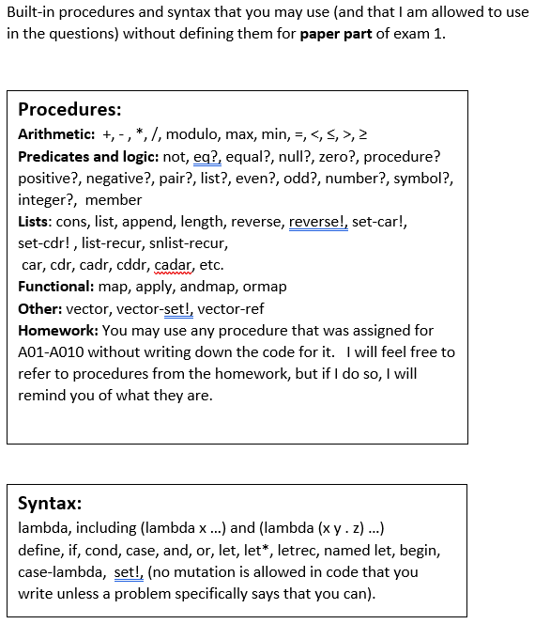
A09

Slide 5
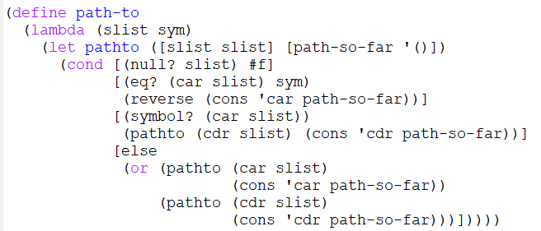
A7 path-to solution
Notice that I avoided using append

Slide 6
Back to Syntax analysis

Slide 7
Variable Definitions and Uses
In (define x (+ x 3)), the two places that the symbol x appears are fundamentally different.
definition (binding) vs. use (occurrence).
declaration vs. reference.
the value named by a variable is that variable's denotation. The variable denotes the value.
In Scheme, can determine the relationship between a variable reference and the declaration that bound it by looking at the code . static (lexical) scoping.
l-value, r-value

Slide 8
Scoping rules in C
#include <stdio.h>
int main() {
int x = 3;
int y;
{
int x = 5;
y = x + 2;
}
printf("%d\n", x+y);
}
A lot like Scheme (lexical scope).
You can tell which definition goes with each use by looking at the code; you do not have to consider what happens at run-time.

Slide 9
lambda-calculus expressions
<LcExpr> ::= <identifier> |
(lambda (<identifier>) <LcExpr>) |
( <LcExpr> <LcExpr> )
We call these three types of expressions
variable uses,
abstractions, and
applications.
Derive ((lambda (x) (x y)) z) (next slide)

Slide 10
<LcExpr> ::= <identifier> |
(lambda (<identifier>) <LcExpr>) |
( <LcExpr> <LcExpr> )
Derive ((lambda (x) (x y)) z)

Slide 11
lambda-calculus expressions - recap
<LcExpr> ::= <identifier> |
(lambda (<identifier>) <LcExpr>) |
( <LcExpr> <LcExpr> )
We call these three types of expressions
variable uses,
abstractions, and
applications.
For now we just treat expressions as a syntactic construct.
We will consider the meanings of these expressions later.
Is this language too restrictive?

Slide 12
Occurs free and occurs bound
For now, this is mainly about applying recursive rules
<LcExpr> ::=
<identifier> |
(lambda (<identifier>) <LcExpr>) |
( <LcExpr> <LcExpr> )
Variable x occurs free in the LcExp e iff one of the following is true:
F1. e is a variable, and e is the same as x.
F2. e is an abstraction (λ (y) e'), where y is different from x and x occurs free in e'.
F3. e is an application (e₁ e₂) where x occurs free in e₁ or in e₂.
Variable x occurs bound in the LcExp e iff one of the following is true:
B1. e is an abstraction (λ (y) e'), where x occurs bound in e', or x and y are the same variable and x occurs free in e'.
B2. e is an application (e₁ e₂) where x occurs bound in e₁ or in e₂.
Does x occur free/bound in …
x
t
(x t)
(lambda (x) (x t))
((lambda (x) x) x)
(lambda (x) (lambda (t) (t x)))
Which rules in the above definitions tell us the answers?
occurs free? occurs bound?
x
t
(x t)

Slide 13
Occurs free and occurs bound
For now, this is mainly about applying recursive rules
<LcExpr> ::=
<identifier> |
(lambda (<identifier>) <LcExpr>) |
( <LcExpr> <LcExpr> )
Variable x occurs free in the LcExp e iff one of the following is true:
F1. e is a variable, and e is the same as x.
F2. e is an abstraction (λ (y) e'), where y is different from x and x occurs free in e'.
F3. e is an application (e₁ e₂) where x occurs free in e₁ or in e₂.
Variable x occurs bound in the LcExp e iff one of the following is true:
B1. e is an abstraction (λ (y) e'), where x occurs bound in e', or x and y are the same variable and x occurs free in e'.
B2. e is an application (e₁ e₂) where x occurs bound in e₁ or in e₂.
Does x occur free/bound in …
x
t
(x t)
(lambda (x) (x t))
((lambda (x) x) x)
(lambda (x) (lambda (t) (t x)))
Which rules in the above definitions tell us the answers?
occurs free? occurs bound?
(lambda (x) (x t))
((lambda (x) x) x)

Slide 14
When dealing with the syntax or meaning of a program, we
Follow the _grammar_

Slide 15
code to test for occurs bound
Variable x occurs bound in the LcExp e iff one of the following is true:
B1. e is an abstraction (λ (y) e'), where x occurs bound in e',
or
x and y are the same variable and x occurs free in e'.
B2. e is an application (e₁ e₂) where x occurs bound in e₁ or in e₂.
<LcExpr> ::=
<identifier> |
(lambda (<identifier>) <LcExpr>) |
(<LcExpr> <LcExpr>)
Let's follow the grammar to write (occurs-bound? sym exp)
(define (occurs-bound sym exp)
Notes:
(define occurs-bound?
(lambda (var exp)
(cond
((symbol? exp) #f)
((eqv? (car exp) 'lambda)
(or (occurs-bound? var (caddr exp))
(and (eqv? (caadr exp) var)
(occurs-free? var (caddr exp)))))
(else (or (occurs-bound? var (car exp))
(occurs-bound? var (cadr exp)))))))
(define occurs-free? ; done in the book, so don't do it here.
(lambda (var exp)
(cond
((symbol? exp) (eqv? var exp))
((eqv? (car exp) 'lambda)
(and (not (eqv? (caadr exp) var))
(occurs-free? var (caddr exp))))
(else (or (occurs-free? var (car exp))
(occurs-free? var (cadr exp)))))))

Slide 16
lexical depth and lexical address (If we have time today)
What are they?
What are they good for?

Slide 17
lexical depth and lexical address
The lexical depth of a bound variable occurrence is the number of levels of nested declarations between it and its declaration.
In (lambda (z) (lambda (x) (lambda (y) (x y)))) the occurrence of y has depth 0 and the occurrence of x has depth 1. There are no occurrences of z.
This is used by the Scheme run-time system (and by your interpreter in A17b) when looking up a local variable's value.
More on that later.

Slide 18
lexical depth and lexical address
Besides lexical depth, the other part of a variable’s lexical address is its position within a declaration list.
In (lambda (x z) (lambda (y) ((x y) z))) The occurrence of x has depth 1 and position 0. The occurrence of y has depth 0 and position 0. The occurrence of z has depth 1 and position 1.

Slide 19
lexical address example
(lexical-address '(lambda (a b c)
(if (eq? b c)
((lambda (c)
(cons a c))
a)
b))) ➔
(lambda (a b c)
(if ((: free eq?) (: 0 1) (: 0 2))
((lambda (c) ((: free cons) (: 1 0) (: 0 0)))
(: 0 0))
(: 0 1)))
You will write lexical-address as part of A10. Also un-lexical-address.

Slide 20
lexical address exercise
(lexical-address
'((lambda (x y)
(((lambda (z)
(lambda (w y)
(+ x z w y)))
(list w x y z))
(+ x y z)))
(y z))) ➔

