Slide 1
CSSE 304 Day 4
Tail-recursive factorial
Anonymous procedures
box-and-pointer diagrams
map and apply
More recursion practice
(preview of next time? lambda and let)

Slide 2
Go for Simple!
Some students wrote
(define first (lambda (x) (car x)))
Simpler:
(define first car)

Slide 3
fact example 1
> (trace fact fact2 fact-acc)
(fact fact2 fact-acc)
> (fact 4)
|(fact 4)
| (fact 3)
| |(fact 2)
| | (fact 1)
| | |(fact 0)
| | |1
| | 1
| |2
| 6
|24
24
> (define fact
(lambda (n)
(cond
[(zero? n) 1]
[else (* n (fact (- n 1)))])))
> (fact 4)
24
> (fact -2)
C-c C-c
break>q
Escape from infinite loop by repeatedly pressing ctrl-c

Slide 4
Fact example 2
> (define fact2
(lambda (n)
(if (or (negative? n)
(not (integer? n)))
"error"
(fact-acc n 1))))
> (define fact-acc
(lambda (n acc)
(if (zero? n)
acc
(fact-acc (- n 1)
(* n acc)))))
> (trace fact fact2 fact-acc)
(fact fact2 fact-acc)
> (fact2 4)
|(fact2 4)
|(fact-acc 4 1)
|(fact-acc 3 4)
|(fact-acc 2 12)
|(fact-acc 1 24)
|(fact-acc 0 24)
|24
24

Slide 5
Make-adder example
> (define make-adder
(lambda (m)
(lambda (n)
(+ m n))))
>

Slide 6
Make-adder example
> (define make-adder
(lambda (m)
(lambda (n)
(+ m n))))
> (define add5 (make-adder 5))
> add5
#<procedure>
> (add5 8)
13

Slide 7
Make-adder example
> (define make-adder
(lambda (m)
(lambda (n)
(+ m n))))
> (define add5 (make-adder 5))
> add5
#<procedure>
> (add5 8)
13
> ((make-adder 5) 8)
13
w

Slide 8
Make-adder example
> (define make-adder
(lambda (m)
(lambda (n)
(+ m n))))
> (define add5 (make-adder 5))
> add5
#<procedure>
> (add5 8)
13
> ((make-adder 5) 8)
13
> (((lambda (m)
(lambda (n)
(+ m n)))
5)
8)
13

Slide 9
Cond
Similar to if-elif-…-else in other languages.
(define member?
(lambda (a ls)
(cond
[(null? ls) #f]
[(eq? (car ls) a) #t]
[else (member? a (cdr ls))])
))
Notes:
Mention the difference between member and member? Is what member does inefficient?

Slide 10
This example is in the on-line slides, but we won’t do it in class, since we did a slightly simpler version in class on day 2
; cond is like if ... else if ... else
(define largest-in-list
(lambda (L)
(cond [(null? L)
(errorf 'largest-in-list
"empty list has ~s "
" no largest element")]
[(null? (cdr L)) (car L)]
[else (max (car L)
(largest-in-list
(cdr L)))])))
; What's the efficiency issue with this?

Slide 11
Answer: We have to do two null? tests for every recursive call.

Slide 12
; more efficient:
(define largest-in-list
(lambda (ls)
(if (null? ls)
(errorf 'largest-in-list
"list cannot be empty")
(largest-in-non-empty ls))))
(define largest-in-non-empty
(lambda (ls)
(if (null? (cdr ls))
(car ls)
(let ([largest-in-cdr (largest-in-non-empty (cdr ls))])
(if (> (car ls) largest-in-cdr)
(car ls)
largest-in-cdr)))))
Using max is simpler, but this is how we could do it if we did not have or did not remember max.

Slide 13
; Now define another version with an accumulator
; (that is also more robust because it checks for non-numbers)
(define largest-in-list
(lambda (ls)
(if (null? ls)
(errorf 'largest-in-list "list cannot be empty")
(largest-in-list-acc (cdr ls) (car ls)))))
(define largest-in-list-acc
(lambda (ls largest-so-far)
(cond [(null? ls) largest-so-far]
[(not (number? (car ls)))
(errorf 'largest-in-list
"everything in the list must be a number")]
[(> (car ls) largest-so-far)
(largest-in-list-acc (cdr ls) (car ls))]
[else (largest-in-list-acc (cdr ls)
largest-so-far)])))

Slide 14
Count reflexive pairs
A relation is a set of ordered pairs; the set of all first elements is the domain. The set of all second elements is the range.
We represent a relation by a list of 2-lists. A 2-list is a list whose length is 2.
A reflexive pair is a 2-list whose first and last elements are the same.
Count-reflexive-pairs (work it out live)
Probably won’t do this in class, but good practice for you

Slide 15
cons vs. list vs. append
box-and-pointer diagrams
(define x '(1 2 3))
(define y '(4 5))
(define z '(6 7))
(cons x y) (list x y) (append x y z)
Notes:
Ask: Can we use map to write positives?
Perhaps write filter-in
(define sorted?
(lambda (numbers)
(or (< (length numbers) 2)
; why is this a bad idea?
(and (<= (car numbers) (cadr numbers))
(sorted? (cdr numbers))))))

Slide 16
apply
What if a procedure expects a number of individual arguments, but we actually have the things that should be its arguments in a list?
We’d like to write
(define list-sum (lambda (L) (+ L)))
but + doesn’t expect a list of arguments.
So we write
define list-sum (lambda (L) (apply + L)))
Application of apply is like consing apply’s first argument onto the list that is its second argument, and then evaluating.
More on map and apply soon
Notes:
After quickly going through the material on this slide, do the following (another apply example):
> (max 2 3 1)
3
> (max '(2 3 1))
. . max: expects argument of type <real number>; given (2 3 1)
> (apply max '(2 3 1))
3
>

Slide 17
Recursive procedures
(make-list n obj) returns a list of n "copies" of obj. [If obj is a 'by-reference" object, such as a list, it makes n copies of the reference].
(firsts ′((a b) (c d) (e f))) ➔ (a c e)
Do it "from scratch".
(map-unary f ls) applies f to each element of ls, and returns the list of the results.
(map-unary (lambda (x) (+ x 2)) '(3 5 9)) ➔ (5 7 11)
How could we use map to write firsts?
map-unary is a special case of built-in procedure map.
Notes:
Ask: Can we use map to write positives?
Perhaps write filter-in
(define sorted?
(lambda (numbers)
(or (< (length numbers) 2)
; why is this a bad idea?
(and (<= (car numbers) (cadr numbers))
(sorted? (cdr numbers))))))

Slide 18
More recursive procedures
positives
(positives ′(1 -3 6 0 2 -1 7) )➔ (1 6 2 7)
Write and use filter-in
sorted?
(sorted? <= '(3 4 2 6)) ➔ #f
(sorted? >= '(4 3 2 1)) ➔ #t
We’ll be lucky if we get this far, but, ever the optimist, I included more slides. They are probably a preview of something we’ll do next time.
Notes:
Ask: Can we use map to write positives?
Perhaps write filter-in
(define
(define sorted?
(lambda (numbers)
(or (< (length numbers) 2)
; why is this a bad idea?
(and (<= (car numbers) (cadr numbers))
(sorted? (cdr numbers))))))

Slide 19
(define sorted?
(lambda (numbers)
(or (< (length numbers) 2)
; why is this a bad idea?
(and (<= (car numbers) (cadr numbers))
(sorted? (cdr numbers))))))

Slide 20
lambda with an improper list of arguments
Used when procedure expects a variable number of arguments.
(lambda x body)
when the resulting procedure is applied, all of the arguments are placed into a list and bound to x. Then body is evaluated.
(lambda (x y . z) body)
when the resulting procedure is applied, the first two arguments are bound to x and y,
any remaining arguments are placed into a list and bound to z. Then body is evaluated.
Q1

Slide 21

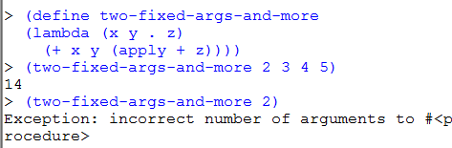
Procedures with an unknown number of arguments

Slide 22

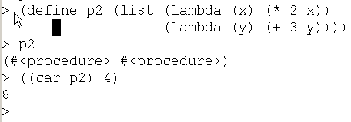
lambda the magnificent review and summary
Lambda is the “function-maker”. define is the “variable-assigner”. There is no special connection between the two:
We can store procedures in a data structure without naming them:

Slide 23

lambda the magnificent
We can pass a procedure as an argument to another procedure:

Slide 24
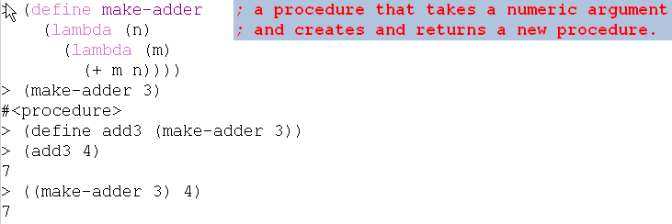
lambda the magnificent
We create a new procedure and return it.
Scheme is not the only language with first-class procedures …

Slide 25
A first-class data object
Can be stored in a data structure
Can be passed as an argument to a procedure
Can be returned by a procedure
In Scheme, procedures are first-class

Slide 26
Translation of let
(define L '(4 3 2))
(let ([first (car L)]
[second (cadr L)])
(list (+ first second) (- first second)))
The let expression is equivalent to
((lambda (first second)
(list (+ first second) (- first second)))
(car L)
(cadr L))
let and cond are both examples of “syntactic sugar”, as are and and or.

Slide 27
more on let
(define xxx
(lambda (L)
(let ([a (car L)]
[b (cdr L)]
[c (car b)])
(list c a))))
What goes wrong if we evaluate (xxx '(1 2 3))?
Translate the let expression to an application of lambda
Notes:
DO the translation on the board.
Tell them that one of the problems in A4 is to do this translation automatically.

Slide 28
let*
What we really wanted was
(define xxx
(lambda (L)
(let* ([a (car L)]
[b (cdr L)]
[c (car b)])
(list c a))))
which translates into
(define xxx
(lambda (L)
(let ([a (car L)])
(let ([b (cdr L)])
(let ([c (car b)])
(list c a))))))

