Slide 1
CSSE 304 Day 4
cons, list, append, box-and-pointer
More recursion practice
map and apply
lambda and let

Slide 2
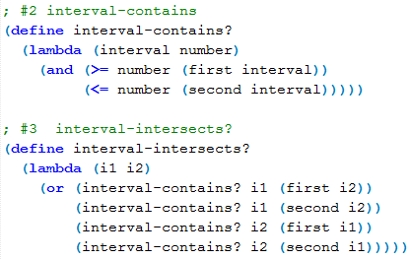
Solutions to two A1 problems

Slide 3
cons vs. list vs. append
box-and-pointer diagrams
(define x '(1 2 3))
(define y '(4 5))
(cons x y) (list x y) (append x y)
Notes:
Ask: Can we use map to write positives?
Perhaps write filter-in
(define sorted?
(lambda (numbers)
(or (< (length numbers) 2)
; why is this a bad idea?
(and (<= (car numbers) (cadr numbers))
(sorted? (cdr numbers))))))

Slide 4
Recursive procedures
(make-list n obj) returns a list of n "copies" of obj. [If obj is a 'by-reference" object, such as a list, it makes n copies of the reference].
(firsts ′((a b) (c d) (e f))) ➔ (a c e)
Do it "from scratch".
(unary-map f ls) applies f to each element of ls, and returns the list of the results.
(unary-map (lambda (x) (+ x 2)) '(3 5 9)) ➔ (5 7 11)
How could we use unary-map to write firsts?
Note that unary-map is a special case of Scheme's map, so we'll just write map from now on.
Notes:
Ask: Can we use map to write positives?
Perhaps write filter-in
(define sorted?
(lambda (numbers)
(or (< (length numbers) 2)
; why is this a bad idea?
(and (<= (car numbers) (cadr numbers))
(sorted? (cdr numbers))))))

Slide 5
More recursive procedures
positives
(positives ′(1 -3 6 0 2 -1 7) )➔ (1 6 2 7)
Write and use filter-in
sorted?
(sorted? <= '(3 4 2 6)) ➔ #f
(sorted? >= '(4 3 2 1)) ➔ #t
Notes:
Ask: Can we use map to write positives?
Perhaps write filter-in
(define
(define sorted?
(lambda (numbers)
(or (< (length numbers) 2)
; why is this a bad idea?
(and (<= (car numbers) (cadr numbers))
(sorted? (cdr numbers))))))

Slide 6
(define sorted?
(lambda (numbers)
(or (< (length numbers) 2)
; why is the above a bad idea?
(and (<= (car numbers) (cadr numbers))
(sorted? (cdr numbers))))))

Slide 7
apply
What if a procedure expects a number of individual arguments, but we actually have the things that should be its arguments in a list?
We’d like to write
(define list-sum (lambda (L) (+ L)))
but + doesn’t expect a list of arguments.
So we write
define list-sum (lambda (L) (apply + L)))
Application of apply is like consing apply’s first argument onto the list that is its second argument, and then evaluating.
More on map and apply soon
Notes:
After quickly going through the material on this slide, do the following (another apply example):
> (max 2 3 1)
3
> (max '(2 3 1))
. . max: expects argument of type <real number>; given (2 3 1)
> (apply max '(2 3 1))
3
>

Slide 8
lambda with an improper list of arguments
Used when procedure expects a variable number of arguments.
(lambda x body)
when the resulting procedure is applied, all of the arguments are placed into a list and bound to x. Then body is evaluated.
(lambda (x y . z) body)
when the resulting procedure is applied, the first two arguments are bound to x and y,
any remaining arguments are placed into a list and bound to z. Then body is evaluated.
Q1

Slide 9

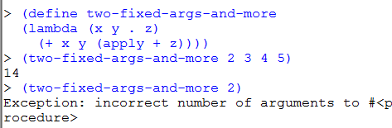
Procedures with an unknown number of arguments

Slide 10

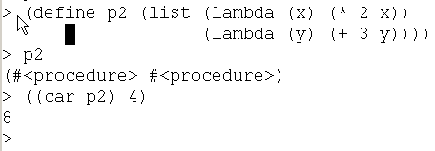
lambda the magnificent review and summary
Lambda is the “function-maker”. define is the “variable-assigner”. There is no special connection between the two:
We can store procedures in a data structure without naming them:

Slide 11

lambda the magnificent
We can pass a procedure as an argument to another procedure:

Slide 12
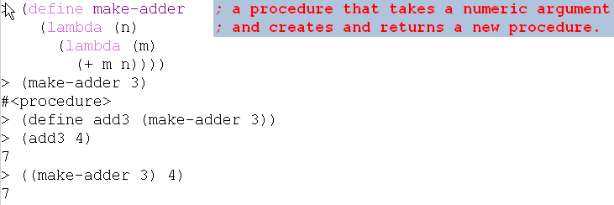
lambda the magnificent
We can create a new procedure and return it.
Scheme is not the only language with first-class procedures …

Slide 13
A first-class data object
Can be stored in a data structure
Can be passed as an argument to a procedure
Can be returned by a procedure
In Scheme, procedures are first-class

Slide 14
RECAP: "Usual" factorial definition
> (define fact
(lambda (n)
(if (zero? n)
1
(* n (fact (- n 1))))))
> (fact 5)
120
> (fact 75)
24809140811395398091946477116594033660926243886570122837795894512655842677572867409443815424000000000000000000

Slide 15
trace this procedure
> (trace fact)
(fact)
> (fact 4)
|(fact 4)
| (fact 3)
| |(fact 2)
| | (fact 1)
| | |(fact 0)
| | |1
| | 1
| |2
| 6
|24
24
>(define fact
(lambda (n)
(if (zero? n)
1
(* n
(fact (- n 1))))))

Slide 16
RECAP : Factorial with accumulator
> (define fact-tail (lambda (n accum)
(if (zero? n)
accum
(fact-tail (- n 1) (* n accum)))))
> (define factorial
(lambda (n)
(fact-tail n 1)))
> (trace fact-tail)
(fact-tail)
> (trace factorial)
(factorial)
> (factorial 4)
; fact-tail is ; "tail- ; recursive". ; Scheme ; doesn't grow ; the stack.
|(factorial 4)
|(fact-tail 4 1)
|(fact-tail 3 4)
|(fact-tail 2 12)
|(fact-tail 1 24)
|(fact-tail 0 24)
|24
24
> (untrace)

