Slide 1
CSSE 304 Day 9
"OOP" in Scheme?
Preview of an A8 problem
case-lambda and compose
(Miscellaneous examples and exercises)
Notes:
When I put slides on line, leave out Proving language Properties 5 slide.
After class, redo the slides and include that one.

Slide 2
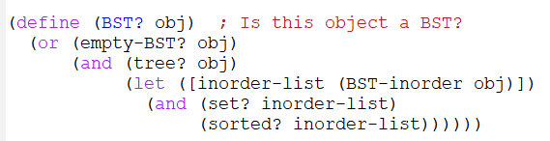
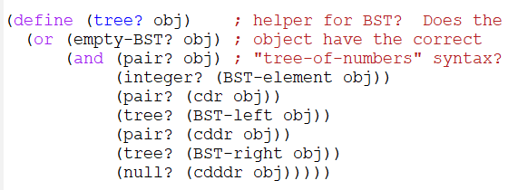
BST? solution

Slide 3
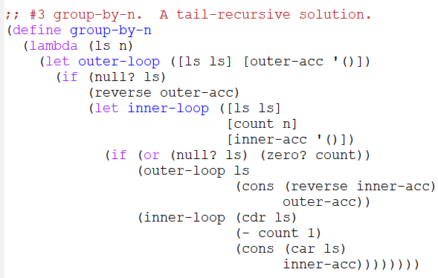
group-by-n solution

Slide 4
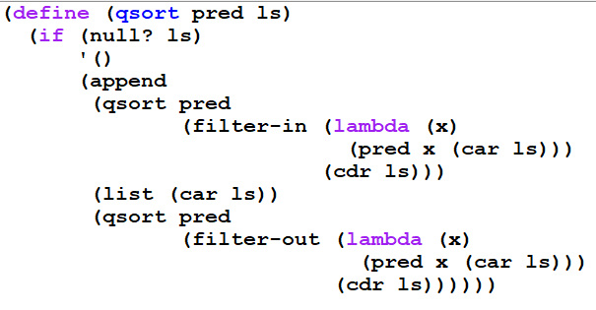
qsort solution (Swi Bhanghi)

Slide 5
How might we do OOP IN SCHEME, using only things that we have seen so far?
http://community.schemewiki.org/?object-oriented-programming
Constructing objects
"fields"
"methods"
method arguments

Slide 6
"OO Programming" in Scheme
We need to find a way to encapsulate "fields" and "methods", so that fields can only be accessed/changed by using the methods.
We can represent an object by a _____.
"Fields" are persistent local variables.
A "method name" is the first argument to the "object" procedure
"method arguments" are the other arguments to the procedure.

Slide 7
> (define s1 (make-stack))
> (define s2 (make-stack)) > (s1 'push 'a)
> (s2 'push 'z)
> (s1 'push 'b)
> (s1 'pop)
b
(s1 'empty?)
#f
> (s2 'push (s1 'pop))
> (s1 'empty?)
#t
> (s2 'pop)
a
> (s2 'pop)
z
> (s2 'pop)
Exception in car: () is not a pair
>
A better error message would be a nice improvement here
Transcript for the use of the stack "class"

Slide 8
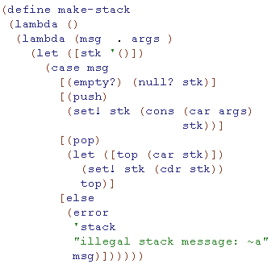
Encapsulation: Creating "objects" in a mostly functional language
The car of the stk list contains the top of the stack
What is the problem with this code? How to fix it?
This code contains a subtle error. Can you see what it is?
Notes:
The problem is that it recreates stk every time you call a method.
FIX: Move the let outside the inner lambda
ASK: What goes wrong if we move the let outside the outer lambda?
ANSWER: There is only one stack, shared by all "stack objects"

Slide 9
Encapsulation: Creating "objects" in a mostly functional language
The car of the stk list contains the top of the stack
Reverse these two code lines
What is the problem with this code? How to fix it?
This code contains a subtle error. Can you see what it is?
Notes:
The problem is that it recreates stk every time you call a method.
FIX: Move the let outside the inner lambda
ASK: What goes wrong if we move the let outside the outer lambda?
ANSWER: There is only one stack, shared by all "stack objects"

Slide 10
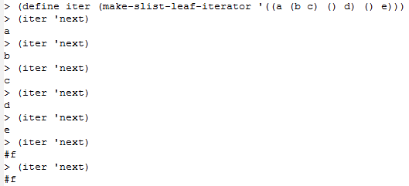
HW 8 Preview
You will implement another class, slist-leaf-iterator. Your procedure, given an s-list s, will make an iterator "object" that iterates s.
An easy way to implement this? Good idea?

Slide 11
HW 8 Preview
You will use this stack "class" implementation as a helper procedure in your implementation of another class, slist-leaf-iterator. Your procedure, make-slist-leaf-iterator, given an s-list s, will make an iterator "object" for s.
Why is the "easy" approach from the last slide inefficient? Think of an slist with tens of thousands of symbols.
In the HW problem, your iterator procedures are not allowed to traverse more of the tree than is required for the 'next calls that actually happen.
That's where a stack object comes in.
Can be similar to the preorder iterator in Weiss*, Chapter 18.
* Data Structures and Problem Solving Using Java
But the code will be simpler than Weiss’s because Scheme notation is simpler.

Slide 12
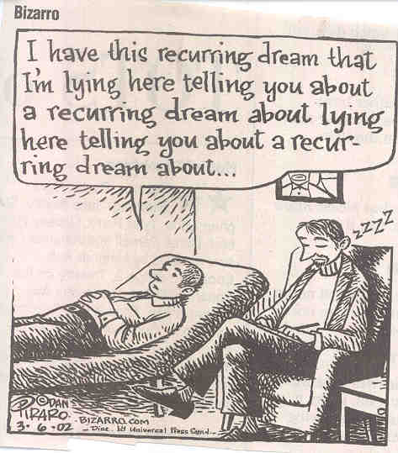
Interlude

Slide 13
Compose and case-lambda

Slide 14
Compose With Any Number of Arguments
compose, which creates the composition of any number of one-argument procedures.
> (define caddddddr (compose car cdr cdr cdr cdr cdr cdr)) > (define id (compose)) > (caddddddr '(1 2 3 4 5 6 7 8)) 7 > (id '(a b c)) (a b c)
Notes:
A likely solution, but not a good one:
(define compose
(lambda fn-list
(lambda (x)
(if (null? fn-list)
x
((car fn-list)
((apply compose (cdr fn-list))
x))))))
See later slides for better version.

Slide 15
Simple compose Solution
(define compose
(lambda fn-list
(lambda (x)
(if (null? fn-list)
x
((car fn-list)
((apply compose (cdr fn-list))
x))))))
Notes:
Hide this slide before

Slide 16
CASE-Lambda
Another way of defining variable-arity procedures (by example)

Slide 17
Scheme’s case-lambda
A simpler way to define a procedure that takes a variable number of arguments:
(define fact
(case-lambda
[(n) (fact n 1)]
[(n acc) (if (zero? n)
acc
(fact (- n 1)
(* n acc)))]))

Slide 18
Another case-lambda example
(define substring1
(case-lambda
[(s)
(substring1 s 0)]
[(s start)
(substring s
start (string-length s))]
[(s start end)
(substring s start end)]))

Slide 19
compose 2-3 using case-lambda
(define compose ; two or three arg version
(case-lambda ; of compose from A6
[(f g) (lambda (x) (f (g x)))]
[(f g h) (lambda (x) (f (g (h x))))])) Try it:
> ((compose car cdr cdr) '(1 2 3 4))
3
> ((compose car cdr cdr cdr) '(1 2 3 4))
Error: incorrect number of arguments to #<procedure compose>.
Type (debug) to enter the debugger.
Notes:
Hide this slide before

Slide 20
compose using case-lambda
Full version of compose takes any number of arguments
(define compose
(case-lambda
[() (lambda (x) x)]
[(first . rest)
(lambda (x)
(first ((apply compose rest) x)))]))

Slide 21
compose using case-lambda
Full version of compose (takes any number of arguments):
(define compose
(case-lambda
[() (lambda (x) x)]
[(first . rest)
(lambda (x)
(first ((apply compose rest) x)))]))
To slightly increase the efficiency, we can add a new case. Place it between the current first and second cases. [(single-arg) single-arg]

Slide 22
Two Approaches to compose
1st version
(define compose1
(case-lambda
[() (lambda (x) x)]
[(first . rest)
(let ([composed-fns (apply compose1 rest)])
(lambda (x)
(first (composed-fns x))))]))
Compared to
(define compose2
(case-lambda
[() (lambda (x) x)]
[(first . rest)
(lambda (x)
(first ((apply compose2 rest) x)))]))
Can you determine which one is better and why?
2nd version
Notes:
Hide this slide before

Slide 23
Experiment with 2nd compose
> (trace compose2)
(compose2)
> (define cadddr (compose2 car cdr cddr))
|(compose2 #<procedure car> #<procedure cdr> #<procedure cddr>)
|#<procedure>
> (cadddr '(1 2 3 4))
|(compose2 #<procedure cdr> #<procedure cddr>)
|#<procedure>
|(compose2 #<procedure cddr>)
|#<procedure>
|(compose2)
|#<procedure>
4
(define compose2
(case-lambda
[() (lambda (x) x)]
[(first . rest)
(lambda (x)
(first ((apply compose2 rest) x)))]))
What is the problem here?

Slide 24
Experiment with the 1st compose
> (trace compose1)
(compose1)
> (define cadddr (compose1 car cdr cddr))
|(compose1 #<procedure car> #<procedure cdr> #<procedure cddr>)
| (compose1 #<procedure cdr> #<procedure cddr>)
| |(compose1 #<procedure cddr>)
| | (compose1)
| | #<procedure>
| |#<procedure>
| #<procedure>
|#<procedure>
> (cadddr '(1 2 3 4))
4
(define compose1
(case-lambda
[() (lambda (x) x)]
[(first . rest)
(let ([composed-fns
(apply compose1 rest)])
(lambda (x)
(first (composed-fns x))))]))
Why is this better?

Slide 25
Review of recursive definitions and inductive proofs
What must we do in order to prove a property P(n) by (strong) induction?
Define the set E as follows.
0 ∈ E.
If m ∈ E, then m + 2 ∈ E.
Nothing else is in E. (usually we’ll leave out this last part of recursive definitions. We always assume it).
Theorem: If a non-negative integer n ∈ E, then n is even.
Proof by (strong) induction:
Notes:
Skipped for now in 201510
Base casse: 0 is even. 1 is not even.
Induction step: Suppose n> 1 ∈E. Assume by induction that every smaller element of E is even.
Since n is not 0, there must be an m in E such that m + 2 = n.
By induction m is even, i.e. m = 2*r for some integer r. Thus n = m + 2 = 2*r + 2 = 2*(r+1). true for this case!
Are we done? No. We also have to show that odd numbers are not in E.

Slide 26
In-class Practice problems
Practice with lists and mutation.
These problems have frequently cleared up some student misconceptions.
I recommend discussing the problems with another person. If two of you are stuck or unsure, ask me.
for the list of procedures problems, I suggest figuring out the answer first, and then (if you wish) checking your answer using a Scheme interpreter. Don't use the interpreter first!

Slide 27
List of procedures problem
>(define a )
>(list ((car a) 4 7)
((cadr a) 4 7))
(11 28)

Slide 28
List of procedures problem
> (define a ′(+ *)) ; Does this work?
> (list ((car a) 4 7)
((cadr a) 4 7))
(11 28)
Notes:
It does not work, because quote keeps + and * from being evaluated, so we just get a list of symbols.
We want a list of procedures

Slide 29
List of procedures problem
> (define a (list + *) ) ;fill it in!
> (list ((car a) 4 7)
((cadr a) 4 7))
(11 28)

Slide 30
Mutation problem
> (define a '(1 2 3 . 4))
(define b (cons (car a) (cdr a))) How many new pairs are created by the second define? How do we know?
> (set-car! a 5)
> (set-car! (cdr a) 6)
> a
> b
Notes:
Draw a box diagram that shows what a and b look like in memory.

Slide 31
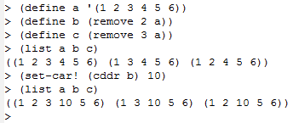
remove may do less than you think!
Can you figure out why the last output is what it is?
Draw box-and-pointer diagrams
Notes:
Notice that remove does not make new nodes for all of the elements of the list

Slide 32
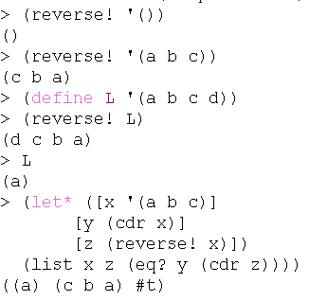
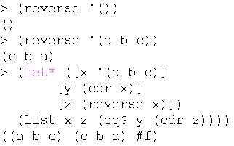
In-class exercise (if there is time)
write reverse and reverse! procedures
For reverse!, you will need to use set-cdr!
Both should be O(n).
These transcripts might help you to distinguish between them.
Do this with another student or two.
Notes:
Suggestion for 2011: Email a link to the Exam slides to students on Wednesday, so there is no need to spend much time on them in class.

Slide 33
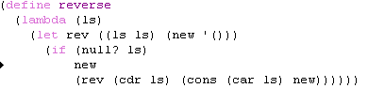
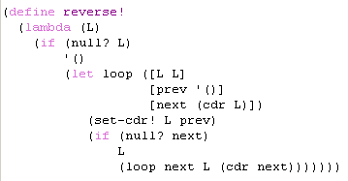
Solutions

Slide 34
Review of recursive definitions and inductive proofs
Define the set E as follows:
0 ∈ E.
If m ∈ E, then m + 2 ∈ E.
Nothing else is in E. (usually we’ll leave out this last part of recursive definitions. We always assume it).
Theorem: A non-negative integer n ∈ E if and only if n is even. I.e., n even implies n∈E, and n odd implies n ∉ E.
Proof by (strong) induction:
Notes:
Base case: 0 is even. true for this case!
Induction step: n> 0 ∈E. Assume by induction that every smaller element of E is even.
Since n is not 0, there must be an m in E such that m + 2 = n.
By induction m is even, i.e. m = 2*r for some integer r. Thus n = m + 2 = 2*r + 2 = 2*(r+1). true for this case!

Slide 35
Proving Language Properties
In class, we will look at a few details of the following proof.
You should look at the rest of the details later.

Slide 36
Proving language properties
<exp> ::= <exp> + <term> | <term>
<term> ::= <term> * <factor> | <factor>
<factor> ::= ( <exp> ) | <number>
<number> ::= <number> <digit> | <digit>
<digit> ::= 0 | 1 | 2 | 3 | 4 | 5 | 6 | 7 | 8 | 9
Prove that any string s of terminals derived from any of the above non-terminals contains an even number of parentheses. We do it by induction on the number of steps in the derivation of s.
Base case. (there is only one step in the derivation of s): All one-step derivations start with <digit>
Clearly anything derived from <digit> has no parentheses. It consists of a single digit.
Induction cases. In all other cases, it takes more than one step to derive s from one of the given non-terminal symbols.
We base the proof on which production is used in the first step of the derivation.
We have to consider a separate case for each such production.
In each case, we assume by induction that any shorter derivation (one with fewer steps) from any of the non-terminals produces a string with an even number of parentheses.
Notes:
And show

Slide 37
Proving language properties 2
<exp> ::= <exp> + <term> | <term>
<term> ::= <term> * <factor> | <factor>
<factor> ::= ( <exp> ) | <number>
<number> ::= <number> <digit> | <digit>
<digit> ::= 0 | 1 | 2 | 3 | 4 | 5 | 6 | 7 | 8 | 9
Prove that any string of terminals s derived from any of the above non-terminals contains an even number of parentheses. We do it by induction on the number of steps in the derivation of s.
Induction cases. If it takes more than one step to derive s from one of the given non-terminal symbols,
we assume by induction that any shorter derivation (one with fewer steps) from any of the non-terminals produces a string with an even number of parentheses.
Case 1: <number> → <digit> is the first step in the derivation of s.
Anything derived from <digit> contains no parentheses (base case),
This production adds no parentheses.
Thus there are no parentheses in s. Zero is an even number.

Slide 38
Proving language properties 3
<exp> ::= <exp> + <term> | <term>
<term> ::= <term> * <factor> | <factor>
<factor> ::= ( <exp> ) | <number>
<number> ::= <number> <digit> | <digit>
<digit> ::= 0 | 1 | 2 | 3 | 4 | 5 | 6 | 7 | 8 | 9
Induction cases. It takes more than one step to derive s from one of the given non-terminal symbols.
Case 2: <number> → <number> <digit> is the first step.
Anything derived from <digit> contains no parentheses (base case),
The derivation from the <number> on the RHS involves fewer steps than the derivation of s, thus the string it derives contains an even number of parentheses (in fact this number is zero).
s is the concatenation of a derivation from <number> and a derivation from <digit> on the RHS. Thus there are no parentheses in s.

Slide 39
Proving language properties 4
<exp> ::= <exp> + <term> | <term>
<term> ::= <term> * <factor> | <factor>
<factor> ::= ( <exp> ) | <number>
<number> ::= <number> <digit> | <digit>
<digit> ::= 0 | 1 | 2 | 3 | 4 | 5 | 6 | 7 | 8 | 9
Induction cases. It takes more than one step to derive s from one of the given non-terminal symbols.
Case 3: <factor> → ( <exp> ) is the first step.
The derivation of a terminal string from the <exp> on the RHS of this production involves fewer steps than the derivation of s, thus (by induction) the string s' that is derived from <exp> contains an even number (call that number p) of parentheses.
s has the form ( s' ), so it contains p+2 parentheses. Since p is an even number, so is p+2.
Fill in some other interesting cases (10 minutes, with another student) Q6

Slide 40
Proving language properties 5
<exp> ::= <exp> + <term> | <term>
<term> ::= <term> * <factor> | <factor>
<factor> ::= ( <exp> ) | <number>
<number> ::= <number> <digit> | <digit>
<digit> ::= 0 | 1 | 2 | 3 | 4 | 5 | 6 | 7 | 8 | 9
Induction cases. It takes more than one step to derive s from one of the given non-terminal symbols.
Case 4: <exp> → <exp> + <term> is the first step.
The derivation from the <exp> on the RHS involves fewer steps than the derivation of s, thus (by induction) the string s’ that it derives contains an even number (call it p) of parentheses.
The derivation from the <term> on the RHS involves fewer steps than the derivation of s, thus (by induction) the string s’’ that it derives contains an even number (call it q) of parentheses.
s has the form s’ + s’’, so it contains p+q parentheses. Since p and q are even numbers, so is p+q.

Slide 41
Proving language properties 6
The other cases for the induction step are similar, and are left as an exercise for you.
Usually we will not be so formal,
but we will assume the ideas that underlie this proof when we discuss the properties of various grammars and the languages that are derived from them.

Slide 42
Assignment XXX written problem
Consider the following grammar for a language whose terminal symbols are a and b:
<S> ::= <A> <A>
<A> ::= <A> <A> <A> | b <A> | <A> b | a
Describe in English the language L generated by this grammar, if <S> is the start symbol.
Prove that the only strings of terminals that can be generated by this grammar are strings in L.
Describe an algorithm that, given a string w in L, lists a sequence of productions that can be used to produce a derivation of w from <S>.
What are parts 2 and 3 really about?
If w can be derived from the grammar, then w∈L. (L is the language from part 1)
If w∈L, then w can be derived from the grammar.

Slide 43
Variable Definitions and Uses
In (define x (+ x 3)), the two places that the symbol x appears are fundamentally different.
definition (binding) vs. use (occurrence).
declaration vs. reference.
the value named by a variable is that variable's denotation. The variable denotes the value.
In Scheme, can determine the relationship between a variable reference and the declaration that bound it by looking at the code . static (lexical) scoping.
l-value, r-value

Slide 44
Scoping rules in C
#include <stdio.h>
int main() {
int x = 3;
int y;
{
int x = 5;
y = x + 2;
}
printf("%d\n", x+y);
}
A lot like Scheme (lexical scope).
You can tell which definition goes with each use by looking at the code; you do not have to consider what happens at run-time.

