Slide 1
CSSE 304 Day 6
More map and apply
Box and Pointer Diagrams
Mutation of Lists
Practice: letrec and/or named let
Notes:
File needed: largest-in-list-2007.ss

Slide 2
Interlude
Computer programming is an art,
because it applies accumulated knowledge to the world,
because it requires skill and ingenuity, and
especially because it produces objects of beauty.
Programmers who subconsciously view themselves as artists will enjoy what they do and will do it better. -- Donald Knuth, Computer Programming as an Art Turing Award Speech

Slide 3
More map and apply examples
(define ms-size
(lambda (ms)
(apply + (map cadr ms))))
(define sorted? ; with “normal” less
(lambda (lon)
(or (null? lon)
(apply <= lon))))

Slide 4
Examples: map and apply
(map < '(1 5 7) '(2 4 6))
(map list '(1 5 7) '(2 4 6) '(0 8 3))
(apply cons '(2 3))
(list '()) (map list '()) (apply list '())
(define cube (lambda(x) (* x x x)))
(define (apply-many functions arg) (map (lambda (function) (apply function (list arg))) functions))
(apply-many (list - cube (lambda (x) (/ x 2))) 3)
(apply-many '(- cube (lambda (x) (/ x 2))) 3)
(apply-many `(,- ,cube ,(lambda (x) (/ x 2))) 3) quasi-quote, unquote
(apply + 1 2 '(3 4 5)) ; a different form of apply?

Slide 5
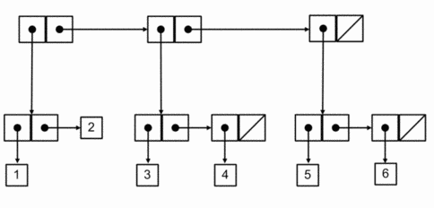
More complex box-and-pointer diagrams
How would Scheme output this? How would you write code to construct it? (without using quote)
Should the numbers be in the boxes (like my previous drawings), or should there be references to them (as here)?
More examples like this for later practice: http://courses.cms.caltech.edu/cs1/assignments/lab5/

Slide 6
Draw box-and-pointer diagrams
… that show the situation after executing this code. Then show what the write statements would print. How many pairs are created altogether?
(define x '((1 2) 3 (4))
(define y (cons (car x) (cdr x)))
(define z (list (cdr x) x))
(define t (append y x))
(write x) (newline)
(write y) (newline)
(write z) (newline) (write t) (newline) ; What happens if we then…
(set-car! (cdr x) 7)
(write t) (newline)
(set-cdr! x x)
(write x) (newline)
Work with one or two other students
Also B&P diagram for ‘(()). You try : '((()))
'(((()))) '((())())

Slide 7
Exercise
Write largest-in-lists, which takes a list of lists of numbers and finds the largest number. Returns #f if there are no numbers in any of the lists. Don't use any separate helper procedures (use letrec or named let)
(largest-in-lists '((1 3 5) () (4) (2 6 1) (4))) ➔ 6
(largest-in-lists '(() ())) ➔ #f
Work with another student or two on one computer, pair program. Test cases available on the PLC grading server.
As you pair program, the driver should be the person whose next birthday happens soonest. Send code to other partner at the end of class.

