Slide 1
CSSE 304 Day 10
Procedural Abstraction

Slide 2
Four similar recursive procedures
(define list-sum (lambda (ls) …) ; sum of a list-of-numbers;
(define list-prod (lambda (ls) …) ; product of a list-of-numbers;
(define apply-to-all ; curried version of map (lambda (proc) (lambda (ls) … )
(define member?-c ; is item a member of ls? (lambda (item) (lambda ls) …)
What do the four procedures have in common? What are their differences? Can we abstract the recursion pattern, creating a procedure that makes list-recursion procedures?
Notes:
Answer on next slide

Slide 3
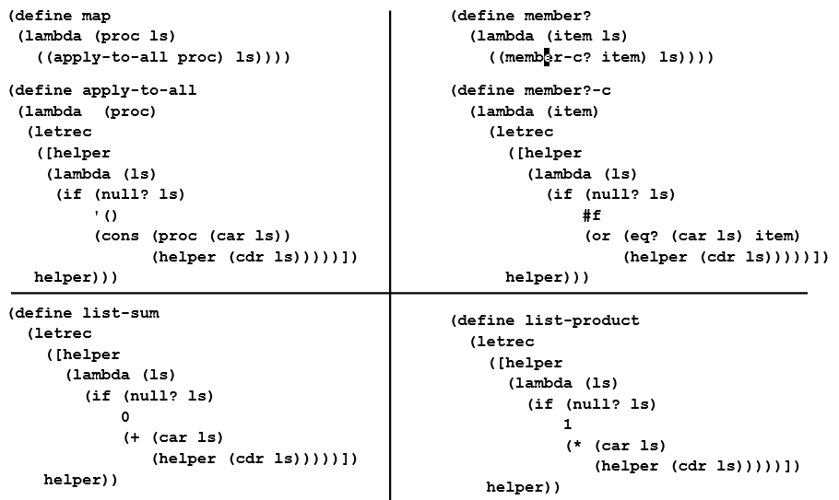
Procedural Abstraction

Slide 4
Follow-up
Of the five procedures, four are good to write using list-recur. The other is not so good. Which one, and why?
Come up with another example that is easier to write with list-recur than to write it directly.
Assignment 9.
Write snlist-recur, which similarly abstracts over s-lists, and use it to write several procedures.
Write bt-recur, which abstracts “bt” functions, and use it to write two procedures.

Slide 5
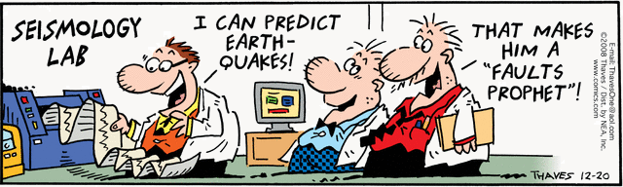
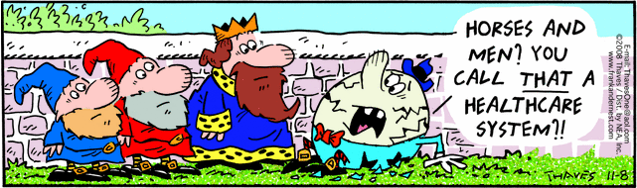
Interlude

