Slide 1
CSSE 304 Day 8
Programs about s-lists
Most of today's class will be live coding.
You may want to copy the starting code from the Live-in-class folder, Day 07.
Notes:
In 201510, I only had 5 minutes to talk about grammars in Day 7; had expected to have more.
MOVE FAST!

Slide 2
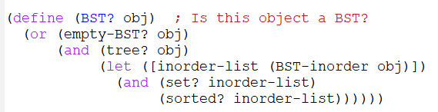
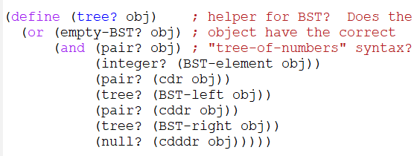
BST? solution

Slide 3
Some Big Ideas from 304 so far
recursion, especially recursive processing of lists, lists of lists, etc.
lambda, let, let*, letrec, named let
first-class data – (procedures are this in Scheme)
map and apply
currying and procedural abstraction (Day 10)
primitive types vs. “reference” types
syntax and semantics
grammars, derivations, derivation trees
Code that “follows the grammar” (today)
OO programming in Scheme (Day 9)
Efficient programs (Day 11, Compose and Case-lambda video)

Slide 4
Exam 1
Monday, Dec 21, 6:30-9:000 PM.
1. “Written” part on Moodle. Closed book, notes, etc. 25-40%
2. “Computer” part: submit to PLC server. 60-75%. Can use all course materials, including any code that you have written.
Exam covers course material up through A9 and Day 12 lecture (but not Day 11).
Most of the emphasis will be on A6-9.
Joanna plans to conduct a remote review session sometime next weekend.

Slide 5
s-list programming examples
contains?
count-occurrences
notate-depth
flatten
subst
I will do some of these on my computer (with your help) to make sure that they are correct.
You can do them on your computer or on paper; the latter may be preferable for some students.
We will do most of these (maybe all of them) during the next class meeting.

