Slide 1
CSSE 304 Programming Language Concepts
Claude Anderson Professor of Computer Science and Software Engineering
Typical virtual office hours MTWRF 1:30-3:30 (plus additional hours many days)
My weekly schedule is also linked from the course Schedule Page and Moodle
anderson@rose-hulman.edu csse304-staff@rose-hulman.edu
TAs for Winter, 2020-21: Omar Fayoumi, Nathan Greiner, Megan Merz, Jonathan Moyers, Andrew Orians, Andy Sadler, Eric Tu, Shixin Wu
Joanna Garrett and Duncan McKee – PercopoTutors for the Learning Center
Notes:
Take to Class:
Printout of these slides
Student pictures from Banner
Printout of Day01-02_transcript
Handouts for everyone:
Announcements page
EoPL-1 excerpt
Assignment 0 Handin sheet
Spend a while on this slide. Pass around th attendance roster
After Class:
Edit the Resources/Day01_scheme_intro.ss file to reflect what we got through today, and put it on-line.

Slide 2
TAs
TA lab hours begin today. A bit trickier when everything is online. M-F 2:00-4:50 and 7:00-11:00. Sunday 4:00-11:00
Please give me feedback on how the assistants are doing.
There is an anonymous feedback survey on Moodle.
And another one for feedback on the course itself.

Slide 3
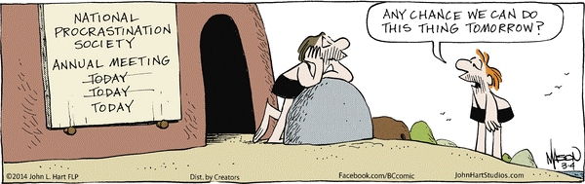
Scheme-athon begins!
First 2.5 weeks of the course If you are a member of NPS, plan to suspend your membership for this term!

Slide 4
Your questions
Elementary Scheme (things that were covered in the five intro videos).
Save more advanced questions for later, or ask on Piazza
Course policies and procedures
Finding things on the web

Slide 5
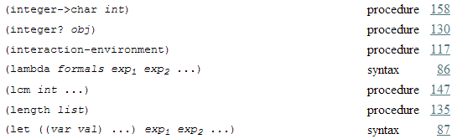
This is from The Scheme Programming Language “Summary of Forms”
What’s the difference between “procedure” and “syntax”?

Slide 6
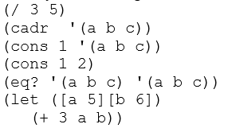
Review a few things from the videos
Draw pictures and show what is printed

Slide 7
Scheme overview at end of this slide set
After the next “Live Demo” slide, there are 8 more slides that give a high-level overview of Scheme.
I don’t usually go over these slides in class, but I suggest that you read through them quickly when you get time.
I’ll be happy to answer any questions that you may have on these at the beginning of tomorrow’s class.

Slide 8
Live demo and group work
We’ll go a little bit farther with Scheme
After the live demo I will split you up into breakout rooms.
Work on some aspect of HW1 in the time that you have.
Someone who has Scheme installed should be the driver.
Driver can share code (by email) with others at the end of class time.
It is possible (because I am still not an expert on managing an online class session) that we won’t get to the group work.

Slide 9
Overview of Scheme
The next six slides give an overview of the Scheme language.
Good stuff! Pretty self-explanatory.
Duplicated on your class notes hand-out.
Read it before tomorrow’s class; if you have questions, ask them in tomorrow’s class.
Now we are going to jump right into more Scheme exploration.

Slide 10
Overview of Scheme 1
Invented in 1975 by Guy Steele and Gerald Sussman at MIT.
Syntax similar to LISP, semantics more like the Algol family (Pascal, Ada, C, Java …)
Expression-oriented and interactive (like Maple, Python, MatLab).
Notes:
GO through these slides quickly so we can get to the live demo.

Slide 11
Overview of Scheme 2
Data and programs have the same syntax http://xkcd.com/859/
(Linked) lists are a fundamental, built-in data type
Not statically typed (similar to Python, Maple, PHP, JavaScript; unlike C and Java)
Everything is in prefix form: (+ a b) instead of a + b
Argument passing is similar to Java
primitives are passed to procedures by value
others (lists, vectors*, etc.): references passed by value.
* vector is Scheme's array type.
Similar to Java arrays

Slide 12
Overview of Scheme 3
Symbols can be data
Somewhat similar to Maple
Procedures are (first-class) data
Can pass them as arguments to other procedures
A procedure can create and return another procedure
Can store a procedure in a data structure (such as a list or array of procedures)
More on this soon!
Minimal procedure overloading.
Notes:
More on first-class procedures next week.

Slide 13
Overview of Scheme 4
Java’s new operator has no Scheme equivalent
Instead there are specific procedures for creating objects of each type:
cons creates a pair (pair is Scheme's main data type)
vector creates a vector (like a C or Java array)
list creates a (proper) list of its arguments
string creates a string from zero or more characters
lambda (which is not a procedure*) creates a procedure
define-syntax (also not a procedure) creates new syntax that extends the Scheme language itself
*In the Summary of Forms at the end of TSPL, "not a procedure" is denoted by "syntax"
http://scheme.com/tspl4/summary.html

Slide 14
Scheme data types and constants
Numbers
6 -12 14283917850923094767626456
5/17 (+ 1/3 1/6) (max 5 7 3)
7.05 3.5e7 (+ 2e3 3e2)
TSPL section 6.3 lists the available operations on numbers.
Boolean (note that if returns a value)
#t #f (if (< a b) a (+ b 1))
String
″This is a String″ (string-length ″Hello″)

Slide 15
Data types and constants 2
Character
#\A #\newline (char->integer #\A)
Symbol (quote hello) ′hello
Vector (like an array in other languages)
#(1 3 2) (make-vector 5 7) (vector-ref v 4)
Empty List ( )
Pair (3 . 5)
List of three elements: (3 5 7)
Improper list (3 5 7 . 8)
List of lists: ((2 4) (5 6 7) (8) ())
Draw pictures

Slide 16
Live demo
Scheme source file-name extensions
.ss , .scm I’ll use .ss
I'll demonstrate SWL and the Emacs editor.
In-class coding will be in the Live-in-class folder, linked from Resources column of Day 1 of the schedule page.
We will continue this demo/discussion tomorrow.
You can follow along on your computer, or you can just watch, think, and ask questions.
Notes:
After Class:
Edit the Resources/Day01_scheme_intro.ss file to reflect what we got through today, and put it on-line.

