Slide 1
CSSE 304 Day 14
What questions do you have?
Extending a language's syntax
Scheme's define-syntax

Slide 2
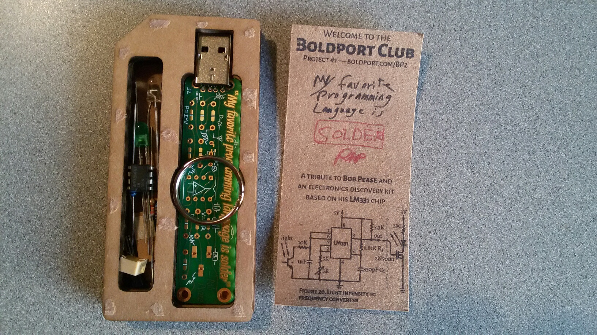

Slide 3
define-syntax and syntax-rules
General form:
(define-syntax <identifier>
(syntax-rules ( {<keyword>}* )
{ [pattern template] }⁺ ))
What gets expanded
How to expand it
Notes:
Usually there are no extra keywords.
Exception: cond as part of else.

Slide 4
Live coding time
my-let
my-if
++
++-post
my-and
for loop

Slide 5
Computation in lambda calculus
Key ideas:
beta reduction
alpha conversion
eta reduction
Number representation 0 := λ f x. x 1 := λ f x. f x 2 := λ f x. f (f x) 3 := λ f x. f (f (f x))
Operations
SUCC := λ n f x. f (n f x)
PLUS := λ m n f x. n f (m f x)
MULT := λ m n. m (PLUS n) 0
AND := λ p q. p q p
OR := λ p q. p p q
NOT := λ p a b. p b a
IFTHENELSE := λ p a b. p a b
http://en.wikipedia.org/wiki/Lambda_calculus#Arithmetic_in_lambda_calculus http://safalra.com/science/lambda-calculus/integer-arithmetic/
Notes:
Tell students that they don't have to know the details of any of this; it is just a little "cultural foray" in to language theory.

Slide 6
λ-calculus and Turing completeness
The untyped lambda-calculus is Turing complete (meaning that we can compute anything with it that we can compute with any other accepted formal model of computation)
http://en.wikipedia.org/wiki/Turing_completeness
This article may also be helpful:
http://en.wikipedia.org/wiki/Lambda_calculus

Slide 7
Combinators

Slide 8
Expressions with no free variables …
… are called combinators (lambda (f g) (lambda (x) (f (g x))))
A famous combinator, Y, is the “recursion maker”.
What is a good name for this combinator?

Slide 9
The Y-combinator
http://dangermouse.brynmawr.edu/cs245/ycomb_jim.html
http://www.ece.uc.edu/~franco/C511/html/Scheme/ycomb.html

Slide 10
Y-combinator ("recursion maker")
(define Y
(lambda (f)
((lambda (x)
(f (lambda (t)
((x x) t))))
(lambda (x)
(f (lambda (t)
((x x) t)))))))
Note that while Y is unusual, there is nothing that looks recursive about it.

Slide 11
Y-combinator can be applied to …
(define H
(lambda (g)
(lambda (n)
(if (zero? n)
1
(* n (g (- n 1)))))))
Note that there is nothing recursive about H. We simply pass in g and possibly call it.
But ...
> ((Y H) 5)
120
(for example)
Note: This is the "applicative-order Y-combinator" which works in Scheme.
In the pure lambda-calculus, in which parameters are passed "by name".
the Y-combinator is simpler.

Slide 12
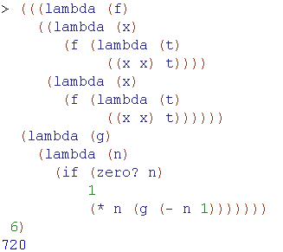
Y-combinator generates “recursion” without using define or other naming mechanisms
Notes:
no define, no letrec. It's truly an anonymous recursive procedure.

