Slide 1
Please mark yourself in attendance on Moodle!

Slide 2
CSSE 304 Programming Language Concepts
Michael Hewner (based on course designed by Claude Anderson) Professor of Computer Science and Software Engineering
Office hours 4-5PM MTThF
hewner@rose-hulman.edu
Post your questions on class message board!
TAs for Fall, 2020: Cade Parkhurst, Nathan Greiner, Luke McNeil, Megan Merz, Elvis Morales Campoverde, Jonathan Moyers
There may also be PercopoTutors for the Learning Center
Notes:
Take to Class:
Printout of these slides
Student pictures from Banner
Printout of Day01-02_transcript
Handouts for everyone:
Announcements page
EoPL-1 excerpt
Assignment 0 Handin sheet
Spend a while on this slide. Pass around th attendance roster
After Class:
Edit the Resources/Day01_scheme_intro.ss file to reflect what we got through today, and put it on-line.

Slide 3
CSSE 304 Day 1
What's on the web?
Scheme Intro (assumes that you viewed the five videos)
Instructor/course intro: will happen Day 3
because we will dive into Scheme for the first two class days.
Scheme-a-thon: Days 1-12.

Slide 4
Announcements
TA lab hours begin Friday.
Student assistants can give you help on installing Scheme and/or editors, getting started with Scheme programming.
Please give me feedback on how the assistants are doing.
If something else is going on in F-217, the assistants may be in F-225. If you don't know who the assistant is, be bold and ask.

Slide 5
Daily Course Announcements
Announcements In-between class times: Piazza or email Mostly Piazza

Slide 6
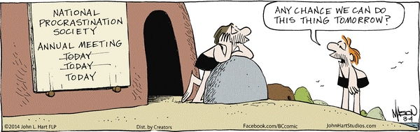
Scheme-athon begins!
First 2.5 weeks of the course If you are a member of NPS, plan to suspend your membership for this term!

Slide 7
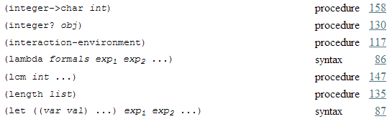
From today’s class notes
This is from The Scheme Programming Language “Summary of Forms”
What’s the difference between “procedure” and “syntax”?

Slide 8
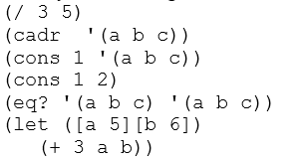
Activity
Talk with the other student(s) at your table.
What will Scheme print when we enter each of these?

Slide 9
Overview of Scheme
The next six slides give an overview of the Scheme language.
Good stuff! Pretty self-explanatory.
Read it before tomorrow’s class; if you have questions, ask them in tomorrow’s class.
Now we are going to jump right into more Scheme exploration.

Slide 10
Overview of Scheme 1
Invented in 1975 by Guy Steele and Gerald Sussman at MIT.
Syntax similar to LISP, semantics more like the Algol family (Pascal, Ada, C, Java …)
Expression-oriented and interactive (like Maple, Python, MatLab).
Notes:
GO through these slides quickly so we can get to the live demo.

Slide 11
Overview of Scheme 2
Data and programs have the same syntax http://xkcd.com/859/
(Linked) lists are a fundamental, built-in data type
Not statically typed (similar to Python, Maple, PHP, JavaScript; unlike C and Java)
Everything is in prefix form: (+ a b) instead of a + b
Argument passing is similar to Java
primitives are passed to procedures by value
others (lists, vectors*, etc.): references passed by value.
* vector is Scheme's array type.
Similar to Java arrays

Slide 12
Overview of Scheme 3
Symbols can be data
Somewhat similar to Maple
Procedures are (first-class) data
Can pass them as arguments to other procedures
A procedure can create and return another procedure
Can store a procedure in a data structure (such as a list or array of procedures)
More on this soon!
Minimal procedure overloading.
Notes:
More on first-class procedures next week.

Slide 13
Overview of Scheme 4
Java’s new operator has no Scheme equivalent
Instead there are specific procedures for creating objects of each type:
cons creates a pair (pair is Scheme's main data type)
vector creates a vector (like a C or Java array)
list creates a (proper) list of its arguments
string creates a string from zero or more characters
lambda (which is not a procedure*) creates a procedure
define-syntax (also not a procedure) creates new syntax that extends the Scheme language itself
*In the Summary of Forms at the end of TSPL, "not a procedure" is denoted by "syntax"
http://scheme.com/tspl4/summary.html

Slide 14
Scheme data types and constants
Numbers
6 -12 14283917850923094767626456
5/17 (+ 1/3 1/6) (max 5 7 3)
7.05 3.5e7 (+ 2e3 3e2)
TSPL section 6.3 lists the available operations on numbers.
Boolean (note that if returns a value)
#t #f (if (< a b) a (+ b 1))
String
″This is a String″ (string-length ″Hello″)

Slide 15
Data types and constants 2
Character
#\A #\newline (char->integer #\A)
Symbol (quote hello) ′hello
Vector (like an array in other languages)
#(1 3 2) (make-vector 5 7) (vector-ref v 4)
Empty List ( )
Pair (3 . 5)
List of three elements: (3 5 7)
Improper list (3 5 7 . 8)
List of lists: ((2 4) (5 6 7) (8) ())
Draw pictures

Slide 16
Live demo
Scheme source file-name extensions
.ss , .scm I’ll use .ss
I'll demonstrate SWL and the Emacs editor.
In-class coding will be in the Live-in-class folder, linked from Resources column of Day 1 of the schedule page.
We will continue this demo/discussion tomorrow.
You can follow along on your computer, or you can just watch, think, and ask questions.
Notes:
After Class:
Edit the Resources/Day01_scheme_intro.ss file to reflect what we got through today, and put it on-line.

