Slide 1
CSSE 304 Day 25
CPS Pitfalls
Add letrec to the interpreted language

Slide 2
Please convert slist-subst in sublists-cps.rkt
You have test cases to help you
Use your guide from the last class – ask me for help if you need
I will go over it when you’re done

Slide 3
CPS tips
The goal is to make all substantial procedure calls tail calls
A “substantial” procedure for the exercises is one that we’ve asked you to convert to CPS
Look for and remove non-tail substantial procedure calls everywhere – in the original procedure, in apply-k, in helper procedures
You should never create an (init-k) continuation yourself, except in test cases and manual testing. Wanting to do this is an indication you’re trying to call a cps procedure in a non-tail position.

Slide 4
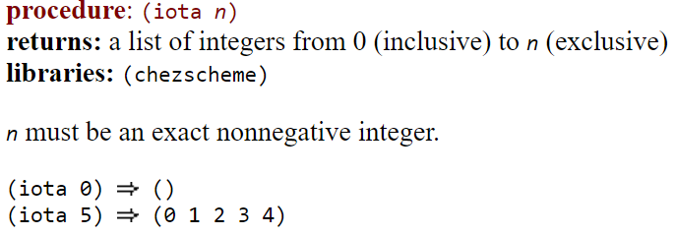

iota
From CSUG:
From Wikipedia:
For practice later: Use iota to write range:
(range 5 9) ➔ (5 6 7 8 9)

Slide 5
Add letrec to the interpreted language
Limited version of letrec
One that’s like the way letrec SHOULD always be used.
(letrec ([var <lambda-exp>] ... ) body body2 ... )
could be parsed into [letrec-exp
(proc-names (list-of symbol?))
(idss (list-of (list-of symbol?)))
(bodiess (list-of (list-of expression?)))
(letrec-bodies (list-of expression?)]
This is one possible way of parsing it. 0thers are also acceptable.

Slide 6
Example of a parsed letrec expression
[letrec-exp
(proc-names (list-of symbol?))
(idss (list-of (list-of symbol?)))
(bodiess (list-of (list-of expression?)))
(letrec-bodies (list-of expression?))]
This is one possible way of parsing it. 0thers are also accepta-ble.
(define odd?
(letrec ([odd? (lambda (n)
(if (zero? n)
#f
(even? (- n 1))))]
[even? (lambda (m)
(if (zero? m)
#t
(odd? (- m 1))))])
(lambda (x)
(odd? x))))
Parsed from of the blue code:
(letrec-exp
(odd? even?)
((n) (m))
(((if-exp (app-exp (var-exp zero?) (var-exp n)) …))
((if-exp (app-exp (var-exp zero?) (var-exp m)) …)))
((lambda-exp (x) ((app-exp (var-exp odd?) (var-exp x))))))

Slide 7
letrec Evaluation
Closures are created and added to the letrec environment
bodies of the letrec are evaluated in order
When one of the letrec closures is applied
new environment must extend the letrec environment
If it were let instead of letrec,
the new environment would extend the enclosing environment instead

Slide 8
How to evaluate letrec?
(define eval-exp
(lambda (exp env)
(cases expression exp
. . .
[letrec-exp (proc-names idss bodiess letrec-bodies)
(eval-bodies letrec-bodies
(extend-env-recursively
proc-names idss bodiess env))]
. . .
So the question becomes: how do we implement extend-env-recursively?
We saw when we drew
environment and closure diagrams that we need a recursive environment here

Slide 9
Extend-env-recursively: Three possible approaches
0. Implement extend-env-recursively in terms of Scheme's letrec. Nope!
1. No mutation: A new kind of environment extension: recursively-extended-env-record
2. Mutation: A normal extended environment, then use set-car! or vector-set! to implement the circularity.
Notes:
I really don't like 0.

Slide 10
Disclaimer
The succeed and fail arguments to the apply-env procedure
Add to the usability
but not to the initial understandability of the code when you see new environment approaches.
So I won't include them here.
Easy to add back in, once you understand each of these approaches to letrec implementation.

Slide 11
datatype for no-mutation approach
(define-datatype environment environment?
[empty-env-record]
[extended-env-record
(syms (list-of symbol?))
(vals (list-of scheme-value?))
(env environment?)]
[recursively-extended-env-record
(proc-names (list-of symbol?))
(idss (list-of (list-of symbol?)))
(bodiess (list-of (list-of expression?)))
(old-env environment?)])
We already had these two variants

Slide 12
Recursive extension without mutation
(define extend-env-recursively
(lambda (proc-names idss bodiess old-env)
(recursively-extended-env-record
proc-names idss bodiess old-env)))

Slide 13
(define apply-env
(lambda (env sym)
(cases environment env
[empty-env-record ()(apply-global-env sym)]
[extended-env-record (syms vals env)
(let ((pos (list-find-position sym syms)))
(if (number? pos)
(list-ref vals pos)
(apply-env env sym)))]
[recursively-extended-env-record
(procnames idss bodiess old-env)
(let ([pos (list-find-position sym procnames)])
(if (number? pos)
(closure (list-ref idss pos)
(list-ref bodiess pos)
env)
(apply-env old-env sym)))])))
What is the disadvantage of this approach?
Why not simply do it like let environments?
Notes:
Disadvantage: We have to re-create the closures every time we apply one of the letrec-bound procedures.

Slide 14
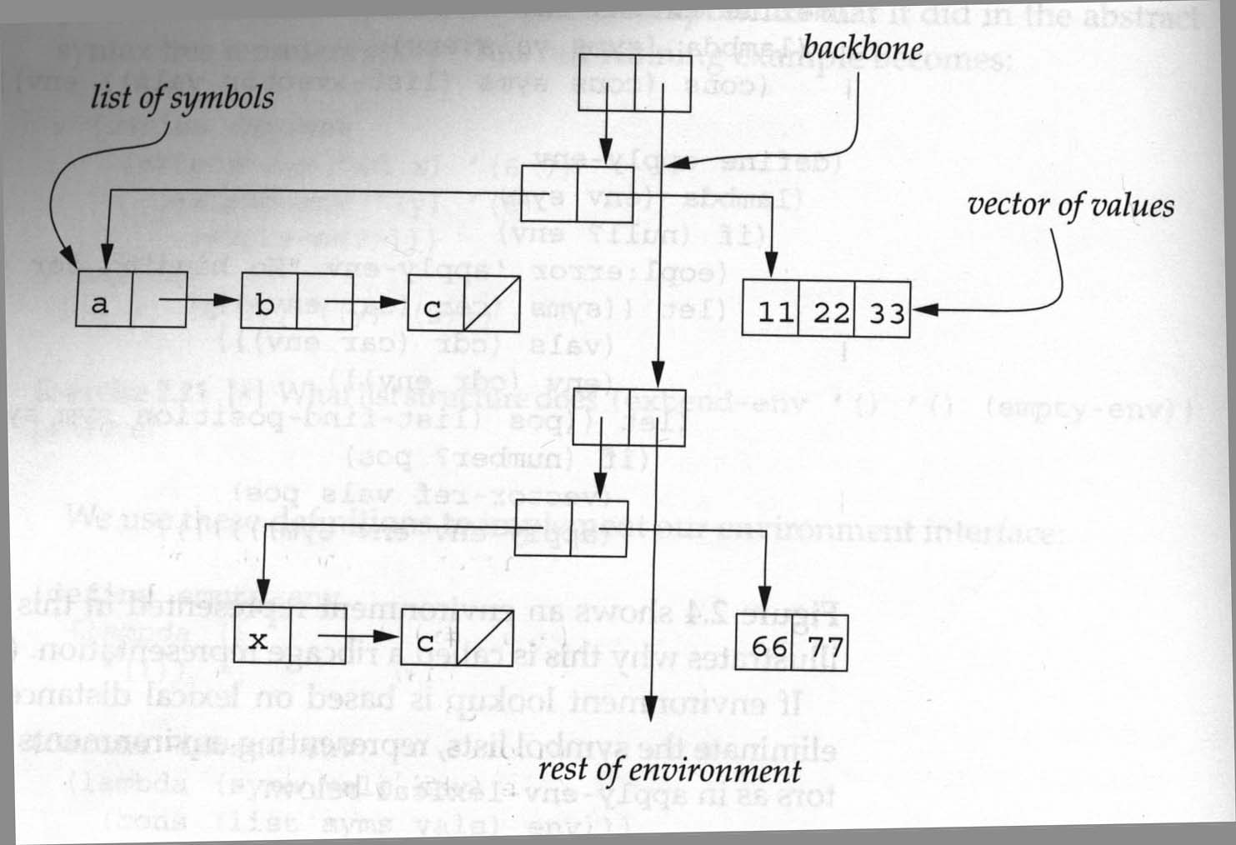
Mutation solution: Uses the ribcage implementation of environments.

Slide 15
Mutation solution: Uses the ribcage implementation of environments.
(define extend-env-recursively
(lambda (proc-names idss bodiess old-env)
(let ([len (length proc-names)])
(let ([vec (make-vector len)])
(let ([env (extended-env-record
proc-names vec old-env)])
(for-each
(lambda (pos ids bodies)
(vector-set! vec
pos (closure ids bodies env)))
(iota len) idss bodiess)
env)))))
With this representation, we can use the original extended-env-record and apply-env; it does not need the additional case for recursive environments.
This let has two bodies
(iota 4) ➔ (0 1 2 3)
You can easily write the code…

Slide 16
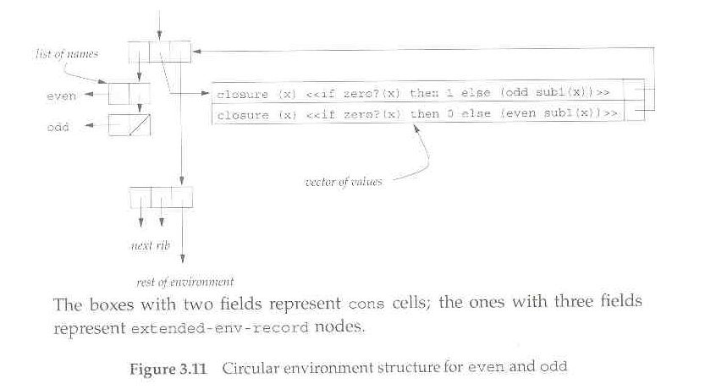
Note that in this mutation approach, we do not need recursively-extended-env-records, and we do not have to change apply-env at all.

Slide 17
Another Mutation solution: Expand the source code using syntax-expand.
(define odd?
(letrec ([o? (lambda (n)
(if (zero? n)
#f
(e? (- n 1))))]
[e? (lambda (m)
(if (zero? m)
#t
(o? (- m 1))))])
o?))
How can we expand this to an expression involving let and set! ?
Notes:
Write the translation to let with set! on the boaard

Slide 18
Onward to set! implementation.
We may will not get here on Monday.

Slide 19
Binding vs. Assignment
A binding creates a new name and associated value.
In Scheme, accomplished by define, let, letrec, or application of a closure
An assignment changes the value of a variable an existing binding.
set!, or top-level define of an already-defined variable.

Slide 20
Add set! to the interpreter
r-values vs l-values
x = x + 1;
We need a way of changing the value of a bound variable
Why doesn't the current setup support this?
How can we fix this?

Slide 21
Add set! to the interpreter
ADT approach: Add a new environment observer:
(apply-env-ref env var) returns a reference to the variable in question.
(deref ref) gets the value stored in the location that is referenced by ref.
(set-ref! ref value) changes the value stored there
If we have apply-env-ref, then apply-env does not have to be a basic operation of the environment datatype:
(define apply-env
(lambda (env var)
(deref (apply-env-ref env var))))
but it may be more efficient to implement apply-env directly (in a representation-dependent way).

Slide 22
Implementing set!
Once we have references, it is easy. A new clause for eval-exp's cases:
[set!-exp (id exp) (set-ref! (apply-env-ref env id) (eval-exp exp env))]
All that is left to do is to implement references! (we'll look at multiple approaches)

