Slide 1
CSSE 304 Day 10
Procedural Abstraction

Slide 2
What is up with currying?
Ordinary functions require us to provide all their data at once
A curried function allows us to pass part of their data at one time, and the rest of their data at another
Can also make it easier to compose or operate on functions – we’ll see an example of this today

Slide 3
Four similar recursive procedures
(define list-sum (lambda (ls) …) ; sum of a list-of-numbers;
(define list-prod (lambda (ls) …) ; product of a list-of-numbers;
(define apply-to-all ; curried version of map (lambda (proc) (lambda (ls) … )
(define member?-c ; is item a member of ls? (lambda (item) (lambda ls) …)
What do the four procedures have in common? What are their differences? Can we abstract the recursion pattern, creating a procedure that makes list-recursion procedures?
Notes:
Answer on next slide

Slide 4
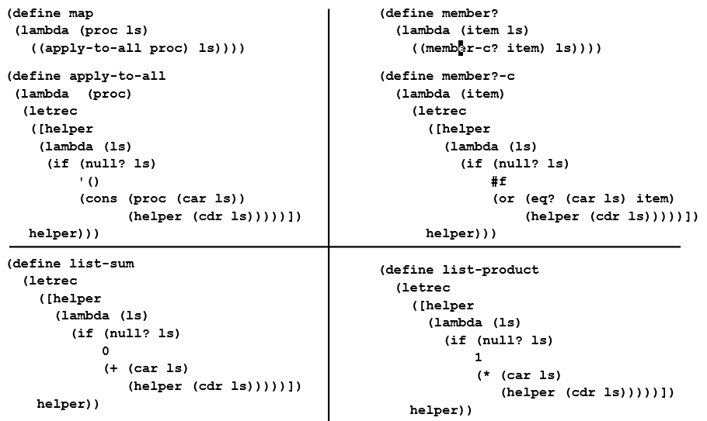
Procedural Abstraction

Slide 5
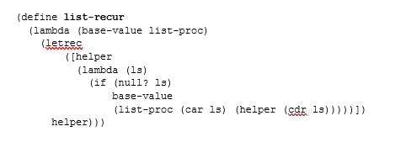

Slide 6
Follow-up
Of the five procedures, four are good to write using list-recur. The other is not so good. Which one, and why?
Come up with another example that is easier to write with list-recur than to write it directly.
Assignment 9.
Write snlist-recur, which similarly abstracts over s-lists, and use it to write several procedures.
Write bt-recur, which abstracts “bt” functions, and use it to write two procedures.

Slide 7
Procedural abstraction
This idea of using lambdas (i.e. procedures) to create functions that are very general is very fundamental to functional programming
Rather than abstracting over *types* of things (traditional OO) we aim to abstract over processes
When we build things by combining really abstract things like list recur, it can be initially very hard to understand what’s going on
But –of course – to solve very hard problems with very small amounts of code…we’ll need code that works in a sort of unexpected way

Slide 8
list-recur abstracts list recursion
Before the next class
Try to come up with at least one other procedure that is easy to write using list-recur. Hopefully something that is not a clone of one that we wrote.
And write it!
(define list-sum (list-recur 0 +)
(define list-prod (list-recur 1 *)
(define apply-to-all
(lambda (proc)
(list-recur ′()
(lambda (x y)
(cons (proc x) y)))))
(define member-c?
(lambda (item)
(list-recur #f (lambda (x y)
(or (equal? item x)
y)))))
(define length (list-recur ;fill it in
)
Your examples?
One of these is a bad idea!
Which one and why?
Notes:
(define reverse (list-recur '() (lambda (x y) (append y (list x)))))
Don't print this slide on the website until after class.

