Slide 1
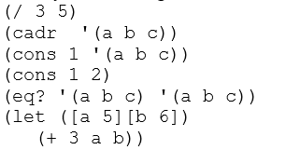
Activity
Talk with the other student(s) at your table.
What will Scheme print when we enter each of these?

Slide 2

Scheme Intro
Buffalo
Art by Helvetica Blanc (https://helveticablanc.com). Licensed under a Creative Commons Attribution-NonCommercial-ShareAlike 4.0 International license.

Slide 3
Logistics
Clone the course repo
Follow the schedule page to see when assignments are due
Submit assignments via gradebook
Read the “mini-syllabus” I’ve handed out

Slide 4
What makes scheme scheme?
In my option, not so much a language as building blocks for creating your own languages
Prizes simplicity of syntax to allow for flexibility – this is why it looks like parenthesis soup
Prioritizes the procedure as it’s primary source of abstraction (this makes it a functional language)
Which begs the question…

Slide 5
What is a procedure?

Slide 6
Better question: what are the rules of a procedure call?
(define proc-a
(lambda (x y)
(display "a procedure")
(+ x y)))
(define proc-b
(lambda (q)
(display "b procedure")
(* 7 q)))
(proc-a 100 (proc-b 3))

Slide 7
Can every (structure) be a procedure?
(if (> a 7)
(display "big")
(display "small"))

Slide 8
Can every (structure) be a procedure?
literal
(if (> a 7)
(display "big")
(display "small"))
identifier
Structures that are not are called “syntax”

