Slide 1
CSSE 304 Days 27 - 29
Receivers
Escape procedures
Call-with- procedures
Review continuations
Intro to call/cc
call/cc examples
Notes:
To add:
Good and bad code for letrec
To take:
Springer/Friedman excerpt to read

Slide 2
Warm-up for call/cc
Receivers
Escape procedures Continuations
call/cc involves both receivers and escape procedures, so we first define both of those.
Then we review continuations.

Slide 3
My discussion of call/cc is loosely based the book Scheme and the Art of Programming by George Springer and Daniel Friedman.

Slide 4
Review of Continuations
Consider the evaluation of the expression:
(let ([x (+ y 2)]) (if (< x 4) 5 (- x 6))
What is the continuation of 6 ? (+ y 2) ? (- x 6) ? (< x 4)
Notes:
I plan to go slow. Please don't let anything go over your head today. We can revisit anything!

Slide 5
Receivers
A receiver is an argument (which also happens to also be a procedure) passed to a procedure, with the intention that the procedure will eventually apply that receiver to some values; i.e. pass values to that receiver.
Example: When we represent continuations by Scheme procedures, those continuations that we pass to CPS procedures are receivers. (lambda (v) …) They expect to receive a value for v.
Sometimes receivers are called callbacks.

Slide 6
Old Receiver Example: call-with-values
> (call-with-values (lambda () (values 3 4)) list) (3 4)
list is a receiver (we previously called it the consumer)

Slide 7
new receiver example
From TSPL: The following shows the use of call-with-output-file to write a list of objects (the value of list-to-be-printed), separated by newlines, to the file named "myfile.ss."
(call-with-output-file "myfile.ss" (lambda (p) ; this is the "receiver"
(let f ([ls list-to-be-printed]) (if (not (null? ls)) (begin (write (car ls) p) (newline p) (f (cdr ls)))))))
The receiver expects to receive an output port as its argument
(define call-with-output-file (lambda (filename proc) (let ((p (open-output-file filename))) (let ((v (proc p))) (close-output-port p) v))))

Slide 8
An escape procedure
Pretend that we have a procedure escape-+ that adds its arguments and returns this sum as the final answer, no matter what the context.
(* (escape‑+ 5 6) 3) ➔
(escape-+ (escape-+ 2 4) 5) ➔
Notes:
We can say that escape-+ ignores the current continuation, or "escapes from" the current continuation.
Answers: 11, 6

Slide 9
An escape procedure
Pretend that we have a procedure escape-+ that adds its arguments and returns this sum as the final answer, no matter what the context.
(* (escape‑+ 5 6) 3) ➔ 11
(escape-+ (escape-+ 2 4) 5) ➔ 6
Notes:
We can say that escape-+ ignores the current continuation, or "escapes from" the current continuation.
Answers: 11, 6

Slide 10
Escaper (a mostly fictitious procedure)
More generally, suppose that we have a procedure escaper that takes any procedure as an argument and returns an equivalent escape procedure.
Thus (escaper +) creates a procedure that is equivalent to escape-+
(+ 3 ((escaper +) 4 5)) ➔
(+ ((escaper (lambda (x) (- (* x 3) 7))) 5) 4) ➔
Notes:
Answers: 9, 8

Slide 11
Escaper (a mostly fictitious procedure)
More generally, suppose that we have a procedure escaper that takes a procedure as an argument and returns an equivalent escape procedure.
(escaper +) creates a procedure that is equivalent to escape-+
(+ 3 ((escaper +) 4 5)) ➔ 9
(+ ((escaper (lambda (x) (- (* x 3) 7))) 5) 4) ➔ 8
Notes:
Answers: 9, 8

Slide 12
You can experiment with escaper
You can define escaper in Chez Scheme by loading escaper.ss in the following way (from the command line):
escaper.ss is linked from the schedule page
sliderule 1:12pm > petite escaper.ss
Petite Chez Scheme Version 6.7
Copyright (c) 1985-2001 Cadence Research Systems
> ((call/cc receiver-4))
"escaper is defined"
> (cdr ((escaper cdr) '(4 5 6)))
(5 6)
Notes:
Do it.

Slide 13
Escape Procedures
Let p be a procedure. If an application of p abandons the current continuation and does something else instead, we call p an escape procedure.
An example of a Scheme escape procedure that we have already used:
Is escaper an escape procedure?
Notes:
Answer: error

Slide 14
"call-with" procedures
(call-with-values producer consumer)
The receiver is the consumer.
It receives the values returned by a call to the producer.
(call-with-output-file filename proc)
The receiver is proc.
It receives the output port obtained by opening the output file whose name is filename.
(call-with-current-continuation receiver)
The receiver receives the current continuation.

Slide 15
dining out example from Springer and Friedman, Part 5 intro
(define dine-out
(lambda (restaurant)
(enter restaurant)
(read-menu)
(let ([food-I-ordered
(order-some-food)])
(eat food-I-ordered)
(pay-for food-I-ordered restaurant)
(exit restaurant))))
For future reference:
A photograph corresponds to a continuation.
“Taking a photograph” corresponds to applying call/cc to a receiver.
The receiver receives the photograph (continuation).
Rubbing a photograph and escaping corresponds to applying a continuation to an argument.
I will read an excerpt from the book

Slide 16
Call/cc definition and exampleS

Slide 17
call/cc
call/cc is an abbreviation for call‑with‑current‑continuation .
call/cc is a procedure that takes one argument; the argument is a receiver.
this receiver is a procedure that takes one argument; that argument (in this case) is a continuation.
A continuation is a procedure (that takes one argument); that continuation embodies the context of the application of call/cc. The continuation is an escape procedure.
The application (call/cc receiver) has the same effect as (receiver continuation), where the continuation is
an escape procedure that embodies the execution context of the entire call/cc expression.

Slide 18
call/cc definition summary
(call/cc receiver) ➔ (receiver current-continuation),
Hence the name: call‑with‑current‑continuation.
Rephrasing it: What is that continuation? If c (for context) is a procedure that represents the execution context of this application of call/cc, then the continuation is equivalent to (escaper c).
call/cc does not create the continuation. It “reifies” it.

Slide 19
call/cc example
(call/cc receiver) ➔ (receiver continuation)
a) (+ 3 (call/cc (lambda (k) (* 2 (k 5)))))
The receiver is
The context is
The continuation is
Thus (+ 3 (call/cc (lambda (k) (* 2 (k 5))))) is equivalent to

Slide 20
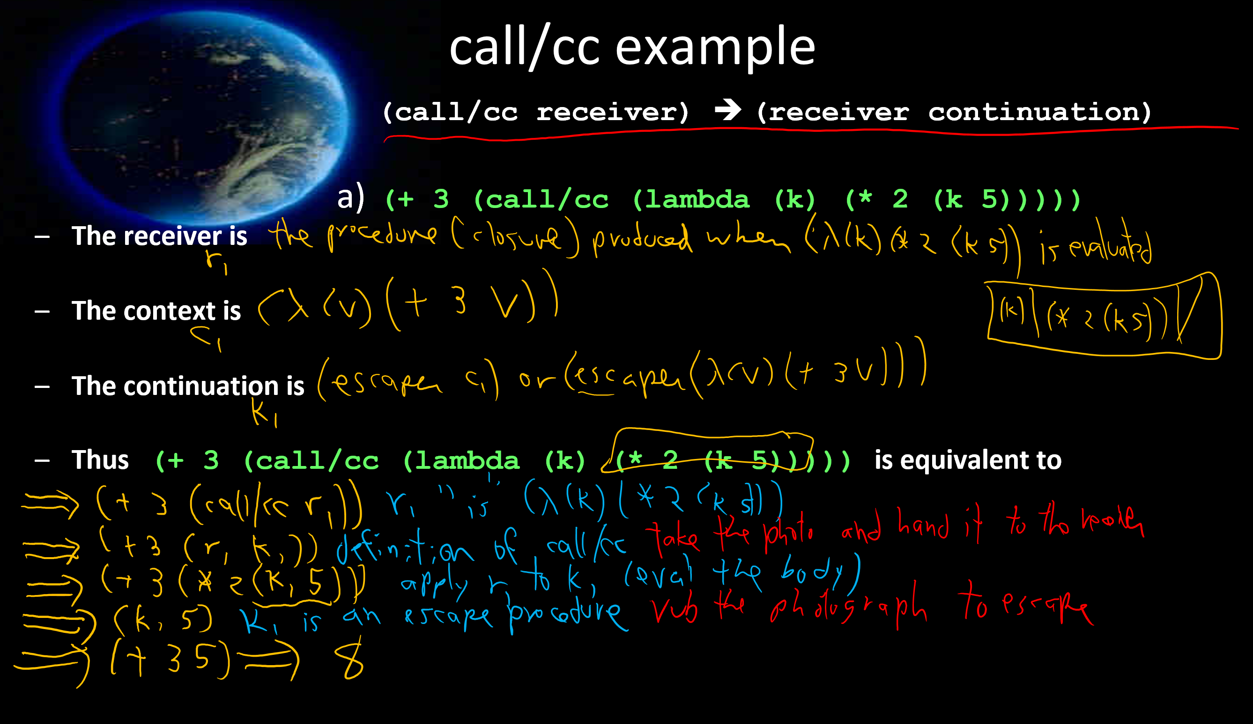

Slide 21
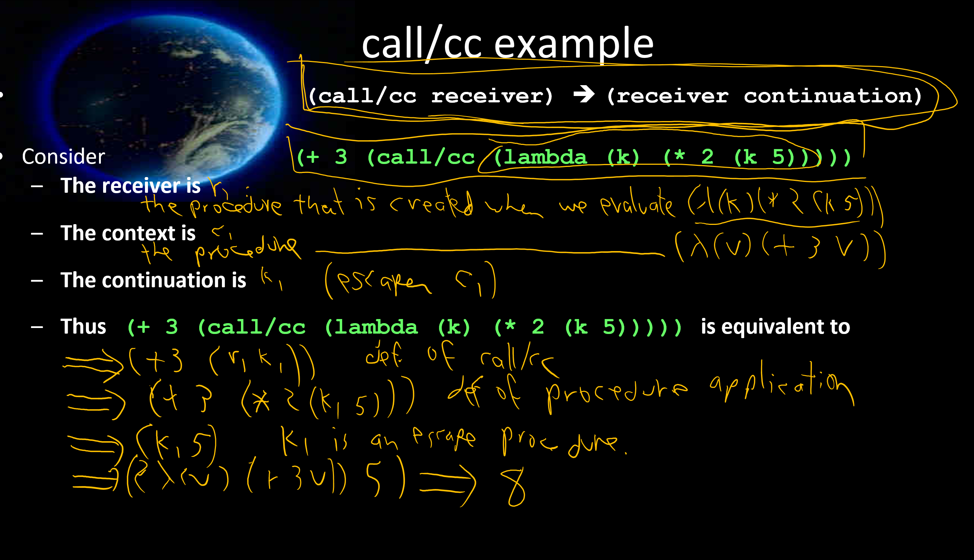

Slide 22
More call/cc examples
(call/cc receiver) ➔ (receiver continuation)
a) (+ 3 (call/cc (lambda (k) (* 2 (k 5)))))
b) (+ 3 (call/cc (lambda (k) (* 2 5))))
c) (+ 3 (call/cc (lambda (k) (k (* 2 5)))))
Notes:
Next day questions (use RSG):
What is a receiver?
Is call/cc a procedure, or syntax?
IS call/cc an escape procedure?
What does call/cc expect as its argument?
What is call/cc an abbreviation for?
What does the receiver receive?

Slide 23
More call/cc examples
(call/cc receiver) ➔ (receiver continuation)
d) (define xxx #f)
(+ 5 (call/cc (lambda (k)
(set! xxx k) 2))) ; xxx is equivalent to?
(* 7 (xxx 4))
Notes:
Next day questions (use RSG):
What is a receiver?
Is call/cc a procedure, or syntax?
IS call/cc an escape procedure?
What does call/cc expect as its argument?
What is call/cc an abbreviation for?
What does the receiver receive?

Slide 24
More call/cc examples
(call/cc receiver) ➔ (receiver continuation)
d) (define xxx #f)
(+ 5 (call/cc (lambda (k) take the photograph
(set! xxx k) save the photograph 2))) ; xxx is equivalent to?
(* 7 (xxx 4)) rub the photograph

Slide 25
A simple call/cc example (call/cc receiver) ➔ (receiver continuation)
e) (call/cc procedure?)

Slide 26
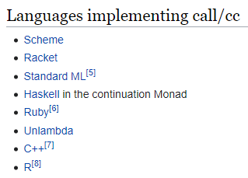
call/cc in other languages
https://en.wikipedia.org/wiki/Call-with-current-continuation#Languages_implementing_call/cc What you will find there:

Slide 27
f) List-index
But "standard recursion" seems so much more natural!
Standard approach: (define (list-index item L) (cond [(null? L) -1] [(eq? (car L) item) 0] [else (+ 1 (list-index item (cdr L)))]))
Can we use call/cc to escape with the -1 answer?
What is the problem with this?
One solution: accumulator approach

Slide 28
f) (define list-index
(lambda (sym L)
(call/cc
(lambda (answer)
(let loop ([L L])
(cond [(null? L) (answer -1)]
[(eqv? sym (car L)) 0]
[else (+ 1 (loop (cdr L)))]))))))
> (list-index 'a '(b a c))
1
> (list-index 'a '(b d c))
-1

Slide 29
(call/cc receiver) ➔ (receiver continuation)
g) ((car (call/cc list))
(list cdr 1 2 3))

Slide 30
Interlude: quotes
Premature optimization is the root of all evil in programming. - C.A.R. Hoare Do you know what he is famous for?
There is no code so big, twisted, or complex that maintenance can't make it worse. - Gerald Weinberg
Computer Science is the only discipline in which we view adding a new wing to a building as being maintenance. – Jim Horning

Slide 31
All this from that short code?
(call/cc receiver) ➔ (receiver continuation)
h) (let ([f #f] [i 0])
(call/cc (lambda (k) (set! f k)))
(printf "~a~n" i)
(set! i (+ i 1))
(if (< i 10) (f "ignore")))

Slide 32
Strange indeed!
i) (define strange1
(lambda (x)
(display 1)
(call/cc x)
(display 2)))
(strange1 (call/cc (lambda (k) k)))

Slide 33
Error Handling with Continuations
try {
potentially erroring code
ordinary code that relies on success
} catch (errorflavor) {
error handling code
}
// try causes a call-cc, with a continuation that will bring us directly to the catch
//post try code looks at the result to determine if an error happened, if so it invokes the catch, otherwise it returns the value

Slide 34
Continuations with user input
We often want functions that look like this
(define (calc-complex-thing x y)
(let ((user-val (ask-user-question))
(do-calculculation x y user-value)))
But the reality is that interacting with the user actually forces us out of our functions. So we need ugly callback.
(open-dialog “user question” (lambda (user-val) (do-calculation x y user-val)))
;; see how this function weirdly returns

Slide 35
“mondo bizarro” example
j)
(define strange2
(lambda (x)
(display 1)
(call/cc x)
(display 2)
(call/cc x)
(display 3)))
(strange2 (call/cc (lambda (k) k)))
We may not do this one in class; good practice for you.
1 1 2 1 3

