Slide 1
CSSE 304 Day 2
Basic Lambda & Recursion

Slide 2
Finding today’s starting code
Course repo - ClassMaterials/Lambda/startingcode.ss
If I didn’t tell you today’s class was called lambda, you could see it on the schedule page
You need to “git pull” because I pushed it earlier today (that’s usual)
The starting code errors if you load it, but don’t worry…

Slide 3
Day 2 things to do
Your non-Scheme questions
Your Scheme Questions
Run the A1 offline test code
More recursive procedures (together)
Still more recursive procedures (in breakout rooms)

Slide 4
Students Questions
Questions about the syllabus or course policies?
Questions about installation, tool use, etc.?
Questions about Scheme?

Slide 5
Running my test code on your own computer
I will demonstrate this in Visual Studio Code
Notes:
The first one is true. And according to the evaluations from the 13 or so times I have taught this, most of the students like it too!
On Senior exit surveys, one question we ask is "What is your favorite CSSE course?" Every year, this one gets the most votes.
Full dusclosure: It usually also gets one or two votes for least favorite course
The second one is true only if you don't keep up!
In Spring of 2009, 61 students. 28 A's and 10 B+'s
Unfortunately, every time I teach the course a few students get behind and can never catch up.
Decide now that this will not be you!
On most assignments, you will spend a lot of time writing a little bit of code, and you will learn a lot. The assignments are key. They are cumulative. Do not miss any,

Slide 6
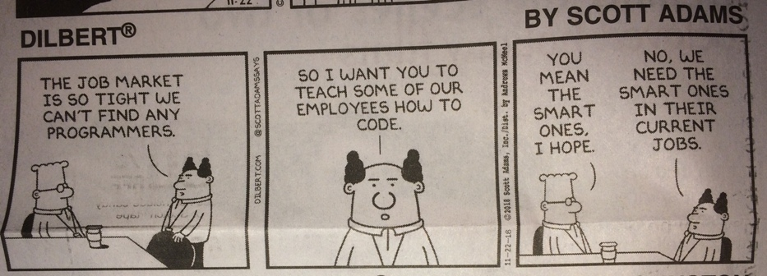
Interlude

Slide 7
I’ll write these procedures
Write procedures to
Find the median of three numbers
Given a list of numbers lon and a number n, return a new list of numbers where each element is n more than the corresponding element of lon.
Count how many times the number n occurs in the list lon.
* "…if any time remains," Tom schemed parenthetically.

Slide 8
Lets look at lambda declaring a “function”
Name (not part of lambda)
parameters
(define median-of-three
(lambda (a b c)
(- (+ a b c) (max a b c) (min a b c))))
Body – doesn’t run until later
(lambda (var₁ ... var_{n}) body₁ body₂ ...)
Formal details in TSPL 4.2 and onward

Slide 9
Lambda is a syntax that returns a procedure
Same idea in Javascript
add1 = function(number) { return number + 1 }
We usually will name it but not always
((lambda (x y) (+ x y)) 1 2)
Sometimes called a “closure” or “lexical closure”
Right now think blob of code that’s ready to run

Slide 10
More recursive procedures
Work with the students sitting next to you
The student whose birthday is soonest should drive.
(square-sum n) returns the sum of the squares of the first n positive integers.
(square-all lon) returns a list of the squares of the numbers in lon.
(make-list n obj) returns a list of n "copies" of obj. [If obj is a "by-reference" object, such as a list, make-list makes n copies of the reference].
Notes:
On the board, like the previous one:
(define square-sum
(lambda (n)
(if (zero? n)
0
(+ (* n n) (square-sum (- n 1))))))
This one is on the quiz. Let them have about 3 minutes to work on it. Ask if everyone has it. If so, then move on, and don't go over it.
(define square-all
(lambda (ls)
(if (null? ls)
'()
(cons (* (car ls) (car ls))
(square-all (cdr ls))))))
On the board, like the previous one:
(define make-list
(lambda (n obj)
(if (zero? n)
'()
(cons obj (make-list (- n 1))))))

