Slide 1
CSSE 304
Live coding today: Live-in-class/Day34_and_35
Starting code: 5-reverse-imperative.-starting-code.ss
Day 34
Imperative form

Slide 2
Implementing Reference parameters
For definiteness, I use an “each value in an environment is in a cell” approach. This should be easily adaptable to the “vector of values” or ”list of values” approaches to references.

Slide 3
(let ([a 3]
[b 4]
[rotate (lambda (x (ref y) (ref z))
(let ([temp x])
(set! x y)
(set! y z)
(set! z temp)
(list x y z)))])
(let ([result (rotate a b (+ a b))])
(list a b result)))
What interpreter changes are needed before we call apply-proc? Mainly a change to eval-rands: return a list of cells instead of a list of values.
What interpreter changes are needed in the apply-proc closure case? If it’s not a ref param, put the corresponding argument value in a new cell.
A small change to the expression datatype definition.
No changes to parse-exp or syntax-expand
Notes:
Draw the diagram on the board

Slide 4
A change to extend-env
This works for the “cell” representation of references. It’s slightly more complex for the ribcage representation without cells.
First, modify extend-env so that its second argument is a list of cells containing the values. Thus the values are put into the cells before calling extend-env.
Each level of extended environment will still contain a list or vector of cells, but these cells will not be created by extend-env.

Slide 5
Imperative form
As close to C or Assembly Language as we can get in Scheme

Slide 6
What is the difference between an interpreter and a complier?
Interpreter is a program that runs another program (e.g. petite is a program that runs .ss scheme programs)
Hopefully at this point you feel confident implementing interpreters – after A18 hopefully you feel confident implementing high level interpreters in low languages
Complier is a program that outputs an assembly language program (broadly)

Slide 7
Compliers -> Syntax expansion
Complier is a program that outputs an assembly language program (broadly)
Once we convert, henceforth we can run the program directly on the CPU (which you can think of as an interpreter with very limited core forms)
A complier like a really complex syntax expansion – like your syntax expansion, none of its structures exist at runtime

Slide 8
Syntax expansion
Could you write a syntax expansion that could convert a scheme function to cps? I hope you intuit that the answer is yes.
Your textbook has the details
If we have the capability to do such a syntax expansion, we can convert a high-level language (scheme) to a language more like C. It doesn’t have things like lambdas – but it does have function calls, parameters – and for that reason “environments”

Slide 9
Imperative form
Imperative form is a final transformation, that transforms cps-ized code into code that relies on sets and gotos
This is a form that is very close to what you’d need to actually run the code on a processor with assembly language
To build a scheme complier: regular scheme -> cps scheme -> imperative form scheme -> assembly language
* data structures, garbage collection

Slide 10
A simple example
We’re not going to have you write stuff to convert scheme code in an automated way – we’re just going to ask you to do the transformation by hand, as you’ve done for cps
The code in these slides is linked from today’s Resources column in the Schedule Page.

Slide 11
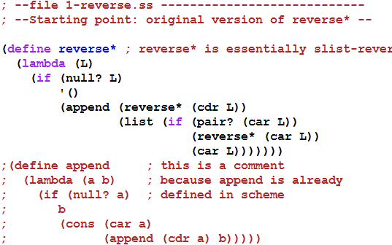

A simple example
Next: convert to CPS

Slide 12
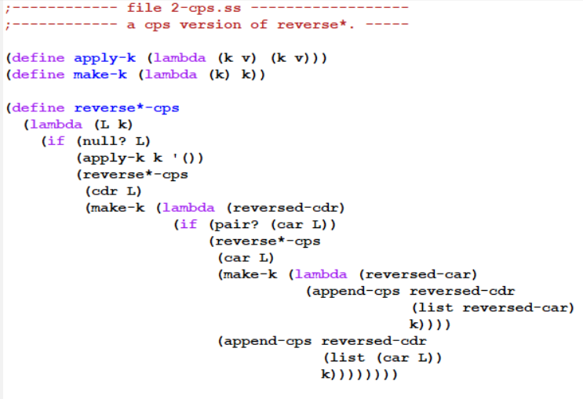
Convert to CPS form – part 1 Represent continuations as Scheme procedures

Slide 13
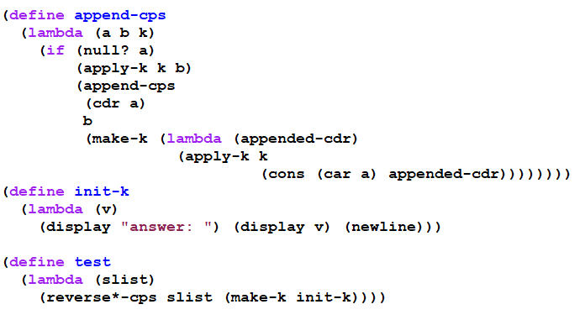

Convert to CPS form – part 2 Represent continuations as Scheme procedures

Slide 14
with tracing
(trace-define reverse*-cps
(lambda (L k)
(if (null? L)
(k '())
(reverse*-cps
(cdr L)
(trace-lambda cdr-k (reversed-cdr)
(if (pair? (car L))
(reverse*-cps
(car L)
(trace-lambda car-k (reversed-car)
(append-cps
reversed-cdr
(list reversed-car)
k)))
(append-cps reversed-cdr
(list (car L))
k)))))))
(trace-define append-cps
(lambda (a b k)
(if (null? a)
(k b)
(append-cps
(cdr a)
b
(trace-lambda append-k (appended-cdr)
(k (cons (car a) appended-cdr)))))))
(trace-define init-k
(lambda (v)
(display "answer: ") (display v) (newline)))

Slide 15
the trace
> (reverse*-cps '(a (b () ((c) d))) init-k)
|(reverse*-cps (a (b () ((c) d))) #<procedure>)
|(reverse*-cps ((b () ((c) d))) #<procedure>)
|(reverse*-cps () #<procedure>)
|(apply-k #<procedure> ())
|(cdr-k ())
|(reverse*-cps (b () ((c) d)) #<procedure>)
|(reverse*-cps (() ((c) d)) #<procedure>)
|(reverse*-cps (((c) d)) #<procedure>)
|(reverse*-cps () #<procedure>)
|(apply-k #<procedure> ())
|(cdr-k ())
|(reverse*-cps ((c) d) #<procedure>)
|(reverse*-cps (d) #<procedure>)
|(reverse*-cps () #<procedure>)
|(apply-k #<procedure> ())
|(cdr-k ())
|(append-cps () (d) #<procedure>)
|(apply-k #<procedure> (d))
|(cdr-k (d))
|(reverse*-cps (c) #<procedure>)
|(reverse*-cps () #<procedure>)
|(apply-k #<procedure> ())
|(cdr-k ())
|(append-cps () (c) #<procedure>)
|(apply-k #<procedure> (c))
|(car-k (c))
|(append-cps (d) ((c)) #<procedure>)
|(append-cps () ((c)) #<procedure>)
|(apply-k #<procedure> ((c)))
|(append-k ((c)))
|(apply-k #<procedure> (d (c)))
|(car-k (d (c)))
|(append-cps () ((d (c))) #<procedure>)
|(apply-k #<procedure> ((d (c))))
|(cdr-k ((d (c))))
|(append-cps ((d (c))) (()) #<procedure>)
|(append-cps () (()) #<procedure>)
|(apply-k #<procedure> (()))
|(append-k (()))
|(apply-k #<procedure> ((d (c)) ()))
|(cdr-k ((d (c)) ()))
|(append-cps ((d (c)) ()) (b) #<procedure>)
|(append-cps (()) (b) #<procedure>)
|(append-cps () (b) #<procedure>)
|(apply-k #<procedure> (b))
|(append-k (b))
|(apply-k #<procedure> (() b))
|(append-k (() b))
|(apply-k #<procedure> ((d (c)) () b))
|(car-k ((d (c)) () b))
|(append-cps () (((d (c)) () b)) #<procedure>)
|(apply-k #<procedure> (((d (c)) () b)))
|(cdr-k (((d (c)) () b)))
|(append-cps (((d (c)) () b)) (a) #<procedure>)
|(append-cps () (a) #<procedure>)
|(apply-k #<procedure> (a))
|(append-k (a))
|(apply-k #<procedure> (((d (c)) () b) a))
|(init-k (((d (c)) () b) a))
answer: (((d (c)) () b) a)
This lets us see the flow of control as the CPS procedures execute, but we can't see the details that are hidden inside #<procedure>

Slide 16
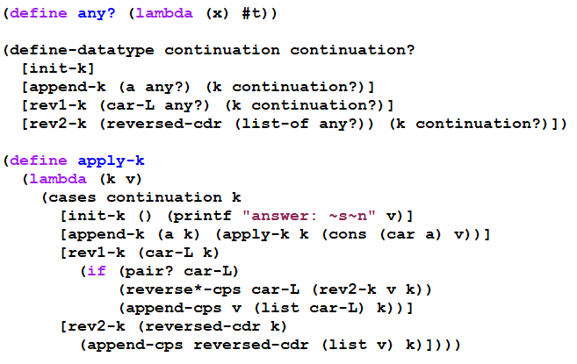
Second Continuation representation part 1 (using define-datatype)

Slide 17
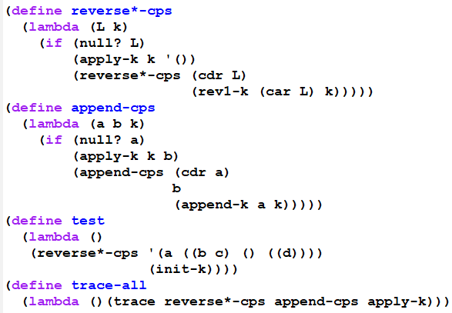

Second Continuation representation part 2 (using define-datatype)

Slide 18
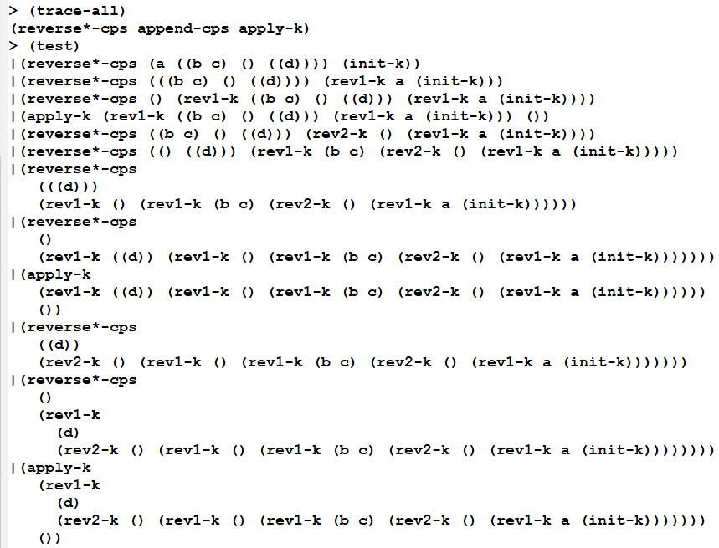
Beginning of a trace (you can generate the rest yourself, using the on-line files)

Slide 19
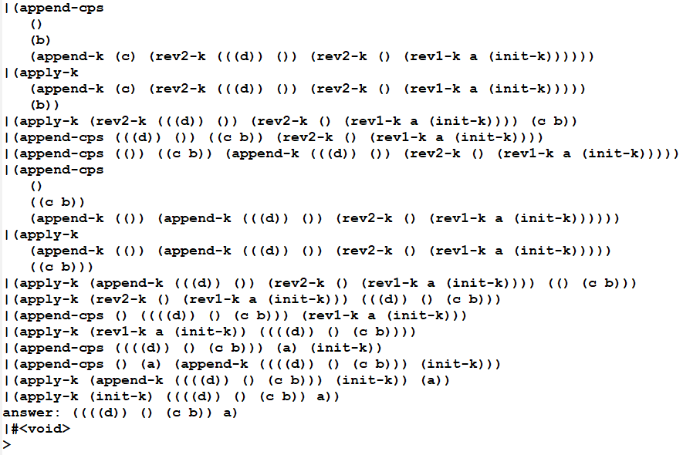
End of the trace (you can generate the whole trace yourself using the on-line files)

Slide 20
What do we have now?
Using this style, we could write the interpreter in any language that provides a means of creating records.
But it would be inefficient if that language's compiler does not handle tail-recursion properly
Could even result in a stack overflow.
So we transform to a style in which the flow of control is really just assignments, BEGINs, IFs, and GOTOs:

Slide 21
Transform to Imperative form
All substantial procedures will be called in tail-position, so they do not need to return.
All substantial procedures will be thunks (procedures that take no arguments), thus there is no need to have stack frames that hold parameters.
Thus each substantial procedure call is equivalent to a "goto"
This can be implemented in almost any language.

Slide 22
Transform to imperative form
Get the code for your section from Live-in-class.
Transform to imperative form.
Be sure to look at the tracing mechanism.
Notes:
Solution code is in SVN/304/SchemeSource/imperative-form.

Slide 23
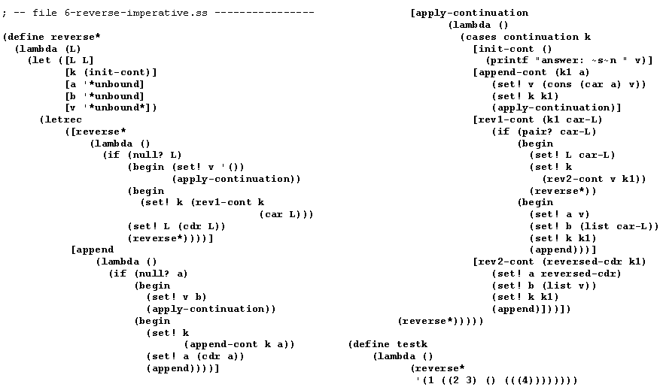
Imperative form
We can do the same set of transformations to our interpreter (but we won’t. )
We could use global variables and procedures instead of let and letrec

Slide 24

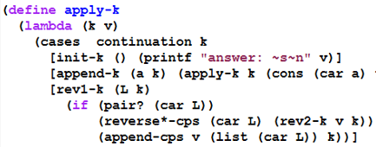
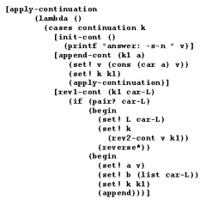
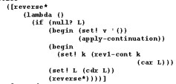
Details of a transformation

Slide 25
Where does this leave us?
All we really need in order to implement things in this style:
implementations of the basic data types (numbers, lists, etc.) and prim-procs
record structures
variable assignment
if
go to
begin
Then we could implement our interpreter in almost any language.

Slide 26
Exercise
Start with another small piece of recursive code, and apply all of these transformations to get it into imperative form.
You may be asked to do this on the final exam.
You’ll write imperative-form code for A19.
A19 is an individual assignment

