Slide 1
CSSE 304 Day 9
Two A6/A7 solutions
"OOP" in Scheme?
ArrayList exercise Live coding today! You may want to get the starting code from ClassMaterials/OOP
Notes:
When I put slides on line, leave out Proving language Properties 5 slide.
After class, redo the slides and include that one.

Slide 2
Scheme-a-thon is Done!
Congratulations. You made it through!
Things should be a little quieter, but the assignments will be bigger

Slide 3
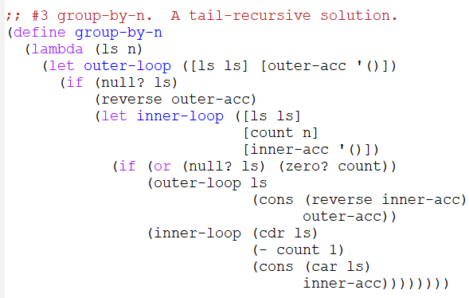
group-by-n solution

Slide 4
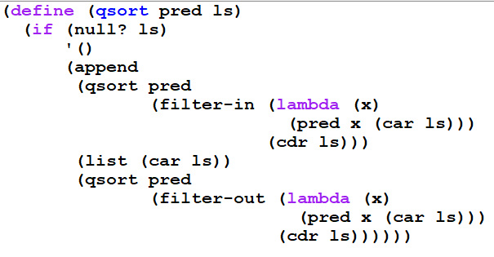
qsort solution (Swi Bhanghi)

Slide 5
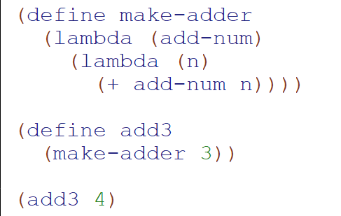
Functions that return functions

Slide 6
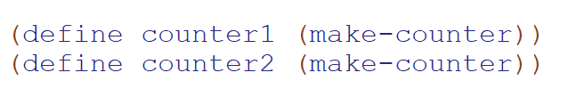
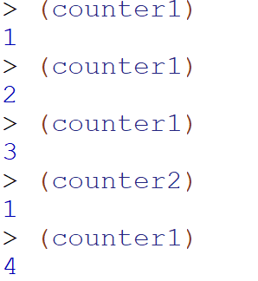
More mysterious

Slide 7
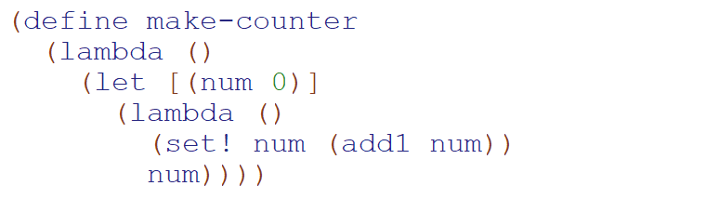
A mystery solved!

Slide 8
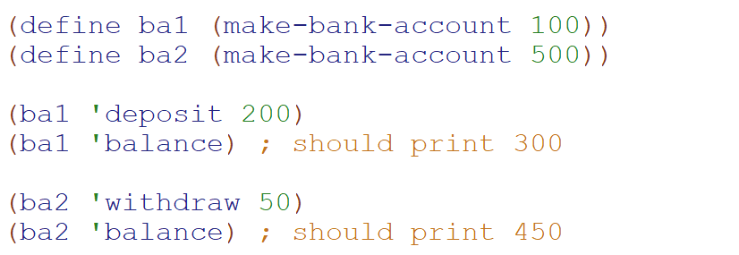
Let’s take it further

Slide 9
Is this “object oriented programming”?
It could be “soil” on which you could grow an object oriented scheme
But to me it is more an illustration of
The subtle way lambdas store (any amount of) data
The power and versatility of lambdas
A tool we can use when we want a little structure that can store something

Slide 10
> (define s1 (make-stack))
> (define s2 (make-stack)) > (s1 'push 'a)
> (s2 'push 'z)
> (s1 'push 'b)
> (s1 'pop)
b
(s1 'empty?)
#f
> (s2 'push (s1 'pop))
> (s1 'empty?)
#t
> (s2 'pop)
a
> (s2 'pop)
z
> (s2 'pop)
Exception in car: () is not a pair
>
Transcript that illustrates the use of the stack "class"
A better error message would be a nice improvement here

Slide 11
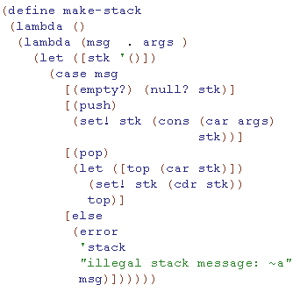
Encapsulation: Creating "objects" in a mostly functional language
The car of the stk list contains the top of the stack
What is the problem with this code? How to fix it?
This code contains a subtle error. Can you see what it is?
Notes:
The problem is that it recreates stk every time you call a method.
FIX: Move the let outside the inner lambda
ASK: What goes wrong if we move the let outside the outer lambda?
ANSWER: There is only one stack, shared by all "stack objects"

Slide 12
Encapsulation: Creating "objects" in a mostly functional language
The car of the stk list contains the top of the stack
Reverse these two code lines
What is the problem with this code? How to fix it?
This code contains a subtle error. Can you see what it is?
Notes:
The problem is that it recreates stk every time you call a method.
FIX: Move the let outside the inner lambda
ASK: What goes wrong if we move the let outside the outer lambda?
ANSWER: There is only one stack, shared by all "stack objects"

Slide 13
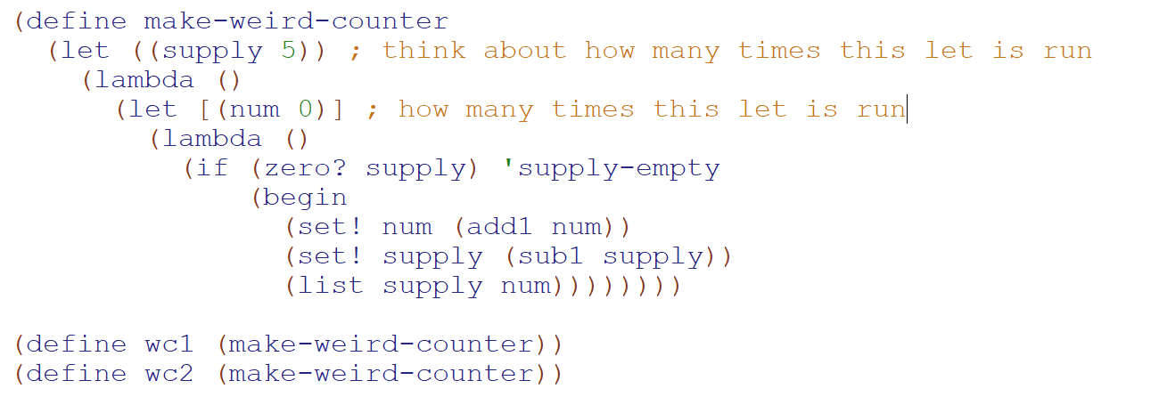

Slide 14
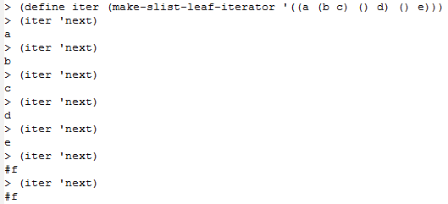
HW 8 Preview
You will implement another class, slist-leaf-iterator. Your procedure, given an s-list s, will make an iterator "object" that iterates the symbols in s.
An easy way to implement this? Good idea?

Slide 15
HW 8 Preview
You will use this stack "class" as a helper procedure in your implementation of another class, slist-leaf-iterator. Your procedure, make-slist-leaf-iterator, given an s-list s, will make an iterator "object" for s.
Why is the "easy" approach from the last slide inefficient? Think of an s-list with tens of thousands of symbols.
In the HW problem, your iterator procedures are not allowed to traverse more of the tree than is required for the 'next calls that actually happen.
That's where a stack object comes in.
Can be similar to the preorder iterator in Weiss*, Chapter 18.
* Data Structures and Problem Solving Using Java
But the code will be simpler than Weiss’s because Scheme notation is simpler.

Slide 16

Interlude

Slide 17
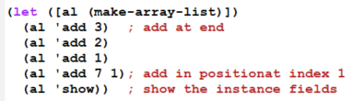
An “ArrayList” class
Let’s make a class that has some of the functionality of the Java ArrayList class.
For starters: implement constructor, (add obj), (add obj n)
Needed fields? Initial values?
What to do when there’s no room to add another object?
Let’s write some code!

