Slide 1
CSSE 304 Day 35
What questions do you have?
Engines
Notes:
Do not include second round-robin slide in PDF.
Find an interlude?

Slide 2
How can we implement this? (hint: call/cc)
(run-pausable (lambda ()
(display 1)
(pause-me)
(display 3)))
(display 2)
(resume)
(display 4)

Slide 3
Ref params
(define f (lambda (x y) (let ([z (g x (+ x y) y (- x y))]
(list z x y))))
(define g (lambda (a b (ref c) (ref d)) (set! a (add1 a)) (set! b (add1 b)) (set! c (add1 c)) (set! d (add1 d)) (+ a b c d)))

Slide 4
Final exam format
Moodle part (a lot of it will be about call/cc and continuations) 60-90 points
Computer part – Write and debug code 60-90 points
Total – 150 points
Exam 1 was 90 points, Exam 2 was 120 points

Slide 5
Final exam material
Will cover the entire course
But more emphasis from things after Exam 2:
Interpreter
How did your team do this?
Add new features to the interpreted language.
CPS, call/cc, imperative form
Everyone should know the what and why of imperative form.
Writing code in imperative form will be an extra-credit problem.
Engines and coroutines

Slide 6
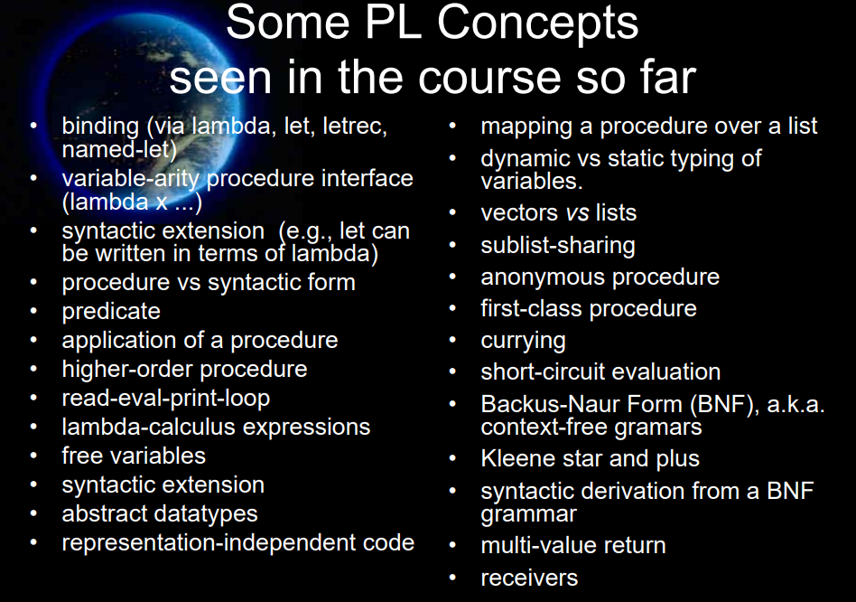

Slide 7
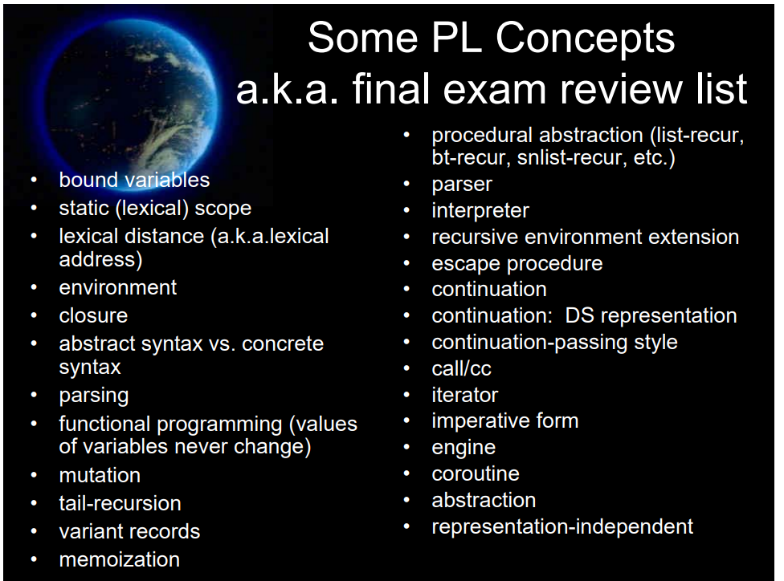

Slide 8
Engines intro
See the engine-intro.ss file
Engines abstract timed pre-emption.
Introduced to Scheme by Haynes and Friedman
A simpler implementation by Dybvig and Hieb is built into Chez Scheme.
engines do not have to be Scheme built-ins, but can be built on top of call/cc.
Documented in TSPL. You should be able to use that code to make engines work in other Scheme environments.

Slide 9
How Engines work 1
(make-engine thunk) creates an engine that will, when applied to three arguments
activate a timer-interrupt mechanism and then
evaluate the body of thunk.
A thunk is simply a procedure that takes no arguments

Slide 10
How Engines work 2
The three arguments passed to an engine are:
ticks: a positive integer specifying the amount of "fuel" given to the engine.
complete: a procedure that specifies what to do if the evaluation of thunk finishes before the fuel expires.
complete is a procedure of two arguments: amount of fuel "left over" and the result of the computation.
expire: a one-argument procedure to be executed if the computation runs out of fuel before it completes.
The argument that will be passed to expire is a new engine that can finish the computation from where it left off.
Notes:
return and expire are similar to succeed and fail continuations

Slide 11
Example
Engine arguments:
ticks (initial amount of fuel)
complete (receives # remaining ticks and answer if computation finishes)
expire (receives engine capable of completing the computation if fuel expires before computation finishes)
(define fib
(lambda (n)
(cond [(zero? n) 0]
[(= n 1) 1]
[else (+ (fib (- n 1))
(fib (- n 2)))])))
(define engine-fib
(lambda (n)
(make-engine
(lambda () (fib n)))))
> (define eng (engine-fib 7))
> (eng 50 cons (lambda (new-eng) (set! eng new-eng)))
> (eng 50 cons (lambda (new-eng) (set! eng new-eng)))
> (eng 50 cons (lambda (new-eng) (set! eng new-eng)))
> (eng 50 cons (lambda (new-eng) (set! eng new-eng)))
> (eng 50 cons (lambda (new-eng) (set! eng new-eng)))
> (eng 50 cons (lambda (new-eng) (set! eng new-eng)))
(9 . 13)
Notes:
How many ticks were needed to complete the computation?
Answer 300 – 9 = 293

Slide 12
mileage
(define mileage ; count the ticks
(lambda (thunk)
(let loop ([eng (make-engine thunk)]
[total-ticks 0])
(eng 50
(lambda (ticks value)
(+ total-ticks (- 50 ticks)))
(lambda (new-engine)
(loop new-engine (+ 50 total-ticks)))))))
> (mileage (lambda () (fib 13)))
5359
> (mileage (lambda () (fib 14)))
8676
> (mileage (lambda () (fib 15)))
14043
> (mileage (lambda () (fib 10)))
1259
> (mileage (lambda () (fib 11)))
2042
> (mileage (lambda () (fib 12)))
3309

Slide 13
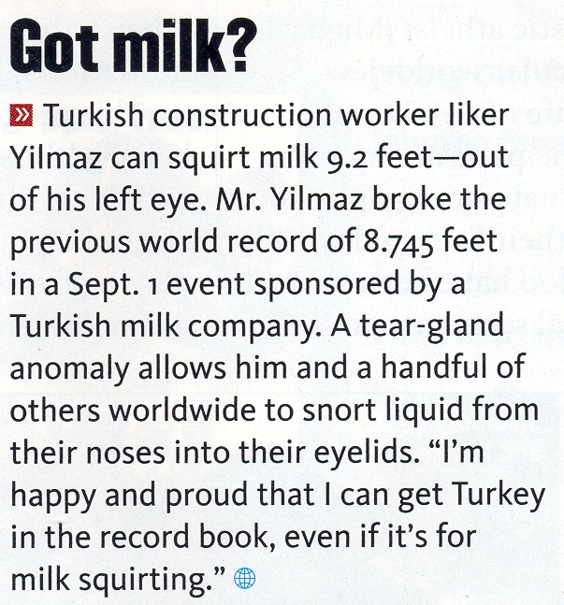
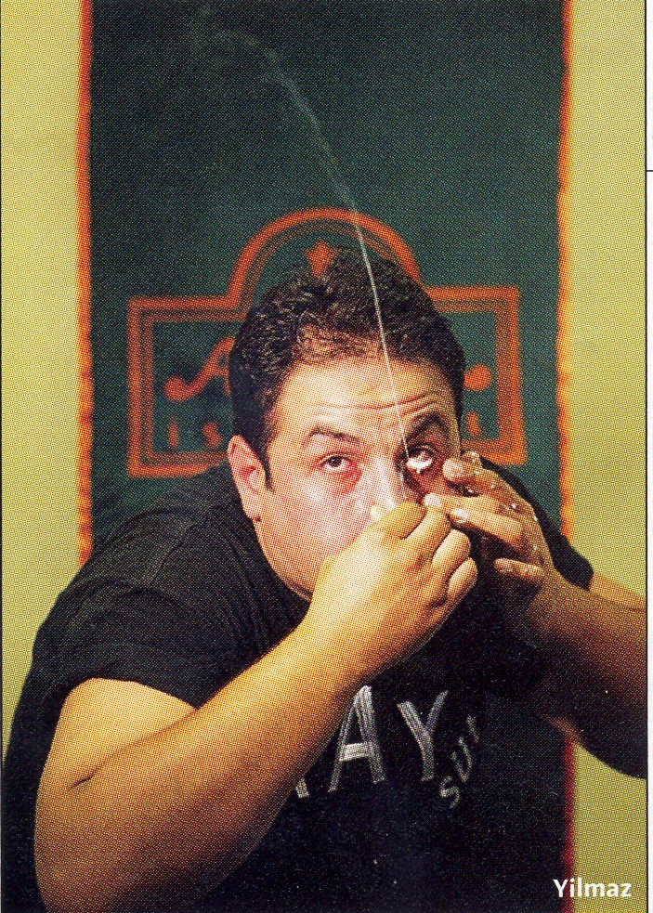
Interlude
Note: It's ilker, not liker

Slide 14
Round Robin Example
Engine arguments:
ticks complete
expire
(define round-robin
(lambda (queue-of-engines)
(if (queue-of-engines 'empty?)
'()
(let ([first-engine (queue-of-engines 'dequeue!)])
(first-engine
1 ; it's only allowed to run for one tick each time.
(lambda (ticks value) ; complete procedure
(cons value (round-robin queue-of-engines)))
(lambda (new-engine) ; expire procedure
(queue-of-engines 'enqueue! new-engine)
(round-robin queue-of-engines)))))))
> (let* ([q (make-queue)]
[nums '(3 7 11 4 12 9 2 6 10 8 1 5)]
[engine-list (map engine-fib nums)])
(for-each (lambda (eng) (q 'enqueue! eng))
engine-list)
(round-robin q)) ; what will the output be?
(define engine-fib
(lambda (n)
(make-engine
(lambda () (fib n)))))
What if we change the number of ticks from 1 to 150?
What will the output be?

Slide 15
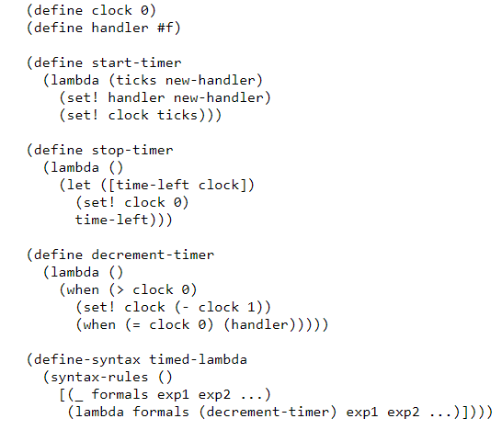
Implement make-engine using call/cc 1

Slide 16
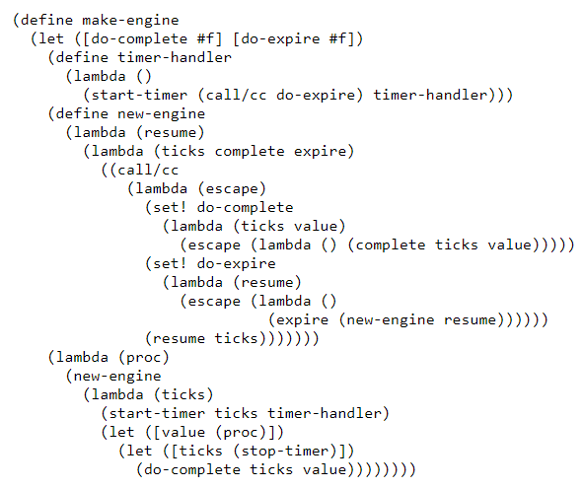
Implement make-engine using call/cc 2
Notes:
Engines from Continuations R. Kent Dybvig and Robert Hieb
https://legacy.cs.indiana.edu/~dyb/pubs/engines.pdf

Slide 17
A more complex example
Simulate a multi-tasking operating system.

Slide 18
(load “ooq")
(define time-slice (lambda () (add1 (random 100))))
(define kernel
(lambda (proc)
(define ready-queue (make-queue))
(define start
(lambda (proc)
(enqueue (make-engine (lambda () (proc trap)))
ready-queue)))
(define restart
(lambda (k v)
(enqueue (make-engine (lambda () (k v)))
ready-queue)))
(define trap
(lambda (msg arg)
(call/cc
(lambda (k)
(engine-return
(lambda ()
(case msg
(uninterruptible
(restart k (arg)))
(start-process
(start arg)
(restart k #f))
(stop-process #f))))))))
Simulate a multi-tasking operating system
(start proc)
(let dispatch ()
(if (empty-queue? ready-queue)
'finished
((dequeue ready-queue)
(time-slice)
(lambda (ticks trap-handler)
(trap-handler)
(dispatch))
(lambda (engine)
(enqueue engine ready-queue)
(dispatch)))))))

Slide 19
; An example that uses this multi-tasking simulator
(define amoeba
(lambda (generation final)
(lambda (trap)
(when (< generation final)
(trap 'uninterruptible
(lambda ()
(writeout generation)))
(trap 'start-process (amoeba (+ generation 1) final))
(trap 'start-process (amoeba (+ generation 1) final)))
(trap 'stop-process #f))))
(define writeln (lambda x (for-each display x) (newline)))
(define writeout
(let ([count 0])
(lambda (n)
(printf "~s " n)
(set! count (+ count (if (< n 10) 2 3)))
(when (>= count 77) (newline) (set! count 0)))))

Slide 20
> (kernel (amoeba 0 9))
0 1 2 1 3 2 2 2 4 3 4 3 3 3 3 5 4 3 4 3 5 4 4 6 5 5 5 4 4 4 4 5 6
4 4 5 4 5 4 7 6 6 6 5 5 5 5 4 6 5 4 6 5 6 5 5 5 5 8 7 7 7 6 7 7 5
5 6 6 6 5 6 6 5 5 6 5 5 5 8 7 7 7 6 6 5 7 6 6 6 5 6 6 5 7 7 6 6 5
5 8 8 7 7 7 8 8 7 6 6 7 7 7 6 6 6 7 6 6 6 6 6 6 6 6 6 6 8 8 8 7 8
8 8 8 7 6 7 7 7 7 6 7 7 7 6 7 7 6 6 6 6 8 7 7 7 6 6 8 8 8 8 7 7 6
7 6 7 6 8 8 8 8 7 7 7 7 6 6 7 5 7 6 8 8 7 7 7 7 7 6 7 6 8 8 8 8 7
7 6 8 8 8 8 8 7 7 7 8 7 7 8 7 8 7 7 7 7 6 8 7 8 7 7 7 7 7 8 7 8 7
8 7 6 6 6 6 7 7 8 8 8 8 8 8 7 8 7 7 7 8 8 8 8 8 8 7 7 7 8 8 8 8 8
7 8 7 8 7 8 7 7 7 7 8 8 8 8 7 8 7 8 7 7 7 8 8 8 8 8 7 8 8 7 8 8 7
7 8 8 8 8 8 8 7 8 8 7 8 7 8 8 7 7 6 6 8 8 8 7 8 8 8 8 8 8 8 8 8 8
8 7 7 7 8 8 7 8 7 8 8 8 8 8 7 8 8 8 7 8 8 8 8 8 8 8 8 7 8 8 8 7 7
7 8 8 8 8 7 8 8 8 7 8 8 8 8 8 8 7 7 7 7 7 8 8 8 7 8 8 8 8 8 8 8 8
8 7 8 8 8 8 8 8 8 8 8 8 7 8 8 7 8 8 8 8 8 8 8 8 8 8 8 8 8 8 8 8 8
8 8 8 8 8 8 8 8 8 8 8 8 8 8 8 8 8 7 7 8 8 8 8 8 8 8 8 7 8 8 8 8 8
8 8 8 8 8 8 8 8 8 8 8 8 8 8 8 8 8 8 7 8 8 8 8 8 8 8 8 8 8 8 8 8 8
8 8 8 8 8 8 8 8 8 8 8 8 8 8 8 8 finished

