Slide 1
CSSE 304 Day 35
What questions do you have?
Engines
Notes:
Do not include second round-robin slide in PDF.
Find an interlude?

Slide 2
Pattern 1: Escape
You apply the continuation within the receiver
The remainder of the receiver is *skipped over*
The value that you pass to the continuation is the return value of the call/cc expression

Slide 3
Pattern 2: Goto
You don’t do anything in the receiver and just put the continuation someplace you can access it later
You execute some post receiver code
You apply the saved continuation to cause the post receiver code to run again

Slide 4
Pattern 3: Resume
You’re executing some code within a receiver but then you need to do something completely different. The completely different code comes in the form of a continuation.
You save your state like you want to do a goto, but then in the receiver you apply this other continuation
When the completely different code is done, it gotos the saved state (i.e. applies that continuation)

Slide 5
Now you try to do it
(run-pausable (lambda ()
(display 1)
(pause-me)
(display 3)))
(display 2)
(resume)
(display 4)

Slide 6
Engines intro
See the engine-intro.ss file
Engines abstract timed pre-emption.
Introduced to Scheme by Haynes and Friedman
A simpler implementation by Dybvig and Hieb is built into Chez Scheme.
engines do not have to be Scheme built-ins, but can be built on top of call/cc.
Documented in TSPL. You should be able to use that code to make engines work in other Scheme environments.

Slide 7
How Engines work 1
(make-engine thunk) creates an engine that will, when applied to three arguments
activate a timer-interrupt mechanism and then
evaluate the body of thunk.
A thunk is simply a procedure that takes no arguments

Slide 8
How Engines work 2
The three arguments passed to an engine are:
ticks: a positive integer specifying the amount of "fuel" given to the engine.
complete: a procedure that specifies what to do if the evaluation of thunk finishes before the fuel expires.
complete is a procedure of two arguments: amount of fuel "left over" and the result of the computation.
expire: a one-argument procedure to be executed if the computation runs out of fuel before it completes.
The argument that will be passed to expire is a new engine that can finish the computation from where it left off.
Notes:
return and expire are similar to succeed and fail continuations

Slide 9
Example
Engine arguments:
ticks (initial amount of fuel)
complete (receives # remaining ticks and answer if computation finishes)
expire (receives engine capable of completing the computation if fuel expires before computation finishes)
(define fib
(lambda (n)
(cond [(zero? n) 0]
[(= n 1) 1]
[else (+ (fib (- n 1))
(fib (- n 2)))])))
(define engine-fib
(lambda (n)
(make-engine
(lambda () (fib n)))))
> (define eng (engine-fib 7))
> (eng 50 cons (lambda (new-eng) (set! eng new-eng)))
> (eng 50 cons (lambda (new-eng) (set! eng new-eng)))
> (eng 50 cons (lambda (new-eng) (set! eng new-eng)))
> (eng 50 cons (lambda (new-eng) (set! eng new-eng)))
> (eng 50 cons (lambda (new-eng) (set! eng new-eng)))
> (eng 50 cons (lambda (new-eng) (set! eng new-eng)))
(9 . 13)
Notes:
How many ticks were needed to complete the computation?
Answer 300 – 9 = 293

Slide 10
mileage
(define mileage ; count the ticks
(lambda (thunk)
(let loop ([eng (make-engine thunk)]
[total-ticks 0])
(eng 50
(lambda (ticks value)
(+ total-ticks (- 50 ticks)))
(lambda (new-engine)
(loop new-engine (+ 50 total-ticks)))))))
> (mileage (lambda () (fib 13)))
5359
> (mileage (lambda () (fib 14)))
8676
> (mileage (lambda () (fib 15)))
14043
> (mileage (lambda () (fib 10)))
1259
> (mileage (lambda () (fib 11)))
2042
> (mileage (lambda () (fib 12)))
3309

Slide 11
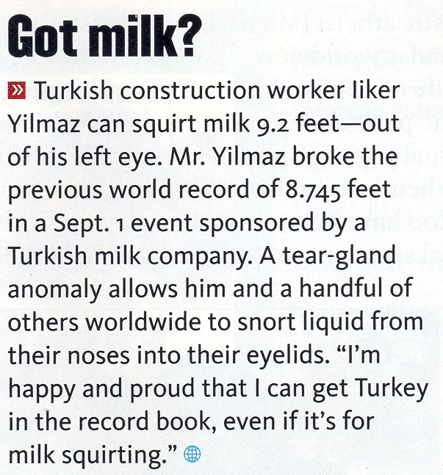
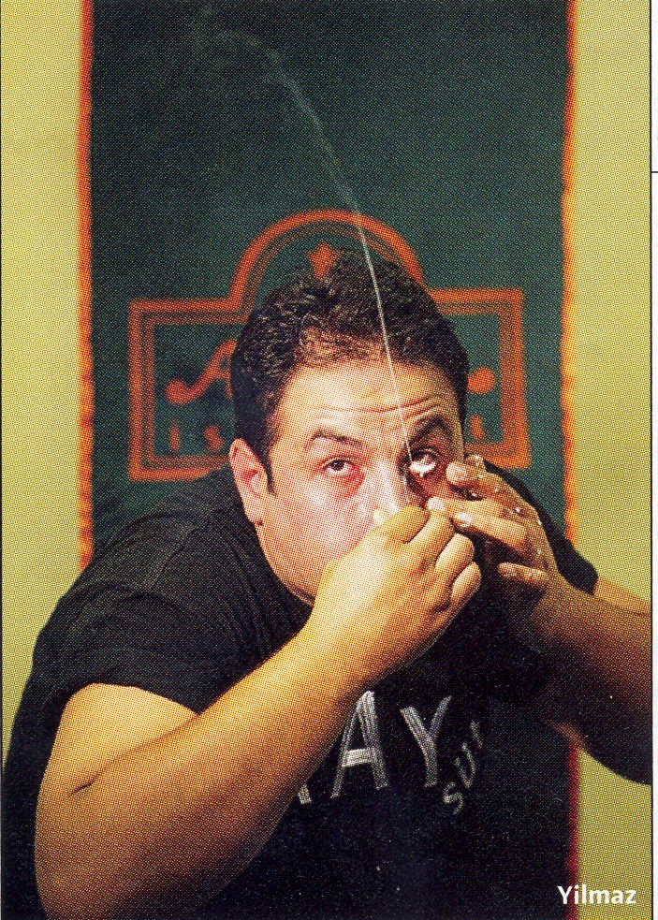
Interlude
Note: It's ilker, not liker

Slide 12
Round Robin Example
Engine arguments:
ticks complete
expire
(define round-robin
(lambda (queue-of-engines)
(if (queue-of-engines 'empty?)
'()
(let ([first-engine (queue-of-engines 'dequeue!)])
(first-engine
1 ; it's only allowed to run for one tick each time.
(lambda (ticks value) ; complete procedure
(cons value (round-robin queue-of-engines)))
(lambda (new-engine) ; expire procedure
(queue-of-engines 'enqueue! new-engine)
(round-robin queue-of-engines)))))))
> (let* ([q (make-queue)]
[nums '(3 7 11 4 12 9 2 6 10 8 1 5)]
[engine-list (map engine-fib nums)])
(for-each (lambda (eng) (q 'enqueue! eng))
engine-list)
(round-robin q)) ; what will the output be?
(define engine-fib
(lambda (n)
(make-engine
(lambda () (fib n)))))
What if we change the number of ticks from 1 to 150?
What will the output be?

Slide 13
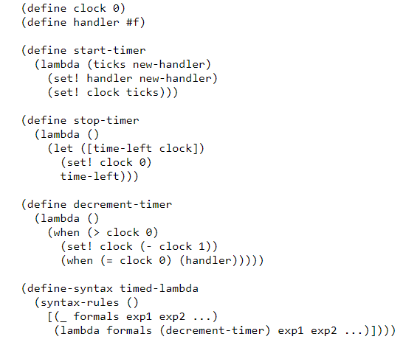
Implement make-engine using call/cc 1

Slide 14
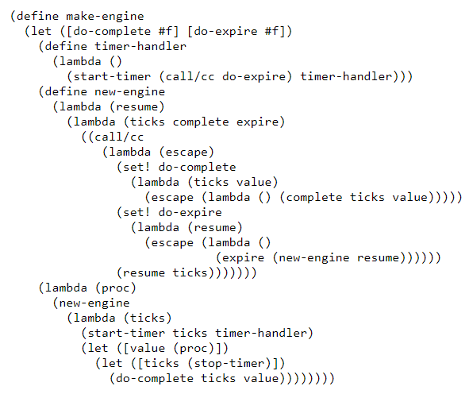
Implement make-engine using call/cc 2
Notes:
Engines from Continuations R. Kent Dybvig and Robert Hieb
https://legacy.cs.indiana.edu/~dyb/pubs/engines.pdf

Slide 15
A more complex example
Simulate a multi-tasking operating system.

Slide 16
(load “ooq")
(define time-slice (lambda () (add1 (random 100))))
(define kernel
(lambda (proc)
(define ready-queue (make-queue))
(define start
(lambda (proc)
(enqueue (make-engine (lambda () (proc trap)))
ready-queue)))
(define restart
(lambda (k v)
(enqueue (make-engine (lambda () (k v)))
ready-queue)))
(define trap
(lambda (msg arg)
(call/cc
(lambda (k)
(engine-return
(lambda ()
(case msg
(uninterruptible
(restart k (arg)))
(start-process
(start arg)
(restart k #f))
(stop-process #f))))))))
Simulate a multi-tasking operating system
(start proc)
(let dispatch ()
(if (empty-queue? ready-queue)
'finished
((dequeue ready-queue)
(time-slice)
(lambda (ticks trap-handler)
(trap-handler)
(dispatch))
(lambda (engine)
(enqueue engine ready-queue)
(dispatch)))))))

Slide 17
; An example that uses this multi-tasking simulator
(define amoeba
(lambda (generation final)
(lambda (trap)
(when (< generation final)
(trap 'uninterruptible
(lambda ()
(writeout generation)))
(trap 'start-process (amoeba (+ generation 1) final))
(trap 'start-process (amoeba (+ generation 1) final)))
(trap 'stop-process #f))))
(define writeln (lambda x (for-each display x) (newline)))
(define writeout
(let ([count 0])
(lambda (n)
(printf "~s " n)
(set! count (+ count (if (< n 10) 2 3)))
(when (>= count 77) (newline) (set! count 0)))))

Slide 18
> (kernel (amoeba 0 9))
0 1 2 1 3 2 2 2 4 3 4 3 3 3 3 5 4 3 4 3 5 4 4 6 5 5 5 4 4 4 4 5 6
4 4 5 4 5 4 7 6 6 6 5 5 5 5 4 6 5 4 6 5 6 5 5 5 5 8 7 7 7 6 7 7 5
5 6 6 6 5 6 6 5 5 6 5 5 5 8 7 7 7 6 6 5 7 6 6 6 5 6 6 5 7 7 6 6 5
5 8 8 7 7 7 8 8 7 6 6 7 7 7 6 6 6 7 6 6 6 6 6 6 6 6 6 6 8 8 8 7 8
8 8 8 7 6 7 7 7 7 6 7 7 7 6 7 7 6 6 6 6 8 7 7 7 6 6 8 8 8 8 7 7 6
7 6 7 6 8 8 8 8 7 7 7 7 6 6 7 5 7 6 8 8 7 7 7 7 7 6 7 6 8 8 8 8 7
7 6 8 8 8 8 8 7 7 7 8 7 7 8 7 8 7 7 7 7 6 8 7 8 7 7 7 7 7 8 7 8 7
8 7 6 6 6 6 7 7 8 8 8 8 8 8 7 8 7 7 7 8 8 8 8 8 8 7 7 7 8 8 8 8 8
7 8 7 8 7 8 7 7 7 7 8 8 8 8 7 8 7 8 7 7 7 8 8 8 8 8 7 8 8 7 8 8 7
7 8 8 8 8 8 8 7 8 8 7 8 7 8 8 7 7 6 6 8 8 8 7 8 8 8 8 8 8 8 8 8 8
8 7 7 7 8 8 7 8 7 8 8 8 8 8 7 8 8 8 7 8 8 8 8 8 8 8 8 7 8 8 8 7 7
7 8 8 8 8 7 8 8 8 7 8 8 8 8 8 8 7 7 7 7 7 8 8 8 7 8 8 8 8 8 8 8 8
8 7 8 8 8 8 8 8 8 8 8 8 7 8 8 7 8 8 8 8 8 8 8 8 8 8 8 8 8 8 8 8 8
8 8 8 8 8 8 8 8 8 8 8 8 8 8 8 8 8 7 7 8 8 8 8 8 8 8 8 7 8 8 8 8 8
8 8 8 8 8 8 8 8 8 8 8 8 8 8 8 8 8 8 7 8 8 8 8 8 8 8 8 8 8 8 8 8 8
8 8 8 8 8 8 8 8 8 8 8 8 8 8 8 8 finished

