Slide 1
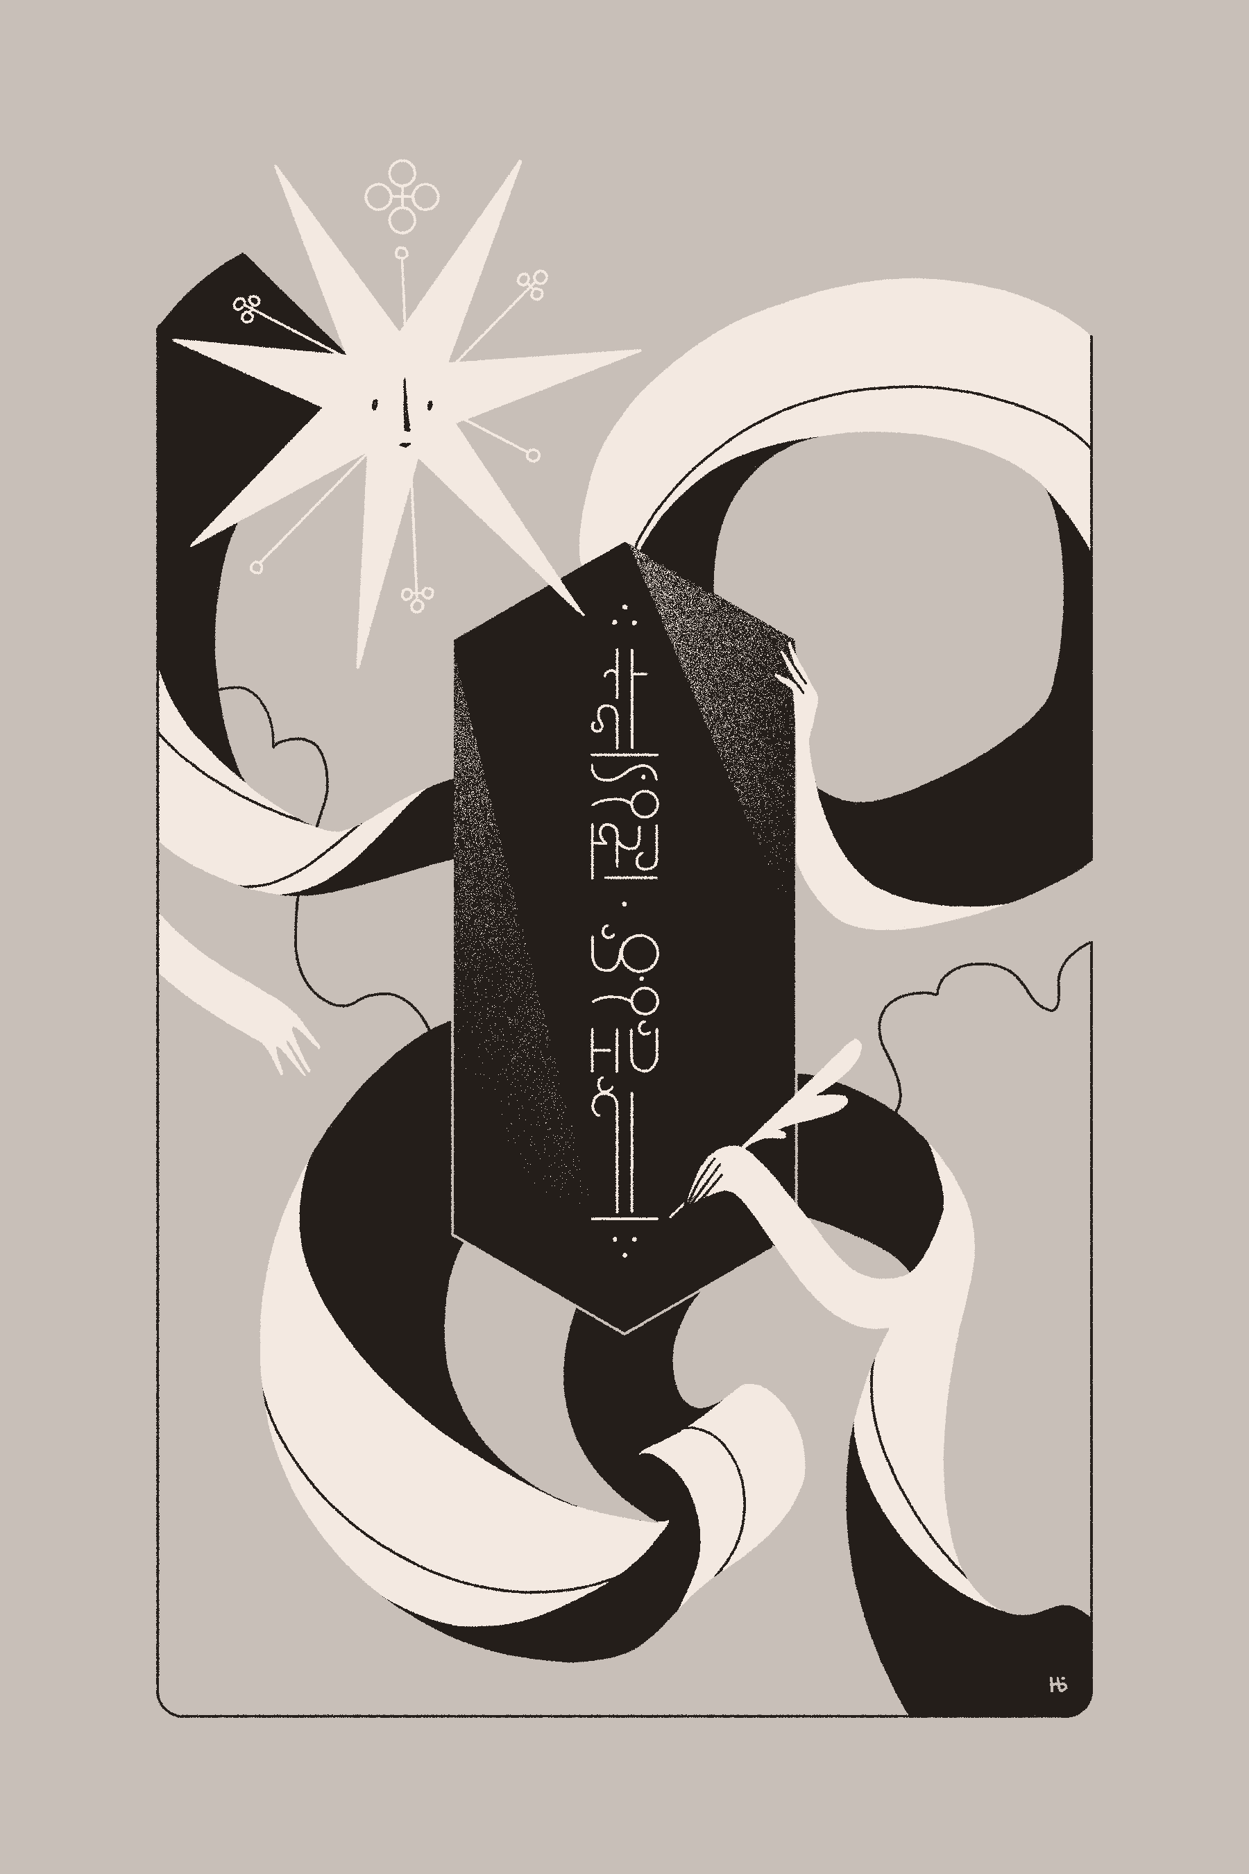
CSSE 304
map filter apply
Art by Helvetica Blanc (https://helveticablanc.com). Licensed under a Creative Commons Attribution-NonCommercial-ShareAlike 4.0 International license.

Slide 2
Consider procedure one-even?
Returns true if a list has exactly 1 even number
Could you solve this with named let?

Slide 3
Recursive procedures
(firsts ′((a b) (c d) (e f))) ➔ (a c e)
Do it "from scratch".
(unary-map f ls) applies f to each element of ls, and returns the list of the results.
(unary-map (lambda (x) (+ x 2)) '(3 5 9)) ➔ (5 7 11)
How could we use unary-map to write firsts?
Note that unary-map is a special case of Scheme's map, so we'll just write map from now on.
Notes:
Ask: Can we use map to write positives?
Perhaps write filter-in
(define sorted?
(lambda (numbers)
(or (< (length numbers) 2)
; why is this a bad idea?
(and (<= (car numbers) (cadr numbers))
(sorted? (cdr numbers))))))

Slide 4
apply
What if a procedure expects a number of individual arguments, but we actually have the things that should be its arguments in a list?
We’d like to write
(define list-sum (lambda (L) (+ L)))
but + doesn’t expect a list of arguments.
So we write
define list-sum (lambda (L) (apply + L)))
Application of apply is like consing apply’s first argument onto the list that is its second argument, and then evaluating.
Notes:
After quickly going through the material on this slide, do the following (another apply example):
> (max 2 3 1)
3
> (max '(2 3 1))
. . max: expects argument of type <real number>; given (2 3 1)
> (apply max '(2 3 1))
3
>

Slide 5
Why don’t you try
Lets go to today’s code

Slide 6
A first-class data object
Can be stored in a data structure
Can be passed as an argument to a procedure
Can be returned by a procedure
In Scheme, procedures are first-class

