Slide 1
Consider procedure one-even?
Returns true if a list has exactly 1 even number
Could you solve this with named let?

Slide 2
CSSE 304 Day 4
map filter apply
Functions with variable numbers of args

Slide 3
Recursive procedures
(firsts ′((a b) (c d) (e f))) ➔ (a c e)
Do it "from scratch".
(unary-map f ls) applies f to each element of ls, and returns the list of the results.
(unary-map (lambda (x) (+ x 2)) '(3 5 9)) ➔ (5 7 11)
How could we use unary-map to write firsts?
Note that unary-map is a special case of Scheme's map, so we'll just write map from now on.
Notes:
Ask: Can we use map to write positives?
Perhaps write filter-in
(define sorted?
(lambda (numbers)
(or (< (length numbers) 2)
; why is this a bad idea?
(and (<= (car numbers) (cadr numbers))
(sorted? (cdr numbers))))))

Slide 4
Why don’t you try
Lets go to today’s code

Slide 5
apply
What if a procedure expects a number of individual arguments, but we actually have the things that should be its arguments in a list?
We’d like to write
(define list-sum (lambda (L) (+ L)))
but + doesn’t expect a list of arguments.
So we write
define list-sum (lambda (L) (apply + L)))
Application of apply is like consing apply’s first argument onto the list that is its second argument, and then evaluating.
More on map and apply soon
Notes:
After quickly going through the material on this slide, do the following (another apply example):
> (max 2 3 1)
3
> (max '(2 3 1))
. . max: expects argument of type <real number>; given (2 3 1)
> (apply max '(2 3 1))
3
>

Slide 6
lambda with an improper list of arguments
Used when procedure expects a variable number of arguments.
(lambda x body)
when the resulting procedure is applied, all of the arguments are placed into a list and bound to x. Then body is evaluated.
(lambda (x y . z) body)
when the resulting procedure is applied, the first two arguments are bound to x and y,
any remaining arguments are placed into a list and bound to z. Then body is evaluated.
Q1

Slide 7

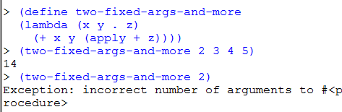
Procedures with an unknown number of arguments

Slide 8

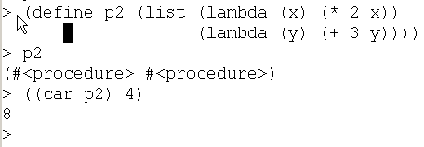
lambda the magnificent review and summary
Lambda is the “function-maker”. define is the “variable-assigner”. There is no special connection between the two:
We can store procedures in a data structure without naming them:

Slide 9

lambda the magnificent
We can pass a procedure as an argument to another procedure:

Slide 10
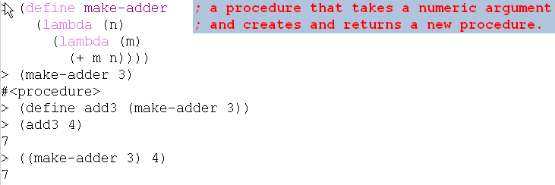
lambda the magnificent
We can create a new procedure and return it.
Scheme is not the only language with first-class procedures …

Slide 11
A first-class data object
Can be stored in a data structure
Can be passed as an argument to a procedure
Can be returned by a procedure
In Scheme, procedures are first-class

