Slide 1
Macros
Making scheme into whatever programming language you want
The most fundamental feature of Scheme

Slide 2
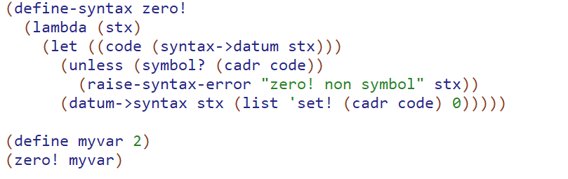

Slide 3
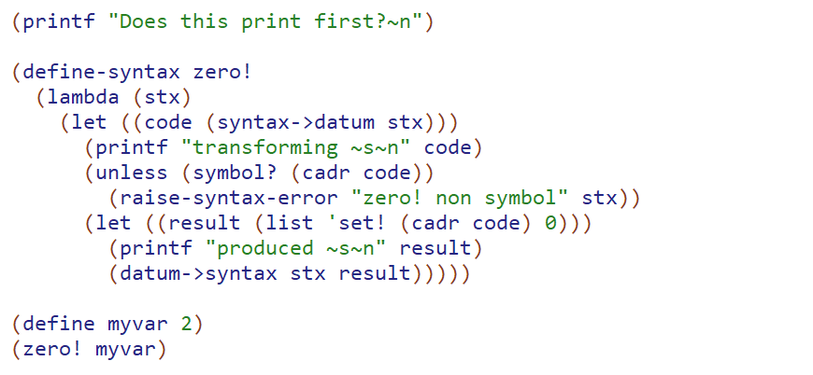

Macro process
Original syntax – (zero! myvar)
Macro (zero! lambda)
Transformed syntax (setq! myvar 0)
Regular execution engine

Slide 4
A few key points
Macros are scheme functions that take in scheme code and output different scheme code
This input and output is in terms of “syntax objects” which can be thought of as scheme lists and symbols plus some additional metadata
All macro transformation occurs before any normal execution occurs
Because the transformation can be any arbitrary scheme function that operates on code, there are almost no limits to the power of macros. In particular, macros can do things that functions can’t.

Slide 5
Implement BW
BW lets you take a scheme function call and invoke it in reverse order
(BW 1 2 +) yields 3
(BW 1 2 3 list) yields (3 2 1)
Note that it does not apply recursively to subexpressions
(BW (list 1 2) (list 2 3) list) yields ((2 3) (1 2))

Slide 6
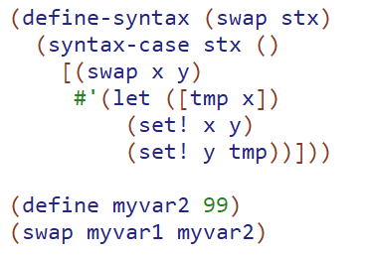
Concise macros
Though macros as syntax functions is powerful, it can get kinda verbose for most purposes. Racket has several more concise variants. I’m gonna teach the syntax case form
Do the classic if exercises

Slide 7

Concise macro Ellipsis
Means the previous pattern 0 to any number of times. Must be matched by an ellipsis in the result template
(define-syntax (dupsyms stx)
(syntax-case stx ()
[(_ sym ...) #'(quote (( sym . sym ) ...))]))
Do the mywhen and topairs exercises

Slide 8
Recursive macros
Macros can expand to other macros
But they can also extend to the same macro.
Let’s implement myand.

Slide 9
Limitations of Macros
(repeat someNumExp someExpressionToRepeat)
e.g. (repeat 3 (display “prints 3 times”))
You might be inclined to try and expand this into
(begin (display “prints 3 times’) (display “prints 3 times’) (display “prints 3 times’))
But this is not a viable approach. Why? Hint: consider if someNumExpression was something like (+ a b).

Slide 10
Macros have edge cases
(define-syntax (repeat stx)
(syntax-case stx ()
[(_ numExp repeatExp ) #'(let repeatme ((count 0))
(if (= count numExp)
(void)
(begin
repeatExp
(repeatme (add1 count)))))]))
If you can out why this is buggy, rewrite it in the in class exercises to be correct.
Notes:
It’s because we repeatedly eval numExp

