Slide 1
CSSE 304 Days 31-32
Exam problems
Interpreter in CPS
(Add call/cc to the interpreted language)
(Another call/cc example)
No class meetings Monday. I will be on my office hours Zoom 9:30-11:30 to assist with A17a and A17b.
17b (reference parameters) is a difficult problem. Before you start writing code, make a drawing/narrative in English that explains how it will work. If you come to me for help with debugging, I will ask you to show me this document.

Slide 2
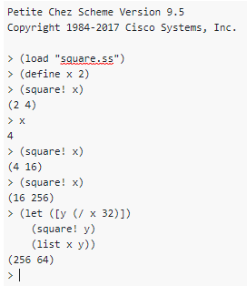
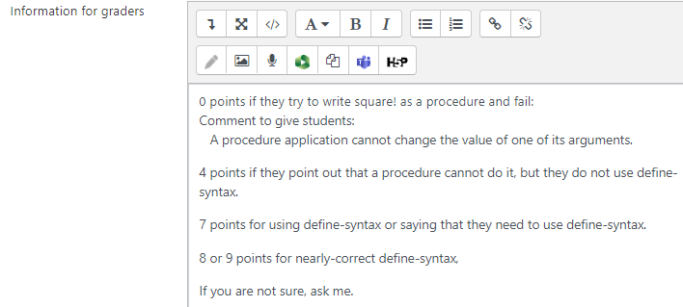
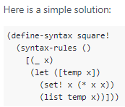
The whole point of this problem is “do you know how procedure evaluation works?” and “do you know the difference between defining a procedure and defining new syntax?” 0 points if you thought square! could be a procedure.

Slide 3
Letrec implementation description
The main thing I was looking for is a description of how the circularity is achieved.
Some students went into detail on what a ribcage is, but missed saying that the environment is created first, then closures that point to that environment, then those closures are added as environment values using vector-set!

Slide 4

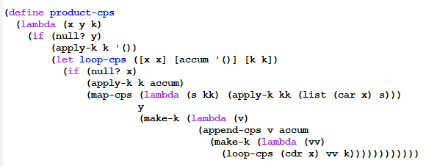
You can’t treat loop-cps as a substantial procedure if you don’t include loop-cps in your code!

Slide 5
Interpreter in CPS
with data-structure continuations

Slide 6
What does a CPS interpreter do for us?
A step toward knowing that we could write the interpreter in a language without
first-class procedures
recursion
The ability to provide first-class continuations to the user
by implementing call/cc.
If every expression-evaluation has an explicit continuation, it's easy to capture and apply that continuation later.
Notes:
Gives us the ability to easily write the interpreter in a way that does not require recursion or first-class procedures in the implementation language.
Since the interpreter always has the current continuation explicitly, it makes it easy to provide continuations as a first-class data type in the language, just as Scheme does via the call/cc procedure.

Slide 7
Convert our Interpreter to CPS
The interpreter (eval-exp) will now take three arguments:
current expression to evaluate
current local environment
current continuation
Continuation abstract data type
A constructor for each type of continuation that the interpreter uses.
(apply-k k v), a procedure that applies the continuation k to the value v .

Slide 8
Previous Interpreter State
(define eval-exp
(lambda (exp env)
(cases expression exp ; look at typical cases
[lit-exp (datum) datum]
[var-exp (id) (apply-env env id)]
[lambda-exp (formals body)
(closure formals body env)]
[app-exp (rator rands)
(let ([proc-value (eval-exp rator env)]
[args (eval-rands rands env)])
(apply-proc proc-value args))]
[let-exp (vars exps bodies)
(eval-bodies body
(extend-env vars
(eval-rands exps env)
env))]
; there are more cases not shown here
)))

Slide 9
Some changes to eval-exp
(define eval-exp ;cps-version
(lambda (exp env k)
(cases expression exp ; look at typical cases
[lit-exp (datum) (apply-k k datum)]
[var-exp (id) (apply-env env id k))]
[lambda-exp (formals bodies)
(apply-k k (closure formals bodies env))]
[app-exp (rator rands)
(eval-exp rator
env
(rator-k rands env k))]
...)))

Slide 10
Continuations in the interpreter
applies the current continuation
(define eval-exp
(lambda (exp env k)
(cases expression exp
[literal-exp (datum)
(apply-k k datum)]
; skip some of the other cases for now
[if-exp (test-exp then-exp else-exp)
(eval-exp test-exp
env
(test-k then-exp else-exp env k))]
; skip some more cases
)))
creates a test-k continuation object

Slide 11
Representing Continuations by Data Types
(define-datatype continuation continuation? [test-k (then-exp expression?) (else-exp expression?) (env environment?) (k continuation?)] ; we will add other continuation variants. )
(define apply-k (lambda (k val) (cases continuation k [test-k (then-exp else-exp env k) (if val (eval-exp then-exp env k) (eval-exp else-exp env k))] ; we will add other continuation variants. )))
(define eval-exp
(lambda (exp env k)
(cases expression exp
. . . ; other cases
[if-exp (test-exp then-exp else-exp)
(eval-exp test-exp env
(test-k then-exp else-exp env k))]
. . . )))

Slide 12
continuation datatype
(define-datatype continuation continuation?
[test-k (then-exp expression?)
(else-exp expression?)
(env environment?)
(k continuation?)]
[rator-k (rands (list-of expression?))
(env environment?)
(k continuation?)]
[rands-k (proc-value scheme-value?)
(k continuation?)] ; etc )

Slide 13
apply-k
(define apply-k
(lambda (k val)
(cases continuation k
[test-k (then-exp else-exp env k)
(if val
(eval-exp then-exp env k)
(eval-exp else-exp env k))]
[rator-k (rands env k)
(eval-rands rands
env
(rands-k val k))]
[rands-k (proc-value k)
(apply-proc proc-value val k)])) ; etc

Slide 14
Exercise :
(define apply-k
(lambda (k val)
(cases continuation k
[let-exps-k (vars bodies env k)
How should the CPS version of this clause be written?
[let-exp (vars exps bodies)
(eval-bodies bodies
(extend-env vars
(eval-rands exps env)
env))]
Beginning of answer:
[let-exp (vars exps bodies)
(eval-rands exps env
(let-exps-k vars bodies env k)]
Applying let-exps-k will call extend-env. Applying extend-env's continuation will call eval-bodies.

Slide 15
Which procedures need to be considered substantial (i.e. need to be CPS)?

Slide 16
Partner drop situation
For folks whos partners have dropped, I’m going to
Find you a new team for A18
Ask you to finish 17a on your own, using the deadline for 17b
Not turn in 17b

Slide 17
Another call/cc example
> (define abc)
> (define fact
(lambda (n)
(cond [(= n 1)
(call/cc (lambda (k)
(set! abc k)
(k 1)))]
[else
(* n (fact (- n 1)))])))
> (fact 4)
24
> (abc 2)
48

Slide 18
More of the fact call/cc example
Back to the café in Paris… the waiter may look a little older, we might be heavier, but we experience the same things as before.
> (trace fact)
(fact)
> (fact 6)
|(fact 6)
| (fact 5)
| |(fact 4)
| | (fact 3)
| | |(fact 2)
| | | (fact 1)
| | | 1
| | |2
| | 6
| |24
| 120
|720
720
> (abc 11)
| | | 11
| | |22
| | 66
| |264
| 1320
|7920
7920
(define fact
(lambda (n)
(cond [(= n 1)
(call/cc (lambda (k)
(set! abc k)
(k 1)))]
[else
(* n (fact (- n 1)))])))

Slide 19
Add call/cc to our interpreted language
Some questions:
What is a (user) continuation? How to represent?
Where in the code should call/cc implementation be? What does it do?
What happens when a continuation is applied? Where should this go in the interpreter? What should the code be?

Slide 20
Add call/cc to the interpreter
Why do we want to start with the CPS version of the interpreter?
What should a continuation be?
Which variant record type should continuation belong to?
(define-datatype proc-val proc-val?
[prim-proc
(name symbol?)]
[closure
(formals (list-of symbol?))
(body expression?)
(env environment?)]
What goes here?)
Reify the continuation!
When the interpreter evaluates
(call/cc receiver), where should the code for that go?
Notes:
Because that way we always "know" the current continuation.
An Abstract Data Type
proc-val?

Slide 21
Add call/cc to the interpreter
(define-datatype proc-val proc-val?
[prim-proc
(name symbol?)]
[closure
(formals (list-of symbol?))
(body expression?)
(env environment?)]
[k-proc (k continuation?)])
What else do we need to change?
(define apply-proc
(lambda (proc-value args k)
(cases proc-val proc-value
. . .
[continuation-proc (k)
]
. . . )))
(define apply-prim-proc
(lambda (prim-proc args k)
(case prim-proc
[(+) (k (apply + args))]
[(-) (k (apply args))]
. . .
[(call/cc)
])))
How do we make it escape?
(call/cc receiver) ➔ (receiver continuation)
Notes:
Because that way we always "know" the current continuation.
An Abstract Data Type
proc-val?

Slide 22
Add call/cc to the interpreter
What should call/cc be?
A primitive procedure
What do we do when it is called?
(define apply-prim-proc
(lambda (prim-proc args k)
(case prim-proc
[(+) (apply-k k (apply + args))]
[(-) (apply-k k (apply - args))]
. . .
[(call/cc) what goes here? ] … )))
Notes:
Because that way we always "know" the current continuation.
An Abstract Data Type
proc-val?

Slide 23
Add call/cc to the interpreter
(define apply-prim-proc
(lambda (prim-proc args k)
(case prim-proc
[(+) (k (+ (1st args) (2nd args)))]
[(-) (k (- (1st args) (2nd args)))]
. . .
[(call/cc)
(apply-proc (car args) (list (continuation-proc k))
k) ] … )))
Notes:
Because that way we always "know" the current continuation.
An Abstract Data Type
proc-val?

Slide 24
Add call/cc to the interpreter
What else do we need to change?
define apply-proc
(lambda (proc-value args k)
(cases proc-val proc-value
. . .
[continuation-proc (k)
What goes here? ]
. . . )))

Slide 25
Add call/cc to the interpreter
What else do we need to change?
(define apply-proc
(lambda (proc-value args k)
(cases proc-val proc-value
. . .
[continuation-proc (k)
(apply-k
k
(car args))]
. . . )))
What about the original k?

Slide 26
Imperative form (topic for week 9)
Today we do the concept and background (if there is time),
Next time we examine the details

Slide 27
Implementation environment
Scheme is a great language to use when implementing an interpreter.
But does it do too much for us?
Could we easily write the Assignment 18 interpreter in another language?
One without first-class procedures?

Slide 28
A simple example
The interpreter involves a lot of code, so we will look at transforming a simple example.
The same ideas will work to transform the interpreter.

Slide 29
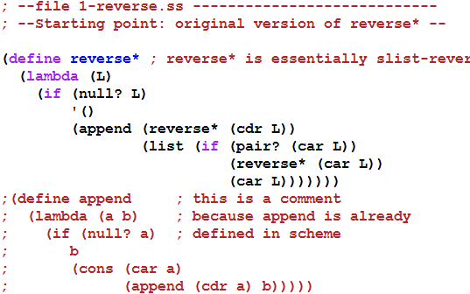

A simple example
Next: convert to CPS

Slide 30
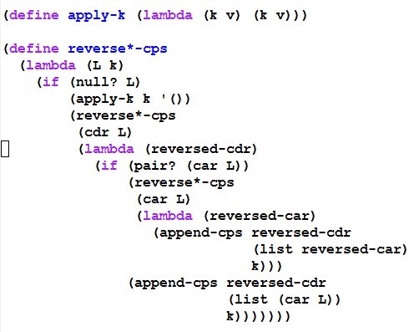
Convert to CPS form – part 1 Represent continuations as Scheme procedures

Slide 31
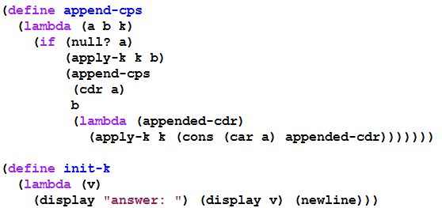
Convert to CPS form – part 2 Represent continuations as Scheme procedures

Slide 32
with tracing
(trace-define reverse*-cps
(lambda (L k)
(if (null? L)
(k '())
(reverse*-cps
(cdr L)
(trace-lambda cdr-k (reversed-cdr)
(if (pair? (car L))
(reverse*-cps
(car L)
(trace-lambda car-k (reversed-car)
(append-cps
reversed-cdr
(list reversed-car)
k)))
(append-cps reversed-cdr
(list (car L))
k)))))))
(trace-define append-cps
(lambda (a b k)
(if (null? a)
(k b)
(append-cps
(cdr a)
b
(trace-lambda append-k (appended-cdr)
(k (cons (car a) appended-cdr)))))))
(trace-define init-k
(lambda (v)
(display "answer: ") (display v) (newline)))

Slide 33
the trace
> (reverse*-cps '(a (b () ((c) d))) init-k)
|(reverse*-cps (a (b () ((c) d))) #<procedure>)
|(reverse*-cps ((b () ((c) d))) #<procedure>)
|(reverse*-cps () #<procedure>)
|(apply-k #<procedure> ())
|(cdr-k ())
|(reverse*-cps (b () ((c) d)) #<procedure>)
|(reverse*-cps (() ((c) d)) #<procedure>)
|(reverse*-cps (((c) d)) #<procedure>)
|(reverse*-cps () #<procedure>)
|(apply-k #<procedure> ())
|(cdr-k ())
|(reverse*-cps ((c) d) #<procedure>)
|(reverse*-cps (d) #<procedure>)
|(reverse*-cps () #<procedure>)
|(apply-k #<procedure> ())
|(cdr-k ())
|(append-cps () (d) #<procedure>)
|(apply-k #<procedure> (d))
|(cdr-k (d))
|(reverse*-cps (c) #<procedure>)
|(reverse*-cps () #<procedure>)
|(apply-k #<procedure> ())
|(cdr-k ())
|(append-cps () (c) #<procedure>)
|(apply-k #<procedure> (c))
|(car-k (c))
|(append-cps (d) ((c)) #<procedure>)
|(append-cps () ((c)) #<procedure>)
|(apply-k #<procedure> ((c)))
|(append-k ((c)))
|(apply-k #<procedure> (d (c)))
|(car-k (d (c)))
|(append-cps () ((d (c))) #<procedure>)
|(apply-k #<procedure> ((d (c))))
|(cdr-k ((d (c))))
|(append-cps ((d (c))) (()) #<procedure>)
|(append-cps () (()) #<procedure>)
|(apply-k #<procedure> (()))
|(append-k (()))
|(apply-k #<procedure> ((d (c)) ()))
|(cdr-k ((d (c)) ()))
|(append-cps ((d (c)) ()) (b) #<procedure>)
|(append-cps (()) (b) #<procedure>)
|(append-cps () (b) #<procedure>)
|(apply-k #<procedure> (b))
|(append-k (b))
|(apply-k #<procedure> (() b))
|(append-k (() b))
|(apply-k #<procedure> ((d (c)) () b))
|(car-k ((d (c)) () b))
|(append-cps () (((d (c)) () b)) #<procedure>)
|(apply-k #<procedure> (((d (c)) () b)))
|(cdr-k (((d (c)) () b)))
|(append-cps (((d (c)) () b)) (a) #<procedure>)
|(append-cps () (a) #<procedure>)
|(apply-k #<procedure> (a))
|(append-k (a))
|(apply-k #<procedure> (((d (c)) () b) a))
|(init-k (((d (c)) () b) a))
answer: (((d (c)) () b) a)
This lets us see the flow of control as the CPS procedures execute, but we can't see the details that are hidden inside #<procedure>

Slide 34
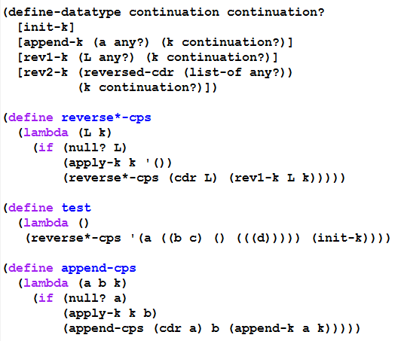
Second Continuation representation part 1 (using define-datatype)

Slide 35
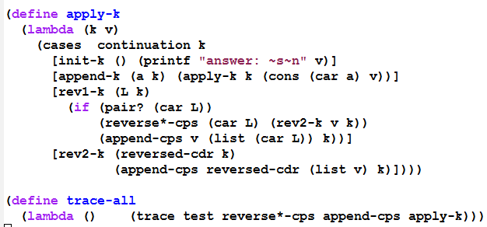

Second Continuation representation part 2 (using define-datatype)

Slide 36
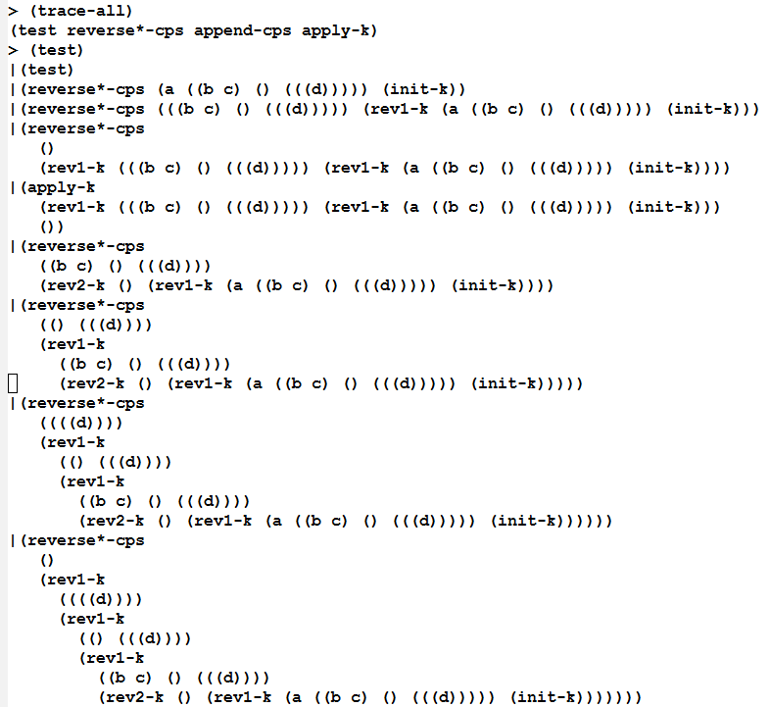
Beginning of a trace (you can generate the rest yourself, using the on-line files)

Slide 37
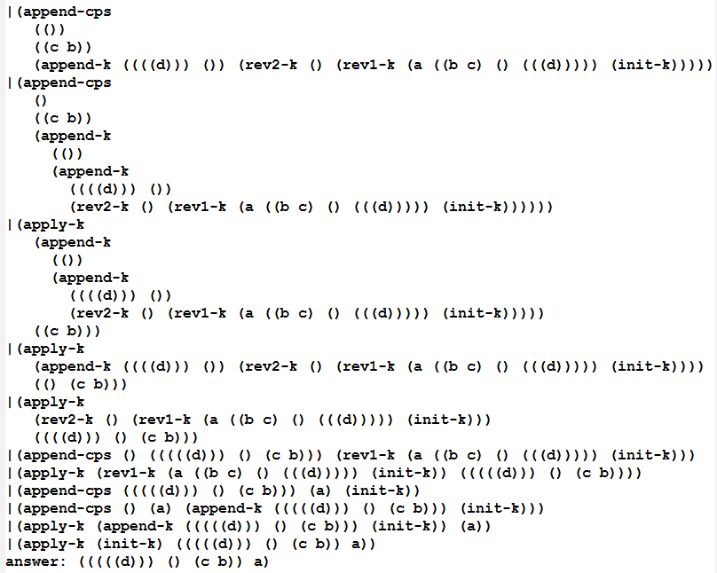
End of the trace (you can generate the whole trace yourself using the on-line files)

Slide 38
What do we have now?
Using this style, we could write the interpreter in any language that provides a means of creating records.
But it would be inefficient if that language's compiler does not handle tail-recursion properly
Could even result in a stack overflow.
So we transform to a style in which the flow of control is really just assignments, BEGINs, IFs, and GOTOs:

Slide 39
Transform to Imperative form
All non-primitive procedures will be called in tail-position, so they do not need to return.
All non-primitive procedures will be thunks (procedures that take no arguments), thus no need for stack frames.
Thus a procedure call is equivalent to a "goto"
This can be implemented in almost any language.

