Slide 1
CSSE 304 Day 37
Course evaluation thoughts
Coroutines

Slide 2
Course Evaluations
Teaching a course for the first time is always a little rough…especially a course with a lot of difficult content
You’ve had to work really hard – hopefully you feel that’s paid off in terms of a deeper understanding of programming
I’ll be changing the course a fair bit in the coming terms – your ideas are welcome

Slide 3
Please be as honest and detailed as you can!
I often find it instructive if folks tell me how they came to understand concepts that were difficult for them
Complaints are useful too – just realize if your complaint is something like “this course should not be a requirement at all” its sort of beyond the scope of what I can accomplish

Slide 4
Coroutines: A reference
Teach Yourself Scheme in Fixnum days by Dorai Sitaram
My coroutine presentation is somewhat similar to this one.
https://ds26gte.github.io/tyscheme/index-Z-H-15.html#TAG:__tex2page_chap_13

Slide 5
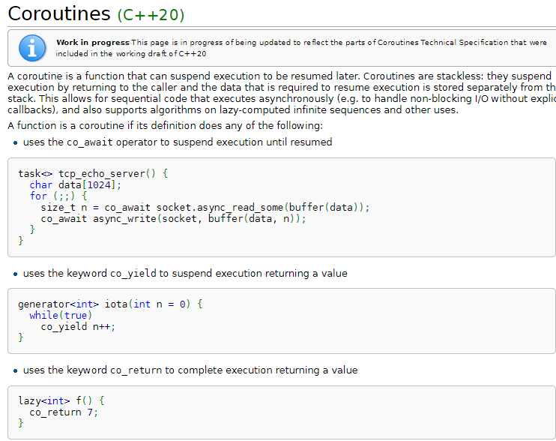
Coroutines are being introduced into C++

Slide 6
Coroutines in Kotlin
https://kotlinlang.org/docs/coroutines-overview.html

Slide 7
Coroutine vs. subroutine
Subordination vs. equal partners
Apply a procedure vs. resume a coroutine
Monopoly analogy
Coroutines do not involve concurrency

Slide 8
Example to illustrate coroutines
(make-coroutine receiver) creates a coroutine that executes the code in receiver.
(resume cor value) resumes the cor coroutine.
Examples are in coroutines.ss
Running the first example:
>(example)
1-a 33 2-a 34 1-b 35 2-b 36 1-c 37

Slide 9
Coroutine example adapted from EoPL, first edition, Chapter 9
(define example
(lambda ()
(call/cc
(lambda (return-cont)
(let ([co1 'undefined]
[co2 'undefined])
(set! co1 (make-coroutine
(lambda (init-val1)
(display " 1-a ")
(display init-val1)
(set! init-val1
(resume co2 (+ 1 init-val1)))
(display " 1-b ")
(display init-val1)
(set! init-val1
(resume co2 (+ 1 init-val1)))
(display " 1-c ")
(return-cont init-val1))))
(set! co2 (make-coroutine
(lambda (init-val2)
(display " 2-a ")
(display init-val2)
(set! init-val2
(resume co1 (+ 1 init-val2)))
(display " 2-b ")
(display init-val2)
(set! init-val2
(resume co1 (+ 1 init-val2)))
(display " 2-c "))))
(co1 33))))))
;; >(example)
;; 1-a 33 2-a 34 1-b 35 2-b 36 1-c 37

Slide 10
Coroutine Implementation
You don’t need to understand all of the details
(define resume 'resume-undefined)
(define make-coroutine
(lambda (body)
(let ([local-continuation 'local-continuation-undefined])
(letrec
([newcoroutine
(lambda (value) (local-continuation value))]
[localresume
(lambda (continuation value)
(let ([value
(call/cc (lambda (k)
(set! local-continuation k)
(continuation value)))])
(set! resume localresume)
value))])
(call/cc
(lambda (exit)
(body (localresume exit newcoroutine))
(error 'coroutine
"fell off end of coroutine")))))))

Slide 11
Same-fringe problem
same-fringe takes two sn-lists and determines whether their leaf nodes (in a pre-order traversal) are the same (and in the same order).
See next slide for examples.
Note that a slight extension of sn-lists is allowed, where the “sn-list” can just be a single number or symbol.

Slide 12
same-fringe examples
> (same-fringe '((1 2 (3) () () 4)) '(1 (((2 ((3) 4))))))
#t
> (same-fringe '((1 2 (3) () () 4)) '(1 (((2 ((3) 5))))))
#f
> (same-fringe '((1 2 (3) () () 4)) '(1 (((2 ((3) ))))))
#f
> (same-fringe '((1 2 (3) () () 4)) '(1 (((2 ((3) 4 5))))))
#f
> (same-fringe '2 '3)
#f
> (same-fringe '2 '2)
#t

Slide 13
A short, simple way to write same-fringe
How would you write it if you only had 1 minute to do it?

Slide 14
A short, simple way to write same-fringe
How would you write it if you only had 1 minute to do it?
Why doesn’t the story end here?
Notes:
(define same-fringe
(lambda (s1 s2)
(equal? (flatten s1) (flatten s2))))

Slide 15
A traditional approach to same-fringe
For each tree, create an iterator that gives each tree element “on-demand”
Iterator behavior is just like Java iterators, but in a functional language, we can make the interface simpler.

Slide 16
Example of iterator behavior
> (define iter (make-slist-leaf-iterator '(((1 (2) (()) (3 4))))))
> (iter)
1
> (iter)
2
> (iter)
3
> (iter)
4
> (iter)
#f
> (iter)
#f

Slide 17
Once we can make iterators, same-fringe is relatively easy.
Same-fringe first creates an iterator for each s-list. It then repeatedly asks each iterator for the next leaf from its s-list, comparing the results, until a list runs out or the leaves are different.
Code on next slide.

Slide 18
same-fringe code
(define same-fringe
(lambda (s1 s2)
(let ([iter1 (make-slist-leaf-iterator s1)]
[iter2 (make-slist-leaf-iterator s2)])
(let loop ()
(let ([leaf1 (iter1)]
[leaf2 (iter2)])
(if (eq? leaf1 leaf2)
(if leaf1
(loop)
#t)
#f)))))))
You wrote the iterator code. Each iterator has its own stack which we must explicitly manage,

Slide 19
Writing the iterator
The next three slides review the ideas of the assignment in which you wrote make-slist-leaf-iterator.
They are for reference; we will not go over them in class

Slide 20
Writing a preorder iterator
It’s easy to write a complete preorder traversal recursively.
Not so easy to write an iterator recursively.
Why?
Soon, we’ll see that call/cc allows us write it simply and recursively.
How did we do the non-recursive iterator in CS 230?
We can use a stack to keep track of the parts of the tree not yet traversed
The algorithm that I use comes form the Weiss DS book Data Structures and Problem Solving With Java, 3rd Edition, pages 621-622.

Slide 21
(define make-slist-leaf-iterator
(lambda (slst)
(let ([stk (make-stack)]) ; Now define two local functions.
(define find-initial-leaf ; first go "left" as far as possible.
(lambda (slst)
(cond [(pair? slst) (stk 'push (cdr slst)) ; leave a trail.
(find-initial-leaf (car slst))]
[(null? slst) (find-next-leaf)] ; no non-empty leaf in
; "car branch";
; so we try the cdr.
[else slst])))
(define find-next-leaf ; Go up a level, to the right,
(lambda () ; and then as far left as possible.
(if (stk 'empty?)
#f ; all leaves have already been visited.
(find-initial-leaf (stk 'pop)))))
(let ([current-element (find-initial-leaf slst)]) ; This puts
; stuff on stk.
(lambda () ; The actual iterator function that we'll return.
(let ([return-val current-element])
(set! current-element (find-next-leaf))
return-val))))))

Slide 22
For completeness, I show the stack constructor
(define make-stack
(lambda ()
(let ([stk '()])
(lambda (msg . args )
(case msg
[(empty?) (null? stk)]
[(push) (set! stk (cons (car args)
stk))]
[(pop) (let ([top (car stk)])
(set! stk (cdr stk))
top)]
[else (error 'stack
"illegal message to stack object: ~a"
msg)])))))

Slide 23
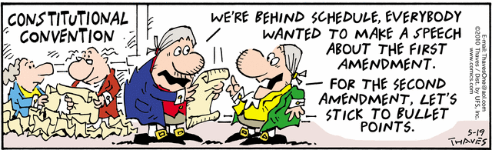
Interlude

Slide 24
A more natural approach
Naturally recursive approach to same-fringe?
Natural, because it just uses "normal" recursion and the runtime stack to keep track of where we are in the computation. We do not have to manage the stack ourselves. We can just do traversals and pause them when a leaf is found.
Coroutines

Slide 25
same-fringe via coroutines

Slide 26
(define same-fringe
(lambda (tree1 tree2)
(call/cc
(lambda (return-cont)
(let ([co1 '()] [co2 '()] [driver '()])
(set! driver
(make-coroutine
(lambda (init-value)
(let loop ()
(let ([leaf1 (resume co1 'whocares)]
[leaf2 (resume co2
'whocare2)])
(if (equal? leaf1 leaf2)
(if (eq? leaf1 #f) (return-cont #t)
(loop))
(return-cont #f)))))))
(set! co1 (make-sf-coroutine driver tree1))
(set! co2 (make-sf-coroutine driver tree2))
(driver 'Whatsittoya?))))))
(define make-sf-coroutine
(lambda (driver tree)
(make-coroutine
(lambda (init-value)
(letrec ([traverse
(lambda (tree)
(if (pair? tree)
(begin
(traverse (car tree))
(if (pair? (cdr tree))
(traverse (cdr tree))))
(resume driver tree)))])
(traverse tree)
(resume driver #f))))))

Slide 27
Course evals
I’d love to give extra credit to students who complete the evaluation.
But I can never know who completed it.
What I can see at any time is how many students from each section completed it.
I will give 5 extra-credit points on the final exam to everyone in a section if at least n-2 students complete the evaluation, where n is the number of students in that section.

Slide 28
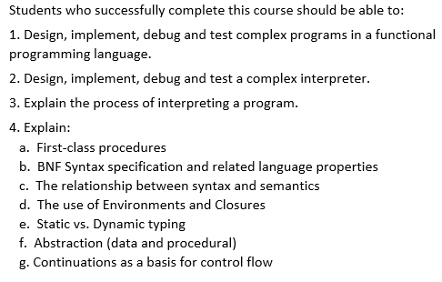
Course evaluations
How have the course and instructor done in helping you meet the official course learning objectives? How can I improve?

Slide 29
Course Evals – perhaps address some of these:
What would you change in the course?
Is there something that you would hate to see me change?
Was the “optional class attendance” policy an enhancement of or a detriment to your learning in the course? Would you recommend that I do that again?

Slide 30
Implementing Reference parameters
For definiteness, I use an “each value in an environment is in a cell” approach. This should be easily adaptable to the “vector of values” or ”list of values” approaches to references.

Slide 31
(let ([a 3]
[b 4]
[rotate (lambda (x (ref y) (ref z))
(let ([temp x])
(set! x y)
(set! y z)
(set! z temp)
(list x y z)))])
(let ([result (rotate a b (+ a b))])
(list a b result)))
What interpreter changes are needed before we call apply-proc? Mainly a change to eval-rands: return a list of cells instead of a list of values.
What interpreter changes are needed in the apply-proc closure case? If it’s not a ref param, put the corresponding argument value in a new cell.
A small change to the expression datatype definition.
No changes to parse-exp or syntax-expand
Notes:
Draw the diagram on the board

Slide 32
A change to extend-env
This works for the “cell” representation of references. It’s slightly more complex for the ribcage representation without cells.
First, modify extend-env so that its second argument is a list of cells containing the values. Thus the values are put into the cells before calling extend-env.
Each level of extended environment will still contain a list or vector of cells, but these cells will not be created by extend-env.

Slide 33
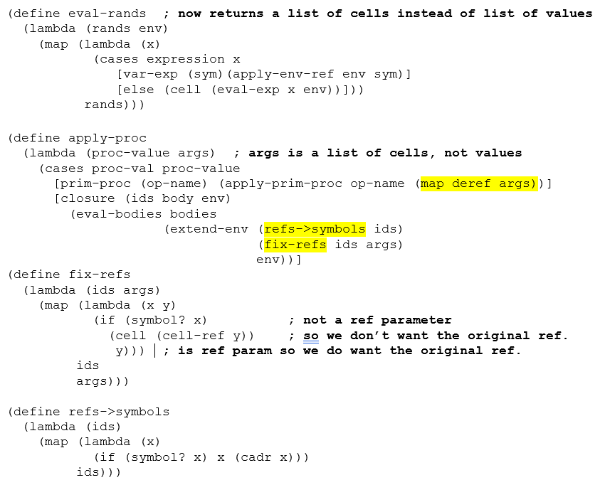
(define extend-env
(lambda (vars cells env)
(extended-env-record
vars cells env)))

