Slide 1
Days 17 and 18
How does Scheme interpret code?

Slide 2
Syntax → Semantics
define-datatype and parse-exp give us a way to get from a concrete representation of program syntax to a more abstract one.
Now we want to get the meaning (interpretation).
How do we implement lexical scoping with first-class procedures?
First question: How to represent the bindings of variables to data? (environments)
We will spend a couple of class days taking an abstract look at this, then we will look at concrete implementations of environments

Slide 3
environments and closures (abbreviated E&C)
Don’t allow yourself to get behind during today’s class
This will be a formalization of what you already “know” intuitively – as we step through, keep in mind
In the end, this should correspond to your existing idea of how scheme programs work (so if it seems to violate those rules, you should stop me)
But, to be a valid formalization, we don’t want to appeal to intuition – instead the process should be totally mechanical

Slide 4
Variable bindings and environments
An environment is a table of variable names (symbols) and their associated values.
The values are not code or pointers to other environments.
a | #t
xyz | "xyz"
i | 4
j | 7
Notes:
In the picture, be sure to include + and list in the global environment.

Slide 5
Variable bindings and environments
The global (top-level) environment is dynamic; symbols are added to the environment via define
the values of symbols can be changed via set!
car
+
However car proc is represented*
However + proc is represented*
* Procedures without code will be treated as a ‘black box’. Procedures with code are represented as closures using the rules I will discuss today.
Notes:
In the picture, be sure to include + and list in the global environment.

Slide 6
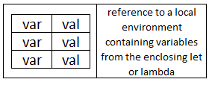
local environments
When a lambda-defined procedure is applied to arguments (also when a let, let*, or letrec is executed), a new local environment is created to hold the bindings of the variables that are defined at that level.
. . .

Slide 7
Evaluate a let expression
Evaluate (in the current environment) the expressions to get the values to be assigned to the let variables.
Create a new local environment with bindings for the let variables. Its "enclosing environment" pointer points to the current environment.
Evaluate the body of the let in this new environment.
> (define a 5)
> (let ([z (+ a 3)]
[t 7]) (let ([y (+ z a)]) (list a t z y)))
However car proc is represented
car
+
… | …
a | 5
However + proc is represented

Slide 8
Procedures (closures)
When a lambda-expression is evaluated, what is returned?
When does the body of a lambda-expression get evaluated?
What kind of info needs to be stored in a procedure?
What happens when a procedure is applied?
(Answers on the next few slides)
Notes:
Closure is another name for "user-defined procedure"

Slide 9

Procedures (closures)
Whenever a lambda expression is evaluated, a procedure (also known as a closure) is created
A closure consists of three parts.
Note that a lambda expression is not a procedure. What is it?
Is the body of a lambda expression ever evaluated during the evaluation of the lambda?
Notes:
A lambda-expression is a piece of code, which, when it gets evaluated, creates a procedure.

Slide 10
Procedure application
I will draw pictures here and verbally describe what is going on. Much of that verbal explanation also appears in writing on the next two slides. You should read them later.
The expressions for the procedure and arguments are evaluated.
A new local environment is created:
Each variable from the procedure's formal parameter list is bound to the corresponding value from the actual argument list.
The new environment's "pointer to an enclosing environment" is set to be a copy of the local environment pointer that is the third part of the closure.
The body of the procedure is evaluated, using this new local environment. If a variable is not found in local environment, look in the global environment.
Simple Example:
> (define add2 (lambda (car) (+ car 2)))
> (add2 17)
car
+

Slide 11

Simple Example
(define add2 (lambda (car) (+ car 2)))
The evaluation of the lambda-expression produces a closure like this:
Because the lambda-expression has no lexically-enclosing bindings, the environment pointer in this closure is null.
The define adds an entry for add2 to the global environment, whose value is this procedure.
Draw picture on the board …

Slide 12
Simple Example (continued)
(add2 17) What happens when the procedure is applied?
First, the value of add2 is looked up in the (global) environment. The value of 17 is itself.
Now we create a new local environment, binding the local variable car to the value 17. The enclosing environment pointer for this local environment is a copy of the closure's null environment pointer.
Now we evaluate the body.
There is no + in the local environment, and there is no enclosing environment, so we find + in the global environment.
the value of car ( which is 17) is found in the local environment.
17 is added to 2 (primitive procedures such as + are applied without making any new environments).

Slide 13
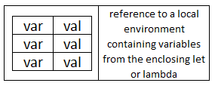
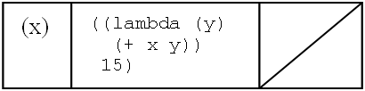
Diagram notation (use it!)
A local environment has two parts:
a table of bindings of variables to values (fixed number of entries)
A pointer to the enclosing local environment
A closure has three parts
List of parameter names
Code (the procedure's body)
A pointer to the environment that was current when the closure was created.

Slide 14
A More Complex Example
((lambda (x)
((lambda (y)
(+ x y))
15))
20)
First, the outer lambda-expression is evaluated to produce this closure:
What happens next?

Slide 15
Summary/Review questions
What happens when a lambda-expression is executed?
When is a new local environment created?
What is the initial value of the current local environment?
When we evaluate a let expression, to what does the "env pointer" in the new local environment point?
When we evaluate a lambda expression, to what does the "env pointer" in the resulting closure point?
When we apply a closure, where does the new local environment get its "enclosing env" pointer?

Slide 16
Summary/Review questions
What happens when a lambda expression is executed?
A closure is created and returned
When is a new local environment created?
When Scheme (a) executes a let (or letrec) or (b) applies a closure to arguments
What is the initial value of the current local environment?
The empty environment
When we evaluate a let, to what does the "env pointer" in the new local environment point?
The local environment that is current when we start to evaluate the let.
When we evaluate a lambda expression, to what does the "env pointer" in the resulting closure point?
The local environment that is current when we start to evaluate the lambda.
When we apply a closure, where does the new local environment get its "enclosing env" pointer?
A copy of the closure's environment pointer

Slide 17
An example with recursion
The following three Scheme expressions are evaluated (in the order shown here):
>(define fact
(lambda (n)
(fact2 n 1))
>(define fact2
(lambda (n acc)
(if (zero? n)
acc
(fact2 (- n 1) (* n acc)))))
>(fact 2)
Draw a diagram showing all closures and local environments that are created during this execution
(with arrows indicating when one of these objects contains a reference to another one). Use words to describe the process.

Slide 18
Example: Similar in complexity to A12
The following two Scheme expressions are evaluated (in the order shown here):
>(define f
(lambda (x)
(let ([a (lambda (y z)
(+ x y z))])
(lambda (b)
(a (+ 5 b) x))))
>((f 3) 4)
I show the details of this example in a video called “Complex E&C example”.
Auxiliary procedure:

Slide 19
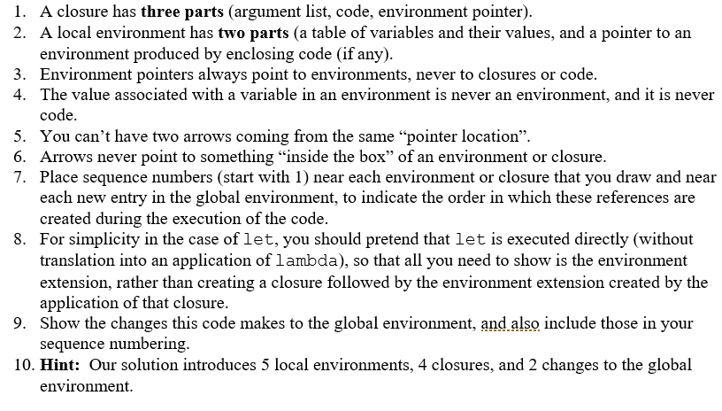
A12 details

Slide 20
Evaluate letrec expressions
Create a new local environment, similar to a let environment, except that:
The “enclosing environment" pointers of all closures that are bound to the letrec variables point to the new environment, not the enclosing environment.
Evaluate the body of the letrec in this new environment.

Slide 21
Example with letrec
>(define odd?
(letrec ([odd? (lambda (n)
(if (zero? n)
#f
(even? (- n 1))))]
[even? (lambda (m)
(if (zero? m)
#t
(odd? (- m 1))))])
(lambda (x)
(odd? x))))
>(odd? 2)
Notes:
Change the code on the quiz to include x and m

Slide 22
Interlude
Quote from Richard Feynman (1918-1988), Caltech physicist and Nobel Prize winner:
There are 10¹¹ stars in the galaxy. That used to be a huge number. But it's only a hundred billion. It's less than the national deficit! We used to call them astronomical numbers. Now we should call them economical numbers.
What does a trillion dollars look like?
https://www.youtube.com/watch?v=WBxWdD9YKdY

