Slide 1
CSSE 304 Day 6
More map and apply
Box and Pointer Diagrams
Mutation of Lists
Notes:
File needed: largest-in-list-2007.ss

Slide 2
Interlude
Computer programming is an art,
because it applies accumulated knowledge to the world,
because it requires skill and ingenuity, and
especially because it produces objects of beauty.
Programmers who subconsciously view themselves as artists will enjoy what they do and will do it better. -- Donald Knuth, Computer Programming as an Art Turing Award Speech

Slide 3
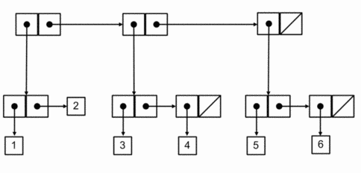
More complex box-and-pointer diagrams
How would Scheme output this? How would you write code to construct it? (without using quote)
Should the numbers be in the boxes (like my previous drawings), or should there be references to them (as here)?
More examples like this for later practice: http://courses.cms.caltech.edu/cs1/assignments/lab5/

Slide 4
Basic rules of list creation
Car always returns the first element of a pair, cdr always returns the 2nd. They never copy.
cons always creates one pair
list creates however many entries it has
Append copies all the pairs passed it (but not what they point to), except the last parameter

Slide 5
Mutation operations
(set! var value) – changes a binding (from define or let)
(set-cdr! pair value) – changes the cdr of a pair (in racket only a mutable pair)
(set-car! pair value) – changes the car of a pair (in racket only a mutable pair)
Lets do some examples!

Slide 6
racket & Set
Racket optimizes defines for constants (defines that are never set!)
This means that you can’t set them after run – set! will fail
But it will work if you have some code that might hypothetically modify the variable
(define mycool 7)
(if (not mycool) (set! mycool 8) 2)
Main takeaway: interactive mode is not as powerful as the code window

Slide 7
Draw box-and-pointer diagrams
… that show the situation after executing this code. Then show what the write statements would print. How many pairs are created altogether?
(define x '((1 2) 3 (4))
(define y (cons (car x) (cdr x)))
(define z (list (cdr x) x))
(define t (append y x))
(write x) (newline)
(write y) (newline)
(write z) (newline) (write t) (newline) ; What happens if we then…
(set-car! (cdr x) 7)
(write t) (newline)
(set-cdr! x x)
(write x) (newline)
Work with one or two other students
Also B&P diagram for ‘(()). You try : '((()))
'(((()))) '((())())

Slide 8
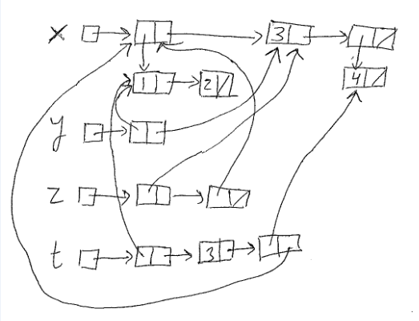
(define x '((1 2) 3 (4))
(define y (cons (car x) (cdr x)))
(define z (list (cdr x) x))
(define t (append y x))
(write x) (newline)
(write y) (newline)
(write z) (newline) (write t) (newline)
((1 2) 3 (4))
((1 2) 3 (4))
((3 (4)) ((1 2) 3 (4)))
((1 2) 3 (4) (1 2) 3 (4))

Slide 9
; What happens if we then…
(set-car! (cdr x) 7)
(write t) (newline)
(set-cdr! x x)
(write x) (newline)
((1 2) 3 (4) (1 2) 7 (4))
Warning in write: cycle detected; proceeding with (print-graph #t)
#0=((1 2) . #0#)

Slide 10
Examples: map and apply
What do each of these return?
(list '()) (map list '()) (apply list '())
(define (apply-many functions arg)
(map (lambda (function)
(function arg)) functions))
(apply-many (list - cube (lambda (x) (/ x 2))) 3)
If you like, broaden apply many to allow arbitrary numbers of arguments
Notes:
We used to talk about quasi-quote, unquote here
I think it’s probably just a distraction
(apply-many '(- cube (lambda (x) (/ x 2))) 3)
(apply-many `(,- ,cube ,(lambda (x) (/ x 2))) 3)

Slide 11
Exercise
Write largest-in-lists, which takes a list of lists of numbers and finds the largest number. Returns #f if there are no numbers in any of the lists. Don't use any separate helper procedures (use letrec or named let)
(largest-in-lists '((1 3 5) () (4) (2 6 1) (4))) ➔ 6
(largest-in-lists '(() ())) ➔ #f
Work with another student on this problem
I’ll go through some solutions in a bit (other powerpoint)

