Slide 1
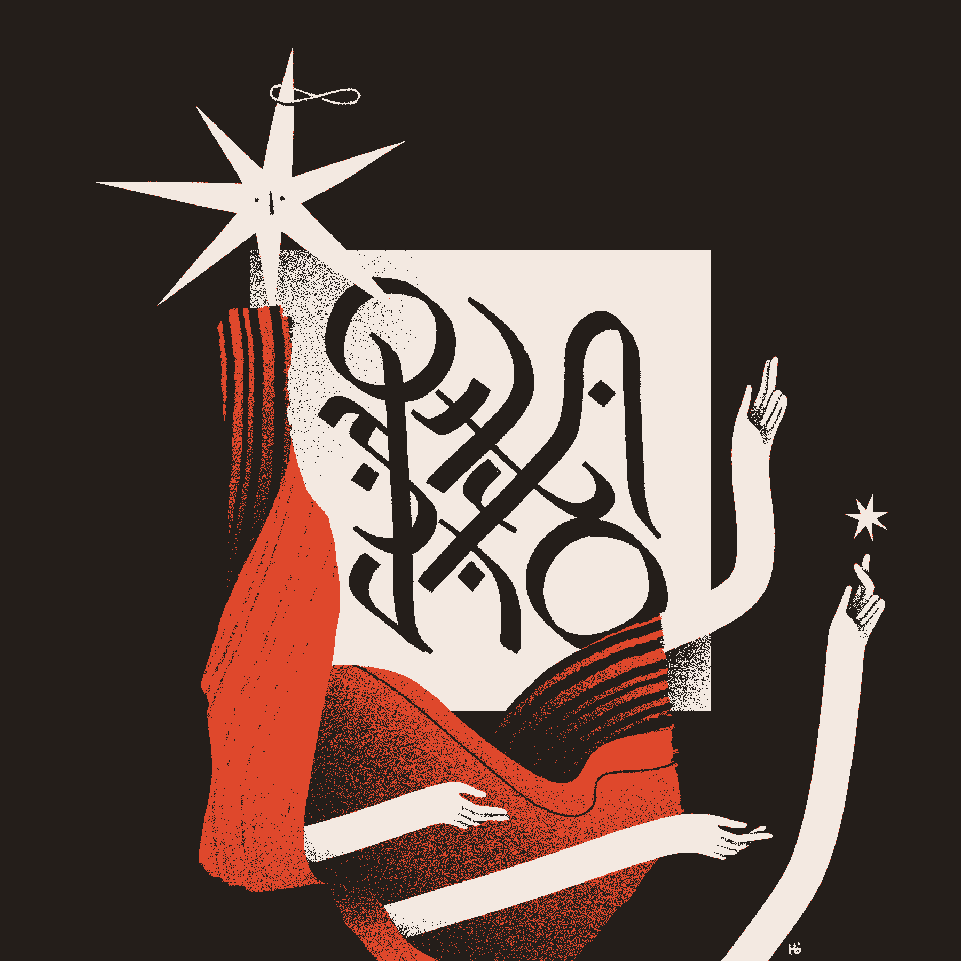
Occurs Bound
Efficient rotate
Review free and bound variables write occurs-bound?
Art by Helvetica Blanc (https://helveticablanc.com). Licensed under a Creative Commons Attribution-NonCommercial-ShareAlike 4.0 International license.

Slide 2
Rotate
Consider this proposed solution
(define rotate ; rotate the last list
; element to the beginning
(lambda (los)
(let loop ([los los]
[sofar '()])
(cond
[(null? los) los]
[(null? (cdr los)) ;one-element list
(cons (car los) sofar)]
[else ; build up the "all but last" list
(loop (cdr los)
(append sofar
(list (car los))))]))))
Notes:
Note that it uses snoc

Slide 3
Rotate
Consider another solution
(define rotate ; build up list in reverse
; order, then reverse it
(lambda (los)
(let loop ([los los]
[sofar '()])
(cond
[(null? los) los]
[(null? (cdr los)) ;one-element list
(cons (car los) (reverse sofar))]
[else ; build "all but last" in reverse
(loop (cdr los)
(cons (car los) sofar))]))))
Notes:
Note that it uses snoc

Slide 4
Rotate – an experiment
(define make-long-list ; make a list of n different numbers.
(lambda (n) (if (zero? n)
'()
(cons n (make-long-list (sub1 n))))))
> (define long (make-long-list 30000))
> (begin
(collect)(time (rotate-linear long))
(collect) (time (rotate long))
'done)
(time (rotate-linear long))
no collections
0 ms elapsed cpu time
2 ms elapsed real time
480040 bytes allocated
(time (rotate long))
869 collections
3183 ms elapsed cpu time, including 127 ms collecting
3187 ms elapsed real time, including 204 ms collecting
3732622096 bytes allocated, including 3729785280 bytes reclaimed
done
>

Slide 5
A simpler rotate
(define rotate
(lambda (L)
(if (null? L)
'()
(let ([rev (reverse L)])
(cons (car rev)
(reverse (cdr rev)))))))

Slide 6
Recap: lambda-calculus expressions
<LcExpr> ::= <identifier> |
(lambda (<identifier>) <LcExpr>) |
( <LcExpr> <LcExpr> )
We call these three types of expressions
variable uses,
abstractions, and
applications.
Derive ((lambda (x) (x y)) z)
For now we just treat expressions as a syntactic construct.
We will consider the meanings of these expressions later.

Slide 7
For now, this is mainly about applying recursive rules
Variable x occurs free in the LcExp e iff one of the following is true:
F1. e is a variable, and e is the same as x.
F2. e is an abstraction (λ (y) e'), where y is different from x and x occurs free in e'.
F3. e is an application (e₁ e₂) where x occurs free in e₁ or in e₂.
Variable x occurs bound in the LcExp e iff one of the following is true:
B1. e is an abstraction (λ (y) e'), where x occurs bound in e', or x and y are the same variable and x occurs free in e'.
B2. e is an application (e₁ e₂) where x occurs bound in e₁ or in e₂.
<LcExpr> ::=
<identifier> |
(lambda (<identifier>) <LcExpr>) |
( <LcExpr> <LcExpr> )

Slide 8
When dealing with the syntax or meaning of a program, we
Follow the _grammar_

Slide 9
Code for occurs-bound?
Variable x occurs bound in the LcExp e iff one of the following is true:
B1. e is an abstraction (λ (y) e'), where x occurs bound in e',
or
x and y are the same variable and x occurs free in e'.
B2. e is an application (e₁ e₂) where x occurs bound in e₁ or in e_{2.}
<LcExpr> ::= <identifier> |
(lambda (<identifier>) <LcExpr>) |
( <LcExpr> <LcExpr> )
Let's follow the grammar to write (occurs-bound? sym exp)
(define occurs-bound? (lambda (sym exp)
Notes:
(define occurs-bound?
(lambda (var exp)
(cond
((symbol? exp) #f)
((eqv? (car exp) 'lambda)
(or (occurs-bound? var (caddr exp))
(and (eqv? (caadr exp) var)
(occurs-free? var (caddr exp)))))
(else (or (occurs-bound? var (car exp))
(occurs-bound? var (cadr exp)))))))
(define occurs-free? ; done in the book, so don't do it here.
(lambda (var exp)
(cond
((symbol? exp) (eqv? var exp))
((eqv? (car exp) 'lambda)
(and (not (eqv? (caadr exp) var))
(occurs-free? var (caddr exp))))
(else (or (occurs-free? var (car exp))
(occurs-free? var (cadr exp)))))))

Slide 10
Activity
In pairs
Step 1: Write occurs-free
Key idea: in a lambda expression:
(lambda (q) ???)
q can never be free in ???
Step 2: Write all-free

