Slide 1
Deadlock Avoidance
CSSE 332
Operating Systems
Rose-Hulman Institute of Technology

Slide 2
The deadlock problem
A set of blocked processes each holding a resource and waiting to acquire a resource held by another process in the set
Example
System has 2 disk drives
P1 and P2 each holds one disk drive and each needs another one
Example
semaphores A and B, initialized to 1
Notes:
Write this example on the board.
P₀ P₁
wait (A); wait(B)
wait (B); wait(A)
Discuss it with students.

Slide 3
Approaches to deadlock handling
Ignore Deadlock (Ostrich approach)
If infrequent enough and result is not serious
Used by most operating systems, including UNIX
Deadlock Prevention
Prevent one of the necessary/sufficient conditions
Deadlock Avoidance
Allow the 3 necessary conditions
Dynamically make choices to avoid deadlock
decide based on knowledge of future requests
i.e., find a safe path

Slide 4
Approaches to deadlock handling
Deadlock Detection
Periodically run algorithm to detect circular waiting
After detecting deadlock,
run a recovery algorithm to remove deadlock

Slide 5
Deadlock avoidance
Require system has a priori information
Each process declares the maximum number of resources of each type that it may need
The deadlock-avoidance algorithm dynamically examines the resource-allocation state to ensure that there can never be a circular-wait condition
Resource-allocation state is defined by the number of available and allocated resources, and the maximum demands/claims of the processes
Notes:
The system needs to have advance knowledge about the resource allocation behavior of each process.
How does it get that knowledge?
It examines the resource-allocation state of the system to ensure no circular wait.

Slide 6
Definition of a safe state
System is in a safe state if there exists at least one sequence <P₁, P₂, …, P_{n}> of ALL the processes in the systems such that for each P_{i}, the resources that P_{i} can still request can be satisfied by currently available resources + resources held by all the P_{j}, where j < i.

Slide 7
Basic Facts
If a system is in safe state ⇒ no deadlocks
If a system is in unsafe state ⇒ possibility of deadlock
Avoidance ⇒ ensure that a system will never enter an unsafe state

Slide 8
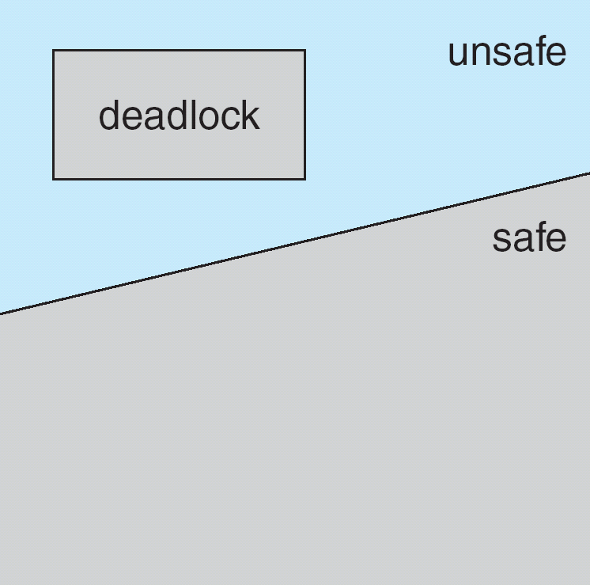
Safe, Unsafe , Deadlock State

Slide 9
Avoidance algorithms
Single instance of a resource type
Use a resource-allocation graph
Multiple instances of a resource type
Use the banker’s algorithm

Slide 10
Use Resource-allocation graph
Claim edge P_{i} → R_{j} indicates that process P_{i} may request resource R_{j}; represented by a dashed line
Claim edge converts to request edge when a process requests a resource
Request edge converted to an assignment edge when the resource is allocated to the process
When a resource is released by a process, assignment edge reconverts to a claim edge
Resources must be claimed a priori in the system
Notes:
We introduce a new type of edge to the RAG → a claim edge
Each process must claim the resources that it will need in advance. A claim is an indication of the resources the process will need during its execution.

Slide 11
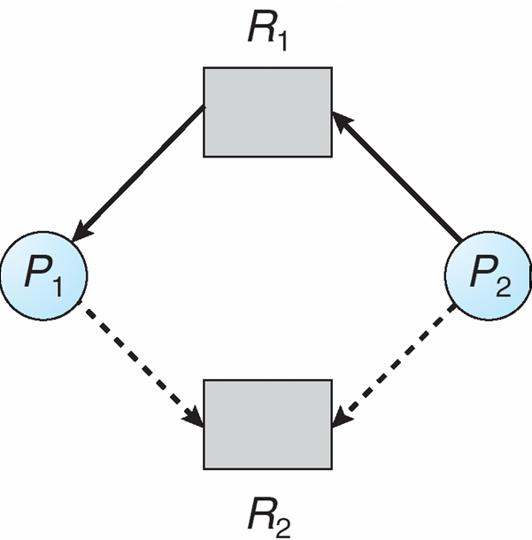
Resource-Allocation Graph

Slide 12
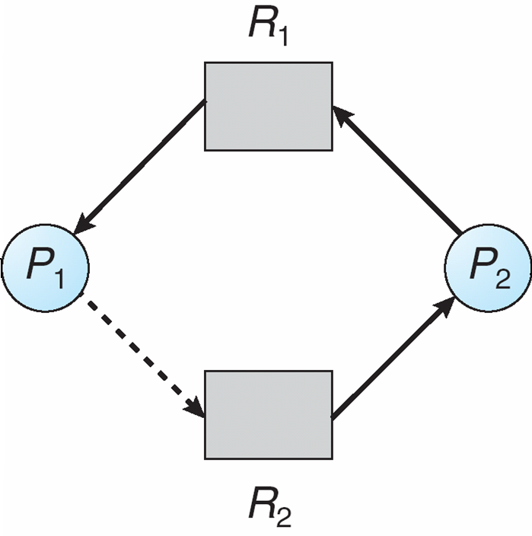
Unsafe state In RAG
Notes:
Assume P2 requests R2.
Convert claim edge to request edge.
Assume R2 is granted to P2
Convert request edge to assignment edge.
Formation of cycle results in unsafe state.

Slide 13
RAG Algorithm
Suppose that process P_{i} requests a resource R_{j}
The request can be granted only if converting the request edge to an assignment edge does not result in the formation of a cycle in the resource allocation graph

Slide 14
Banker’s Algorithm
Multiple instances
Each process must a priori claim maximum use
When a process requests a resource it may have to wait
When a process gets all its resources it must return them in a finite amount of time

Slide 15
Data structures for Banker’s Alg
Let n = number of processes, and m = number of resource types.
Available: Vector of length m. If Available[j] = k, there are k instances of resource type R_{j} available
Max: n x m matrix. If Max[i,j] = k, then process P_{i} may request at most k instances of resource type R_{j}
Allocation: n x m matrix. If Allocation[i,j] = k, then P_{i} is currently allocated k instances of R_{j}
Need: n x m matrix. If Need[i,j] = k, then P_{i} may need k more instances of R_{j} to complete its task
Need [i,j] = Max[i,j] – Allocation [i,j]

Slide 16
Safety Algorithm
1. Let Work and Finish be vectors of length m and n, respectively. Initialize:
Work = Available
Finish [i] = false for i = 0, 1, …, n- 1
2. Find an i such that both:
(a) Finish [i] = false
(b) Need_{i} ≤ Work
If no such i exists, go to step 4
3. Work = Work + Allocation_{i} Finish[i] = true go to step 2
4. If Finish [i] == true for all i, then the system is in a safe state
Notes:
Here, we are simulating granting of resources to processes and marking those that can finish.
If there are unmarked processes (processes that cannot complete), then the system is in an unsafe state.
At the end of the algorithm, all unmarked processes can deadlock.

Slide 17
Resource-Request Alg for Pi
Request = request vector for process P_{i}. If Request_{i} [j] = k, then process P_{i} wants k instances of resource type R_{j}
1. If Request_{i} ≤ Need_{i}, go to step 2. Otherwise, raise error condition, since process has exceeded its maximum claim
2. If Request_{i} ≤ Available, go to step 3. Otherwise P_{i} must wait, since resources are not available
3. Pretend to allocate requested resources to P_{i} by modifying the state as follows:
Available = Available – Request;
Allocation_{i} = Allocation_{i} + Request_{i};
Need_{i} = Need_{i} – Request_{i};
If safe ⇒ the resources are allocated to Pi
If unsafe ⇒ Pi must wait, and the old resource-allocation state is restored
Notes:
If safe → Run the safety algorithm on the previous slide.

Slide 18
Example of Banker’s Algorithm
5 processes P₀ through P₄;
3 resource types:
A (10 instances), B (5instances), and C (7 instances)
Snapshot at time T₀:
Allocation Max Available
A B C A B C A B C
P₀ 0 1 0 7 5 3 3 3 2
P₁ 2 0 0 3 2 2
P₂ 3 0 2 9 0 2
P₃ 2 1 1 2 2 2
P₄ 0 0 2 4 3 3

Slide 19
Example (Cont.)
The content of the matrix Need is defined to be Max – Allocation
Need
A B C
P₀ 7 4 3
P₁ 1 2 2
P₂ 6 0 0
P₃ 0 1 1
P₄ 4 3 1
Is the system in a safe state?
Notes:
The system is in a safe state since the sequence < P1, P3, P4, P2, P0> satisfies safety criteria

Slide 20
Example: P₁ Request (1,0,2)
Check that Request ≤ Available (that is, (1,0,2) ≤ (3,3,2) ⇒ true
Allocation Need Available
A B C A B C A B C
P₀ 0 1 0 7 4 3 2 3 0
P₁ 3 0 2 0 2 0
P₂ 3 0 2 6 0 0
P₃ 2 1 1 0 1 1
P₄ 0 0 2 4 3 1
Can request for (3,3,0) by P₄ be granted?
Can request for (0,2,0) by P₀ be granted?
Notes:
We pretend that the request is granted and leaves the following state.
What does executing the safety algorithm show? Does this request satisfy the safety requirement?
Executing safety algorithm shows that sequence < P1, P3, P4, P0, P2> satisfies safety requirement so we can grant the request to P1.
Consider the last 2 questions with the system in this state.
Cannot grant request of P4 because not enough A
Cannot grant request of P0 because will put system in unsafe state.

