Slide 1

SHIPOGLE
Development Team Number: 9
Client Team Number: 27

Slide 2
WHAT IS SHIPOGLE?
Shipogle is an informal client-to-client platform, where customers can send/deliver a parcel from a source to destination. It depends on the people’s needs and availability.
The application aims to facilitate faster and affordable shipping from one place to another. Deliverers can also make it a side hustle, and earn income.

Slide 3
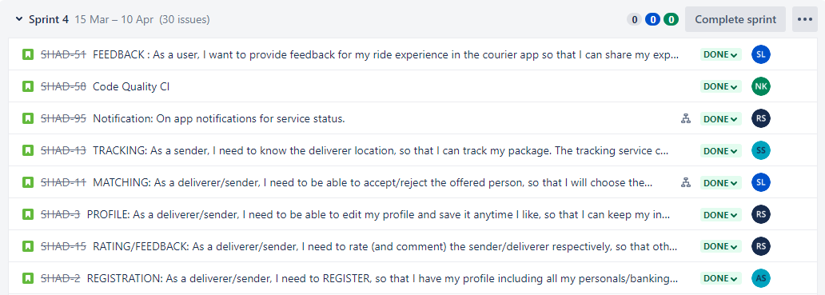
DASHBOARD STATS
Total Tasks:

Slide 4
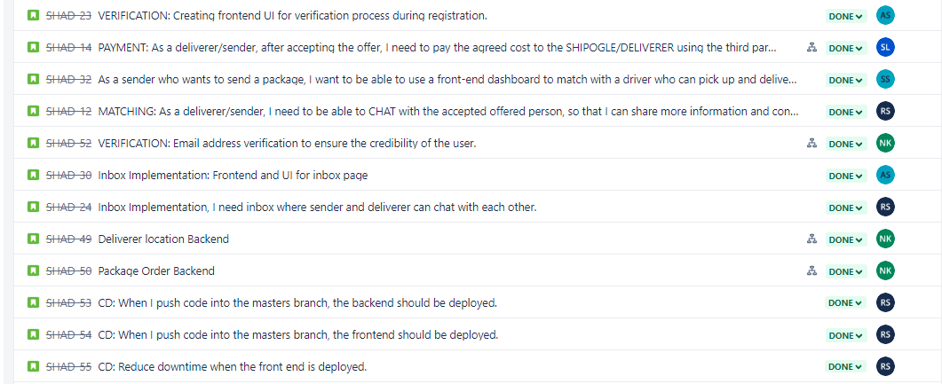

Slide 5
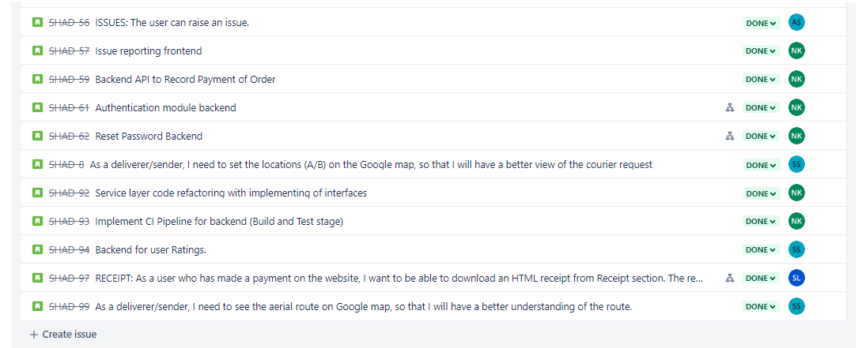

Slide 6
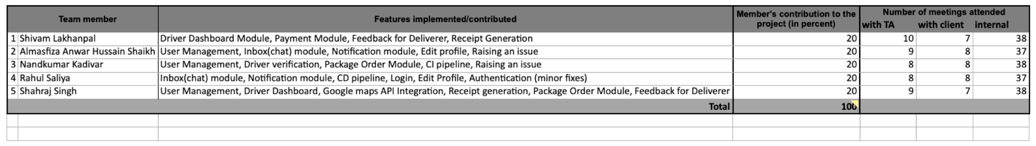
DEVELOPER CONTRIBUTIONS
Here is the developer contribution for each developer on the team. Some features have been shared, and whichever features a dev has touched upon, has been taken into consideration.

Slide 7
DEMO

Slide 8
PROJECT STATUS
Goals | Status (Achieved or Not)
Registration and login for driver/sender. | Achieved
Dashboard functionality for the driver/sender to look at their current order, status etc and search for new sender/driver. | Achieved
Booking a ride (accepted ride) and cancelling a ride with a user. | Achieved
Chatbox implementation for price negotiation. | Achieved
Starting a ride, the status and ending the ride with a generated OTP. | Achieved
Payment for the ride and Receipt generation. | Achieved

Slide 9
PROJECT STATUS CONTD.
Goals | Status (Achieved or Not)
Canceling the ride and getting Refund on the app. | Achieved
Tracking an ongoing ride. | Achieved
Giving Feedback to the deliverer. | Achieved
Raising an issue for the ride. | Achieved

Slide 10
LEARNING
In this project, we learnt on working on Spring Boot framework, with React JS along with continuous deployment on the VM server.
The team collaborated well on feature distribution and participated actively in team meetings and internal discussions. We learnt to communicate efficiently in a developing environment.
We also learnt to work around business requirements in a client-developer relationship, in the project.

