Slide 1
RDBMS : (Relational Database Management System)

Slide 2

MySQL is one of the best RDBMS being used for developing various web-based software applications.
MySQL has stand-alone clients that allow users to interact directly with a MySQL database using SQL, but more often MySQL is used with other programs to implement applications that need relational database capability.

Slide 3
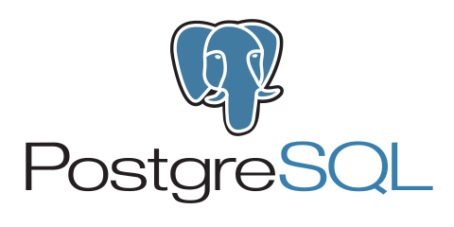
PostgreSQL ,also known as Postgres, is a free and open-source relational database management system (RDBMS) emphasizing extensibility and SQL compliance. ... It is the default database for macOS Server, and is also available for Linux, FreeBSD, OpenBSD, and Windows.

Slide 4

Microsoft SQL Server is a relational database management system developed by Microsoft. As a database server, it is a software product with the primary function of storing and retrieving data as requested by other software applications—which may run either on the same computer or on another computer across a network.

