Slide 1

Skin and extremity dose rates from external beta sources not close to the skin
ralph.whitcher@cleapss.org.uk
44 slides:
Why: How: Where

Slide 2
Meeting IRR17 requirements
if you have a beta source, you’ll probably want to anticipate likely skin and extremity dose rates
(reg 8) as part of your initial risk assessment
(reg 8) modelling foreseeable accidents
(reg 9) quantitatively comparing alternative arrangements
(reg 24/26) retrospective dose reconstruction
… and others.
Varskin is the go-to for close skin contact, but what about > 20 cm away

Slide 3
How: IRR17 doesn't specify any dose measurement/estimation physics
ICRP: The equivalent dose at 0.07 mm skin depth averaged over any 1 cm² of the skin, regardless of the area exposed. But not directly measurable.
IRR17 guidance says the measurable stand-in, ICRU Hp(d), can be used to demonstrate compliance with dose limits. (L121 Appendix 2)

Slide 4
So what’s available for straightforward beta-at-a-distance skin-dose prediction [Hp(0.07)] ?
1. D ≈ 7.5 x 10⁻¹² A/d² Gy/hr (d in m, A in Bq). Quick & dirty absorbed dose rates, a 1970s-vintage precursor to Hp(0.07), an energy-independent approximation
2. Delacroix at 30 cm, inverse square law for other distances. Based on Varskin (1992) (known to be iffy). Stated as Hp(0.07)
3. Online calculators. Commonly traced to Cross et al. If it’s Cross et al. (1982), these are not actually Hp​(0.07) estimates. They are absorbed-dose rates calculated for homogeneous media.

Slide 5
How good are these prediction methods?
The benchmark is Monte Carlo modelling using a reference computational tissue slab, a computational ‘phantom’.
There is more than one reference computational phantom!
Monte Carlo modelling is not ‘plug and play’. Probably quicker to solve cold nuclear fusion in your garage…..

Slide 6
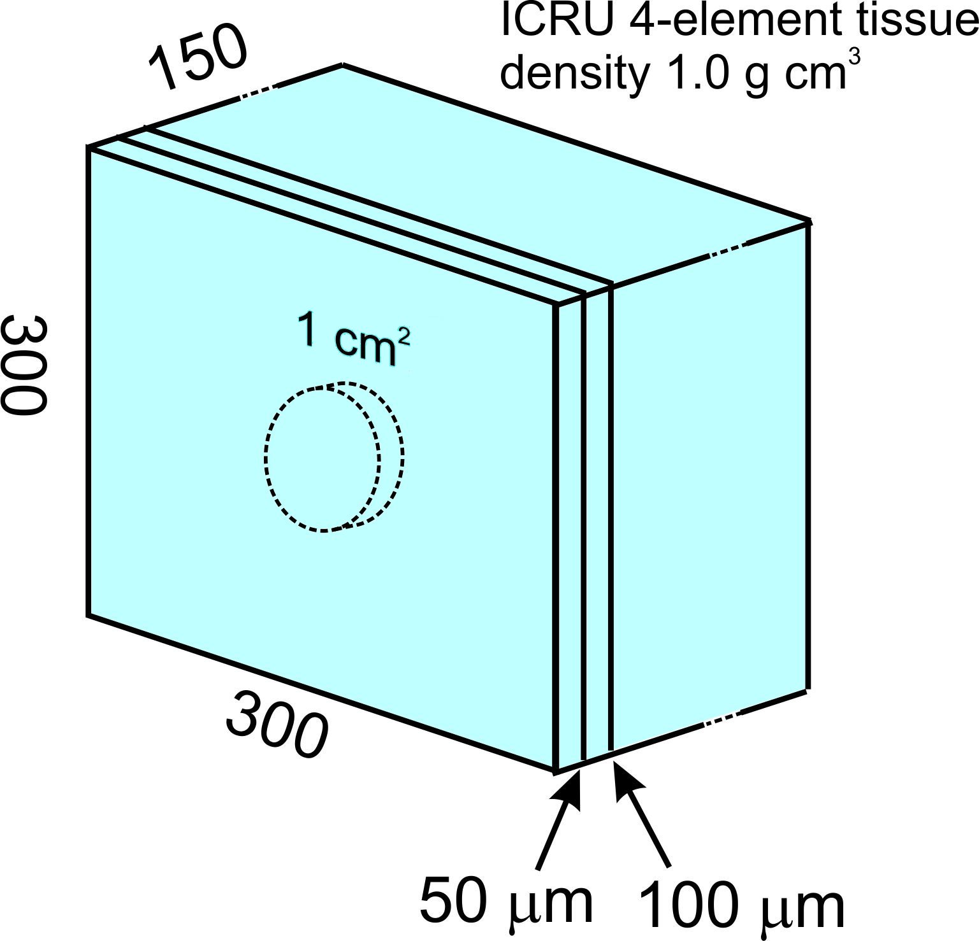
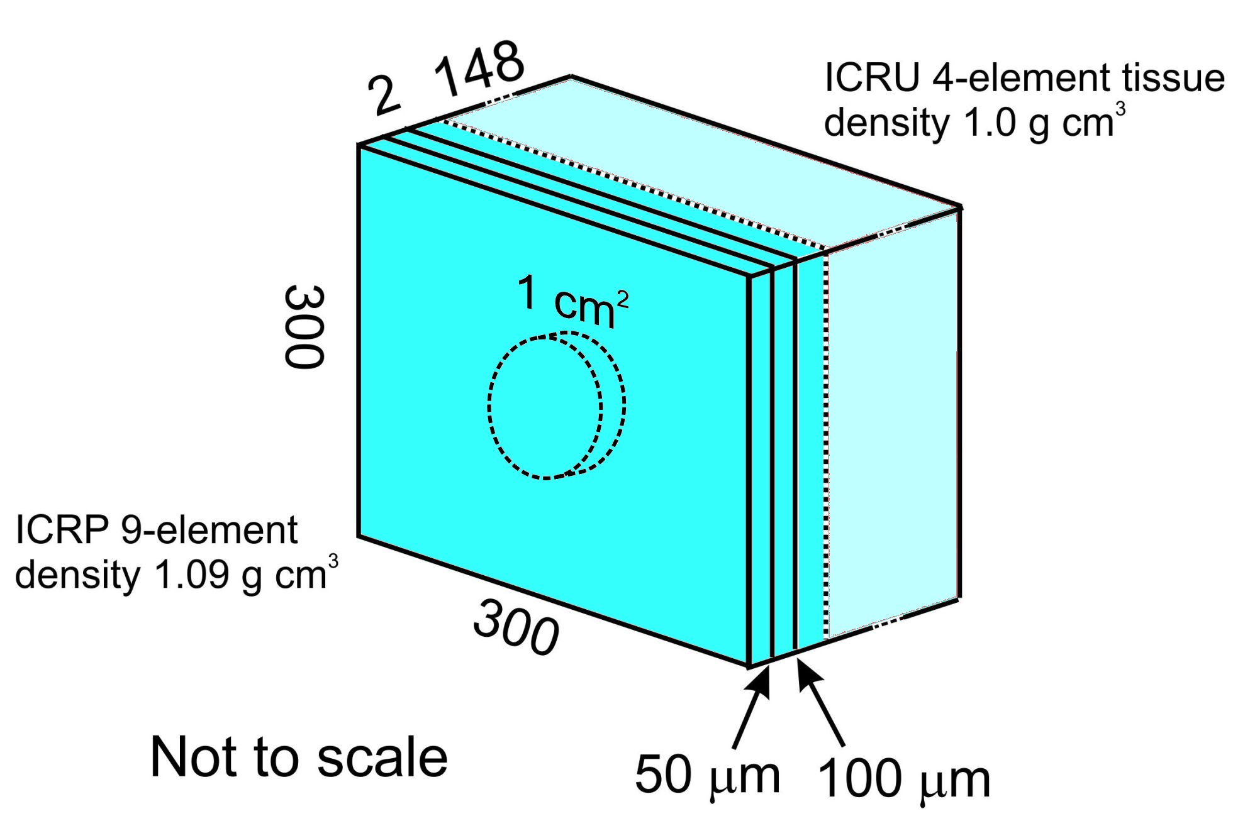
ICRU95/ICRP Skin tissue (trunk) computational phantom
ICRU57 Skin tissue computational phantom

Slide 7
Common nuclear particle transport MC toolkits (n.b. they’re not standalone programs)
MCNP6 - Los Alamos National Laboratory, United States. Export-controlled. DOS-like.
EGSnrc - National Research Council
Canada. Open source, has to be compiled.
Geant4 - International Geant4 Collaboration group. Open source, hosted by CERN. It’s a C++ based toolkit.

Slide 8
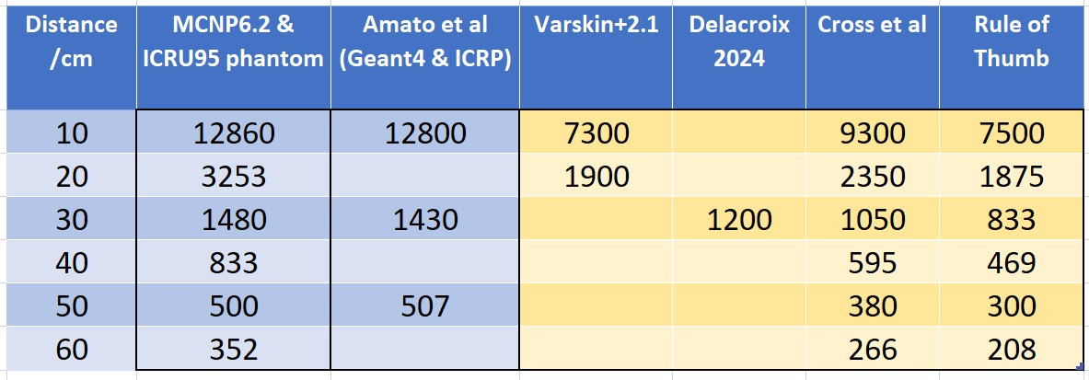

Comparison with MCNP6.2/ICRU 95 skin tissue phantom
10 MBq P-32 point source dose rate (µSv/h) (Emax 1.7107 MeV)
[Dose: Hp(0.07)]
Each MCNP run was 1E8 ‘histories’ and took 80 minutes per run

Slide 9
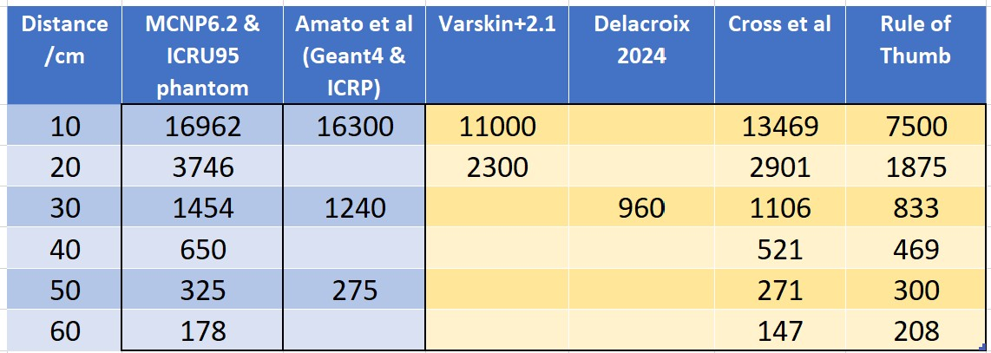
Comparison with MCNP6.2/ICRU 95 skin tissue phantom
10 MBq Sr-90 point source dose rate (µSv/h) (Emax 0.546 MeV)
[Dose: Hp(0.07)]

Slide 10
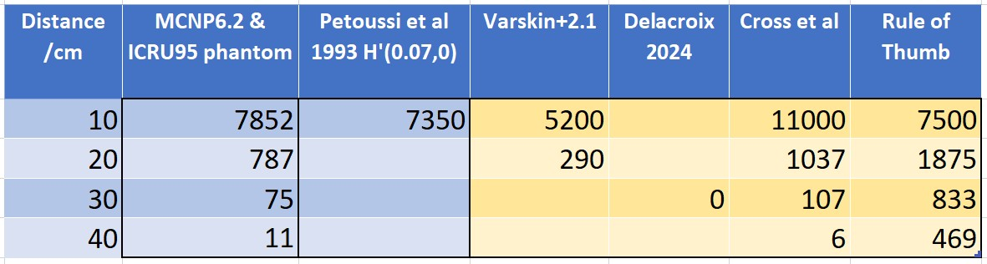
Comparison with MCNP6.2/ICRU 95 skin tissue phantom
10 MBq P-33 point source dose rate (µSv/h) (Emax 0.2485 MeV)
[Dose: Hp(0.07)]

Slide 11
Conclusion - they are all iffy. They mostly underestimate based on M.C./ICRU95, often by well over 40%
Which is often all you need, eg a ball-park figure.
But - sometimes you need better when it comes to:
- calculating what you need for shielding
- evaluating different working arrangements
- retrospective dose estimations
.. and so on

Slide 12
A proposal for an easy-to-use but more reliable algorithm (say aspiration of ~ 10% within M.C. estimates)
Multiply the fluence rate at the skin surface by the fluence-to-dose coefficient

Slide 13
B. Break it down into 6 steps
Calculate the geometry factor into 1 cm² of skin at x cm
For a narrow energy interval, estimate the electron energy remaining at the skin surface
Use the fluence-to-dose coefficient to find the absorbed dose of the electron into 1 cm² of skin
Multiply by the number of electrons/second incident on the 1 cm² of skin
Do that for all the beta energy spectrum
Add up all the energy-interval absorbed dose rates

Slide 14
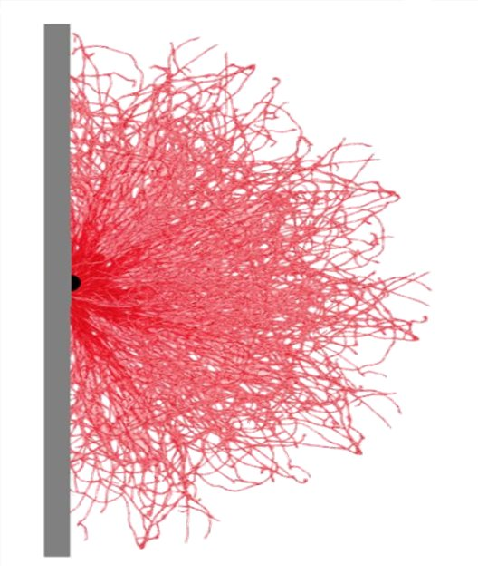
Step 1. Calculate the geometry factor
Electrons have tortuous paths
Monoenergetic
source

Slide 15
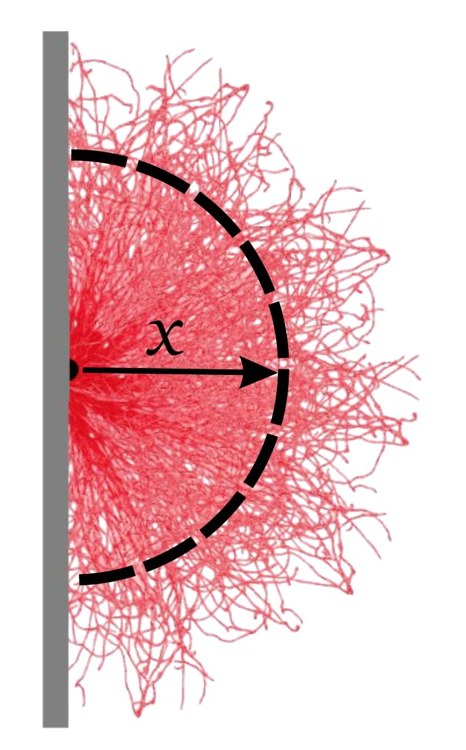
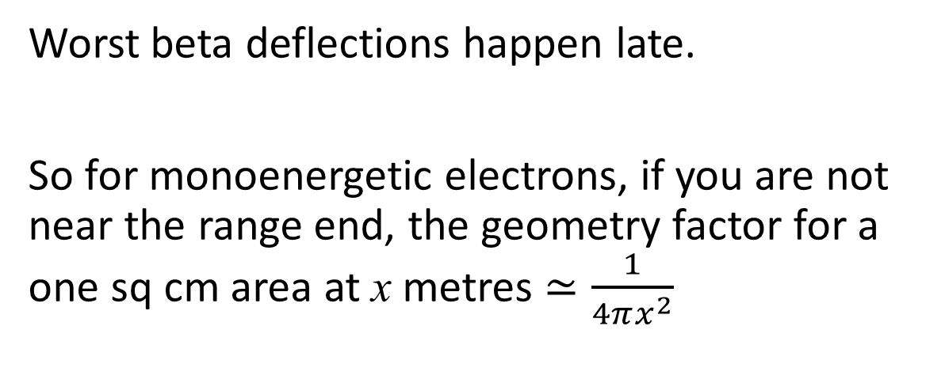
However ………………
Worst beta deflections happen late.
So for monoenergetic electrons, if you are not near the range end, the geometry factor for a one sq cm area at x metres $≃\frac{1}{4πx^{2}}$

Slide 16
Step 2. For a narrow energy interval, estimate the electron energy remaining at the skin surface

Slide 17
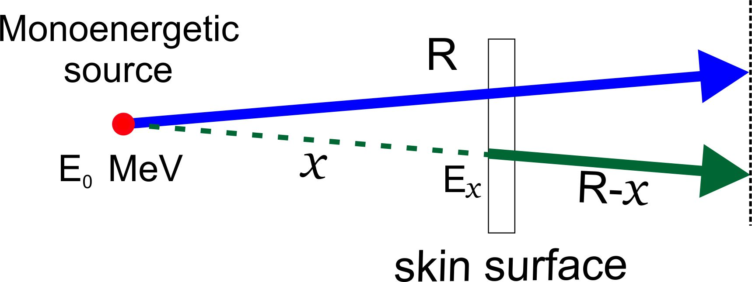
Energy – range - energy

Slide 18
Katz & Penfold range equations are well-established
and turn out to be invertible
E < 2.5 MeV
E >= 2.5 MeV

Slide 19
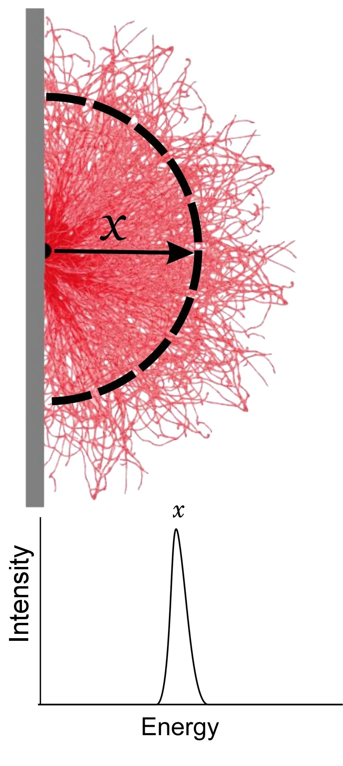
But keep in mind there is energy straggling
The electrons, initially monoenergetic, are not monoenergetic at x. They have a spread of energy.
Ignoring this will cause a dose-rate under-estimation.

Slide 20
Step 3. Fluence-to-dose coefficients (skin, ICRP95)
Using the ICRU95 slab phantom with MCNP6.2 produced many more data points (blue)

Slide 21
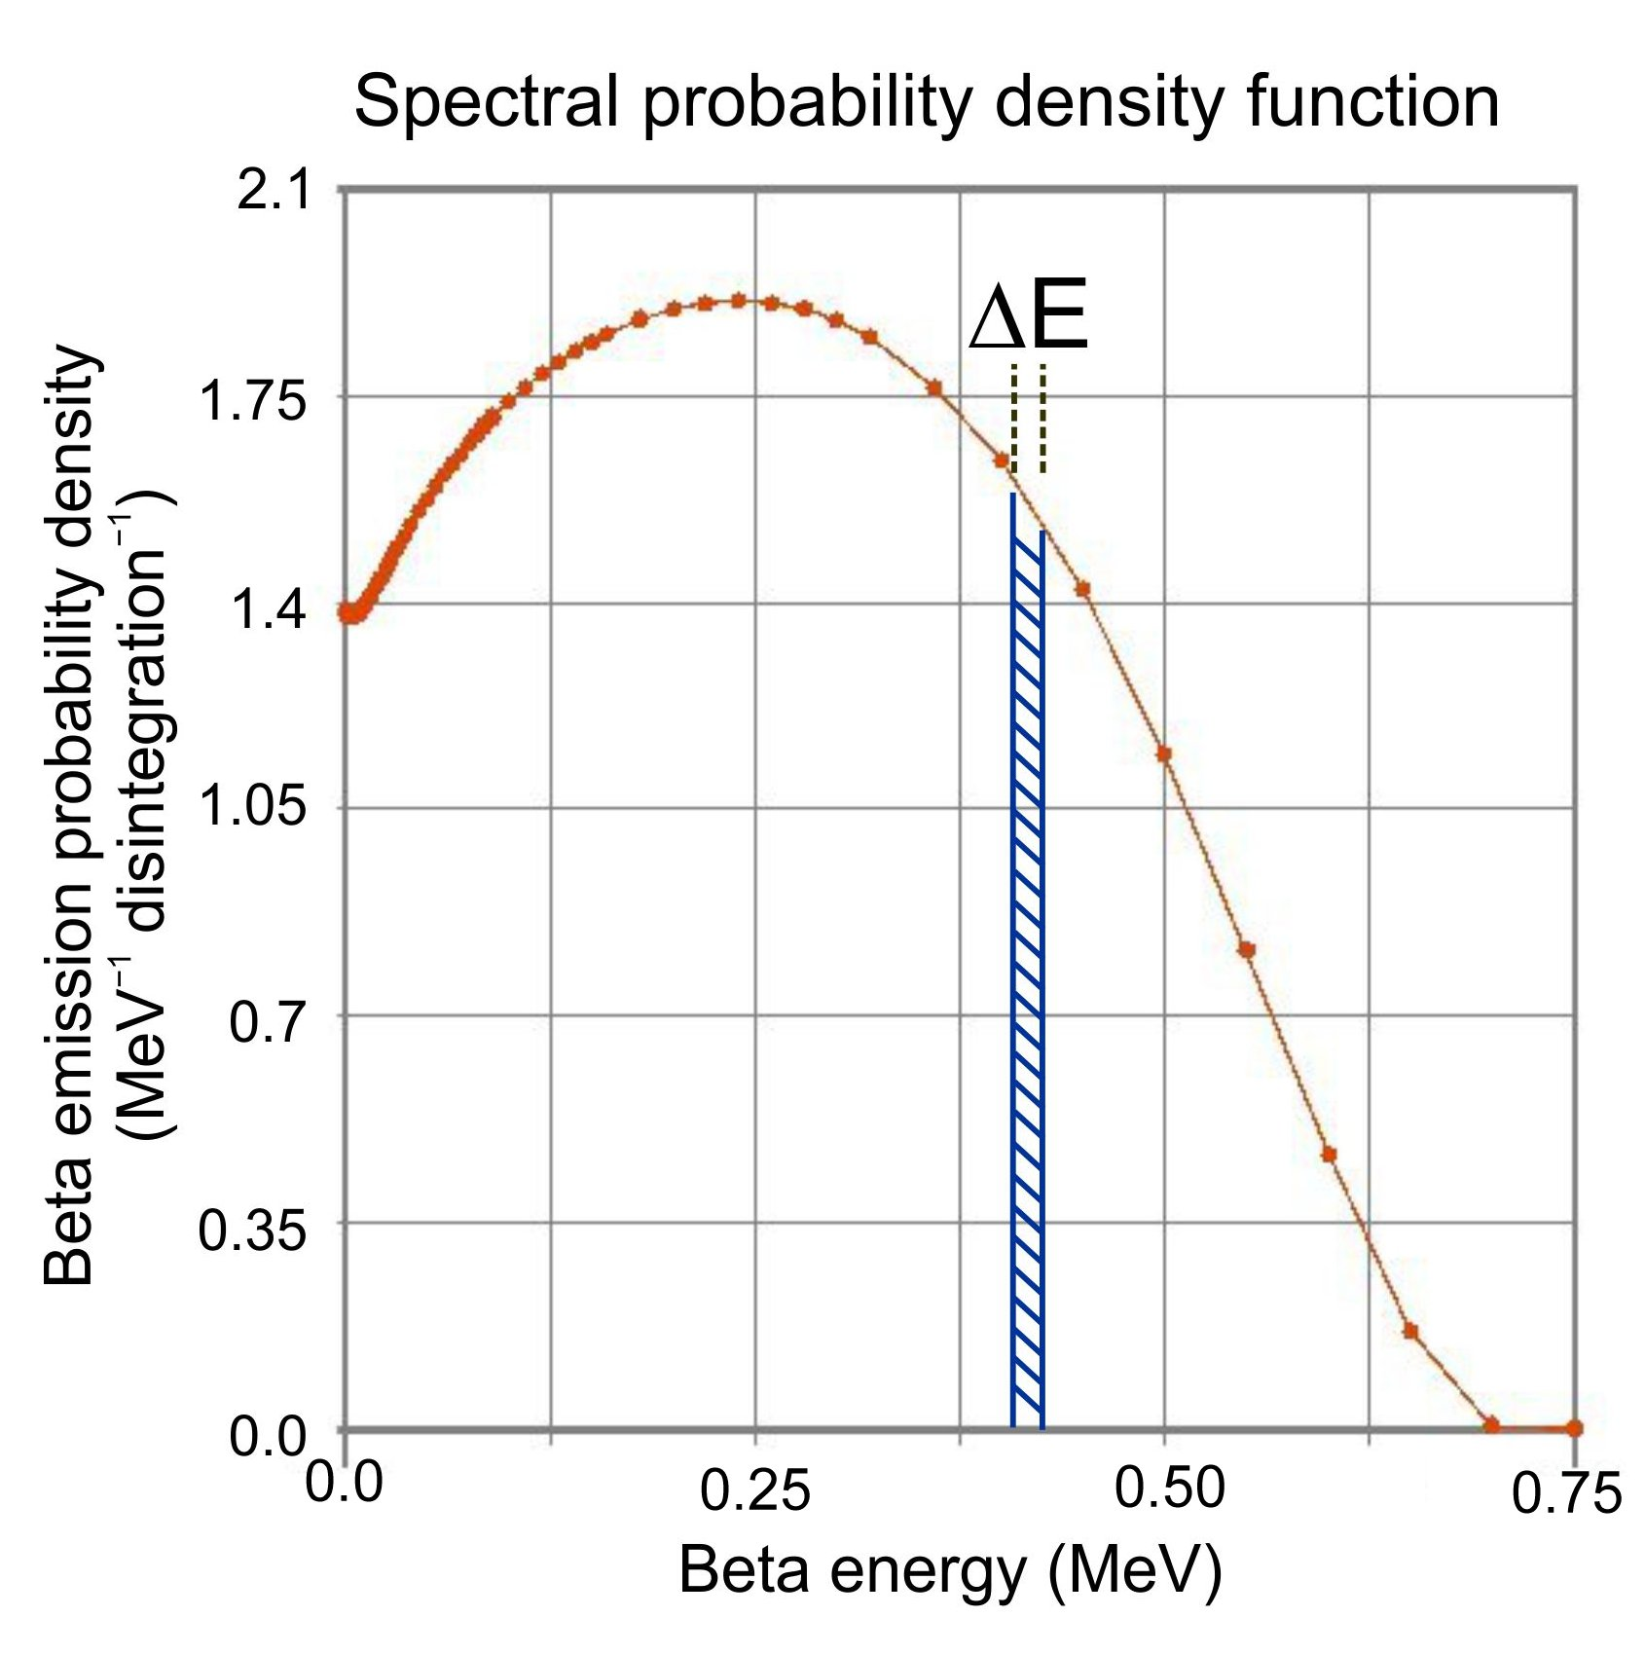
Step 4. Multiply by the number of electrons/second incident on the 1 cm² of skin – ICRP-07.BET
From ICRP-107. Spectral probability density functions for 955 beta radionuclides
The probability that a nuclear disintegration produces a beta particle with an initial energy in the range shown by ΔE is the area of the shaded part under the graph.

Slide 22
Steps 5&6. Put it all together
Absorbed dose rate =
the probability of beta emission at a specific energy interval
x activity
x geometric factor
x residual energy at the skin
x fluence to dose coefficient for that specific energy interval
summed over all the energy intervals
And for electrons, an absorbed dose of 1 Gy into the skin at 50 μm depth in a layer 50 μm thick leads to personal dose equivalent Hp(0.07) of 1 Sv

Slide 23

But what about the energy straggle?
Turns out that for a wide range of beta radionuclides, ignoring the energy straggling caused a remarkably consistent under-estimation by ~ 10% for point sources.
An (optional) empirical energy straggling factor was used to account for this.

Slide 24
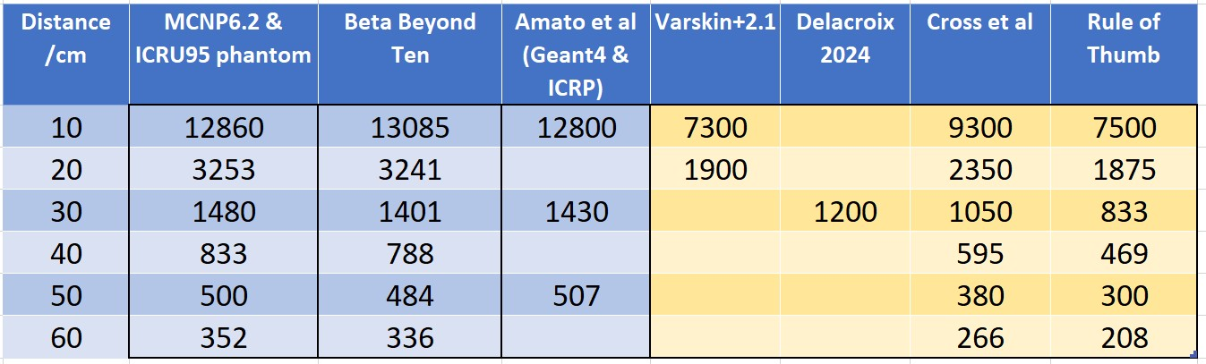
BBT results - comparison
10 MBq P-32 point source dose rate (µSv/h) (Emax 1.7107 MeV)
[Dose: Hp(0.07)]

Slide 25
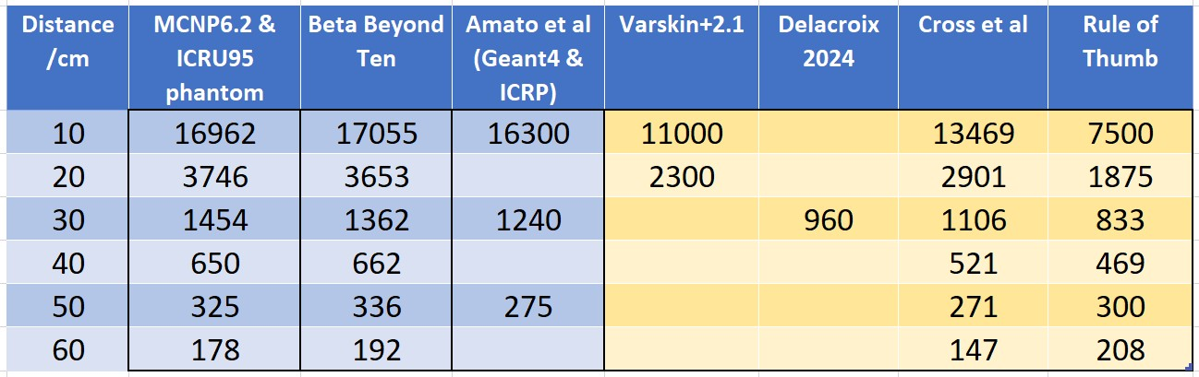
BBT results - comparison
10 MBq Sr-90 point source dose rate (µSv/h) (Emax 0.546 MeV)
(Normally incident) Hp(0.07)

Slide 26
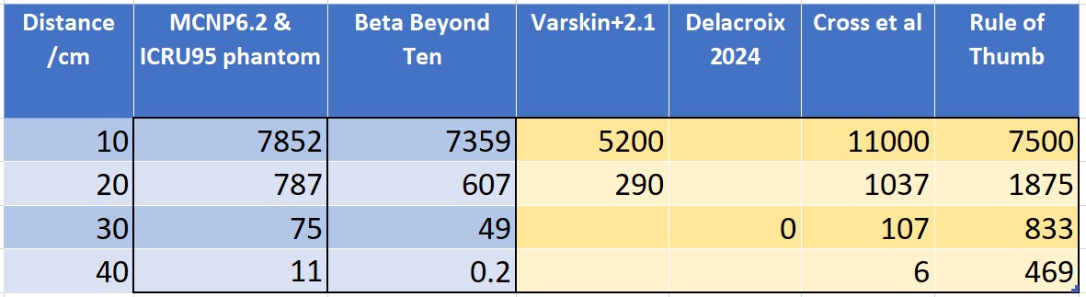
BBT results – comparison
10 MBq P-33 point source dose rate (µSv/h) (Emax 0.2485 MeV)
(Normally incident) Hp(0.07)

Slide 27
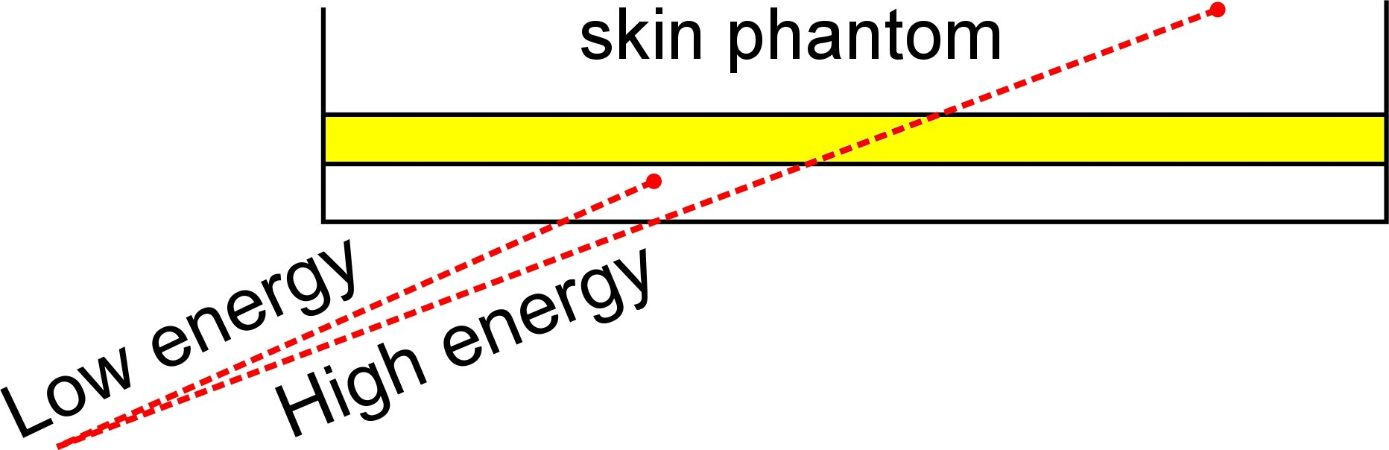
Extending to disc sources
Fluence-to-dose coefficient is affected by the angle of beta incidence

Slide 28
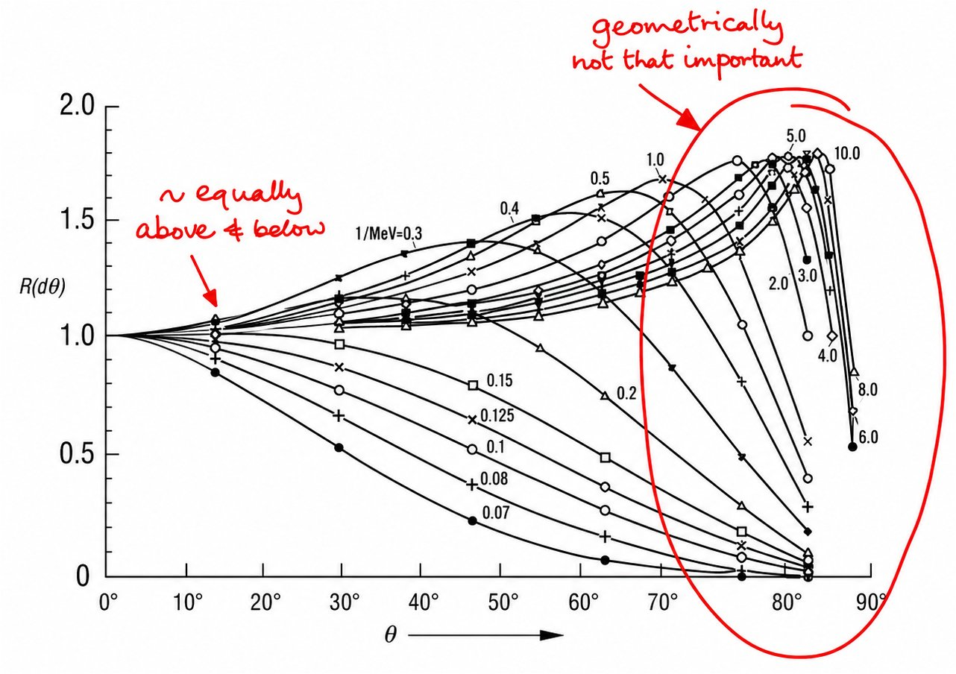
Disc source

Slide 29
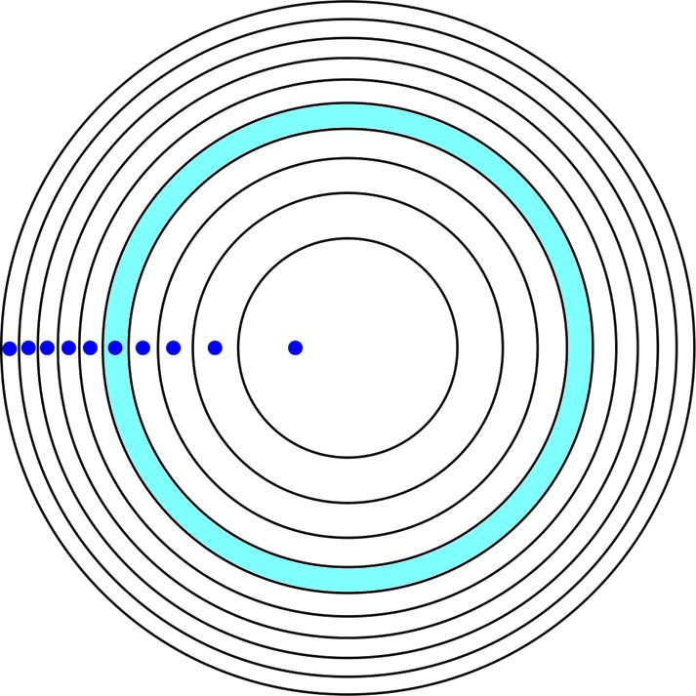
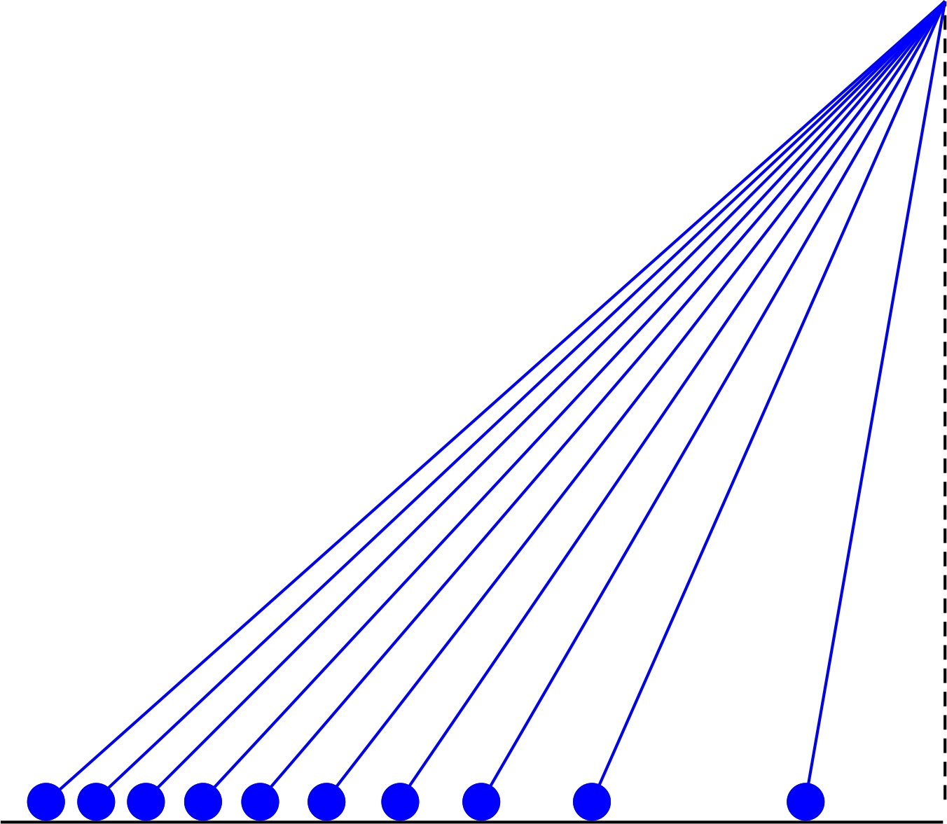
Disc source -
The disc is treated as annuli.
16 smartly-placed samples each with a specific weighting* are used to represent the whole disc very well.
The dose rate from the disc will be the sum of the weighted dose rates from the spot samples.
*Gauss-Legendre numerical integration

Slide 30
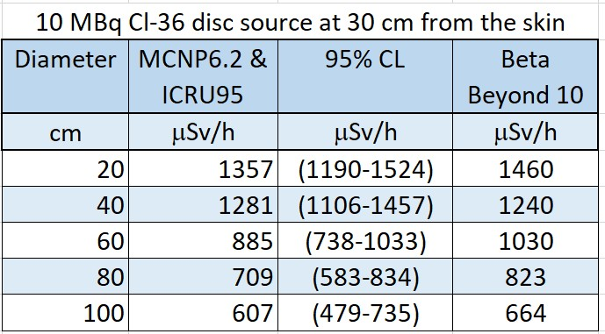
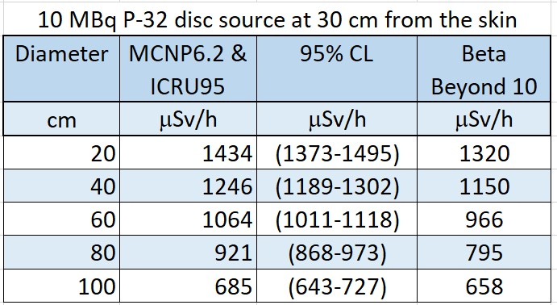
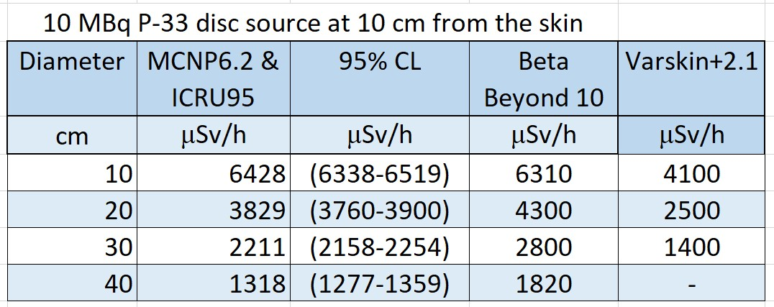
Disc tests so far look OK

Slide 31

E: Is this of help to an RP/RPA?
Better dose estimates from foreseeable incidents
Have the usual tools under-estimated the dose rates to the extent that it challenges previous decisions?
For regulatory justification – the spreadsheet demonstrates and justifies how the dose rate was calculated.
.. so less of

Slide 32
Known limitations
The initial assumptions still apply.
The model was designed mainly for medium- and high-energy beta sources at distances greater than 10 cm. Results become unreliable in other circumstances.
An (optional) empirical factor is used to account for energy straggling. This is an approximation because energy straggling changes with both electron energy and travel distance, but it does give reasonably good agreement with Monte Carlo estimations.
Positrons are also in the database. I’ve not checked the results yet, so use with caution.

Slide 33
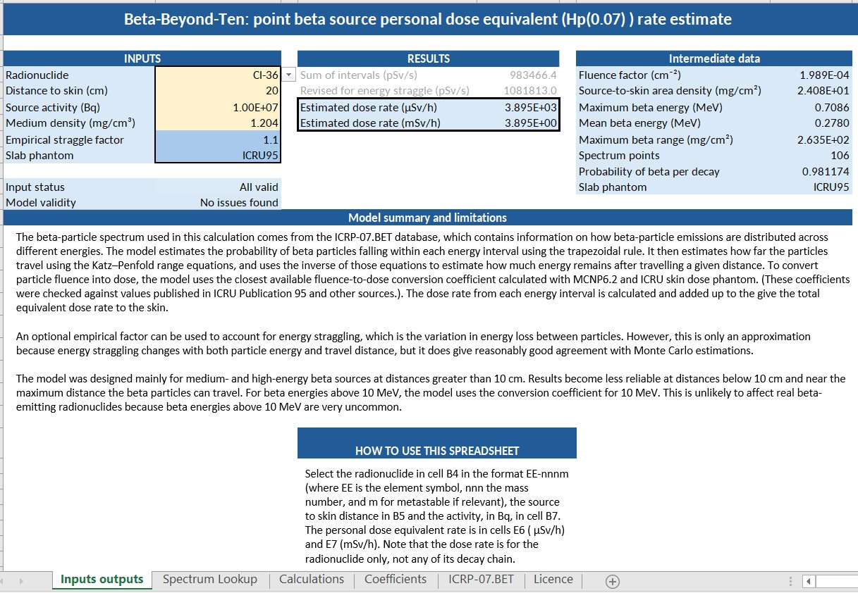
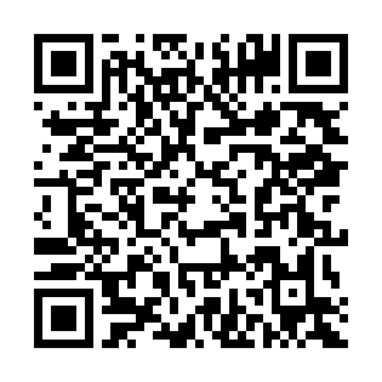
G: Get a copy?
Github
https://github.com/RHW2026/BBT/releases/download/v1.1/BetaBeyondTen_v1_1.xlsx
Contains:
Spreadsheet designed for Microsoft Excel.
(Progressive web application TBA)

