Slide 1
Principles of Distributed Database Systems
M. Tamer Özsu
Patrick Valduriez

Slide 2
Outline
Introduction
Distributed and Parallel Database Design
Distributed Data Control
Distributed Query Processing
Distributed Transaction Processing
Data Replication
Database Integration – Multidatabase Systems
Parallel Database Systems
Peer-to-Peer Data Management
Big Data Processing
NoSQL, NewSQL and Polystores
Web Data Management

Slide 3
Outline
Distributed and Parallel Database Design
Fragmentation
Data distribution
Combined approaches

Slide 4
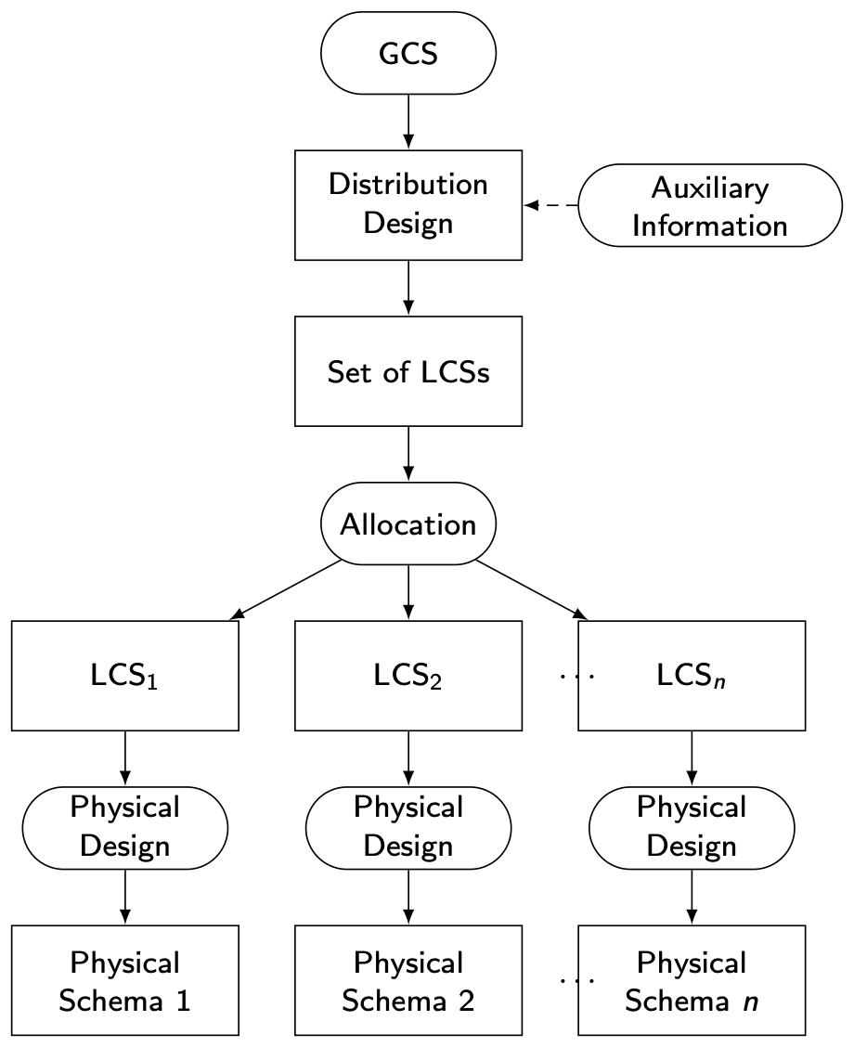
Distribution Design

Slide 5
Outline
Distributed and Parallel Database Design
Fragmentation
Data distribution
Combined approaches

Slide 6
Fragmentation
Can't we just distribute relations?
What is a reasonable unit of distribution?
relation
views are subsets of relations 🡺 locality
extra communication
fragments of relations (sub-relations)
concurrent execution of a number of transactions that access different portions of a relation
views that cannot be defined on a single fragment will require extra processing
semantic data control (especially integrity enforcement) more difficult

Slide 7
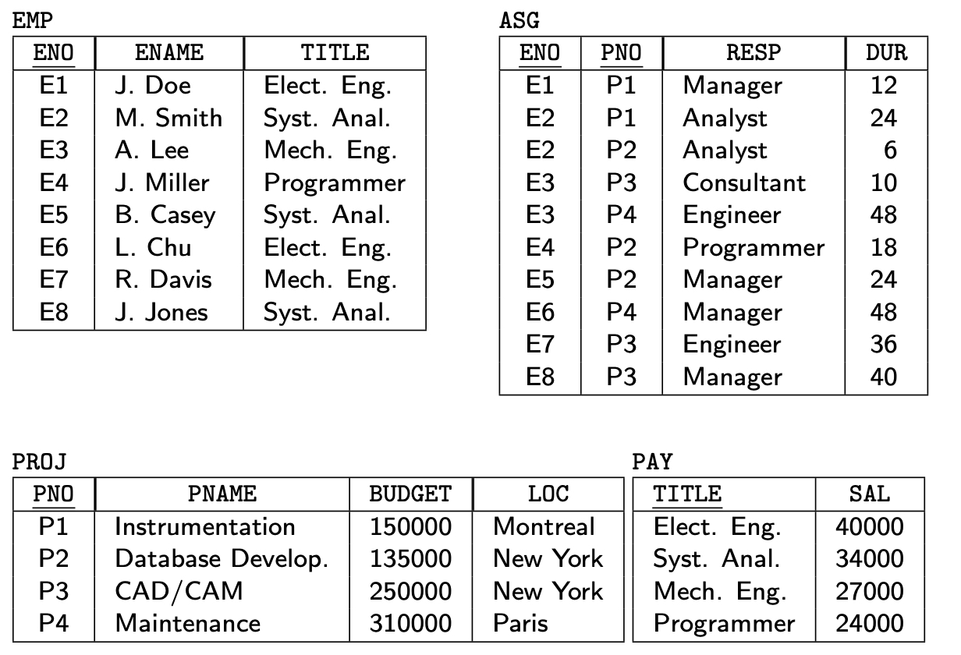
Example Database

Slide 8
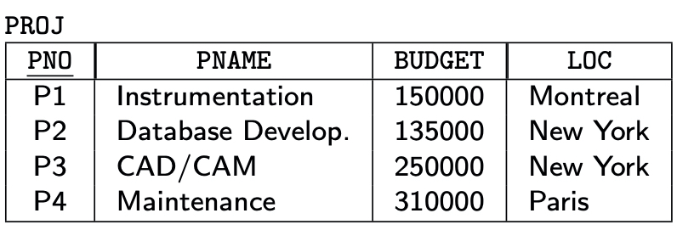
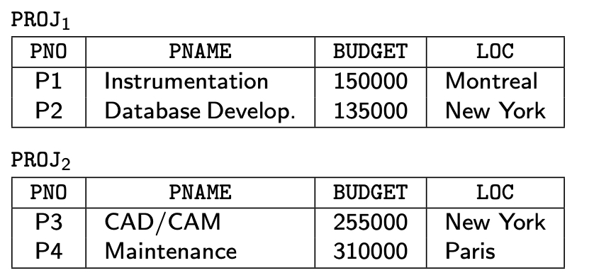
Fragmentation Alternatives – Horizontal
PROJ₁ : projects with budgets less than $200,000
PROJ₂ : projects with budgets greater than or equal to $200,000

Slide 9
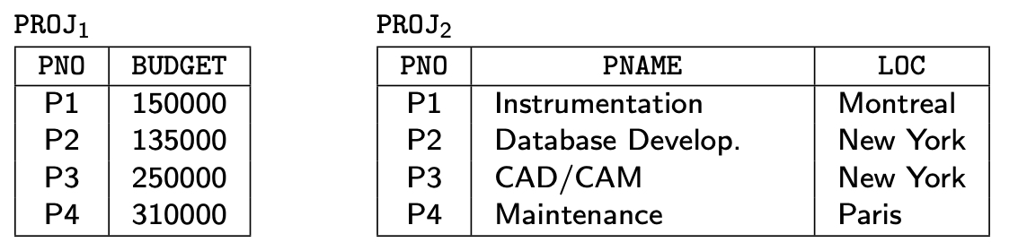
Fragmentation Alternatives – Vertical
PROJ₁: information about project budgets
PROJ₂: information about project names and locations

Slide 10
Correctness of Fragmentation
Completeness
Decomposition of relation R into fragments R₁, R₂, ..., R_{n} is complete if and only if each data item in R can also be found in some R_{i}
Reconstruction
If relation R is decomposed into fragments R₁, R₂, ..., R_{n}, then there should exist some relational operator ∇ such that
R = ∇_{1≤i≤n}R_{i}
Disjointness
If relation R is decomposed into fragments R₁, R₂, ..., R_{n}, and data item d_{i} is in R_{j}, then d_{i} should not be in any other fragment R_{k} (k ≠ j ).

Slide 11

Allocation Alternatives
Non-replicated
partitioned : each fragment resides at only one site
Replicated
fully replicated : each fragment at each site
partially replicated : each fragment at some of the sites
Rule of thumb:

Slide 12
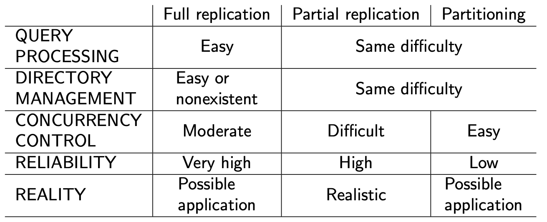
Comparison of Replication Alternatives

Slide 13
Fragmentation
Horizontal Fragmentation (HF)
Primary Horizontal Fragmentation (PHF)
Derived Horizontal Fragmentation (DHF)
Vertical Fragmentation (VF)
Hybrid Fragmentation (HF)

Slide 14
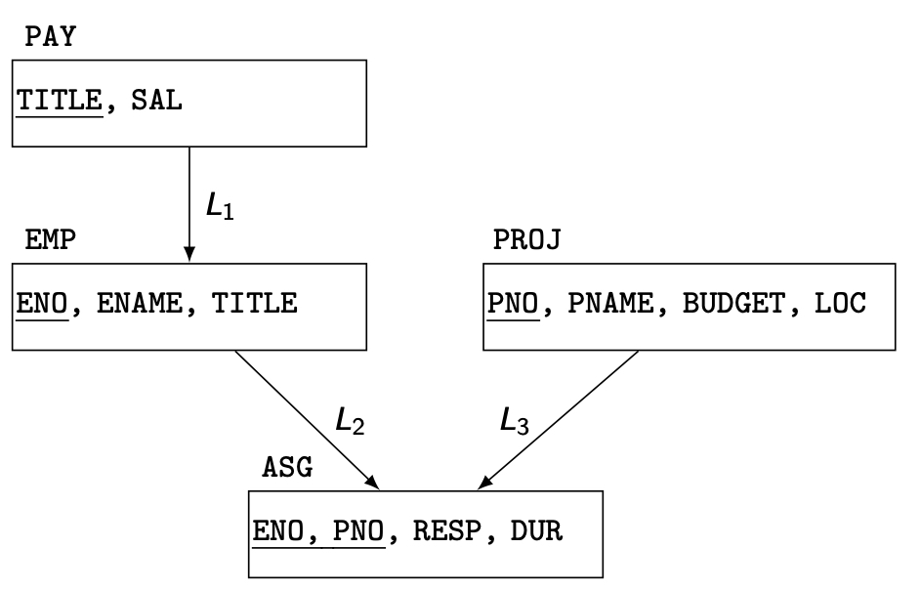
PHF – Information Requirements
Database Information
relationship
cardinality of each relation: card(R)

Slide 15
PHF - Information Requirements
Application Information
simple predicates : Given R[A₁, A₂, …, A_{n}], a simple predicate p_{j} is
p_{j} : A_{i} θValue
where θ ∈ {=,<,≤,>,≥,≠}, Value ∈ D_{i} and D_{i} is the domain of A_{i}.
For relation R we define Pr = {p₁, p₂, …,p_{m}}
Example :
PNAME = "Maintenance"
BUDGET ≤ 200000
minterm predicates : Given R and Pr = {p₁, p₂, …,p_{m}}
define M = {m₁,m₂,…,m_{r}} as
M = { m_{i} | m_{i} = ∧_{pj∈Pr} p_{j}* }, 1≤j≤m, 1≤i≤z
where p_{j}* = p_{j} or p_{j}* = ¬(p_{j}).

Slide 16
PHF – Information Requirements
Example
m₁: PNAME="Maintenance" ∧ BUDGET≤200000
m₂: NOT(PNAME="Maintenance") ∧ BUDGET≤200000
m₃: PNAME= "Maintenance" ∧ NOT(BUDGET≤200000)
m₄: NOT(PNAME="Maintenance") ∧ NOT(BUDGET≤200000)

Slide 17
PHF – Information Requirements
Application Information
minterm selectivities: sel(m_{i})
The number of tuples of the relation that would be accessed by a user query which is specified according to a given minterm predicate m_{i}.
access frequencies: acc(q_{i})
The frequency with which a user application qi accesses data.
Access frequency for a minterm predicate can also be defined.

Slide 18
Primary Horizontal Fragmentation
Definition :
R_{j} = σ_{Fj}(R), 1 ≤ j ≤ w
where F_{j} is a selection formula, which is (preferably) a minterm predicate.
Therefore,
A horizontal fragment R_{i} of relation R consists of all the tuples of R which satisfy a minterm predicate m_{i}.
🡻
Given a set of minterm predicates M, there are as many horizontal fragments of relation R as there are minterm predicates.
Set of horizontal fragments also referred to as minterm fragments.

Slide 19
PHF – Algorithm
Given: A relation R, the set of simple predicates Pr
Output: The set of fragments of R = {R₁, R₂,…,R_{w}} which obey the fragmentation rules.
Preliminaries :
Pr should be complete
Pr should be minimal

Slide 20
Completeness of Simple Predicates
A set of simple predicates Pr is said to be complete if and only if the accesses to the tuples of the minterm fragments defined on Pr requires that two tuples of the same minterm fragment have the same probability of being accessed by any application.
Example :
Assume PROJ[PNO,PNAME,BUDGET,LOC] has two applications defined on it.
Find the budgets of projects at each location. (1)
Find projects with budgets less than $200000. (2)

Slide 21
Completeness of Simple Predicates
According to (1),
Pr={LOC=“Montreal”,LOC=“New York”,LOC=“Paris”}
which is not complete with respect to (2).
Modify
Pr ={LOC=“Montreal”,LOC=“New York”,LOC=“Paris”, BUDGET≤200000,BUDGET>200000}
which is complete.

Slide 22
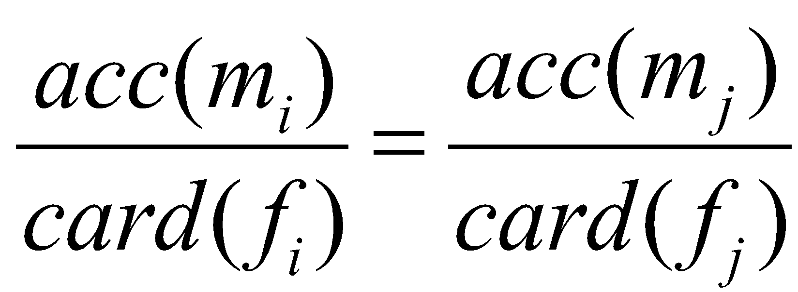
Minimality of Simple Predicates
If a predicate influences how fragmentation is performed, (i.e., causes a fragment f to be further fragmented into, say, f_{i} and f_{j}) then there should be at least one application that accesses f_{i} and f_{j} differently.
In other words, the simple predicate should be relevant in determining a fragmentation.
If all the predicates of a set Pr are relevant, then Pr is minimal.

Slide 23
Minimality of Simple Predicates
Example :
Pr ={LOC=“Montreal”,LOC=“New York”, LOC=“Paris”,
BUDGET≤200000,BUDGET>200000}
is minimal (in addition to being complete). However, if we add
PNAME = “Instrumentation”
then Pr is not minimal.

Slide 24
COM_MIN Algorithm
Given: a relation R and a set of simple predicates Pr
Output: a complete and minimal set of simple predicates Pr' for Pr
Rule 1: a relation or fragment is partitioned into at least two parts which are accessed differently by at least one application.

Slide 25
COM_MIN Algorithm
Initialization :
find a p_{i} ∈ Pr such that p_{i} partitions R according to Rule 1
set Pr' = p_{i} ; Pr ←Pr – {p_{i}} ; F ← {f_{i}}
Iteratively add predicates to Pr' until it is complete
find a p_{j} ∈ Pr such that p_{j} partitions some f_{k} defined according to minterm predicate over Pr' according to Rule 1
set Pr' = Pr' ∪ {p_{i}}; Pr ←Pr – {p_{i}}; F ← F ∪ {f_{i}}
if ∃p_{k} ∈ Pr' which is nonrelevant then
Pr' ← Pr – {p_{i}}
F ← F – {f_{i}}

Slide 26
PHORIZONTAL Algorithm
Makes use of COM_MIN to perform fragmentation.
Input: a relation R and a set of simple predicates Pr
Output: a set of minterm predicates M according to which relation R is to be fragmented
Pr' ← COM_MIN (R,Pr)
determine the set M of minterm predicates
determine the set I of implications among p_{i} ∈ Pr
eliminate the contradictory minterms from M

Slide 27
PHF – Example
Two candidate relations : PAY and PROJ.
Fragmentation of relation PAY
Application: Check the salary info and determine raise.
Employee records kept at two sites ⇒ application run at two sites
Simple predicates
p₁ : SAL ≤ 30000
p₂ : SAL > 30000
Pr = {p₁,p₂} which is complete and minimal Pr'=Pr
Minterm predicates
m₁ : (SAL ≤ 30000)
m₂ : NOT(SAL ≤ 30000) = (SAL > 30000)

Slide 28
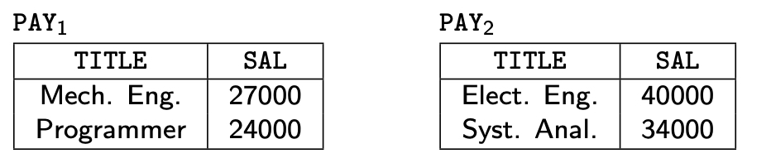
PHF – Example

Slide 29
PHF – Example
Fragmentation of relation PROJ
Applications:
Find the name and budget of projects given their no.
Issued at three sites
Access project information according to budget
one site accesses ≤200000 other accesses >200000
Simple predicates
For application (1)
p₁ : LOC = “Montreal”
p₂ : LOC = “New York”
p₃ : LOC = “Paris”
For application (2)
p₄ : BUDGET ≤ 200000
p₅ : BUDGET > 200000
Pr = Pr' = {p₁,p₂,p₃,p₄,p₅}

Slide 30
PHF – Example
Fragmentation of relation PROJ continued
Minterm fragments left after elimination
m₁ : (LOC = “Montreal”) ∧ (BUDGET ≤ 200000)
m₂ : (LOC = “Montreal”) ∧ (BUDGET > 200000)
m₃ : (LOC = “New York”) ∧ (BUDGET ≤ 200000)
m₄ : (LOC = “New York”) ∧ (BUDGET > 200000)
m₅ : (LOC = “Paris”) ∧ (BUDGET ≤ 200000)
m₆ : (LOC = “Paris”) ∧ (BUDGET > 200000)

Slide 31
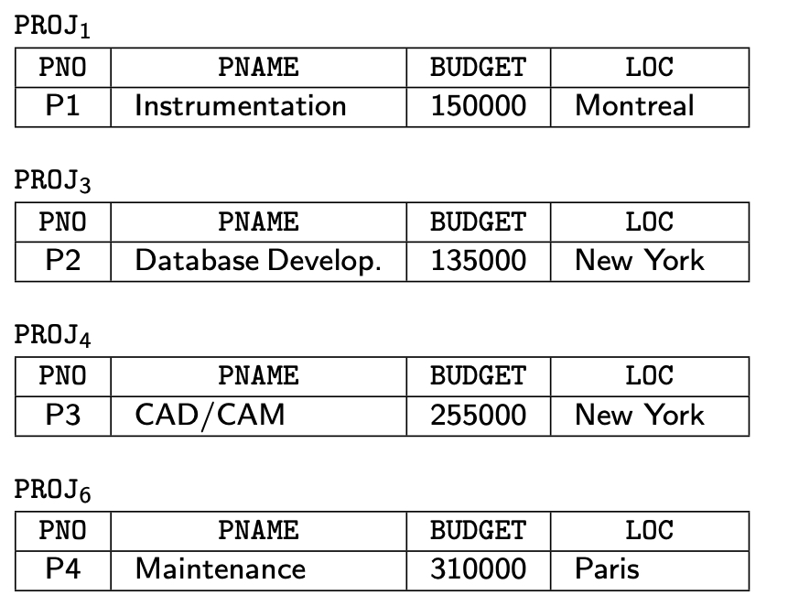
PHF – Example

Slide 32
PHF – Correctness
Completeness
Since Pr' is complete and minimal, the selection predicates are complete
Reconstruction
If relation R is fragmented into F_{R} = {R₁,R₂,…,R_{r}}
R = ∪_{∀Ri ∈FR} R_{i}
Disjointness
Minterm predicates that form the basis of fragmentation should be mutually exclusive.

Slide 33
Derived Horizontal Fragmentation
Defined on a member relation of a link according to a selection operation specified on its owner.
Each link is an equijoin.
Equijoin can be implemented by means of semijoins.

Slide 34
DHF – Definition
Given a link L where owner(L)=S and member(L)=R, the derived horizontal fragments of R are defined as
R_{i} = R ⋉_{F} S_{i}, 1≤i≤w
where w is the maximum number of fragments that will be defined on R and
S_{i} = σ_{Fi} (S)
where F_{i} is the formula according to which the primary horizontal fragment S_{i} is defined.

Slide 35
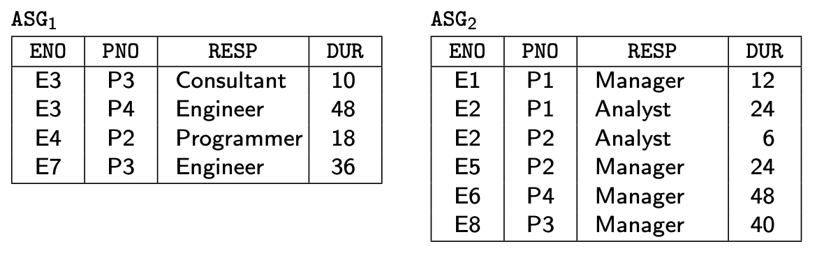
DHF – Example
Given link L₁ where owner(L₁)=SKILL and member(L₁)=EMP
EMP₁ = EMP ⋉ SKILL₁
EMP₂ = EMP ⋉ SKILL₂
where
SKILL₁ = σ_{SAL≤30000}(SKILL)
SKILL₂ = σ_{SAL>30000}(SKILL)

Slide 36
DHF – Correctness
Completeness
Referential integrity
Let R be the member relation of a link whose owner is relation S which is fragmented as F_{S} = {S₁, S₂, ..., S_{n}}. Furthermore, let A be the join attribute between R and S. Then, for each tuple t of R, there should be a tuple t' of S such that
t[A] = t' [A]
Reconstruction
Same as primary horizontal fragmentation.
Disjointness
Simple join graphs between the owner and the member fragments.

Slide 37
Vertical Fragmentation
Has been studied within the centralized context
design methodology
physical clustering
More difficult than horizontal, because more alternatives exist.
Two approaches :
grouping
attributes to fragments
splitting
relation to fragments

Slide 38
Vertical Fragmentation
Overlapping fragments
grouping
Non-overlapping fragments
splitting
We do not consider the replicated key attributes to be overlapping.
Advantage:
Easier to enforce functional dependencies
(for integrity checking etc.)

Slide 39
VF – Information Requirements
Application Information
Attribute affinities
a measure that indicates how closely related the attributes are
This is obtained from more primitive usage data
Attribute usage values
Given a set of queries Q = {q₁, q₂,…, q_{q}} that will run on the relation R[A₁, A₂,…, A_{n}],
use(q_{i},•) can be defined accordingly
⎧
1 if attribute A_{j} is referenced by query q_{i}
use(q_{i},A_{j}) =
⎨
⎩
0 otherwise

Slide 40
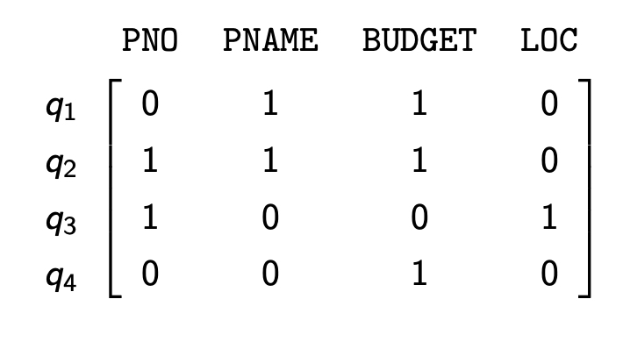
VF – Definition of use(q_{i},A_{j})
Consider the following 4 queries for relation PROJ
q₁: SELECT BUDGET q₂: SELECT PNAME,BUDGET
FROM PROJ FROM PROJ
WHERE PNO=Value
q₃: SELECT PNAME q₄: SELECT SUM(BUDGET)
FROM PROJ FROM PROJ
WHERE LOC=Value WHERE LOC=Value
1
0
0
0
1
1

Slide 41
VF – Affinity Measure aff(A_{i},A_{j})
The attribute affinity measure between two attributes A_{i} and A_{j} of a relation R[A₁, A₂, …, A_{n}] with respect to the set of applications Q = (q₁, q₂, …, q_{q}) is defined as follows :
∑
aff (A_{i}, A_{j}) =
(query access)
all queries that access A_{i} and A_{j}
∑
access
query access =
access frequency of a query *
execution
all sites

Slide 42
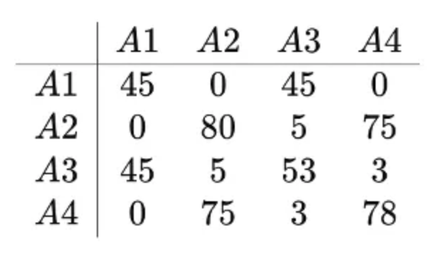
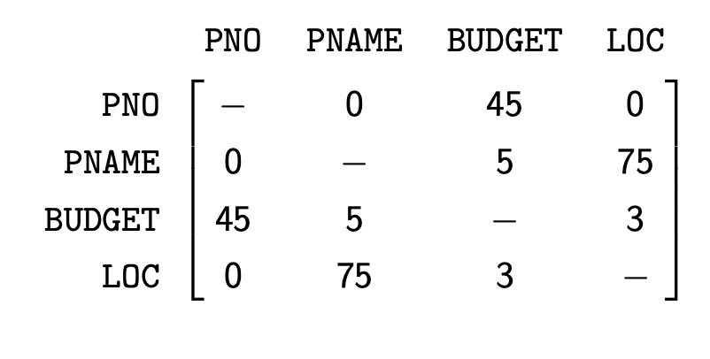
VF – Calculation of aff(A_{i}, A_{j})
Assume each query in the previous example accesses the attributes once during each execution.
Also assume the access frequencies
Then
aff(A₁, A₃) = 15*1 + 20*1+10*1
= 45
and the attribute affinity matrix AA is
(Let A₁=PNO, A₂=PNAME, A₃=BUDGET,
A₄=LOC)
S₁
S₂
S₃
q₁
15
20
10
q₂
5
0
0
q₃
25
25
25
q₄
3
0
0

Slide 43
VF – Clustering Algorithm
Take the attribute affinity matrix AA and reorganize the attribute orders to form clusters where the attributes in each cluster demonstrate high affinity to one another.
Bond Energy Algorithm (BEA) has been used for clustering of entities. BEA finds an ordering of entities (in our case attributes) such that the global affinity measure is maximized.
AM =
∑
∑
(affinity of A_{i} and A_{j} with their neighbors)
i
j

Slide 44
Bond Energy Algorithm
Input: The AA matrix
Output: The clustered affinity matrix CA which is a perturbation of AA
Initialization: Place and fix one of the columns of AA in CA.
Iteration: Place the remaining n-i columns in the remaining i+1 positions in the CA matrix. For each column, choose the placement that makes the most contribution to the global affinity measure.
Row order: Order the rows according to the column ordering.

Slide 45
Bond Energy Algorithm
“Best” placement? Define contribution of a placement:
cont(A_{i}, A_{k}, A_{j}) = 2bond(A_{i}, A_{k})+2bond(A_{k}, A_{l}) –2bond(A_{i}, A_{j})
where
∑
n
bond(A_{x},A_{y}) =
aff(A_{z},A_{x})aff(A_{z},A_{y})
z =1

Slide 46
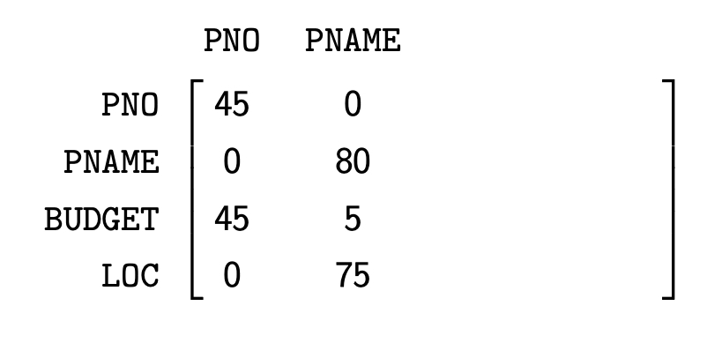
BEA – Example
Consider the following AA matrix and the corresponding CA matrix where PNO and PNAME have been placed. Place BUDGET:
Ordering (0-3-1) :
cont(A₀,BUDGET,PNO) = 2bond(A₀, BUDGET)+2bond(BUDGET, PNO)
–2bond(A₀ , PNO)
= 8820
Ordering (1-3-2) :
cont(PNO,BUDGET,PNAME) = 10150
Ordering (2-3-4) :
cont (PNAME,BUDGET,LOC) = 1780

Slide 47
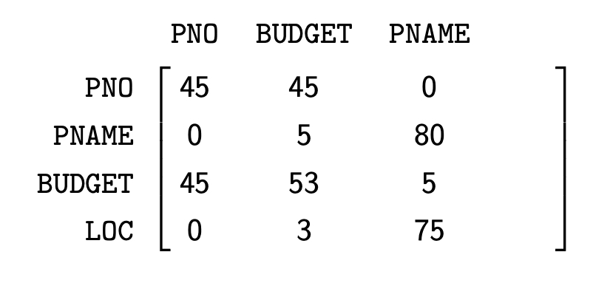
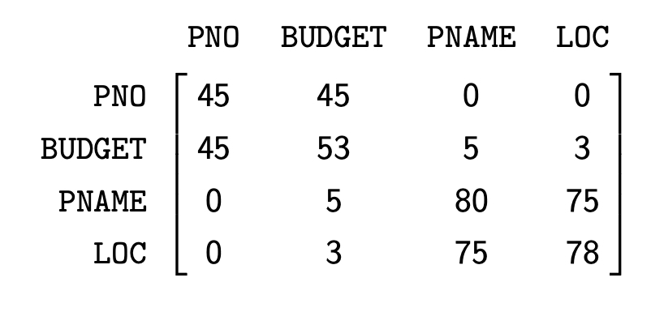
BEA – Example
Therefore, the CA matrix has the form
When LOC is placed, the final form of the CA matrix (after row organization) is

Slide 48
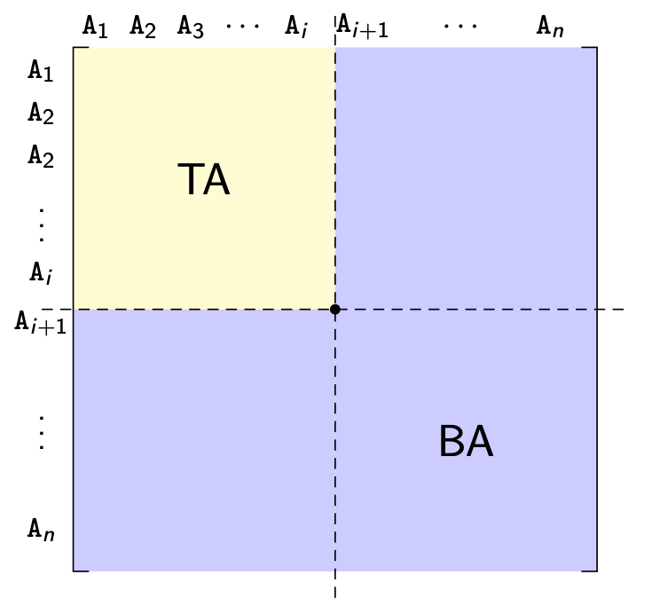
VF – Algorithm
How can you divide a set of clustered attributes {A₁, A₂, …, A_{n}} into two (or more) sets {A₁, A₂, …, A_{i}} and {A_{i}, …, A_{n}} such that there are no (or minimal) applications that access both (or more than one) of the sets.

Slide 49
VF – ALgorithm
Define
TQ = set of applications that access only TA
BQ = set of applications that access only BA
OQ = set of applications that access both TA and BA
and
CTQ = total number of accesses to attributes by applications that access only TA
CBQ = total number of accesses to attributes by applications that access only BA
COQ = total number of accesses to attributes by applications that access both TA and BA
Then find the point along the diagonal that maximizes
CTQ*CBQ−COQ²

Slide 50
VF – Algorithm
Two problems :
Cluster forming in the middle of the CA matrix
Shift a row up and a column left and apply the algorithm to find the “best” partitioning point
Do this for all possible shifts
Cost O(m²)
More than two clusters
m-way partitioning
try 1, 2, …, m–1 split points along diagonal and try to find the best point for each of these
Cost O(2^{m})

Slide 51
VF – Correctness
A relation R, defined over attribute set A and key K, generates the vertical partitioning F_{R} = {R₁, R₂, …, R_{r}}.
Completeness
The following should be true for A:
A = ∪ A_{Ri}
Reconstruction
Reconstruction can be achieved by
R = ⋈_{K} R_{i}, ∀R_{i} ∈ F_{R}
Disjointness
TID's are not considered to be overlapping since they are maintained by the system
Duplicated keys are not considered to be overlapping

Slide 52
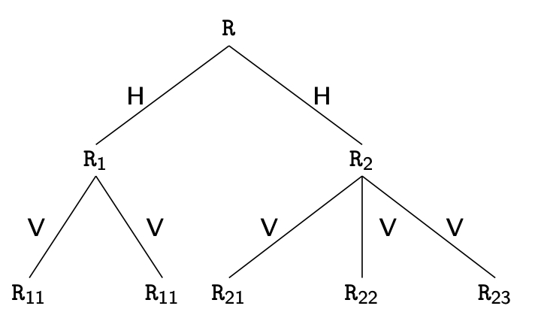
Hybrid Fragmentation

Slide 53
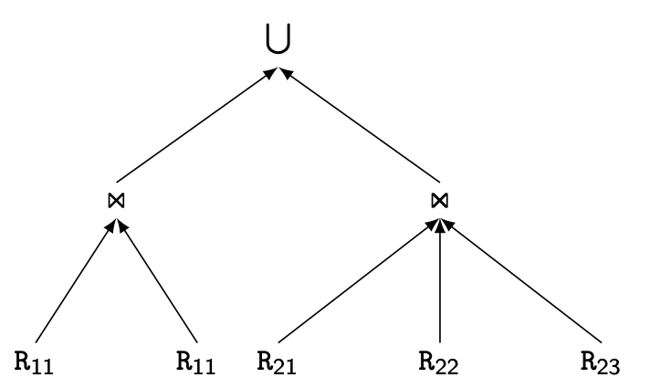
Reconstruction of HF

Slide 54
Outline
Distributed and Parallel Database Design
Fragmentation
Data distribution
Combined approaches

Slide 55
Fragment Allocation
Problem Statement
Given
F = {F₁, F₂, …, F_{n}} fragments
S ={S₁, S₂, …, S_{m}} network sites
Q = {q₁, q₂,…, q_{q}} applications
Find the "optimal" distribution of F to S.
Optimality
Minimal cost
Communication + storage + processing (read & update)
Cost in terms of time (usually)
Performance
Response time and/or throughput
Constraints
Per site constraints (storage & processing)

Slide 56
Information Requirements
Database information
selectivity of fragments wrt query(q): # tuples responding to q
size of a fragment: cardinality * length
Application information
access types and numbers
access localities
Communication network information
unit cost of storing data at a site
unit cost of processing at a site
Computer system information
bandwidth
latency
communication overhead

Slide 57
Allocation
File Allocation (FAP) vs Database Allocation (DAP):
Fragments are not individual files
relationships have to be maintained
Access to databases is more complicated
remote file access model not applicable
relationship between allocation and query processing
Cost of integrity enforcement should be considered
Cost of concurrency control should be considered

Slide 58
Allocation Model
General Form
min(Total Cost)
subject to
response time constraint
storage constraint
processing constraint
Decision Variable
1 if fragment F_{i} is stored at site S_{j}
x_{ij} =
0 otherwise

Slide 59
Allocation Model
Total Cost
Storage Cost (of fragment F_{j} at S_{k})
Query Processing Cost (for one query)
processing component + transmission component
∑
query processing cost +
all queries
∑
∑
cost of storing a fragment at a site
all sites
all fragments
(unit storage cost at S_{k}) * (size of F_{j}) * x_{jk}

Slide 60
Allocation Model
Query Processing Cost
Processing component
access cost + integrity enforcement cost + concurrency control cost
Access cost
Integrity enforcement and concurrency control costs
Can be similarly calculated
∑
∑
(no. of update accesses+ no. of read accesses) *
all sites
all fragments
x_{ij} * local processing cost at a site

Slide 61
Allocation Model
Query Processing Cost
Transmission component
cost of processing updates + cost of processing retrievals
Cost of updates
Retrieval Cost
∑
∑
update message cost +
all sites
all fragments
∑
∑
acknowledgment cost
all sites
all fragments
∑
min
(cost of retrieval command +
all sites
all fragments
cost of sending back the result)

Slide 62
Allocation Model
Constraints
Response Time
execution time of query ≤ max. allowable response time for that query
Storage Constraint (for a site)
Processing constraint (for a site)
∑
storage requirement of a fragment at that site ≤
all fragments
storage capacity at that site
∑
processing load of a query at that site ≤
all queries
processing capacity of that site

Slide 63
Allocation Model
Solution Methods
FAP is NP-complete
DAP also NP-complete
Heuristics based on
single commodity warehouse location (for FAP)
knapsack problem
branch and bound techniques
network flow

Slide 64
Allocation Model
Attempts to reduce the solution space
assume all candidate partitionings known; select the “best” partitioning
ignore replication at first
sliding window on fragments

Slide 65
Outline
Distributed and Parallel Database Design
Fragmentation
Data distribution
Combined approaches

Slide 66
Combining Fragmentation & Allocation
Partition the data to dictate where it is located
Workload-agnostic techniques
Round-robin partitioning
Hash partitioning
Range partitioning
Workload-aware techniques
Graph-based approach

Slide 67
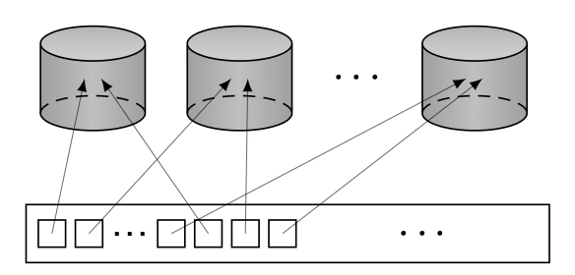
Round-robin Partitioning

Slide 68

Hash Partitioning

Slide 69
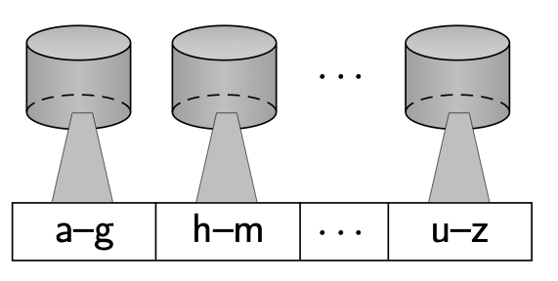
Range Partitioning

Slide 70
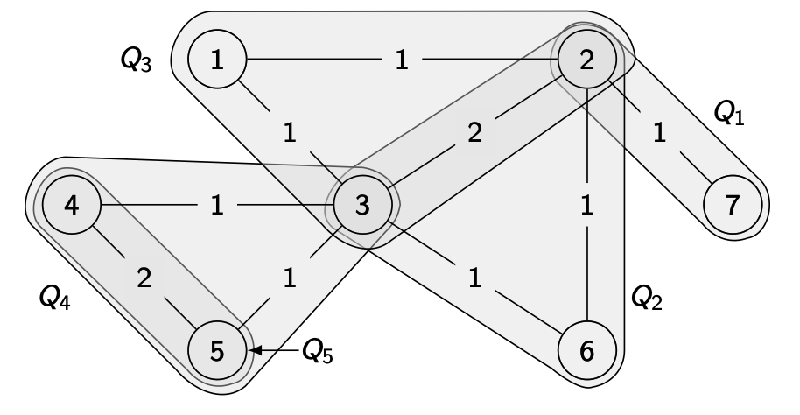
Workload-Aware Partitioning
Examplar: Schism
Graph G=(V,E) where
vertex v_{i} ∈ V represents a tuple in database,
edge e=(v_{i},v_{j}) ∈ E represents a query that accesses both tuples v_{i} and v_{j};
each edge has weight counting the no. of queries that access both tuples
Perform vertex disjoint graph partitioning
Each vertex is assigned to a separate partition

Slide 71
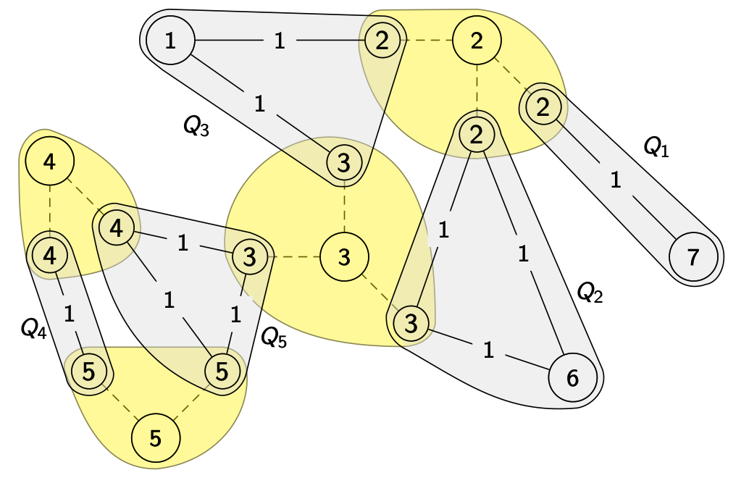
Incorporating Replication
Replicate each vertex based on the no. of transactions accessing that tuple 🡺 each transaction accesses a separate copy

Slide 72
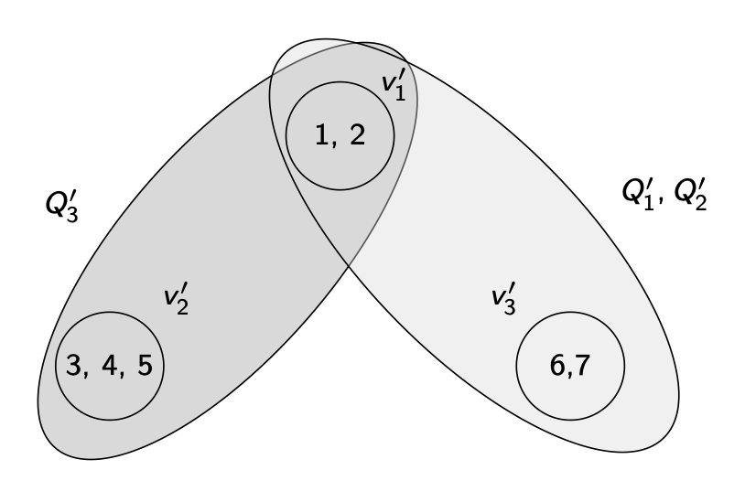
Dealing with graph size
Each tuple a vertex 🡺 graph too big 🡺 directory too big
SWORD
Use hypergraph model
Compress the directory

Slide 73
Adaptive approaches
Redesign as physical (network characteristics, available storage) and logical (workload) changes occur.
Most focus on logical
Most follow combined approach
Three issues:
How to detect workload changes?
How to determine impacted data items?
How to perform changes efficiently?

Slide 74
Detecting workload changes
Not much work
Periodically analyze system logs
Continuously monitor workload within DBMS
SWORD: no. of distributed queries
E-Store: monitor system-level metrics (e.g., CPU utilization) and tuple-level access

Slide 75
Detecting affected data items
Depends on the workload change detection method
If monitoring queries 🡺 queries will identify data items
Apollo: generalize from “similar” queries
SELECT PNAME FROM PROJ WHERE BUDGET>20000 AND LOC=‘LONDON’
⇩
SELECT PNAME FROM PROJ WHERE BUDGET>? AND LOC=‘?’
If monitoring tuple-level access (E-Store), this will tell you

Slide 76
Performing changes
Periodically compute redistribution
Not efficient
Incremental computation and migration
Graph representation 🡺 look at changes in graph
SWORD and AdaptCache: Incremental graph partitioning initiates data migration for reconfiguration
E-Store: determine hot tuples for which a migration plan is prepared determine; cold tuple reallocation as well
Optimization problem; real-time heuristic solutions
Database cracking: continuously reorganize data to match query workload
Incoming queries are used as advice
When a node needs data for a local query, this is hint that data may need to be moved

