Slide 1
Principles of Distributed Database Systems
M. Tamer Özsu
Patrick Valduriez

Slide 2
Outline
Introduction
Distributed and Parallel Database Design
Distributed Data Control
Distributed Query Processing
Distributed Transaction Processing
Data Replication
Database Integration – Multidatabase Systems
Parallel Database Systems
Peer-to-Peer Data Management
Big Data Processing
NoSQL, NewSQL and Polystores
Web Data Management

Slide 3
Outline
Distributed Data Control
View management
Data security
Semantic integrity control

Slide 4
Semantic Data Control
Involves:
View management
Security control
Integrity control
Objective :
Ensure that authorized users perform correct operations on the database, contributing to the maintenance of the database integrity.

Slide 5
Outline
Distributed Data Control
View management
Data security
Semantic integrity control

Slide 6
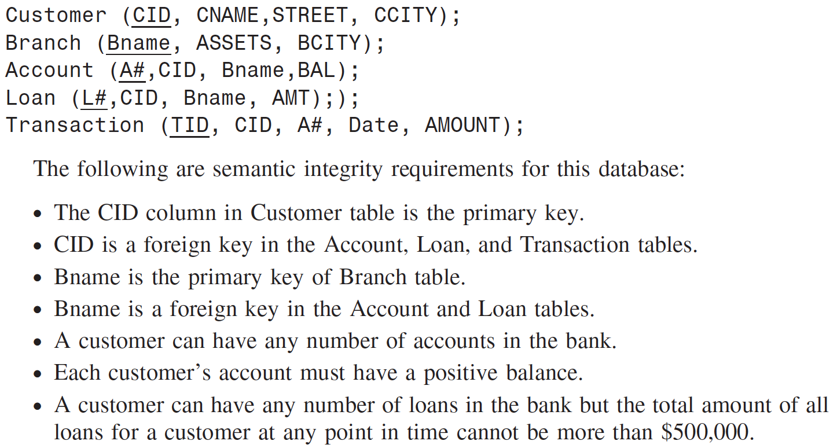
Distributed Query Processing: Semantics

Slide 7
Distributed Query Processing: Semantics
This database is distributed in a four-site system consisting of four database servers:
in Minneapolis (MPLS), St. Paul (StP), St. Cloud (StC), and Mankato (MK).
MPLS: <Customer>
St. Paul: Local fragments of <Loan, Account>
St. Cloud: Local fragments of <Loan, Account>
Mankato: <Branch, Transactions>
Question:
Insert @ Loan: Initiated in St. Paul at the Grant branch, the loan number is 1234, the amount is
$150,000, and the loan belongs to customer 1111.

Slide 8
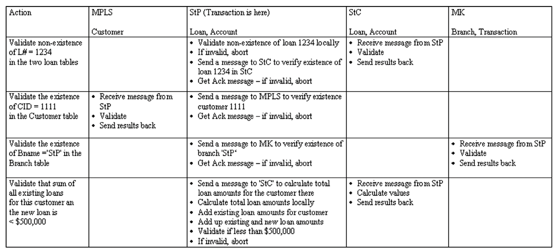
Distributed Query Processing: Semantics
** Transaction handling: Activation of ‘Read_Locks’, ‘Write_Locks’, ‘RW_Locks’ across sites

Slide 9
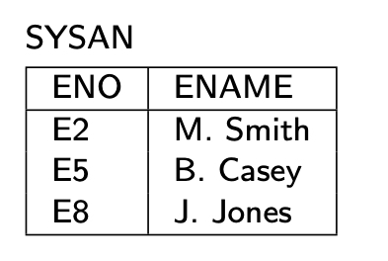
View Management
View – virtual relation
generated from base relation(s) by a query
not stored as base relations
Example :
CREATE VIEW SYSAN(ENO,ENAME)
AS SELECT ENO,ENAME
FROM EMP
WHERE TITLE= "Syst. Anal."
EMP
ENO
ENAME
TITLE
E1
J. Doe
Elect. Eng
E2
M. Smith
Syst. Anal.
E3
A. Lee
Mech. Eng.
E4
J. Miller
Programmer
E5
B. Casey
Syst. Anal.
E6
L. Chu
Elect. Eng.
E7
R. Davis
Mech. Eng.
E8
J. Jones
Syst. Anal.

Slide 10
View Management
Views can be manipulated as base relations
Example :
SELECT ENAME, PNO, RESP
FROM SYSAN, ASG
WHERE SYSAN.ENO = ASG.ENO

Slide 11
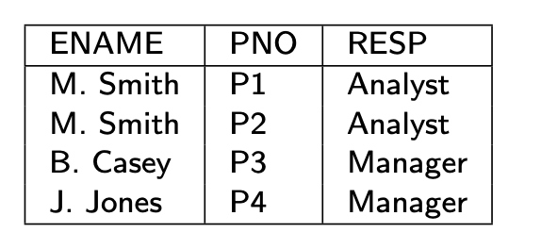
Query Modification
Queries expressed on views
Queries expressed on base relations
Example :
SELECT ENAME, PNO, RESP
FROM SYSAN, ASG
WHERE SYSAN.ENO = ASG.ENO
SELECT ENAME,PNO,RESP
FROM EMP, ASG
WHERE EMP.ENO = ASG.ENO
AND TITLE = "Syst. Anal."

Slide 12
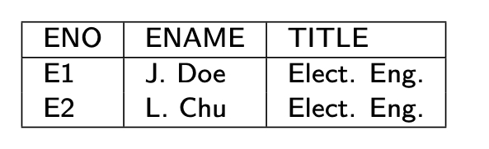
View Management
To restrict access
CREATE VIEW ESAME
AS SELECT *
FROM EMP E1, EMP E2
WHERE E1.TITLE = E2.TITLE
AND E1.ENO = USER
Query
SELECT *
FROM ESAME

Slide 13
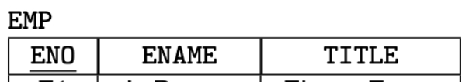
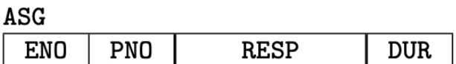
View Updates
Updatable
CREATE VIEW SYSAN(ENO,ENAME)
AS SELECT ENO,ENAME
FROM EMP
WHERE TITLE="Syst. Anal."
Non-updatable
CREATE VIEW EG(ENAME,RESP)
AS SELECT ENAME,RESP
FROM EMP, ASG
WHERE EMP.ENO=ASG.ENO
Deletion <Smith, Analyst> cannot be propagated, since ambiguous.
Deletions of Smith in relation EMP or analyst in relation ASG are both meaningful, but the system does not know which is correct.

Slide 14
View Management in Distributed DBMS
Views might be derived from fragments.
View definition storage should be treated as database storage
Query modification results in a distributed query
View evaluations might be costly if base relations are distributed
Use materialized views

Slide 15
Materialized View
Origin: snapshot in the 1980’s
Static copy of the view, avoid view derivation for each query
But periodic recomputing of the view may be expensive
Actual version of a view
Stored as a database relation, possibly with indices
Used much in practice
DDBMS: No need to access remote, base relations
Data warehouse: to speed up OLAP
Use aggregate (SUM, COUNT, etc.) and GROUP BY

Slide 16
Materialized View Maintenance
Process of updating (refreshing) the view to reflect changes to base data
Resembles data replication but there are differences
View expressions typically more complex
Replication configurations more general
View maintenance policy to specify:
When to refresh
How to refresh

Slide 17
When to Refresh a View
Immediate mode
As part of the updating transaction, e.g. through 2PC
View always consistent with base data and fast queries
But increased transaction time to update base data
Deferred mode (preferred in practice)
Through separate refresh transactions
No penalty on the updating transactions
Triggered at different times with different trade-offs
Lazily: just before evaluating a query on the view
Periodically: every hour, every day, etc.
Forcedly: after a number of predefined updates

Slide 18
How to Refresh a View
Full computing from base data
Efficient if there has been many changes
Incremental computing by applying only the changes to the view
Better if a small subset has been changed
Uses differential relations which reflect updated data only

Slide 19
Differential Relations
Given relation R and update u
R⁺ contains tuples inserted by u
R⁻ contains tuples deleted by u
Type of u
insert R⁻ empty
delete R⁺ empty
modify R⁺ ∪ (R – R⁻ )
Refreshing a view V is then done by computing
V⁺ ∪ (V – V⁻ )
computing V⁺ and V⁻ may require accessing base data

Slide 20
Example
EG = SELECT DISTINCT ENAME, RESP
FROM EMP, ASG
WHERE EMP.ENO=ASG.ENO
EG⁺= (SELECT DISTINCT ENAME, RESP
FROM EMP, ASG⁺
WHERE EMP.ENO=ASG⁺.ENO) UNION
(SELECT DISTINCT ENAME, RESP
FROM EMP⁺, ASG
WHERE EMP⁺.ENO=ASG.ENO) UNION
(SELECT DISTINCT ENAME, RESP
FROM EMP⁺, ASG⁺
WHERE EMP⁺.ENO=ASG⁺.ENO)
Self-maintainability: To avoid accessing base relations such that a view can be stored at a different site, the view should be maintainable using only the view and the differential relations.
EMP+ :
<E9, B. Martin, Programmer> → EMP
ASG+ :
<E4, P3, Programmer, 12>,
<E9, P3, Programmer, 12> → ASG.

Slide 21
Techniques for Incremental View Maintenance
Different techniques depending on:
View expressiveness
Non recursive views: SPJ with duplicate elimination, union and aggregation
Views with outerjoin
Recursive views
Most frequent case is non recursive views
Problem: an individual tuple in the view may be derived from several base tuples
Example: tuple 〈M. Smith, Analyst〉 in EG corresponding to
〈E2, M. Smith, … 〉 in EMP
〈E2,P1,Analyst,24 〉 and 〈E2,P2,Analyst,6〉 in ASG
Makes deletion difficult
Solution: Counting

Slide 22
Counting Algorithm
Basic idea
Maintain a count of the number of derivations for each tuple in the view
Increment (resp. decrement) tuple counts based on insertions (resp. deletions)
A tuple in the view whose count is zero can be deleted
Algorithm
Compute V⁺ and V⁻ using V, base relations and diff. relations
Compute positive in V⁺ and negative counts in V⁻
Compute V⁺ ∪ (V – V⁻ ), deleting each tuple in V with count=0
Optimal: computes exactly the view tuples that are inserted or deleted

Slide 23
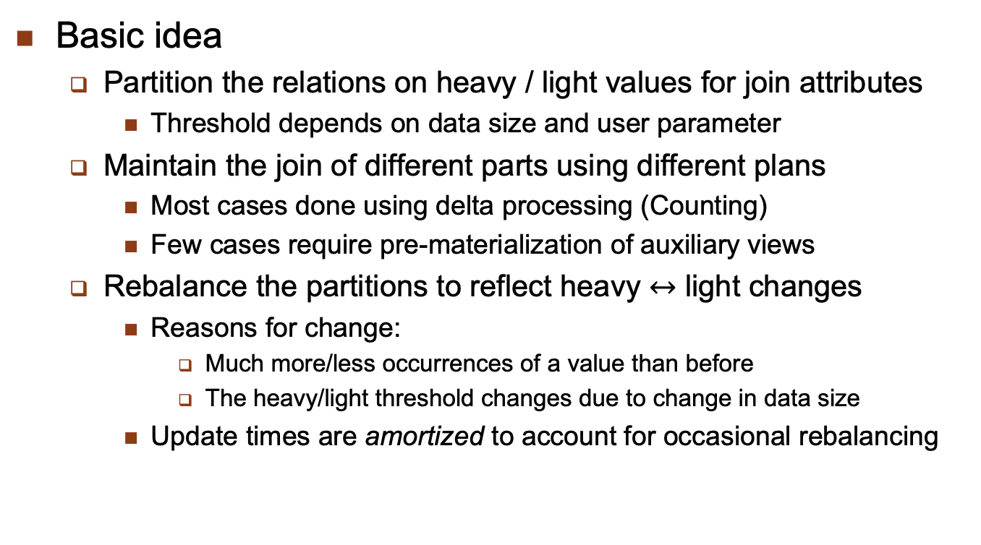
Exploiting Data Skew

Slide 24
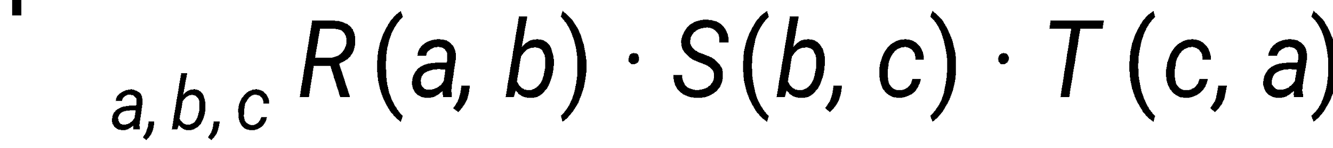
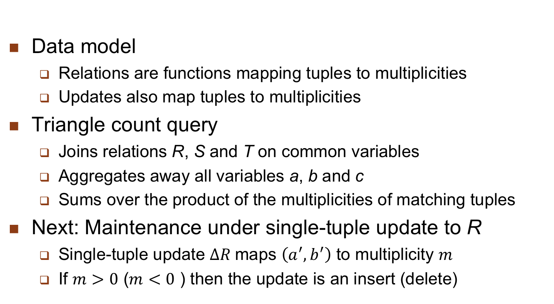
Example: Triangle Count

Slide 25
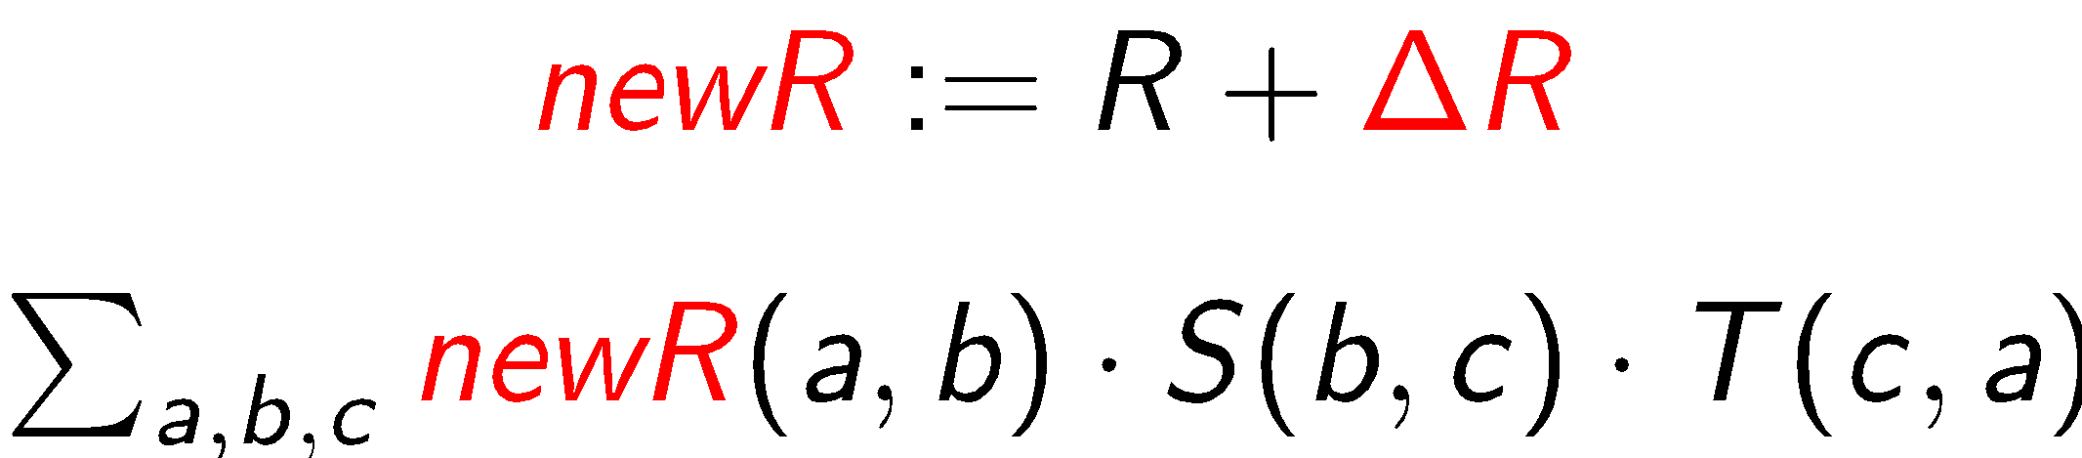
Naïve Maintenance for Triangle Count
Compute from scratch
Maintenance time: O(N^{1.5})
Assuming the input relations have size O(N)
Using existing worst-case optimal join algorithms
No extra space needed

Slide 26
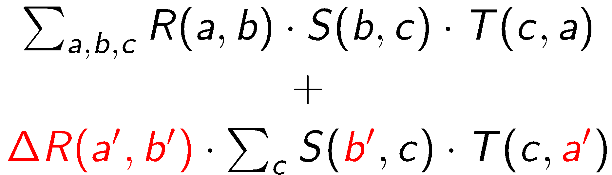
Delta Processing for Triangle Count
Compute the change
Maintenance time: O(N)
Intersect the set of c values paired with b’ in S and with a’ in T
No extra space needed

Slide 27
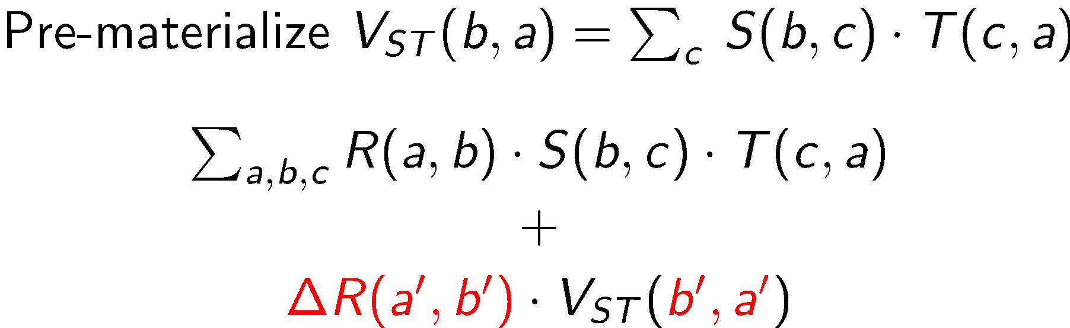
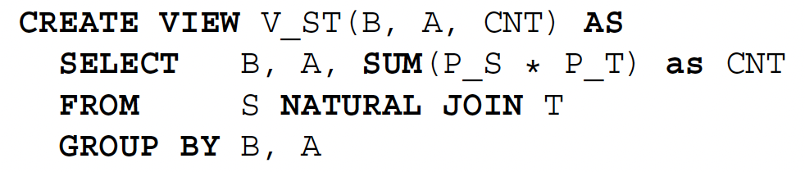
Materialized View for Triangle Count
Compute the change using materialized views
Maintenance time:
Updates to R: O(1) time to look up in V_{ST}
Updates to S and T: O(N) time to maintain V_{ST}
Extra O(N²) space needed for the view V_{ST}

Slide 28
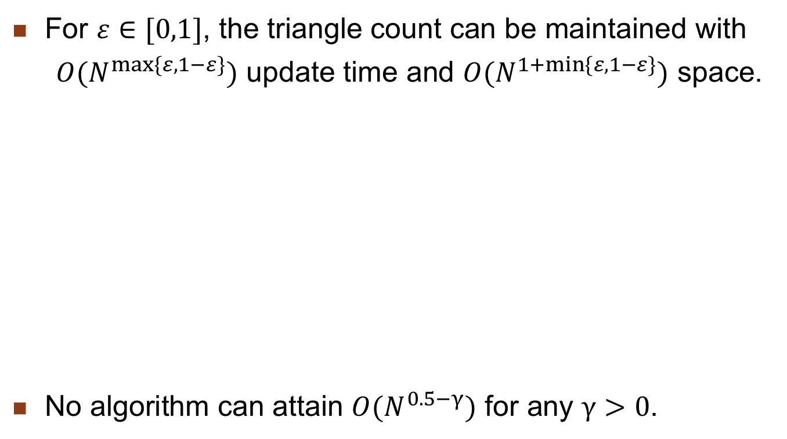
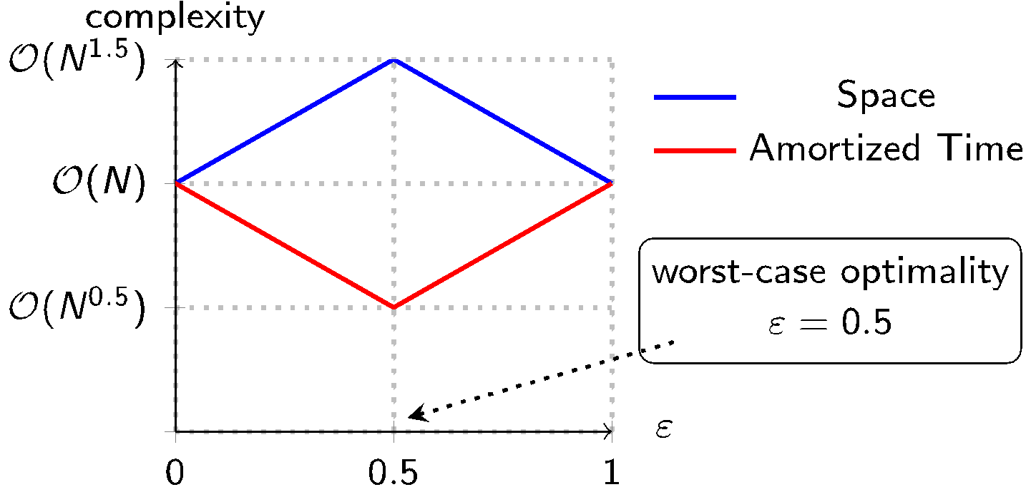
Data Skew for Triangle Count

Slide 29
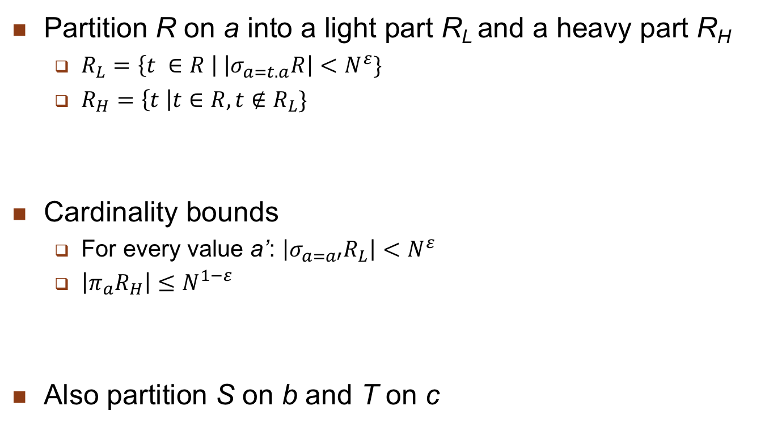
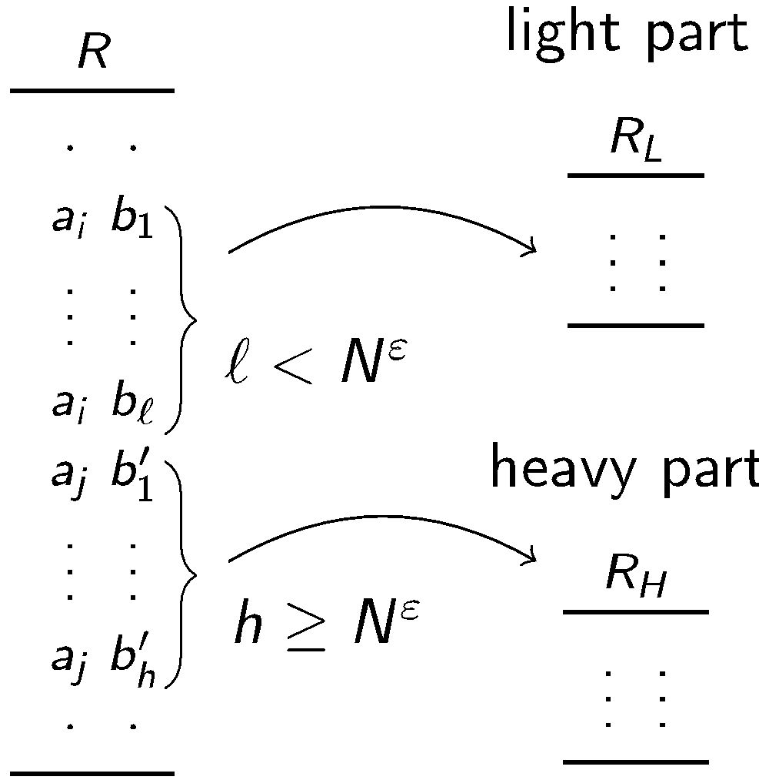
Heavy/Light Partitioning of Relations

Slide 30
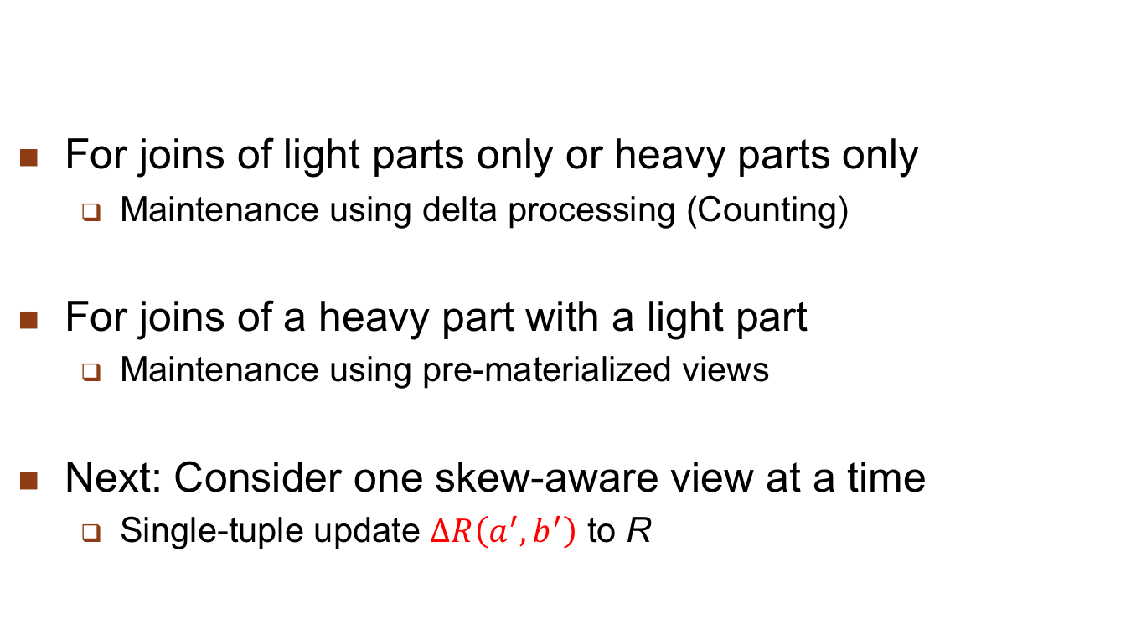
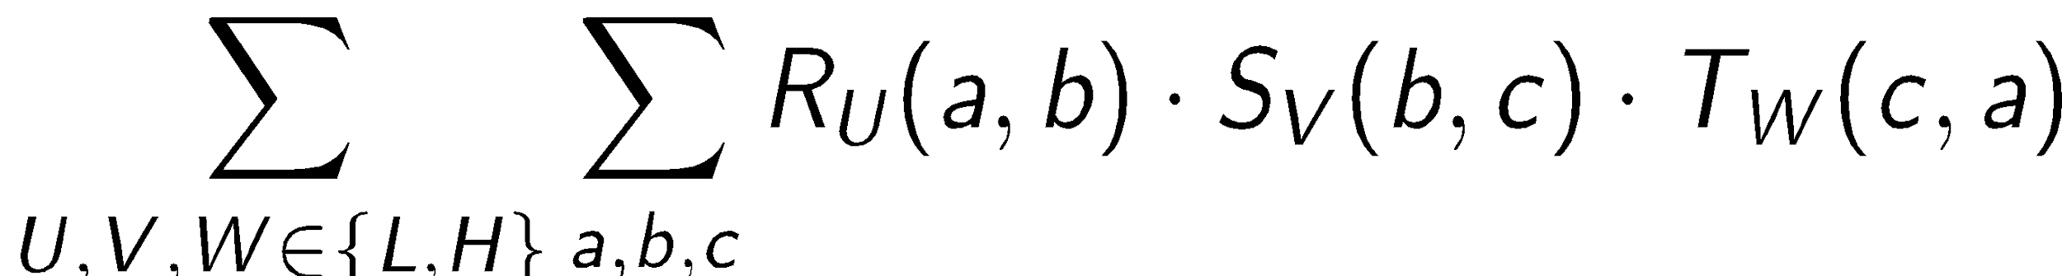
Maintenance for Skew-Aware Views

Slide 31
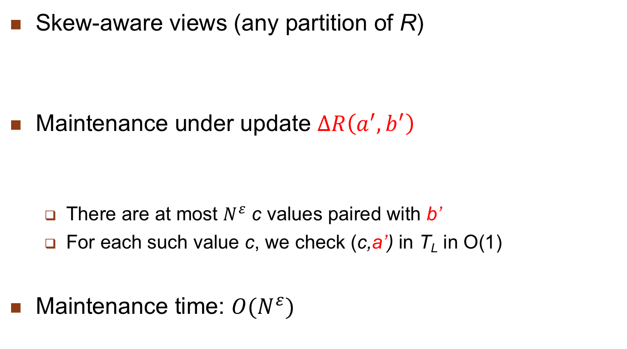
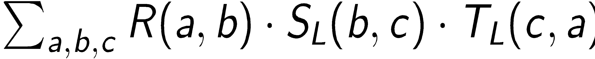
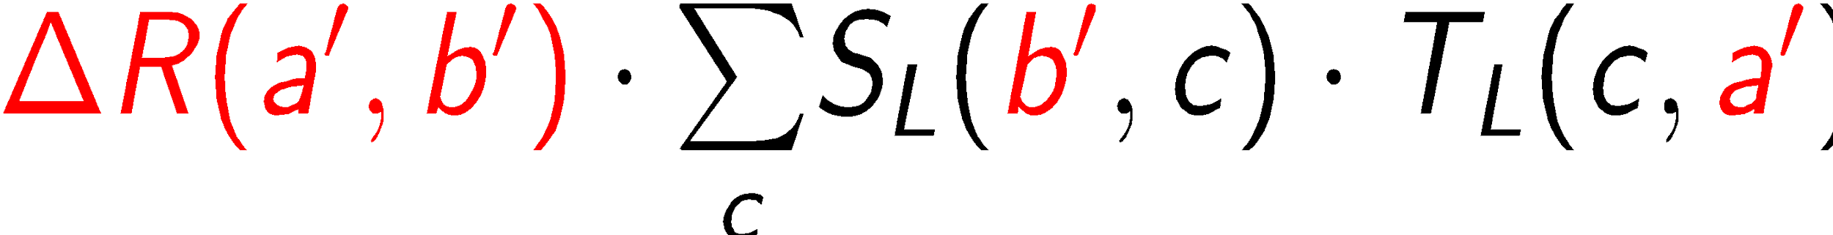
Case 1: Light-Light Interaction

Slide 32
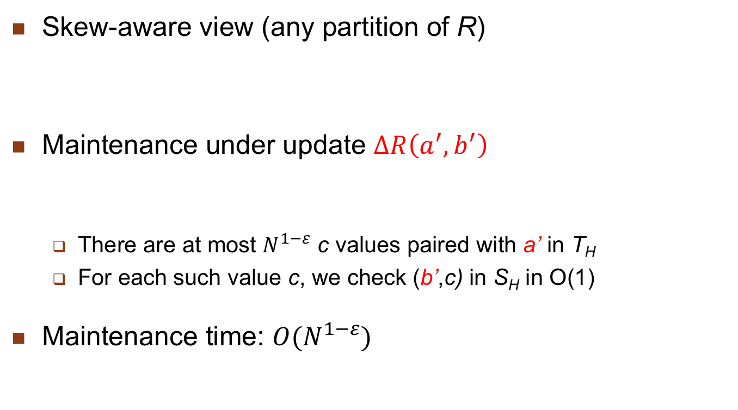
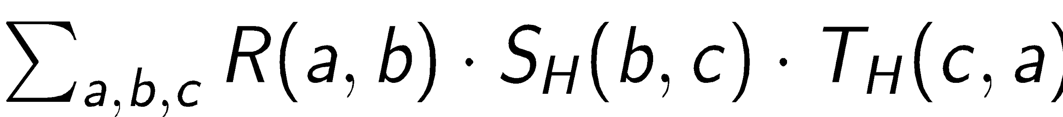
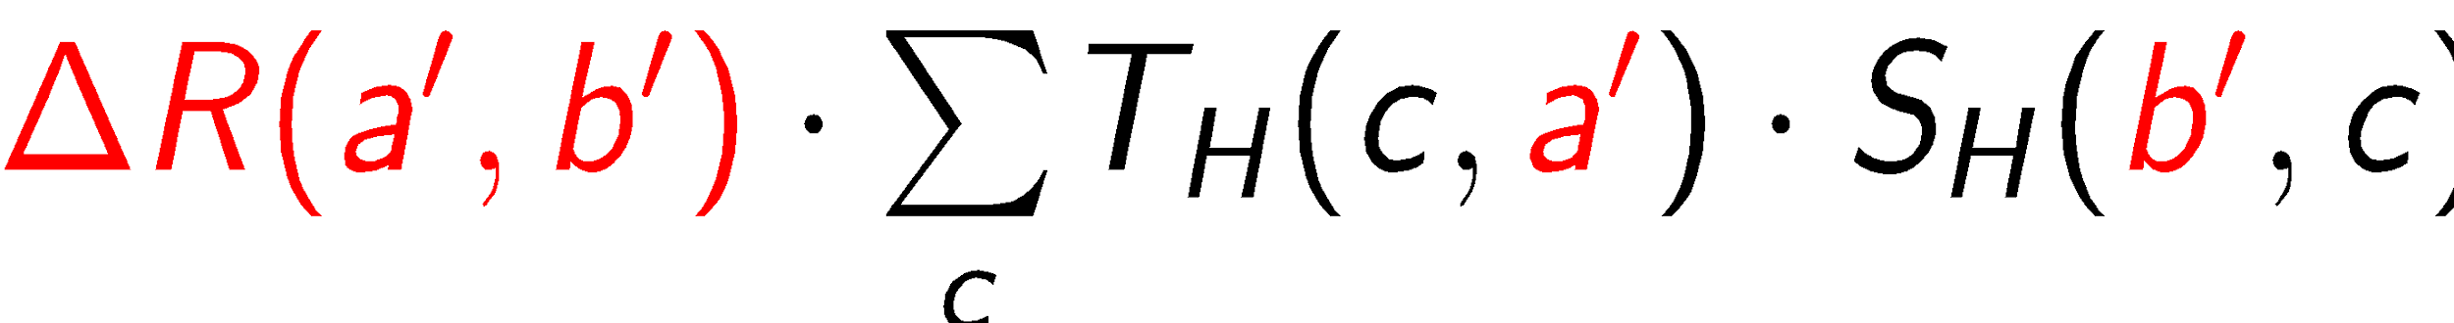
Case 2: Heavy-Heavy Interaction

Slide 33
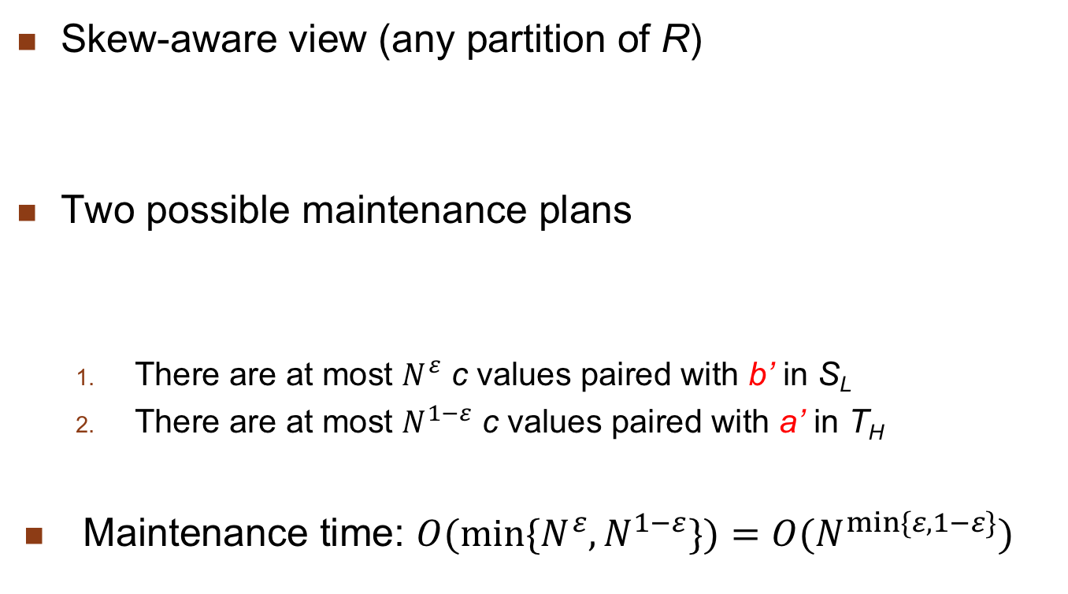
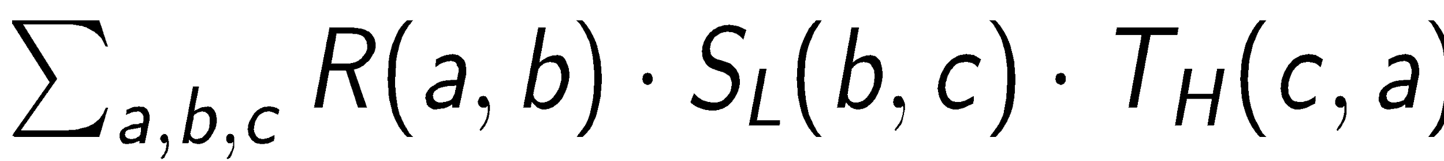
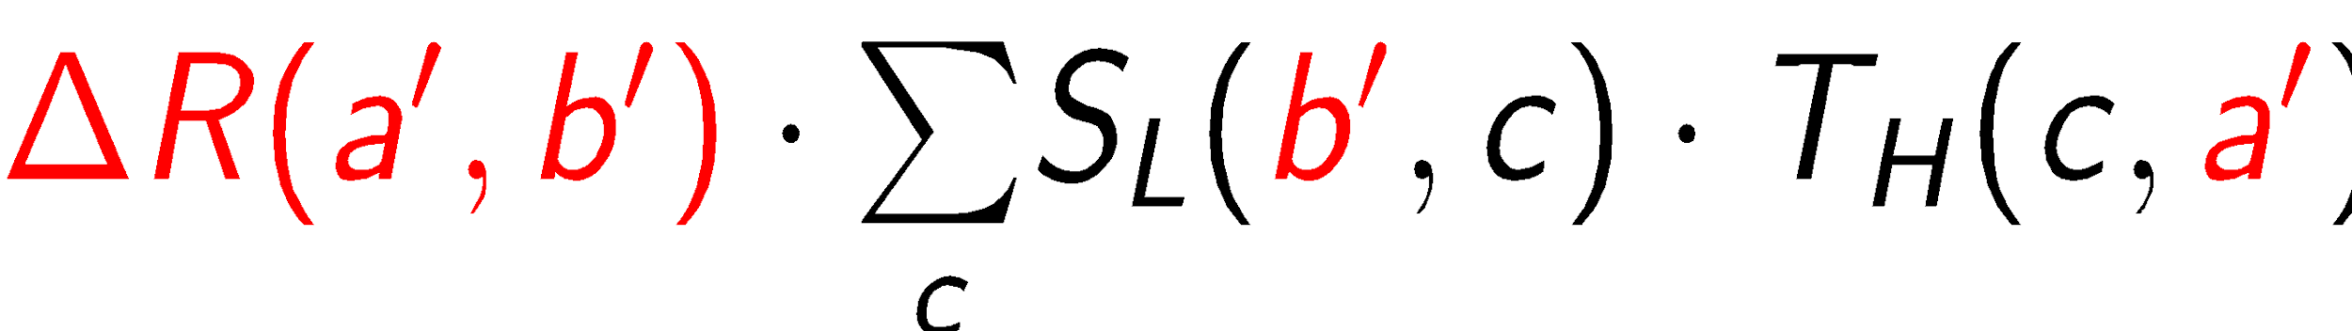
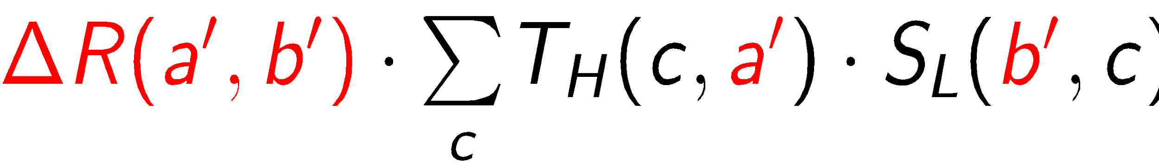
Case 3: Light-Heavy Interaction

Slide 34
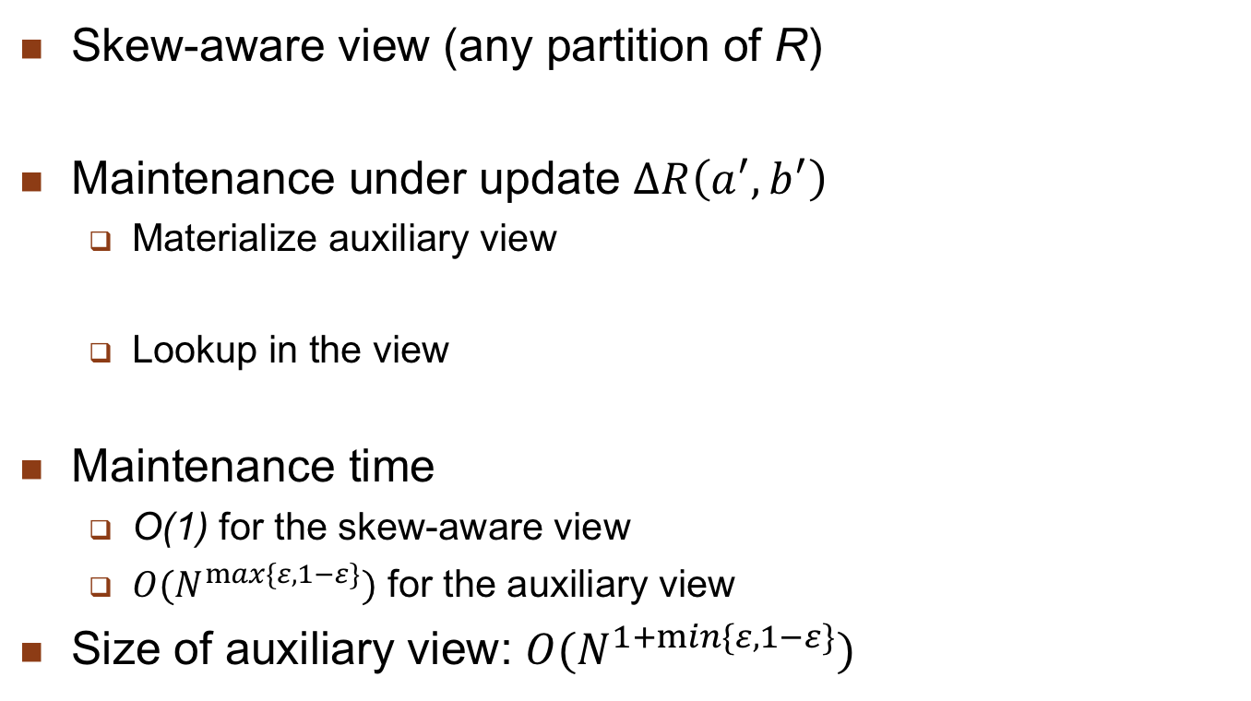
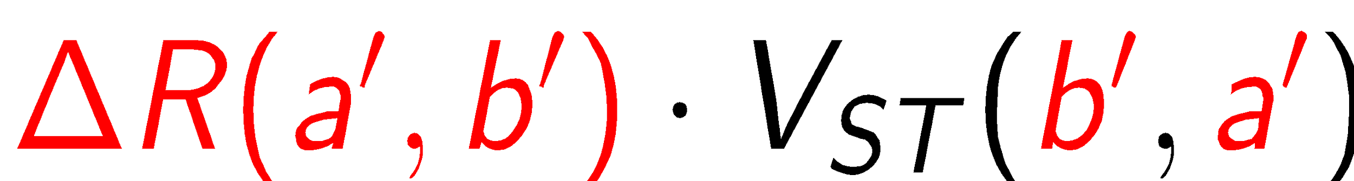
Case 4: Heavy-Light Interaction

Slide 35
View Self-maintainability
A view is self-maintainable if the base relations need not be accessed
Not the case for the Counting algorithm
Self-maintainability depends on views’ expressiveness
Most SPJ views are often self-maintainable wrt. deletion and modification, but not wrt. insertion
Example: a view V is self-maintainable wrt to deletion in R if the key of R is included in V

Slide 36
Outline
Distributed Data Control
View management
Data security
Semantic integrity control

Slide 37
Data Security
Data protection
Prevents the physical content of data to be understood by unauthorized users
Uses encryption/decryption techniques (Public key)
Access control
Only authorized users perform operations they are allowed to on database objects
Discretionary access control (DAC)
Long been provided by DBMS with authorization rules
Mandatory / Multilevel access control (MAC)
Increases security with security levels

Slide 38
Discretionary Access Control
Main actors
Subjects (users, groups of users) who execute operations
Operations (in queries or application programs)
Objects, on which operations are performed
Checking whether a subject may perform an op. on an object
Authorization= (subject, op. type, object def.)
Defined using GRANT OR REVOKE [The revoking process is complex as it must be recursive.]
Centralized: one single user class (admin.) may grant or revoke
Decentralized, with op. type GRANT
More flexible but recursive revoking process which needs the hierarchy of grants

Slide 39
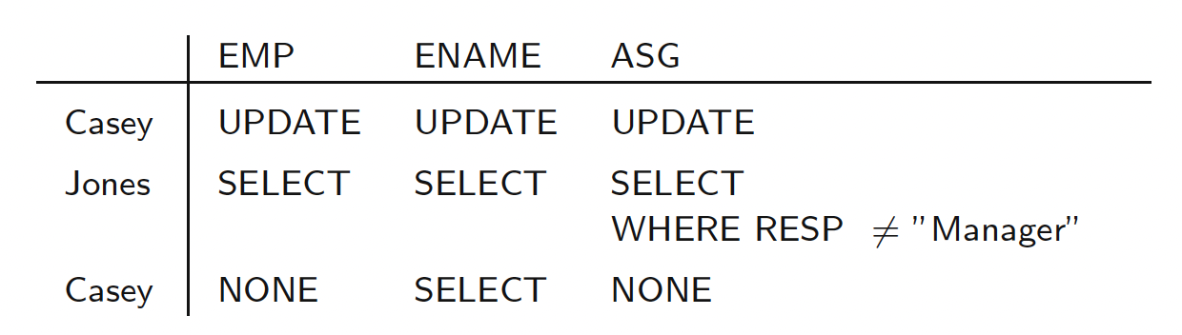
Discretionary Access Control
Authorization matrix:
Role-based access control (RBAC)

Slide 40
Problem with DAC
A malicious user can access unauthorized data through an authorized user
Example
User A has authorized access to R and S
User B has authorized access to S only
B somehow manages to modify an application program used by A so it writes R data in S
Then B can read unauthorized data (in S) without violating authorization rules
Solution: multilevel security based on the famous Bell and Lapuda model (MAC) for OS security

Slide 41
Multilevel Access Control
Different security levels (clearances)
Top Secret > Secret > Confidential > Unclassified
Access controlled by 2 rules:
No read up
subject S is allowed to read an object of level L only if level(S) ≥ L
Protect data from unauthorized disclosure, e.g. a subject with secret clearance cannot read top secret data
No write down:
subject S is allowed to write an object of level L only if level(S) ≤ L
Protect data from unauthorized change, e.g. a subject with top secret clearance can only write top secret data but not secret data (which could then contain top secret data)

Slide 42
MAC in Relational DB
A relation can be classified at different levels:
Relation: all tuples have the same clearance
Tuple: every tuple has a clearance
Attribute: every attribute has a clearance
A classified relation is thus multilevel
Appears differently (with different data) to subjects with different clearances

Slide 43
Example
PROJ*: classified at attribute level
PNO | SL1 | PNAME | SL2 | BUDGET | SL3 | LOC | SL4
P1 P2 P3 | C C S | Instrumentation DB Develop. CAD/CAM | C C S | 150000 135000 250000 | C S S | Montreal New York New York | C S S
PROJ* as seen by a subject with confidential clearance
PNO | SL1 | PNAME | SL2 | BUDGET | SL3 | LOC | SL4
P1 P2 | C C | Instrumentation DB Develop. | C C | 150000 Null | C C | Montreal Null | C C

Slide 44
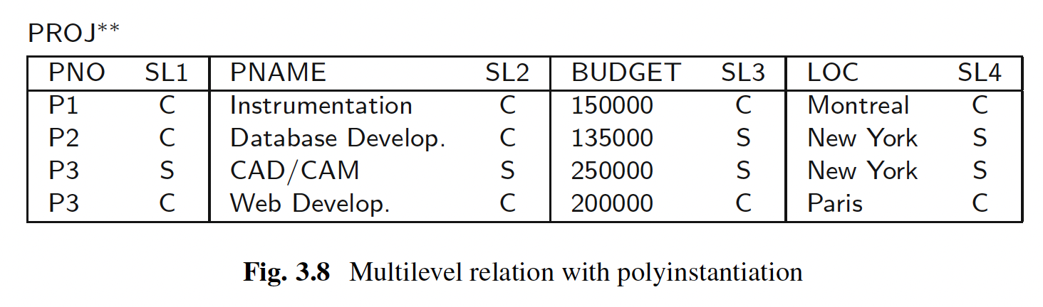
Example

Slide 45
Distributed Access Control
Remote user authentication is necessary since any site of a distributed DBMS
may accept programs initiated, and authorized, at remote sites. To prevent remote access by unauthorized users or applications, users must also be identified and authenticated at the accessed site. Three solutions are possible for managing authentication
Authentication information is maintained at a central site for global users which can then be authenticated only once and then accessed from multiple sites.
The information for authenticating users (user name and password) is replicated at all sites in the catalog. Local programs, initiated at a remote site, must also indicate the user name and password.
All sites of the distributed DBMS identify and authenticate themselves similar to the way users do. Intersite communication is thus protected by the use of the site password. Once the initiating site has been authenticated, there is no need for authenticating their remote users.

Slide 46
Distributed Access Control
Additional problems in a distributed environment
Remote user authentication
Typically using a directory service
Should be replicated at some sites for availability
Management of DAC rules
Problem if users’ group can span multiple sites
Rules stored at some directory based on user groups location
Accessing rules may incur remote queries
Covert channels in MAC

Slide 47
Covert Channels
Indirect means to access unauthorized data
Example
Consider a simple DDB with 2 sites: C (confidential) and S (secret)
Following the “no write down” rule, an update from a subject with secret clearance can only be sent to S
Following the “no read up” rule, a read query from the same subject can be sent to both C and S
But the query may contain secret information (e.g. in a select predicate), so is a potential covert channel
Solution: replicate part of the DB
So that a site at security level L contains all data that a subject at level L can access (e.g. S above would replicate the confidential data so it can entirely process secret queries)

Slide 48
Outline
Distributed Data Control
View management
Data security
Semantic integrity control

Slide 49
Semantic Integrity Control
Maintain database consistency by enforcing a set of constraints defined on the database.
Structural constraints
Basic semantic properties inherent to a data model e.g., unique key constraint in relational model
Behavioral constraints
Regulate application behavior, e.g., dependencies in the relational model
Two components
Integrity constraint specification
Integrity constraint enforcement

Slide 50
Semantic Integrity Control
Procedural
Control embedded in each application program
Declarative
Assertions in predicate calculus
Easy to define constraints
Definition of database consistency clear
But inefficient to check assertions for each update
Limit the search space
Decrease the number of data accesses/assertion
Preventive strategies
Checking at compile time

Slide 51
Semantic Integrity Control
Various solutions have been investigated to design an integrity manager by combining optimization strategies.
Limit the number of constraints that need to be enforced,
Decrease the number of data accesses to enforce a given constraint in the presence of an update transaction,
Define a preventive strategy that detect inconsistencies in a way that avoids undoing updates,
Perform as much integrity control as possible at compile time.

Slide 52
Constraint Specification Language
Predefined constraints
specify the more common constraints of the relational model
Not-null attribute
ENO NOT NULL IN EMP
Unique key
(ENO, PNO) UNIQUE IN ASG
Foreign key
A key in a relation R is a foreign key if it is a primary key of another relation S and the existence of any of its values in R is dependent upon the existence of the same value in S
PNO IN ASG REFERENCES PNO IN PROJ
Functional dependency
ENO IN EMP DETERMINES ENAME

Slide 53
Constraint Specification Language
Precompiled constraints
Express preconditions that must be satisfied by all tuples in a relation for a given update type
(INSERT, DELETE, MODIFY)
NEW - ranges over new tuples to be inserted
OLD - ranges over old tuples to be deleted
General Form
CHECK ON <relation> [WHEN <update type>] <qualification>

Slide 54
Constraint Specification Language
Precompiled constraints
Domain constraint
CHECK ON PROJ (BUDGET≥500000 AND BUDGET≤1000000)
Domain constraint on deletion
CHECK ON PROJ WHEN DELETE (BUDGET = 0)
Transition constraint
CHECK ON PROJ (NEW.BUDGET > OLD.BUDGET AND NEW.PNO = OLD.PNO)

Slide 55
Constraint Specification Language
General constraints
Constraints that must always be true. Formulae of tuple relational calculus where all variables are quantified.
General Form
CHECK ON <variable>:<relation>,(<qualification>)
Functional dependency
CHECK ON e1:EMP, e2:EMP
(e1.ENAME = e2.ENAME IF e1.ENO = e2.ENO)
Constraint with aggregate function
CHECK ON g:ASG, j:PROJ
(SUM(g.DUR WHERE g.PNO = j.PNO) < 100 IF
j.PNAME = "CAD/CAM")

Slide 56
Integrity Enforcement
Two methods
Detection
Execute update u: D → D_{u}
If D_{u} is inconsistent then
if possible: compensate D_{u} → D_{u}’
else
undo D_{u} → D
Preventive
Execute u: D → D_{u} only if D_{u} will be consistent
Determine valid programs
Determine valid states

Slide 57
Query Modification
Preventive
Add the assertion qualification to the update query
Only applicable to tuple calculus formulae with universally quantified variables
UPDATE PROJ
SET BUDGET = BUDGET*1.1
WHERE PNAME = "CAD/CAM"
UPDATE PROJ
SET BUDGET = BUDGET*1.1
WHERE PNAME = "CAD/CAM"
AND NEW.BUDGET ≥ 500000
AND NEW.BUDGET ≤ 1000000

Slide 58
Compiled Assertions
Triple (R,T,C) where
R relation
T update type (insert, delete, modify)
C assertion on differential relations
Example: Foreign key assertion
∀g ∈ ASG, ∃j ∈ PROJ : g.PNO = j.PNO
Compiled assertions:
(ASG, INSERT, C1), (PROJ, DELETE, C2), (PROJ, MODIFY, C3)
where
C1:∀NEW ∈ ASG+ ∃j ∈ PROJ: NEW.PNO = j.PNO
C2:∀g ∈ ASG, ∀OLD ∈ PROJ⁻ : g.PNO ≠ OLD.PNO
C3:∀g ∈ ASG, ∀OLD ∈ PROJ⁻ ∃NEW ∈ PROJ⁺:
g.PNO ≠OLD.PNO OR OLD.PNO = NEW.PNO

Slide 59
Differential Relations
Given relation R and update u
R⁺ contains tuples inserted by u
R⁻ contains tuples deleted by u
Type of u
insert R⁻ empty
delete R⁺ empty
modify R⁺ ∪ (R – R⁻)

Slide 60
Differential Relations
Algorithm:
Input: Relation R, update u, compiled assertion C_{i}
Step 1: Generate differential relations R⁺ and R–
Step 2: Retrieve the tuples of R⁺ and R– which do not satisfy C_{i}
Step 3: If retrieval is not successful, then the assertion is valid.
Example :
u is delete on J. Enforcing (EMP, DELETE, C2) :
retrieve all tuples of EMP⁻
into RESULT
where not(C2)
If RESULT = {}, the assertion is verified

Slide 61
Distributed Integrity Control
Problems:
Definition of constraints
Consideration for fragments
Where to store
Replication
Non-replicated : fragments
Enforcement
Minimize costs

Slide 62
Distributed Integrity Control
Compile Time Validation:
Read-lock the SI-related data items at SIS sites.
These sites either evaluate SI and send the result to the control site or they send data to the control site, which does the SI validation.
If a transaction violates SI, then reject that transaction and terminate it. Otherwise, continue to step 4.
Lock data items at (Wonly + RW + Ronly) sites and execute the transaction. Note that requests to lock and commands to execute are piggybacked when the originating site sends a message to a remote site. This eliminates the need for multiple communications to the same site.
Unlock data items at the sites where successful transactions have committed.

Slide 63
Distributed Integrity Control
Run Time Validation:
Read-lock all SI-related data items at SIS sites, read-lock data items for read-only at Ronly sites, and write-lock data items to read and write at RW sites.
Read, compute, and generate final values to write at RW and Wonly sites.
Read SI-related data items or ask for the results of validation from SIS sites.
If there is a violation, then reject the transaction and unlock by sending messages and terminating the transaction; otherwise, continue to Step 5.
Lock at Wonly sites and execute updates/commit for all successful transactions.
Unlock at sites for successful transactions and terminate.

Slide 64
Distributed Integrity Control
Postexecution Time Validation:
Read-lock data items to read at Ronly sites.
Write-lock data items to write or to read and write at Wonly and RW sites.
Compute new values to be written.
Send new values to the site where they need to be written at Wonly and RW sites.
Send read-lock messages to lock SI-related data items at SIS sites; ask them to send SI-related data items back or the results of their validation to the control site.
If a transaction fails validation, then send reject messages to all the sites at which the transaction has written, to undo the work.
Unlock the sites at which data items were locked and terminate.

Slide 65
Types of Distributed Assertions
Individual assertions
Single relation, single variable
Domain constraint
Set oriented assertions
Single relation, multi-variable
functional dependency
Multi-relation, multi-variable
foreign key
Assertions involving aggregates

Slide 66
Distributed Integrity Control
Assertion Definition
Similar to the centralized techniques
Transform the assertions to compiled assertions
Assertion Storage
Individual assertions
One relation, only fragments
At each fragment site, check for compatibility
If compatible, store; otherwise reject
If all the sites reject, globally reject
Set-oriented assertions
Involves joins (between fragments or relations)
May be necessary to perform joins to check for compatibility
Store if compatible

Slide 67
Distributed Integrity Control
Assertion Enforcement
Where to enforce each assertion depends on
Type of assertion
Type of update and where update is issued
Individual Assertions
If update = insert
Enforce at the site where the update is issued
If update = qualified
Send the assertions to all the sites involved
Execute the qualification to obtain R⁺ and R⁻
Each site enforces its own assertion
Set-oriented Assertions
Single relation
Similar to individual assertions with qualified updates
Multi-relation
Move data to perform joins; then send the result to query master site

Slide 68
Conclusion
Solutions initially designed for centralized systems have been significantly extended for distributed systems
Materialized views and group-based discretionary access control
Semantic integrity control has received less attention and is generally not well supported by distributed DBMS products
Full data control is more complex and costly in distributed systems
Definition and storage of the rules (site selection)
Design of enforcement algorithms which minimize communication costs

