Slide 1
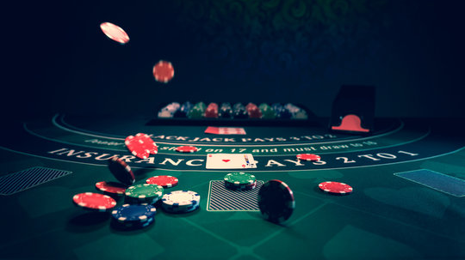
Blackjack Card Counting
Developed by Team FourThorp

Slide 2
Overview
Introduction
Demonstration
Changes
Questions & Answers

Slide 3

Team FourThorp
Robert Hallanger – Project Manager
Matthew Fuentes – Developer
Kelton Jasper – Tester
Ryan Vrbetta - Developer

Slide 4
DEMO
Running Count
True Count = R/D
Tool to inform

Slide 5
Change History
Poker
Image Analysis

Slide 6
Ryan – Q&A
Why FourThorp – Edward Thorp is one of the most notable individuals when it came to the invention of the Hi-Lo card counting system.
How does the grid system work in your code? It works like a spreadsheet; I used a loop with modulo math (I % 4 and I // 4) to dynamically calculate the row and column for each card button, which turns a flat list of cards into a 4-column keypad.
Why did you use a class app: for the GUI? Because the dashboard is the size it is, it was easier and faster to use a functional approach by using a global state variable instead.
Why do you recalculate the hand total from scratch every time? Because aces are dynamic, meaning their number isn't stuck to one value. If I just added points, a hand like A, 10, 6 begins to complicate things a bit, so I figured it was safer and bug free to recalculate the total from the list of cards each time the UI updates.

Slide 7
Ryan – Q&A (cont.)
Why use partial in the button loop? Can’t you just call the function normally? No, because when I call “command=click(rank)” it would start the function as soon as you start the app, which is not intended. Partial freezes the argument specified onto a specific button, so that a King will remember it’s a King for example.
How does the correction feature work? It makes a reversable logic flow. When the "Remove" toggle is active, the math changes from to +1 to –1. It also checks if the card exists in the hand list before trying to remove it to prevent crashes.

