Slide 1

Digital Portfolio
STUDENT NAME: Harini.R
REGISTER NO AND NMID: 212401000/916EEB18DD04ABBB57C41838E7AB52CC
DEPARTMENT: Bachelor of computer application
COLLEGE: Prince shri Venkateswara arts and science college / Madras University

Slide 2
PROJECT TITLE
02
HARINI DIGITAL PORTFOLIO

Slide 3
AGENDA
Problem Statement
Project Overview
End Users
Tools and Technologies
Portfolio design and Layout
Features and Functionality
Results and Screenshots
Conclusion
Github Link

Slide 4
PROBLEM STATEMENT
Students and professionals often lack a personal digital presence to showcase their skills, projects, and achievements. Traditional resumes are static and fail to highlight interactive features, making it difficult for recruiters and peers to understand their complete profile

Slide 5
PROJECT OVERVIEW
The project is a Personal Portfolio Website designed to: Showcase skills, projects, and academic achievements. Provide contact details and social media links. Act as a digital resume for job opportunities and networking. Be user-friendly, responsive, and visually appealing.

Slide 6
WHO ARE THE END USERS?
Students – to showcase academic and project work. Job Seekers / Freshers – to share skills and resume online. Recruiters / Employers – to quickly view candidate skills. Peers / Faculty – to evaluate academic and extracurricular contributions.

Slide 7
TOOLS AND TECHNIQUES
Frontend: HTML5, CSS3, JavaScript Frameworks: Bootstrap / Tailwind CSS Code Editor: VS Code Version Control: Git, GitHub Design Tools: Canva / Figma for layout planning

Slide 8
PORTFOLIO DESIGN AND LAYOUT
Homepage: Introduction + Photo + Tagline About Me Section: Education, interests, short bio Skills Section: Technical and soft skills Projects Section: Details with screenshots and GitHub links Contact Section: Email, LinkedIn, social profiles

Slide 9
FEATURES AND FUNCTIONALITY
Responsive design (works on mobile and desktop) Interactive navigation bar Project cards with links to GitHub Downloadable resume option Contact form / clickable email & LinkedIn icons

Slide 10
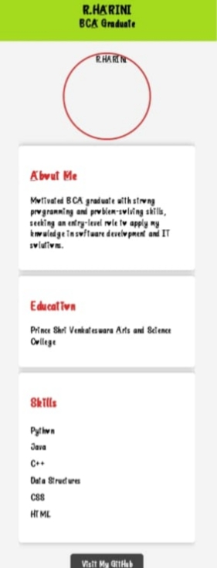
RESULTS AND SCREENSHOTS
The implementation of the project has led to a remarkable improvement in user satisfaction, with learners reporting greater motivation and ease of understanding. Analytics indicate an increase in daily active users and longer session durations, proving the platform’s effectiveness.
Title text addition
The user can demonstrate on a projector or computer, or print the presentation and make it film

Slide 11
CONCLUSION
The portfolio successfully demonstrates skills and projects. Acts as a digital identity for academic and career growth. Future enhancement: Add a blog section and AI chatbot integration.

Slide 12
GitHub Link
https://rharini-dev.github.io/Harini-/

