Slide 1
Option 2: Interior Design Generation Controlled Image Generation using Stable Diffusion
Ruixuan Hou

Slide 2
Contents
Scenario: Interior Design Generation
Generate interior design images from structured inputs
Focus on control, consistency, and realism
Inspired by real-world applications (e.g., IKEA design tools)
Demo & Repository:
Demo Video: https://umsystem.hosted.panopto.com/Panopto/Pages/Viewer.aspx?id=3274e490-82d4-4057-b307-b43101531832
GitHub: https://github.com/RHou02/Quiz3_Option2

Slide 3
Data Source
Synthetic structured data is used
Attributes include:
• Room type
• Style
• Color
• Lighting
Inspired by huggingface/diffusers

Slide 4
Methodology:
Input: structured room data
👇
Convert data into prompts
Generate images
👇
using Stable Diffusion
Compare baseline vs improved prompts

Slide 5
Stable Diffusion Pipeline
• Model: Stable Diffusion v1.5
• Framework: Diffusers
• Process:
Text prompt → latent space → image generation

Slide 6
Prompt Design
Baseline prompt:
Simple text (e.g., “living room”)
Improved prompt:
Structured template:
• Style + Color + Room Type + Lighting
• Example: “A modern white living room with soft lighting”

Slide 7
Control Strategy
• Structured prompts
• Negative prompts:
“not quite fit the description”, low quality, cluttered
• Goal: Improve control and reduce noise

Slide 8
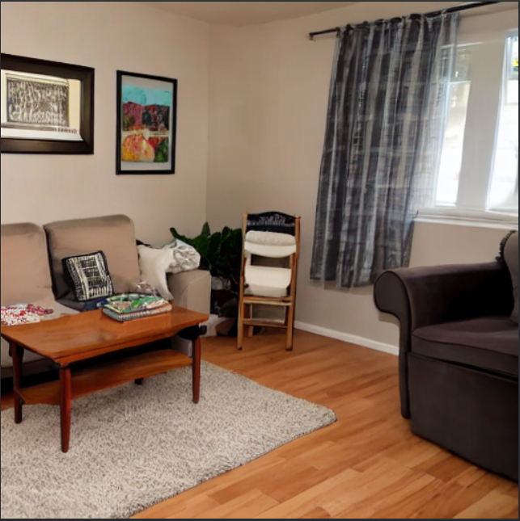
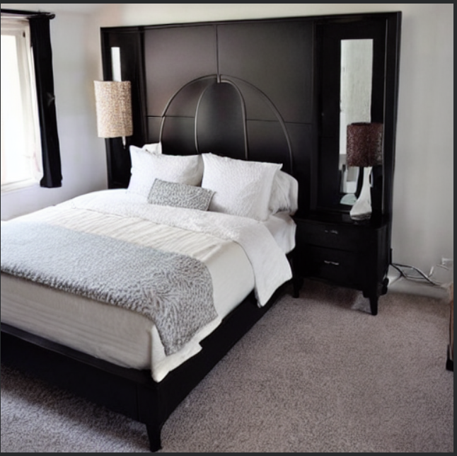
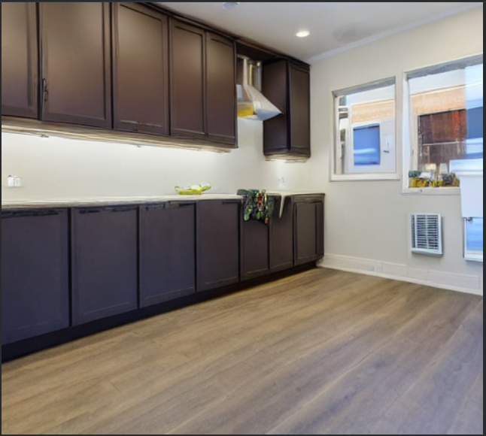
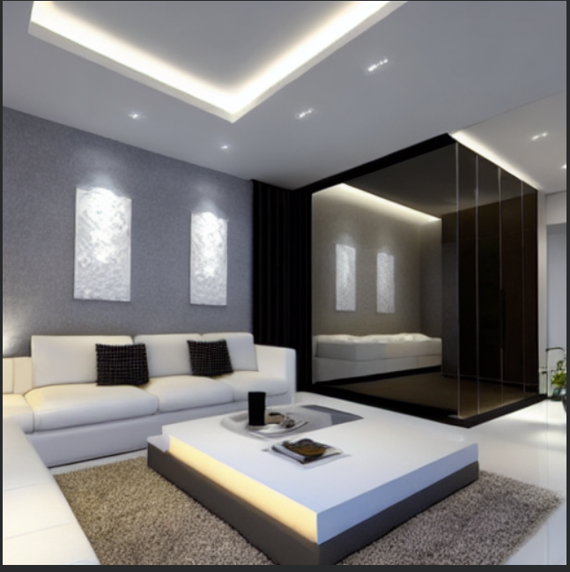
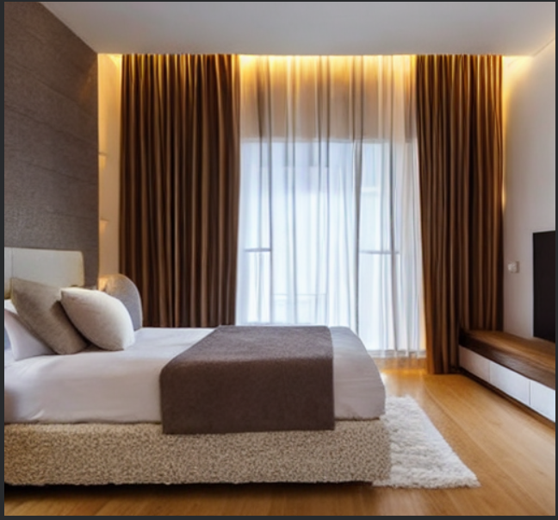
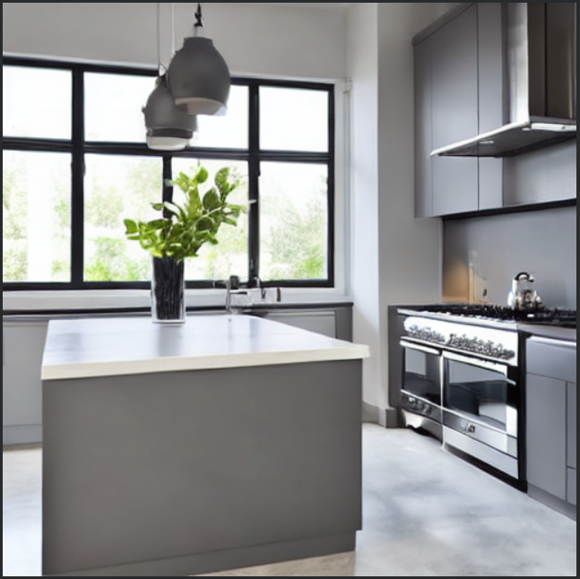
Results
Baseline(1st row) vs Improved comparison(2nd row) (Multiple room types:• Living room• Bedroom• Kitchen)
Living room
Bedroom
Kitchen

Slide 9
Evaluation
Prompt Alignment:
Improved prompts better match descriptions
Quality:
Similar sharpness across both methods
Consistency:
More stable layout and style
Diversity:
Different rooms show clear variation

Slide 10
Findings & Insights
• Structured prompts improve semantic alignment
• Negative prompts reduce noise
• Improved prompts produce more consistent layouts
• Prompt engineering improves control, not resolution
Limitations:
• Limited control over fine details
• Image quality depends on model capability
• Prompt tuning requires manual effort

Slide 11
Tools & Technologies
Python
• Stable Diffusion
• Diffusers
• Google Colab
• ChatGPT (for code assistance)

Slide 12


