Slide 1
PodSupervisor Are your pods sleeping?
Glenn West
gwest@redhat.com
Sep 27, 2022

Slide 2
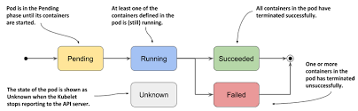
Issue
In a highly redundant OpenShift environment – Fail Fast is important to uptime of applications.
OpenShift “kills” pods on not-ready node when node reboots. In addition, Nodes marked un-scheduable should also be avoided for better uptime.

Slide 3
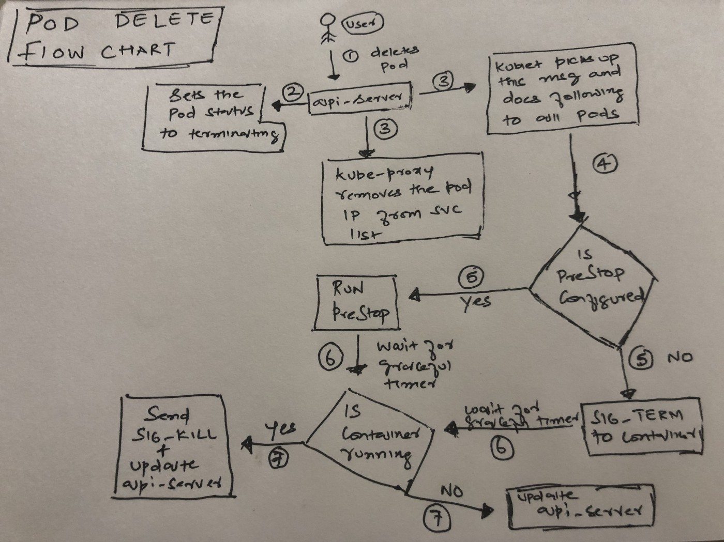
Solution
A new monitor script that watches all nodes for not-ready or un-schedeable are cleaned up of all non-system pods
Non-system pods do not have “openshift-” in there namespace/project name.

Slide 4
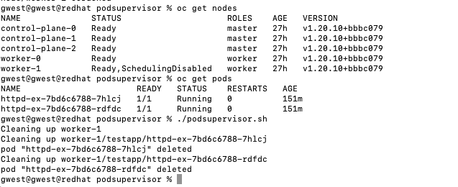
Example
Node is marked un-scheduable
Script is run
Two pods are deleted

Slide 5
Result
Pods have moved to worker-0, as the worker-1 is un-scheduable.
No system/openshift pods were touched or harmed.

Slide 6
Things to add/Enhancements
AvoidList for things like operators or other infra components
State Transition Support – Wait till node is ready once before processing
Event/Notification/Logging
Kill coredns service if exists
Migrate from cronjob to static pod
Wait two cycles of not-ready to trigger

Slide 7
Source
Upstream source:
https://github.com/glennswest/podsupervisor

