Slide 1
PodSupervisor Are your pods sleeping?
Glenn West
gwest@redhat.com
Sep 30, 2022 10:31

Slide 2
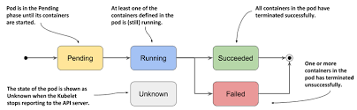
Issue
In a highly redundant OpenShift environment – Fail Fast is important to uptime of applications.
Script “kills” pods on not-ready node and pod will be rescheduled as its settings dictate.

Slide 3
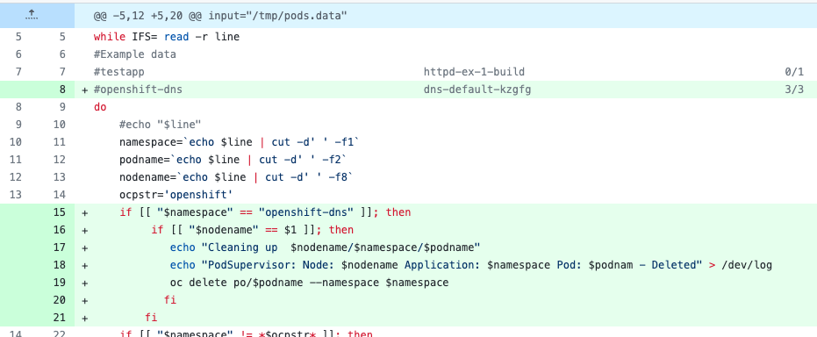
Solution
A new monitor script that watches all nodes for not-ready then cleans up selected pods
Pods may be selected list of names or wildcards
Pods may be avoided by list of names or wildcard
Script auto suspends during upgrades
Default settings watch dns pods.

Slide 4
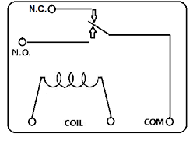

Additional Features
Node flapping detection
Node must be not ready two scans
On pod deletion, alerts are sent to OpenShift Alert Manager.

Slide 5
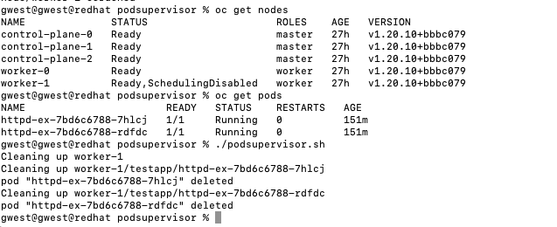
Example
Node is marked
Script is run
Two pods are deleted

Slide 6
Result
Pods have moved to worker-0.
No system/openshift pods were touched or harmed.

Slide 7
Source
Upstream source:
https://github.com/glennswest/podsupervisor

