Slide 1

Notes:
Speaker notes: This is a short talk about the catalogue service in the Eltariff-API project. Heads-up for the audience: the API is still in a development phase — not legally binding, used at your own risk, no obligations for grid operators unless stated (README disclaimer).

Slide 2
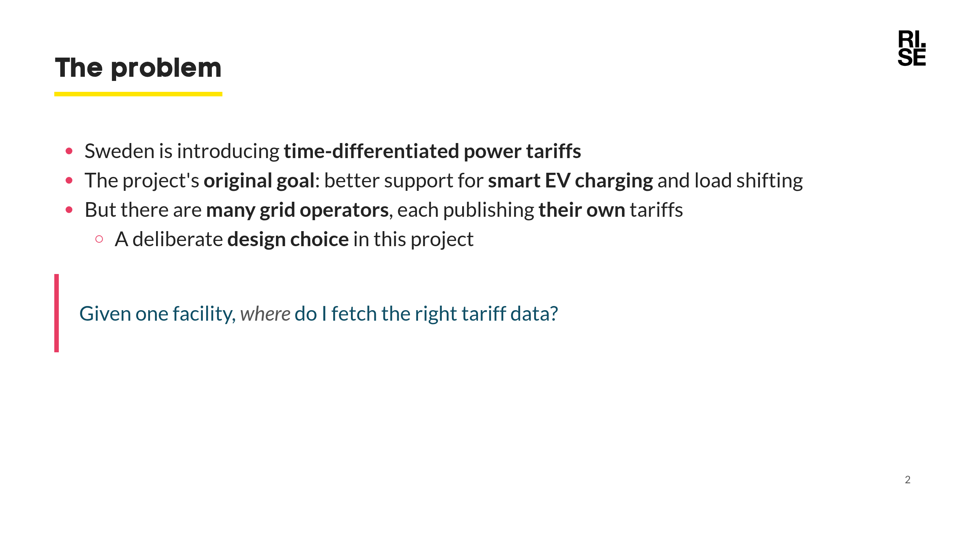
Notes:
Smart charging was the original motivation for this project — making tariff data machine-readable so charging can shift to cheaper / lower-load hours. Letting each operator publish its own tariffs (rather than a central store) was a deliberate design choice. Without a shared index, a client would have to know every operator's API by heart — that discovery problem is exactly what the catalogue solves.

Slide 3
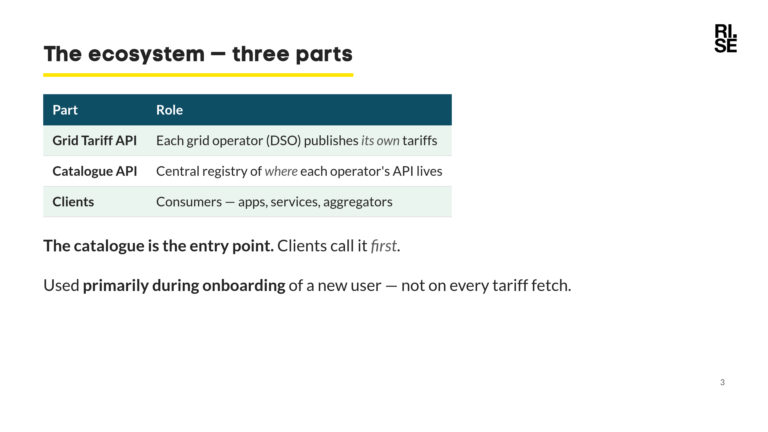
Notes:
Source: the onboarding doc, "Översikt av systemet". Three independent components; the catalogue is the glue that ties operators and clients together. The lookup typically happens once, when a new user/facility is set up; the result is then reused, so the catalogue is not hit on every tariff request.

Slide 4
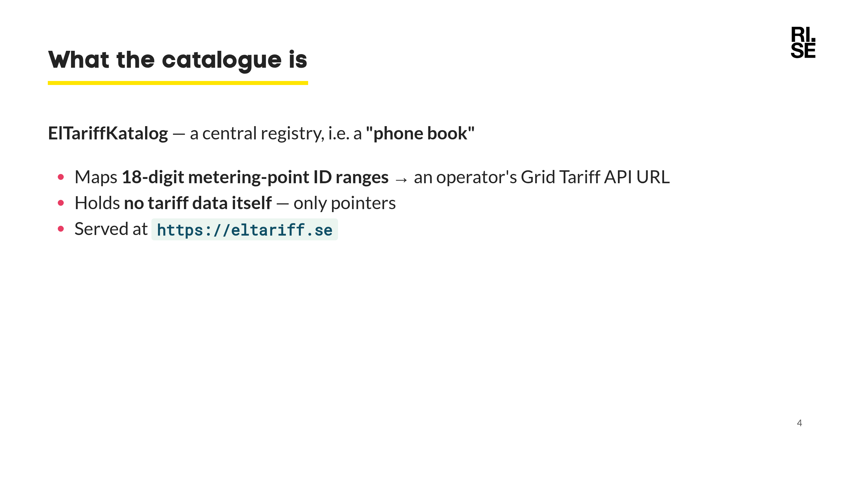
Notes:
Key mental model: the catalogue does NOT store tariffs. It stores "for these facility IDs, go talk to this operator's API at this URL". Lightweight by design. The entry format echoes Norway's static gridcompany-mapping file (on GitHub), but Norway has no catalogue *service* — this catalogue is a new Swedish addition.

Slide 5
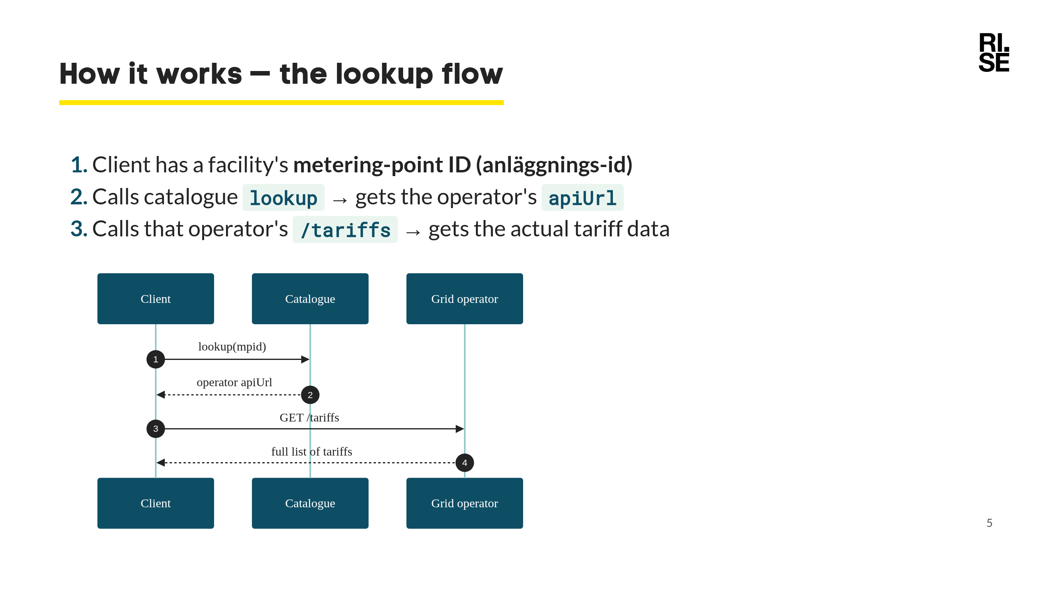
Notes:
Walk the diagram left to right. The catalogue is a one-time redirection step; after that the client talks directly to the operator. This keeps the catalogue small and the tariff data authoritative at the source.

Slide 6
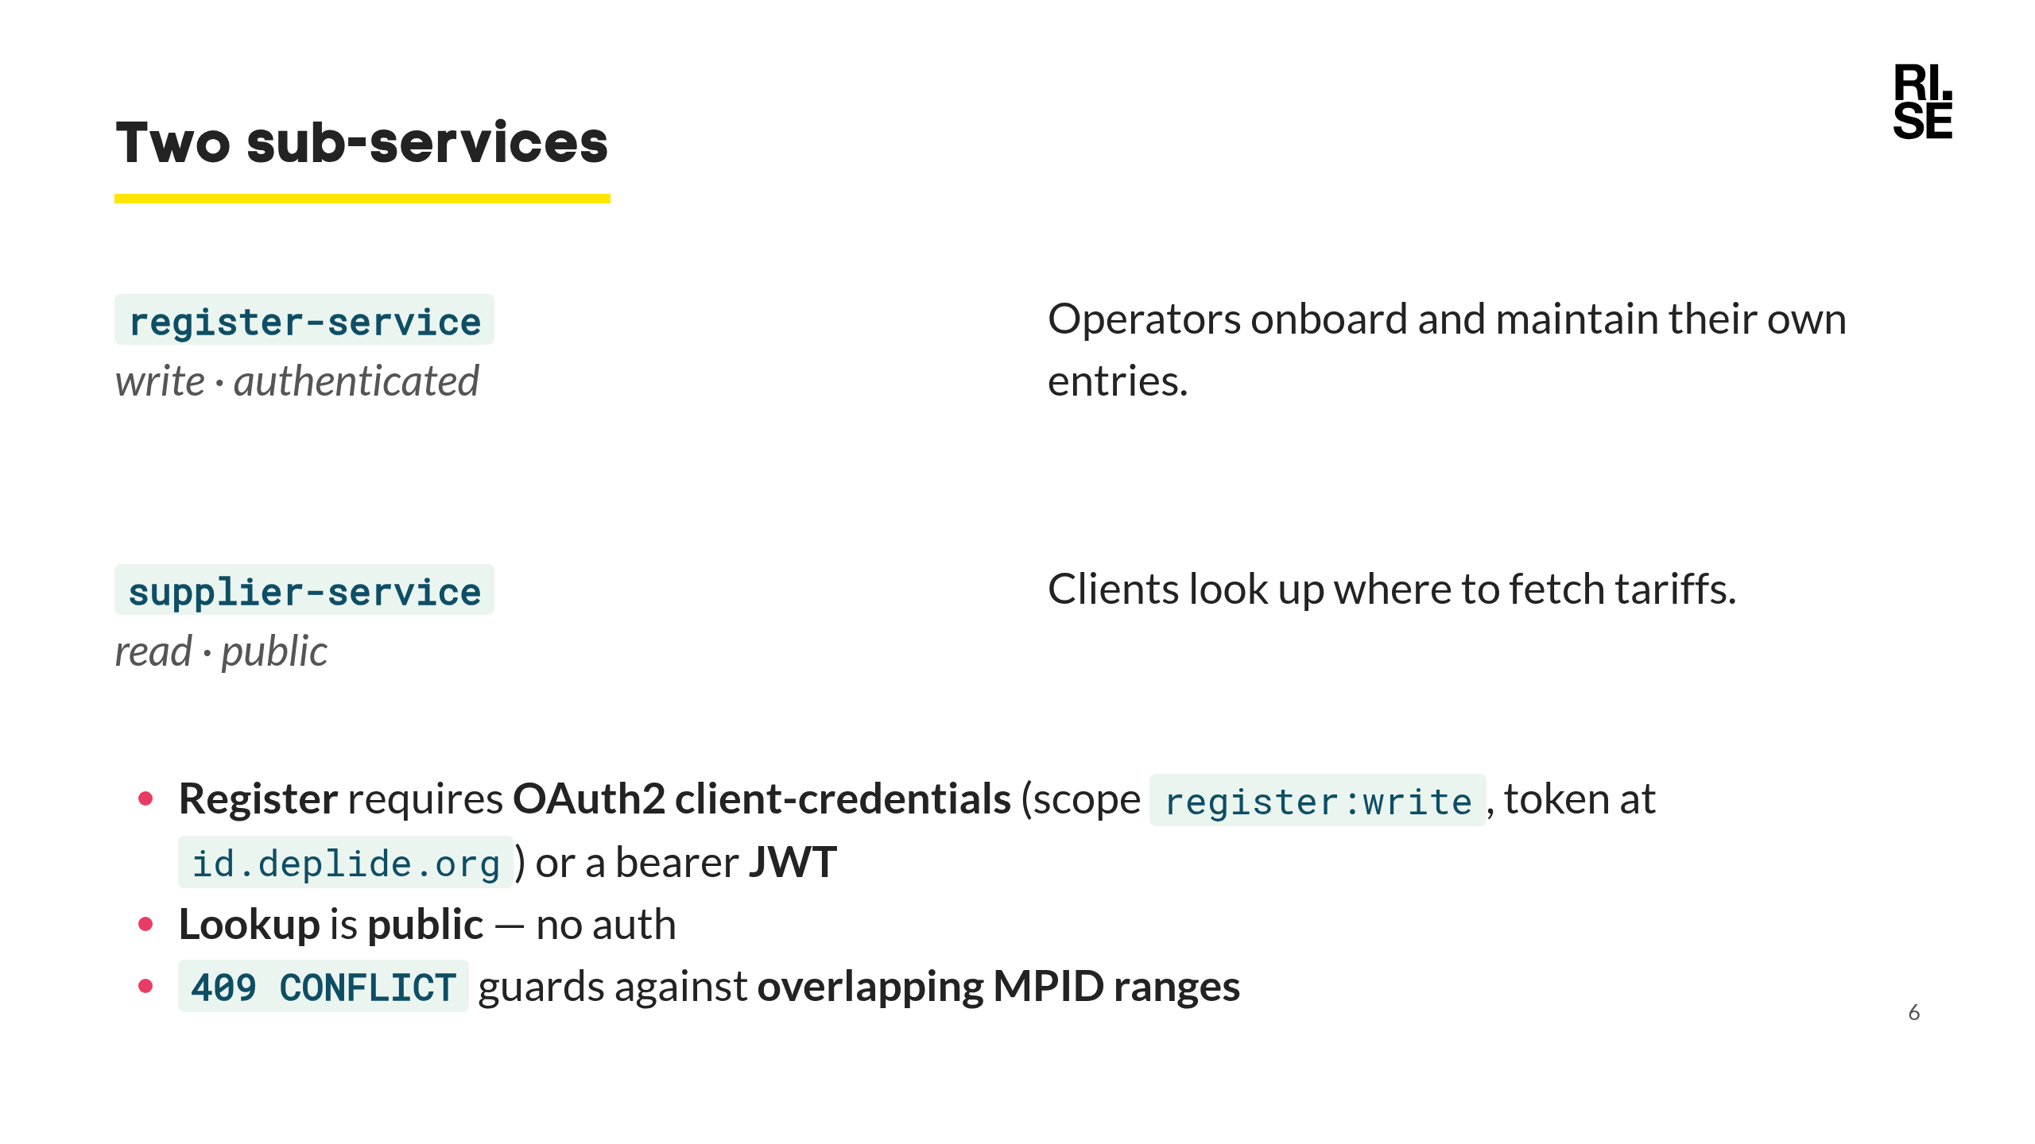
Notes:
Defined as OpenAPI tags in catalogueapi.json. Clean split: writing requires auth, reading is open so any client can discover operators freely. The conflict check is a real domain constraint: two operators must not both claim the same facility ID. Auth details in AUTHENTICATION.md / catalogueapi.json.

Slide 7
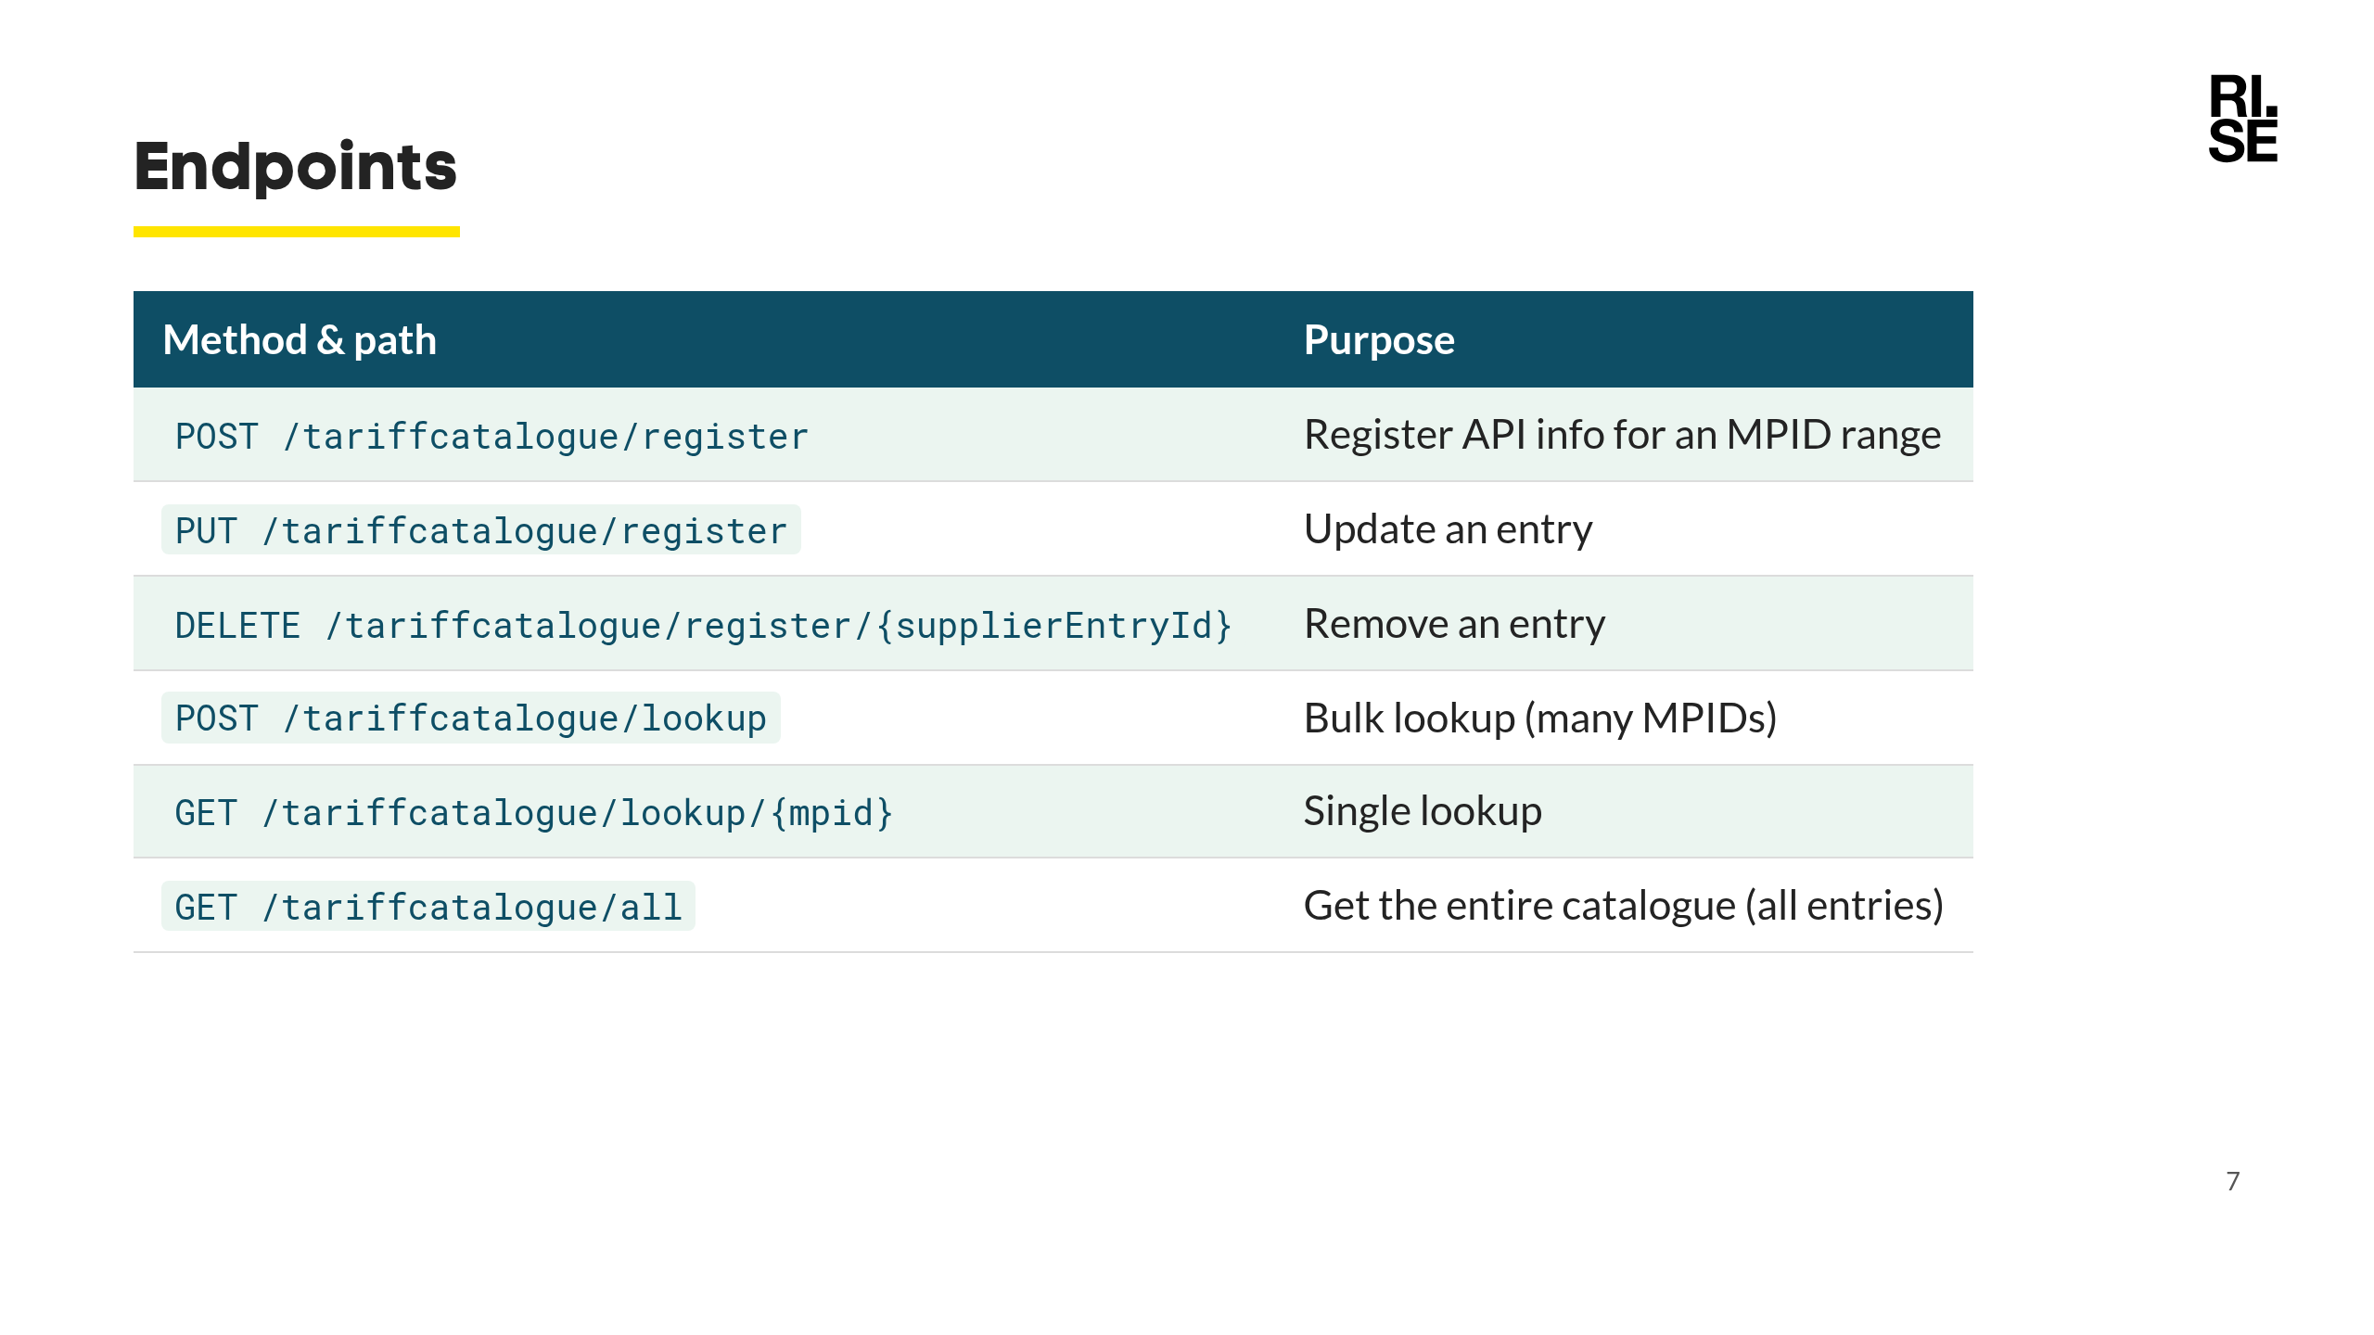
Notes:
The three register endpoints are the authenticated write side; the lookup/all endpoints are the public read side. /all returns the full catalogue.

Slide 8
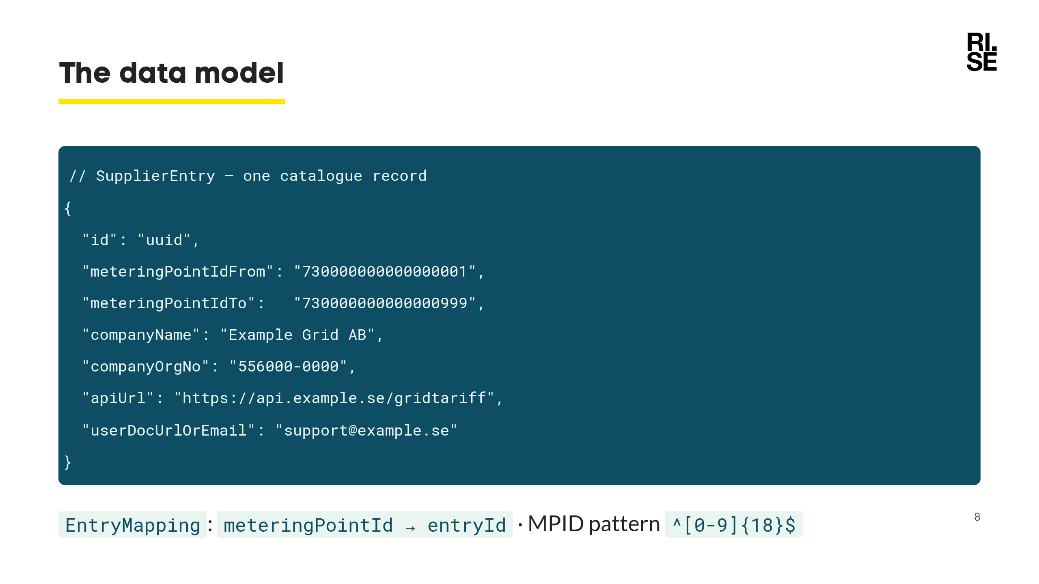
Notes:
SupplierEntry covers a *range* of metering-point IDs, not one. Lookup returns EntryMappings so the client knows which entry serves each requested ID. Source: catalogue.schema.json.

Slide 9
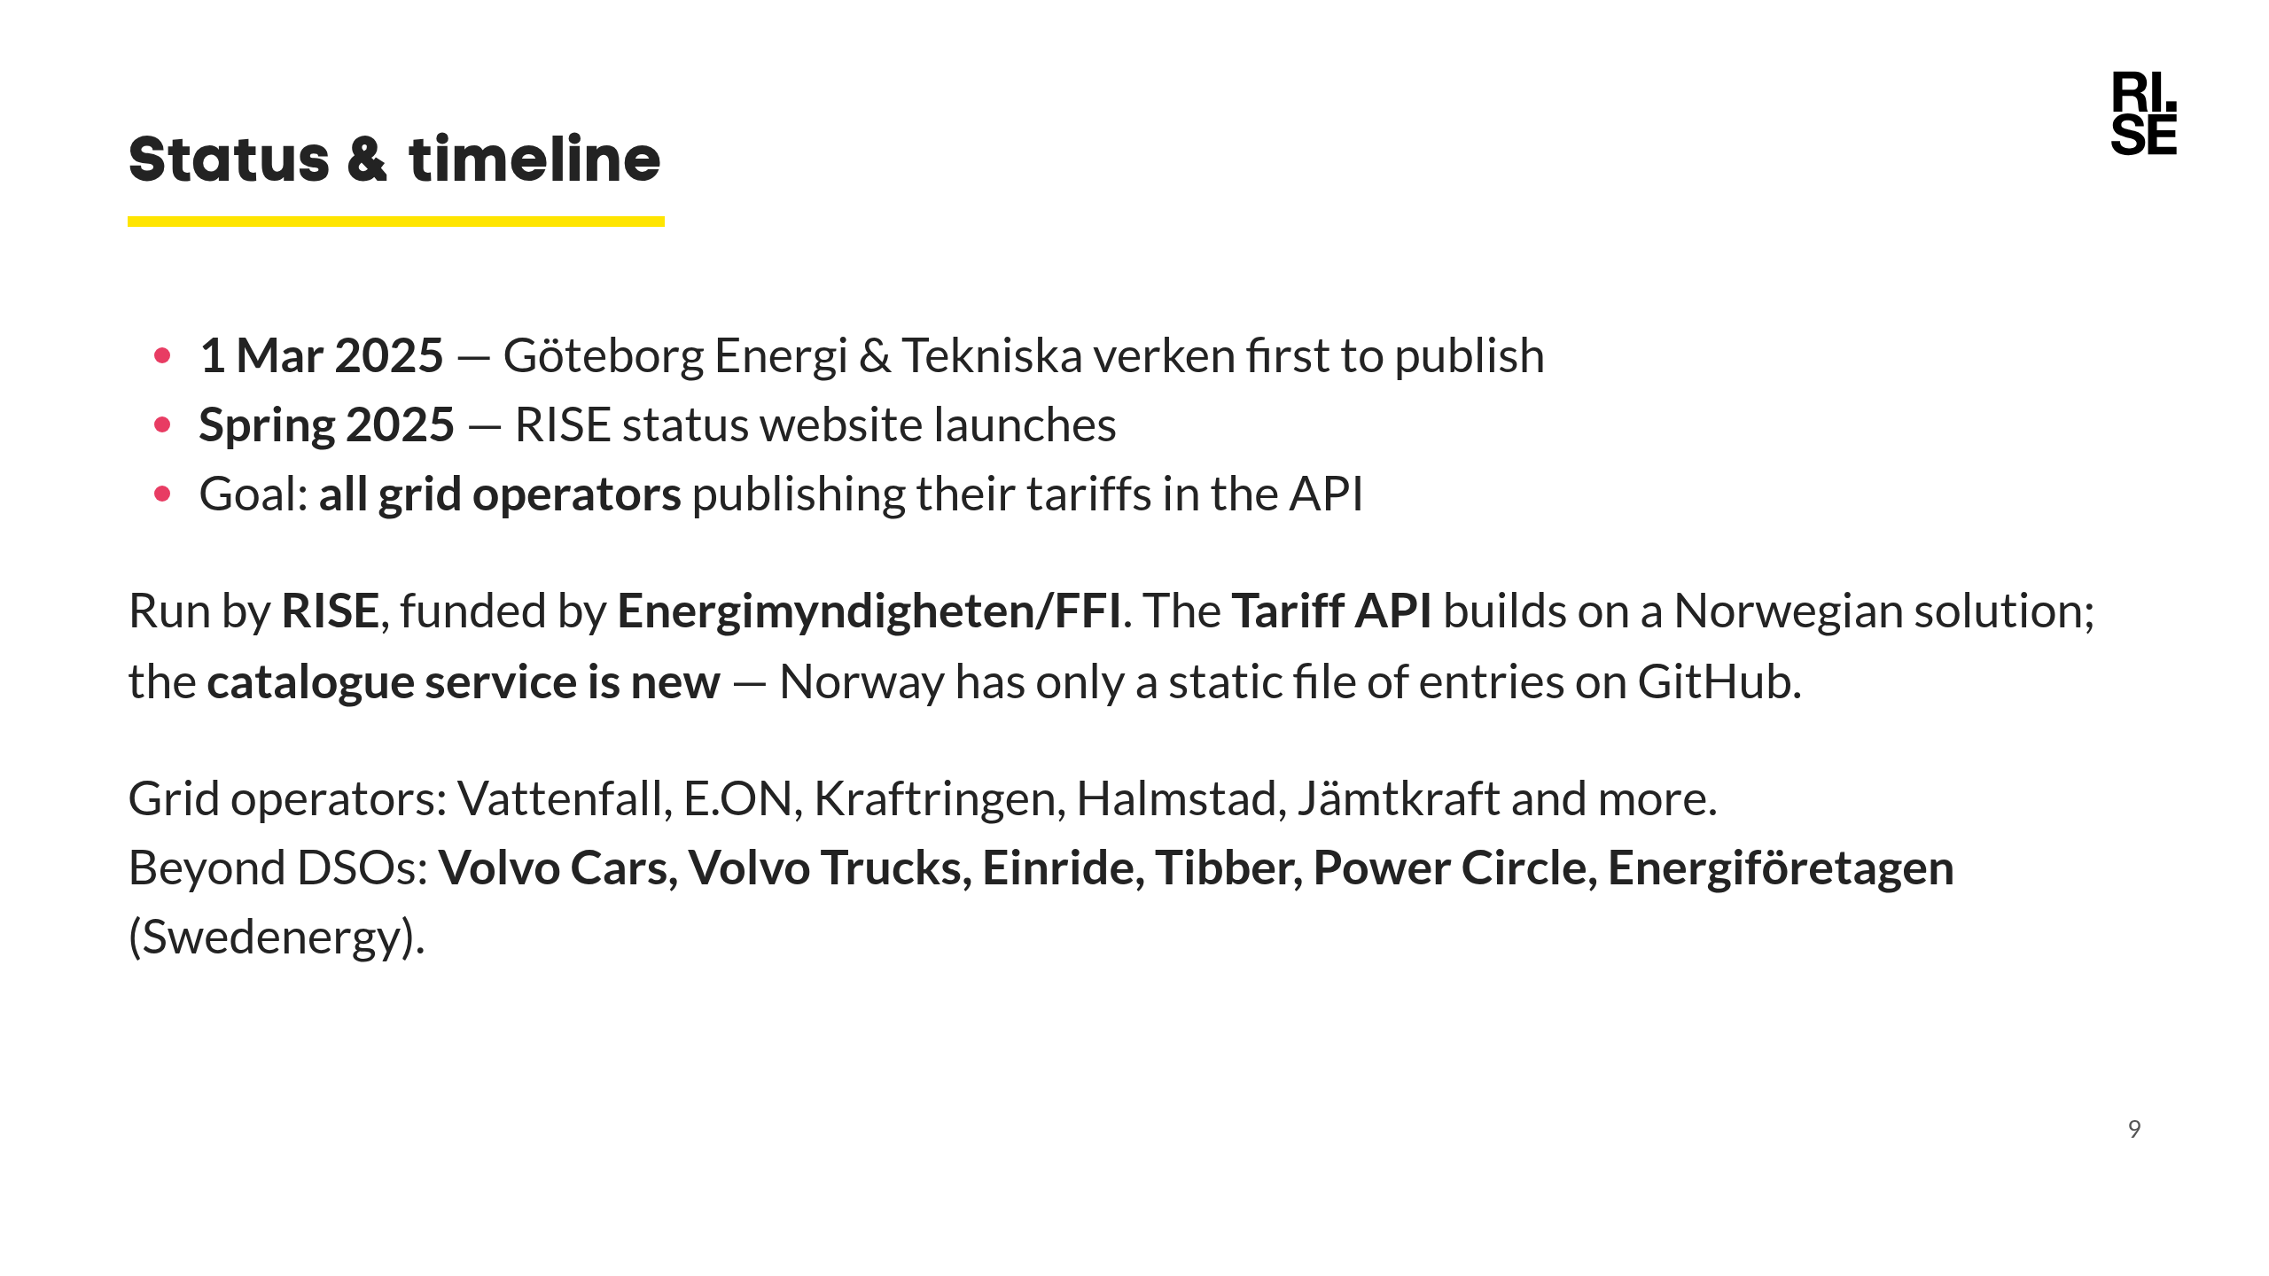
Notes:
Source: SUMMARY.md. Important nuance: only the Grid Tariff API derives from the Norwegian solution. Norway has no catalogue service at all — just a static gridcompany-mapping file on GitHub. The catalogue here is a new Swedish addition. Good slide to convey momentum — real operators live, broad participation.

Slide 10
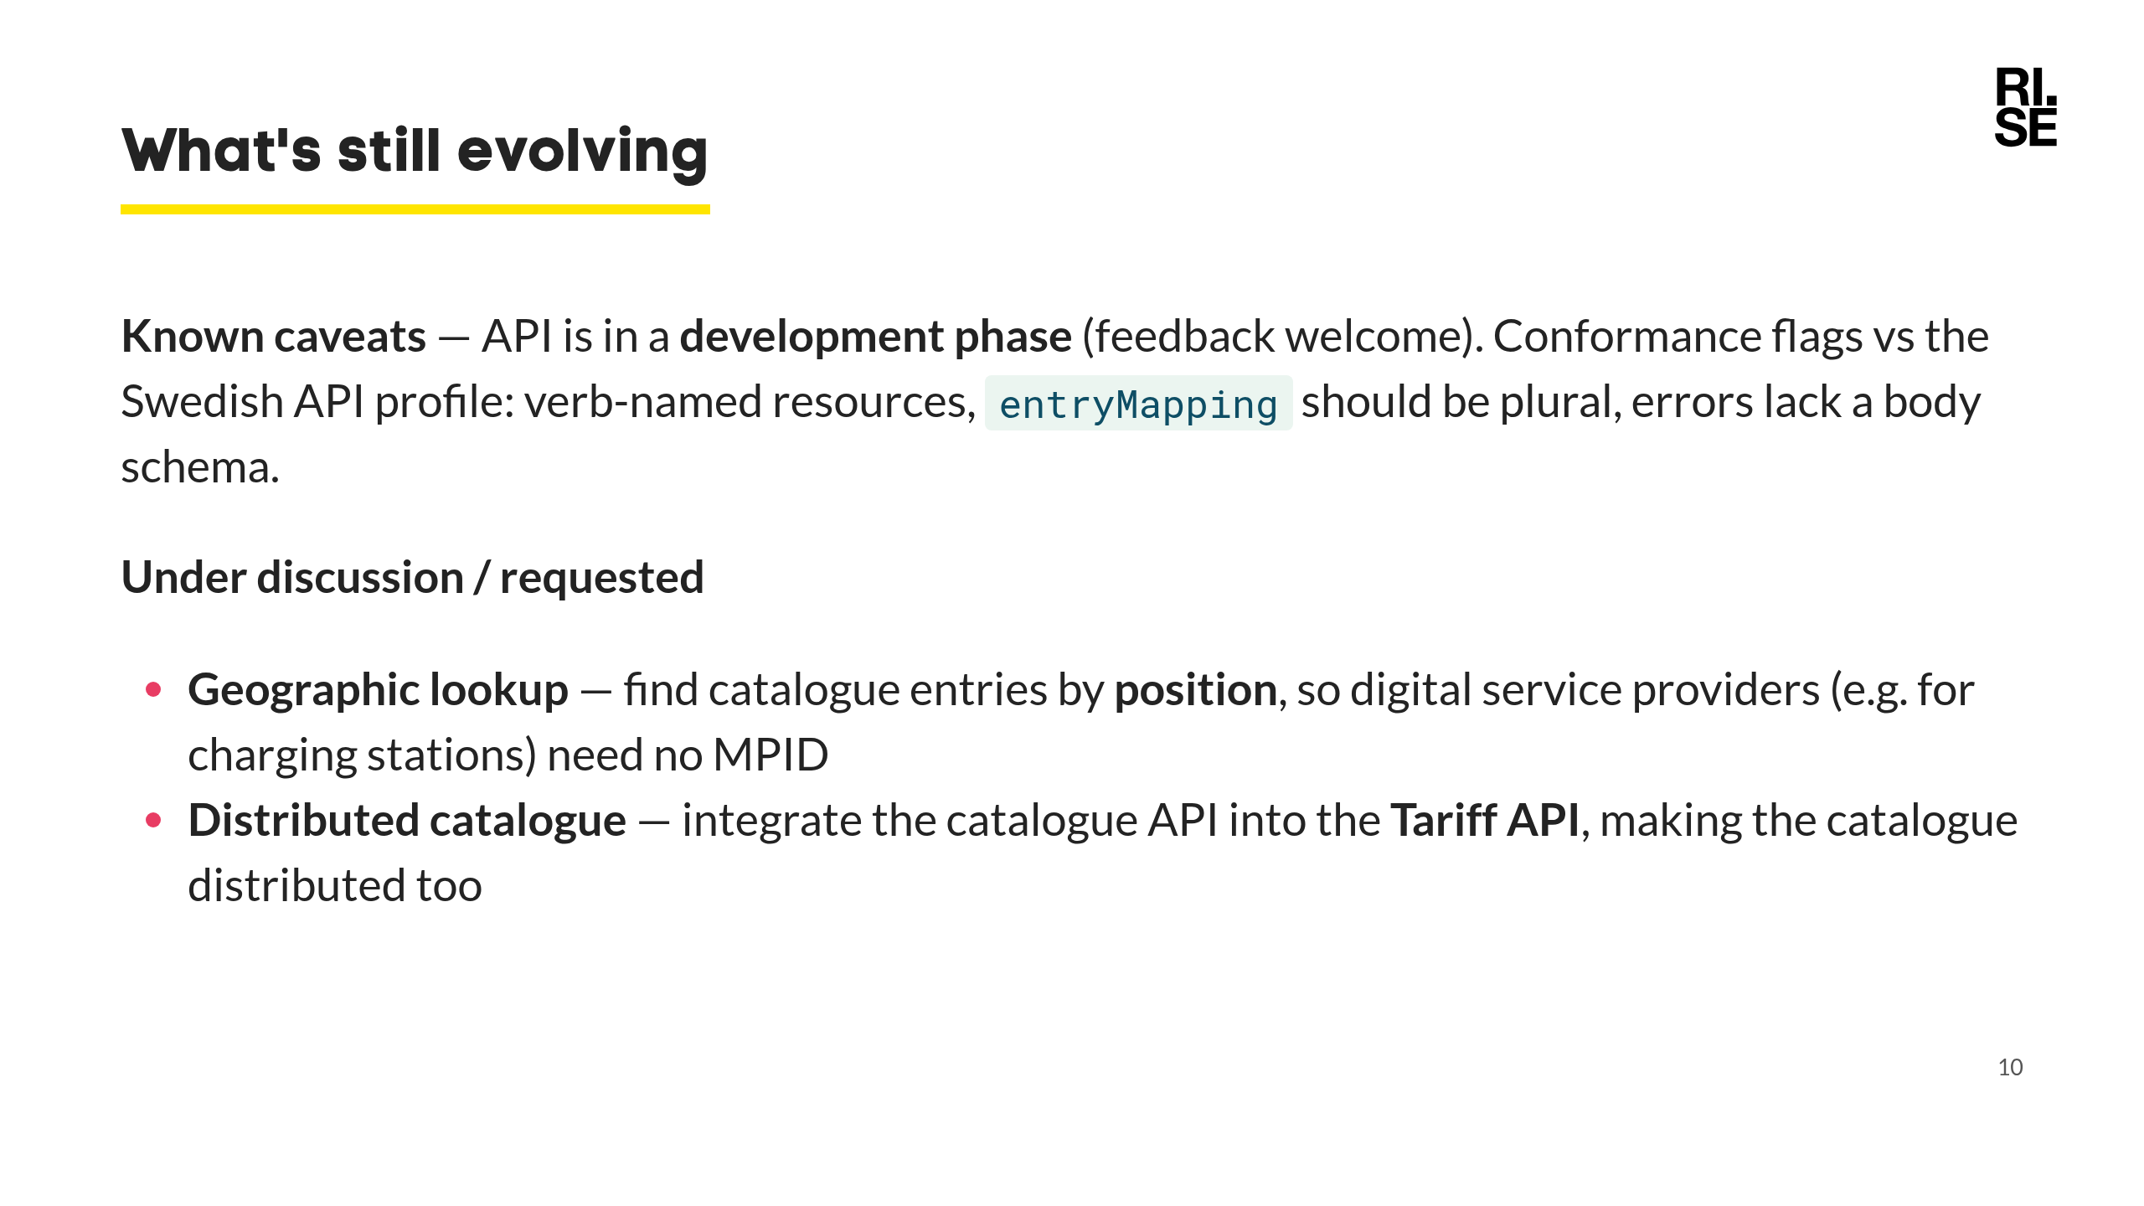
Notes:
First half: known, tracked items in CONFORMANCE_REPORT.md — active, self-aware work. Second half: forward-looking, community-requested directions. - Geographic lookup: a charging-station service knows *where* it is, not the facility's MPID — being able to query by position would remove that friction. - Distributed catalogue: folding the catalogue endpoints into each operator's Tariff API would decentralise the registry instead of relying on one central service.

Slide 11
