Slide 1
Document Similarity
Project Guide :
Dr.Jyoti Deshmukh

Slide 2
Table of contents
01
02
03
04
05
06
Introduction
Problem & solution
Constraints
System Architecture
Conclusion
Refrences

Slide 3
Introduction
In Natural Language Processing (NLP), document similarity refers to the task of determining how similar two or more documents are based on their content. This is crucial in applications like search engines, document clustering, recommendation systems, and plagiarism detection. By comparing the text, we can measure the similarity using various mathematical models and algorithms.
Techniques:
Bag of Words (BoW): Counts word occurrences but ignores context.
TF-IDF (Term Frequency-Inverse Document Frequency): Weighs important words by reducing the impact of common terms.
Word Embeddings: Captures word meanings and context (e.g., Word2Vec, GloVe).
Transformer-based Models: BERT and other deep learning models understand complex semantic relationships.

Slide 4
Problem Statement
In today's digital world, the vast amount of textual data across platforms makes it challenging to efficiently compare and group related documents. Traditional methods, such as keyword matching, often fail to capture the deeper semantic relationships between texts. This limitation leads to poor accuracy in applications like search engines, content recommendations, and plagiarism detection.
The goal is to develop effective and scalable methods for document similarity that can accurately measure both syntactic and semantic relationships between documents. The challenge lies in handling varying document lengths, contexts, and vocabularies while ensuring real-time processing

Slide 5
Constraints
Real-time Performance
Scalability
Must handle large datasets efficiently.
Quick response times for real-time applications.
Language Variability
Contextual Understanding
Capture both syntactic and semantic relationships.
Handle diverse vocabularies and writing styles.
Accuracy
Ensure high precision in similarity detection.

Slide 6
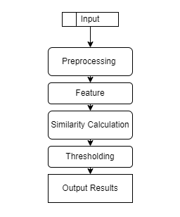
System Architecture

Slide 7
Conclusion
In summary, document similarity is essential for many NLP tasks, such as information retrieval and plagiarism detection. By using various techniques like cosine similarity and advanced embeddings such as BERT, we can effectively measure how similar two documents are.
As NLP technology continues to advance, we can expect improvements in our ability to capture the meaning and context of text. Future research should focus on developing models that better understand the nuances of language, leading to more accurate document similarity assessments.

Slide 8
References
Merlo, P., Henderson, J., Schneider, G., & Wehrli, E. (2003). Learning Document Similarity Using Natural Language Processing. Linguistik online.
Gahman, N., & Elangovan, V. (2023). A Comparison of Document Similarity Algorithms.

Slide 9
Thanks

