Slide 1
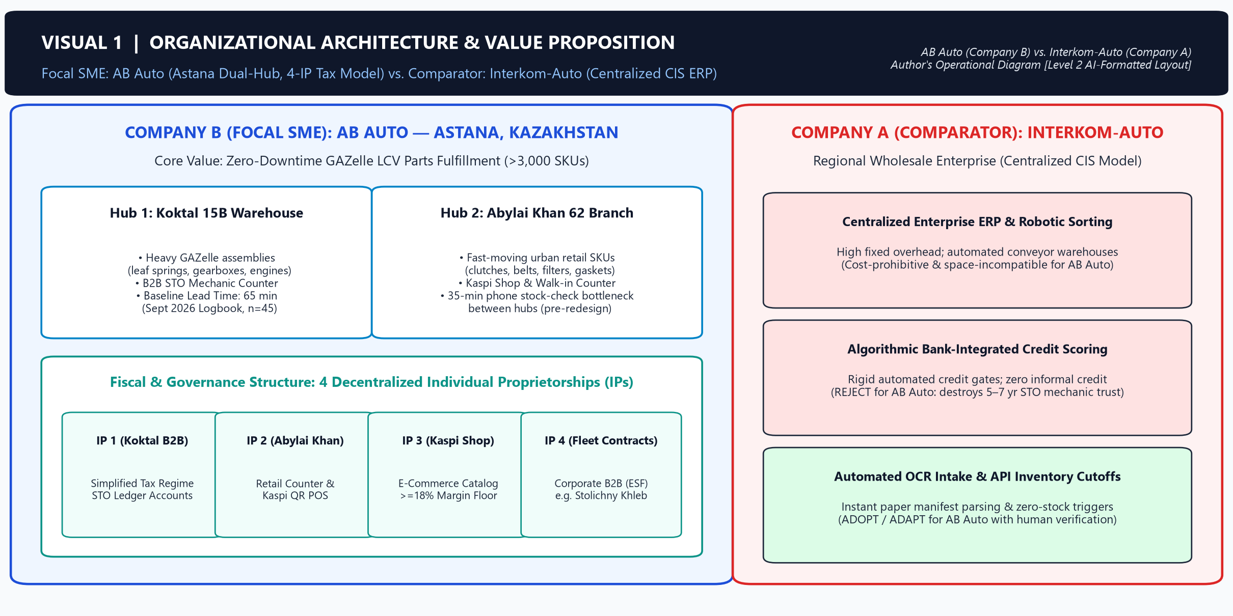
ASTANA IT UNIVERSITY · BA 1204 / BA2026 ASSIGNMENT 3: PHOTO ESSAY | Student: Manat Amir (Group: DPA-2602) | Analytical Commentary: 460 Words
Thesis: AB Auto (Company B) cuts B2B GAZelle counter lead time from 65 to <15 minutes via AI OCR cataloging, Kaspi cutoffs, and QR bin routing, while human verification governs part quality, four-IP tax caps, and STO credit.
Analytical Commentary (Visual 1 — 49 words): AB Auto (Company B) creates urban logistics value in Astana by supplying GAZelle spare parts across its Koktal 15B warehouse and Abylai Khan 62 counter under four Individual Proprietorships (IPs) [4, 5, 8]. Unlike Interkom-Auto’s (Company A) ERP, AB Auto pairs AI speed with human governance [1, 3, 6].
Manat Amir (DPA-2602) | BA 1204 / BA2026 Assignment 3: Photo Essay | Company B: AB Auto vs. Company A: Interkom-Auto | Page 1 of 11
Source: Author's operational architecture diagram compiled from AB Auto 4-IP registration records and Interkom-Auto B2B portal data [4], [5], [6], [8]. [Layout formatted with Level 2 AI script assistance].

Slide 2
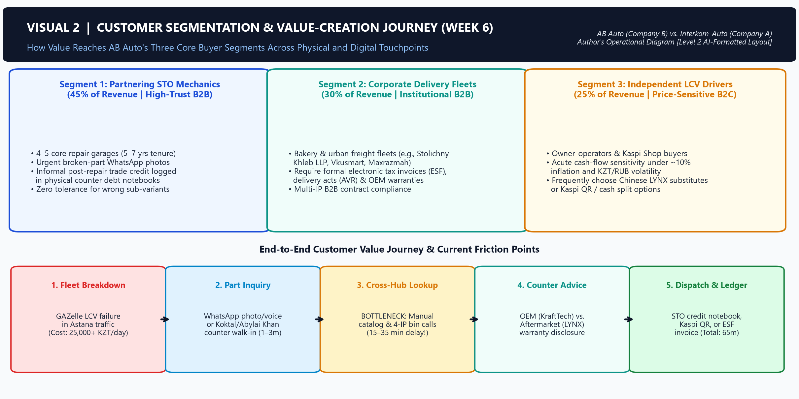
SECTION 2 · CUSTOMER SEGMENTATION & VALUE CREATION (WEEK 6)
Visual 2: B2B & B2C Customer Segmentation and Five-Stage Counter Journey
Analytical Commentary (Visual 2 — 43 words): Weekly Record 6 segments buyers into partnering repair garages (STOs) using five-to-seven-year debt ledgers, corporate fleets like Stolichny Khleb LLP requiring electronic tax invoices (ESF), and cash-sensitive drivers [4, 8]. Because breakdowns halt deliveries, rapid counter dispatch drives value across segments [1, 7].
Manat Amir (DPA-2602) | BA 1204 / BA2026 Assignment 3: Photo Essay | Company B: AB Auto vs. Company A: Interkom-Auto | Page 2 of 11
Source: Author's customer journey map synthesized from Weekly Record 6 field interviews and Koktal 15B counter STO credit notebooks [1], [4], [7], [8]. [Layout formatted with Level 2 AI script assistance].

Slide 3
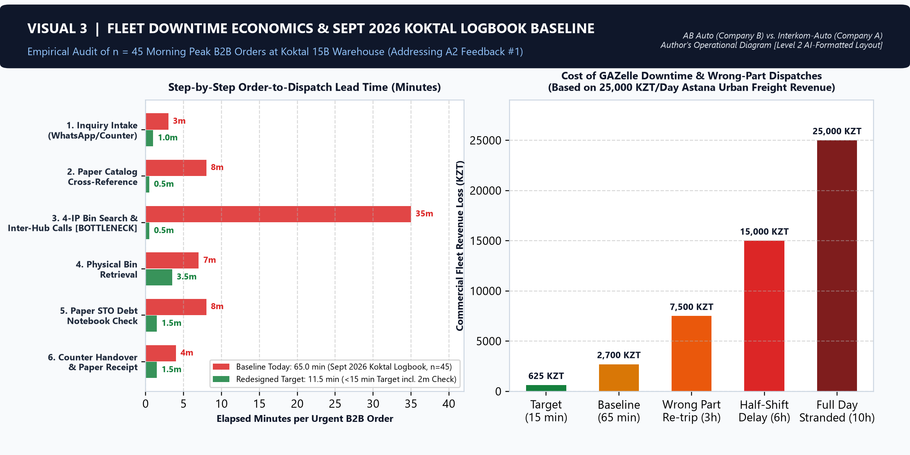
SECTION 2 · CUSTOMER SEGMENTATION & VALUE CREATION (WEEK 6)
Visual 3: Fleet Downtime Economics & September 2026 Koktal Logbook Baseline KPI
Analytical Commentary (Visual 3 — 47 words): Immobilized GAZelle vans cost fleets over 25,000 KZT daily in lost revenue [4, 7]. Auditing the September 2026 in-store counter order logbook at Koktal 15B (n = 45 peak orders) established our 65-minute baseline Order-to-Dispatch Lead Time, including 35 minutes lost to cross-hub phone checks [1, 4].
Manat Amir (DPA-2602) | BA 1204 / BA2026 Assignment 3: Photo Essay | Company B: AB Auto vs. Company A: Interkom-Auto | Page 3 of 11
Source: Author's time-motion chart from AB Auto's September 2026 Koktal 15B In-Store Counter Order Logbook (n = 45 morning peak B2B orders) and Astana freight data [1], [4], [7]. [Level 2 AI-formatted chart].

Slide 4
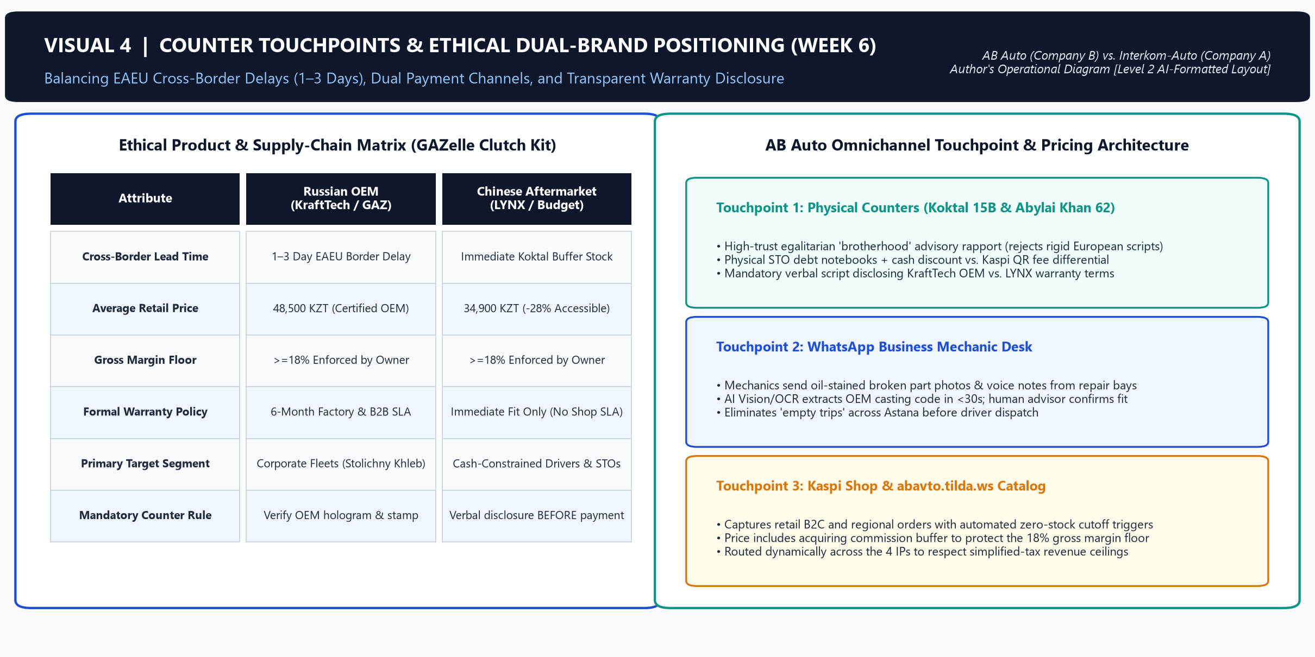
SECTION 2 · CUSTOMER SEGMENTATION & VALUE CREATION (WEEK 6)
Visual 4: Omnichannel Counter Touchpoints & Ethical Dual-Brand Positioning
Analytical Commentary (Visual 4 — 40 words): One-to-three-day EAEU border delays deplete Russian KraftTech OEM stock, forcing trade-offs with Chinese LYNX substitutes [2, 4]. Across WhatsApp, counter, and Kaspi QR touchpoints, advisors preserve mechanic trust via mandatory verbal warranty disclosures rather than rigid scripts [1, 4, 9].
Manat Amir (DPA-2602) | BA 1204 / BA2026 Assignment 3: Photo Essay | Company B: AB Auto vs. Company A: Interkom-Auto | Page 4 of 11
Source: Author's omnichannel touchpoint and brand trade-off matrix from Koktal 15B price lists, EAEU freight logs, and Kaspi rules [1], [2], [4], [9]. [Layout formatted with Level 2 AI script assistance].

Slide 5
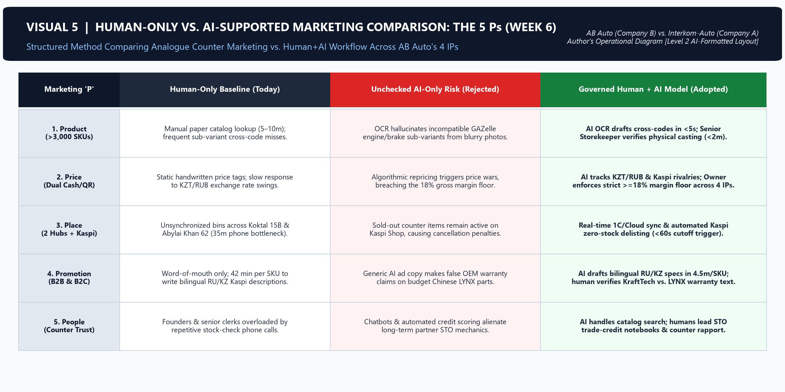
SECTION 3 · HUMAN-ONLY VS. AI-SUPPORTED MARKETING COMPARISON (WEEK 6)
Visual 5: Structured 5 Ps Comparison — Analogue vs. Governed Human + AI Marketing
Analytical Commentary (Visual 5 — 44 words): Comparing human-only versus AI-supported marketing across the 5 Ps shows multimodal vision accelerates OEM cross-referencing, whereas unchecked pricing automation threatens tax compliance [1, 3]. Thus, the Owner enforces an 18% gross margin floor and balances turnover across four IPs under Article 683 [2, 8].
Manat Amir (DPA-2602) | BA 1204 / BA2026 Assignment 3: Photo Essay | Company B: AB Auto vs. Company A: Interkom-Auto | Page 5 of 11
Source: Author's Week 6 5 Ps marketing evaluation across AB Auto's 4 IPs and OpenStax Ch. 11–12 frameworks [1], [2], [3], [8]. [Layout formatted with Level 2 AI script assistance].

Slide 6
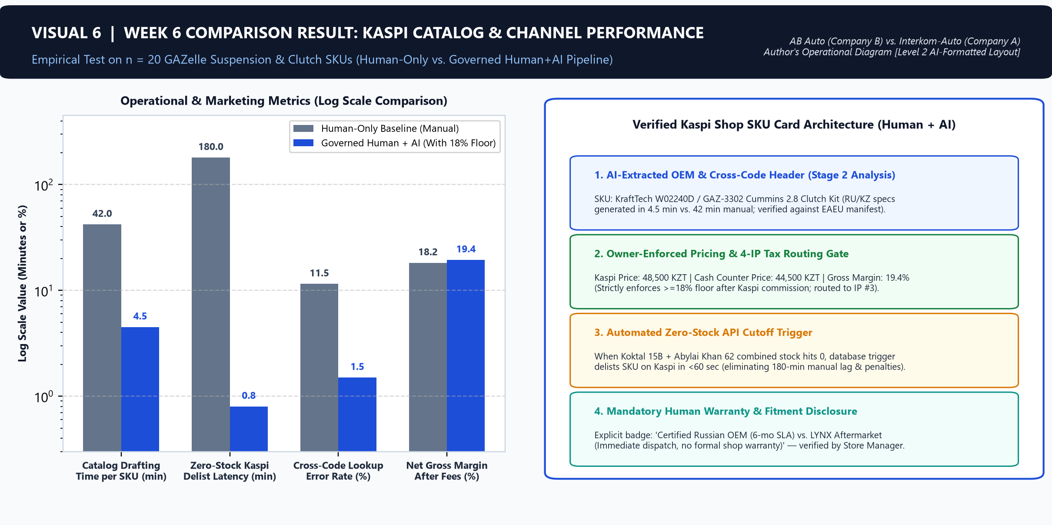
SECTION 3 · HUMAN-ONLY VS. AI-SUPPORTED MARKETING COMPARISON (WEEK 6)
Visual 6: Empirical Kaspi Shop Cataloging & Zero-Stock Cutoff Performance
Analytical Commentary (Visual 6 — 42 words): Our Week 6 trial on 20 GAZelle SKUs proved AI-assisted OCR cataloging cuts Kaspi Shop listing time from 42 to 4.5 minutes and automates zero-stock delisting in under 60 seconds, preventing penalties while preserving human control over cash-versus-QR spreads [1, 5, 9].
Manat Amir (DPA-2602) | BA 1204 / BA2026 Assignment 3: Photo Essay | Company B: AB Auto vs. Company A: Interkom-Auto | Page 6 of 11
Source: Author's Week 6 empirical trial on n = 20 GAZelle clutch/suspension SKUs on Kaspi Shop and abavto.tilda.ws [1], [4], [5], [9]. [Level 2 AI-formatted chart].

Slide 7
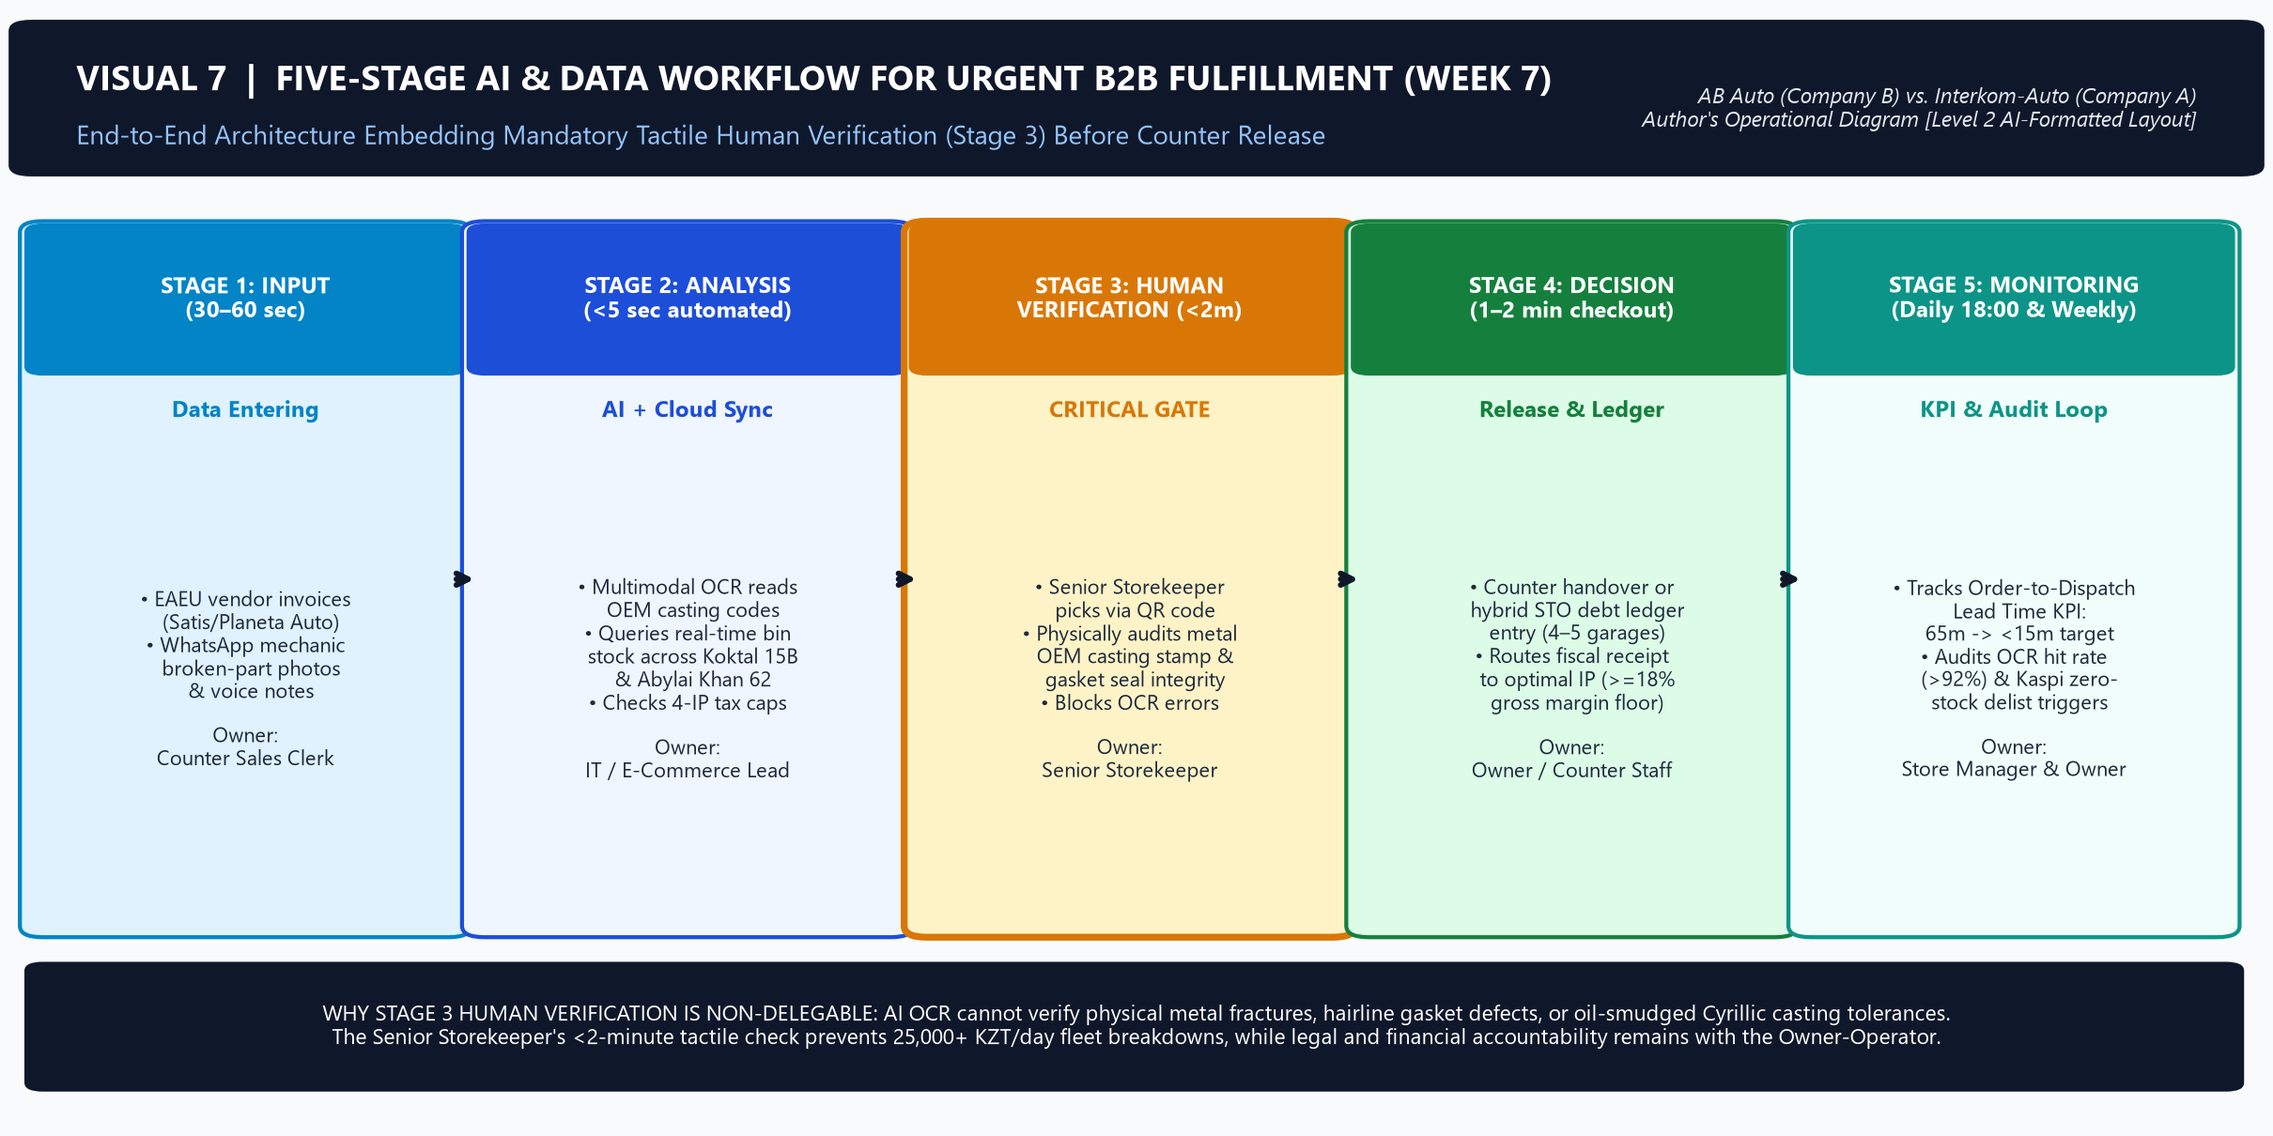
SECTION 4 · FIVE-STAGE AI/DATA WORKFLOW & WAREHOUSE ROUTING (WEEK 7)
Visual 7: Five-Stage AI/Data Workflow with Mandatory Stage 3 Tactile Verification
Analytical Commentary (Visual 7 — 50 words): To eliminate the 35-minute lookup bottleneck, our Week 7 workflow links EAEU invoice and WhatsApp photo intake (Stage 1) to OCR stock matching across four IPs (Stage 2), followed by Senior Storekeeper tactile audits of casting stamps and gasket seals within two minutes (Stage 3) before release [1, 3, 4].
Manat Amir (DPA-2602) | BA 1204 / BA2026 Assignment 3: Photo Essay | Company B: AB Auto vs. Company A: Interkom-Auto | Page 7 of 11
Source: Author's Week 7 AI/Data workflow diagram integrating OpenStax Ch. 13 MIS principles and Koktal 15B operational gates [1], [3], [4]. [Layout formatted with Level 2 AI script assistance].

Slide 8
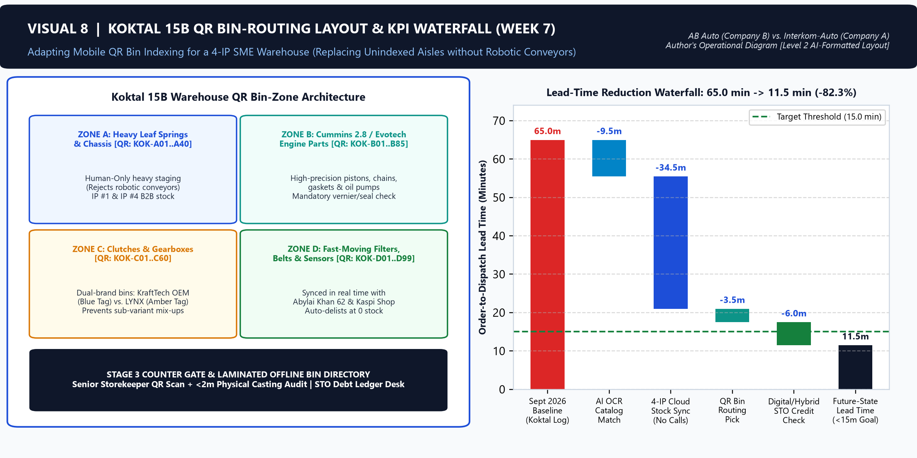
SECTION 4 · FIVE-STAGE AI/DATA WORKFLOW & WAREHOUSE ROUTING (WEEK 7)
Visual 8: Koktal 15B QR Bin-Tracking Layout & Lead-Time Reduction Waterfall
Analytical Commentary (Visual 8 — 44 words): Replacing unindexed shelving at Koktal 15B with mobile QR zone routing cuts physical picking from 7 to 3.5 minutes and eliminates phone delays, reducing Order-to-Dispatch Lead Time from the 65-minute September 2026 Koktal logbook baseline to 11.5 minutes—below our 15-minute target [1, 2, 4].
Manat Amir (DPA-2602) | BA 1204 / BA2026 Assignment 3: Photo Essay | Company B: AB Auto vs. Company A: Interkom-Auto | Page 8 of 11
Source: Author's Koktal 15B warehouse schematic and lead-time waterfall from the September 2026 in-store counter order logbook [1], [2], [4]. [Layout formatted with Level 2 AI script assistance].

Slide 9
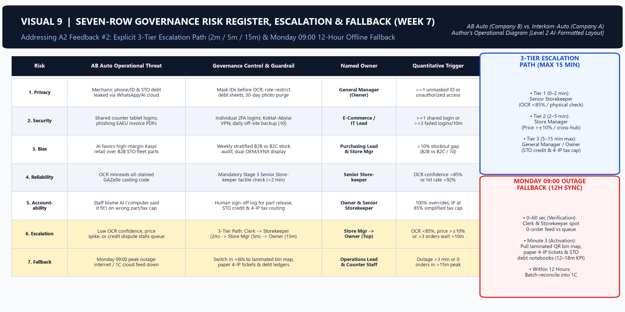
SECTION 5 · GOVERNANCE RISK REGISTER, ESCALATION & FALLBACK (WEEK 7)
Visual 9: Seven-Row Governance Risk Register, 15-Min Escalation & 12-Hour Fallback
Analytical Commentary (Visual 9 — 58 words): Our seven-row risk register enforces CERT/CC two-factor security and strict triggers: if OCR confidence drops below 85% or price variance exceeds ±10%, review escalates from Senior Storekeeper (2m) to Store Manager (5m) and Owner (15m max) [1, 4, 10]. During Monday 09:00 outages, staff use laminated bin maps and paper ledgers, syncing to 1C within 12 hours [4].
Manat Amir (DPA-2602) | BA 1204 / BA2026 Assignment 3: Photo Essay | Company B: AB Auto vs. Company A: Interkom-Auto | Page 9 of 11
Source: Author's Week 7 Governance Risk Register incorporating CERT/CC controls and Koktal 15B Monday 09:00 stress-test protocols [1], [4], [10]. [Layout formatted with Level 2 AI script assistance].

Slide 10
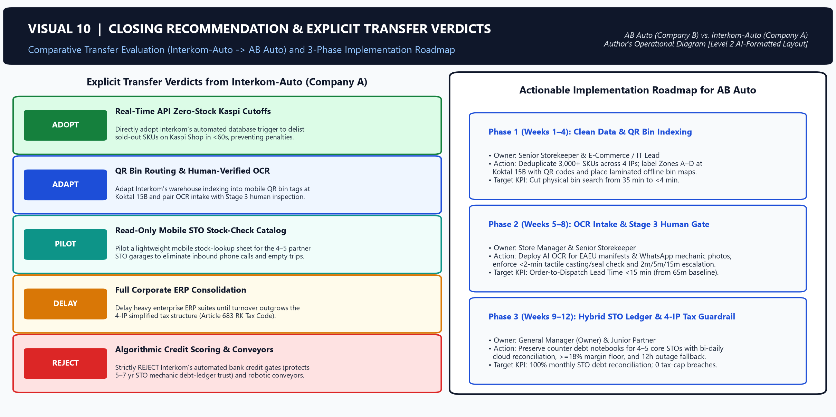
SECTION 6 · CLOSING RECOMMENDATION & EXPLICIT TRANSFER VERDICTS
Visual 10: Actionable Implementation Roadmap & Company A -> Company B Transfer Verdicts
Analytical Commentary (Visual 10 — 43 words): Comparing Interkom-Auto [6], we adopt API zero-stock cutoffs and adapt QR bin routing and human-verified OCR invoice intake [1, 3]. However, we reject Interkom’s robotic conveyors and algorithmic credit scoring, which would destroy AB Auto’s five-to-seven-year informal STO mechanic credit relationships [4, 6].
Manat Amir (DPA-2602) | BA 1204 / BA2026 Assignment 3: Photo Essay | Company B: AB Auto vs. Company A: Interkom-Auto | Page 10 of 11
Source: Author's comparative transfer evaluation of Interkom-Auto (Company A) vs. AB Auto (Company B) and 12-week roadmap [1], [3], [4], [6]. [Layout formatted with Level 2 AI script assistance].

Slide 11
IEEE REFERENCE LIST & EVIDENCE VERIFICATION SUMMARY
10 Verifiable Sources Across Evidence Folder | Total Analytical Commentary: 460 Words (Strictly 400–500 Words)
[1] L. J. Gitman, C. McDaniel, A. Shah, et al., Introduction to Business, 2nd ed. Houston, TX: OpenStax, Rice University, 2026, ch. 10–13.
[2] G. Yeshenkulova, N. Ibadildin, and M. Tleubayeva, Business Administration. Almaty: ZIALY BASPASY, 2026, ISBN 978-601-08-4281-6.
[3] H. J. Wilson and P. R. Daugherty, "Collaborative intelligence: Humans and AI are joining forces," Harvard Business Review, vol. 96, no. 4, pp. 114–123, Jul.–Aug. 2018.
[4] AB Auto, Koktal 15B In-Store Counter Order Logbook, Warehouse Bin Records, and Partnering STO Trade Credit Ledgers (September 2026 Empirical Audit, n = 45 B2B Orders), Astana, Kazakhstan, Sep. 2026.
[5] AB Auto, "Commercial vehicle spare parts catalog and store directory (Koktal 15B & Abylai Khan 62)," abavto.tilda.ws, 2026. [Online]. Available: https://abavto.tilda.ws.
[6] Interkom-Auto, "Automotive parts wholesale and B2B ordering portal," interkom.kz, 2026. [Online]. Available: https://interkom.kz.
[7] Bureau of National Statistics of the Agency for Strategic Planning and Reforms of the Republic of Kazakhstan, "Statistical indicators of domestic trade and commercial transport maintenance in Astana," stat.gov.kz, 2026. [Online]. Available: https://stat.gov.kz.
[8] State Revenue Committee of the Ministry of Finance of the Republic of Kazakhstan, "Tax administration, electronic invoicing (ESF), and simplified declaration regime for individual entrepreneurs (Art. 683, Tax Code of RK)," kgd.gov.kz, 2026. [Online]. Available: https://kgd.gov.kz.
[9] Kaspi.kz, "Kaspi Shop Merchant Partner Rules, SKU Listing Standards, and Kaspi Pay Acquiring Tariffs," kaspi.kz, 2026. [Online]. Available: https://kaspi.kz.
[10] CERT Coordination Center (CERT/CC), "Enterprise network security controls, credential hygiene, and incident response guidelines," Software Engineering Institute, Carnegie Mellon University, cert.org, 2026. [Online]. Available: https://www.kb.cert.org.
AI-Use Level 2 Disclosure & A2 Feedback Compliance Note: All 10 visuals are original operational diagrams/charts created by the author from verified AB Auto field records (specifically sourcing the 65-min baseline KPI to the September 2026 Koktal 15B in-store counter order logbook, n = 45 orders, and detailing the 2m/5m/15m 3-tier escalation path and 12h fallback). Layout formatted using Python/Matplotlib with Level 2 AI assistance; OpenStax and course core texts were never uploaded to any AI system.
Manat Amir (DPA-2602) | BA 1204 / BA2026 Assignment 3: Photo Essay | Company B: AB Auto vs. Company A: Interkom-Auto | Page 11 of 11

