Slide 1
Improvements in automatic ship collision avoidance using AI
Team_ID : 18
Satbir Singh - 2020AIM1016
Challa Uday Kiran Reddy - 2020CSM1007

Slide 2
Motivation
Collision prevention is critical for navigation safety at sea
In the early days, navigational assistance systems were there to help humans in ships tackle collision occurrence
But autonomous vehicles have gained a remarkable amount of attention recently, focusing on solving collision problems by machines
Most of previous works used A* for path planning in maritime environment but not for collision avoidance
Here we worked on improving performance of A* to apply it for collision avoidance

Slide 3
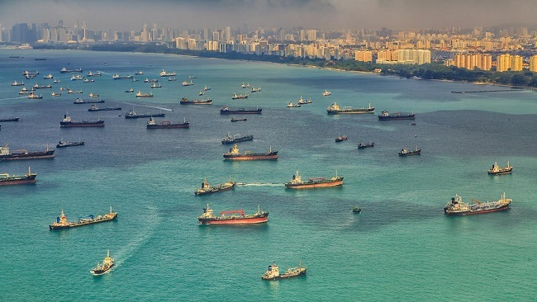
Problem Statement
Automated navigation in congested waters is more challenging. In this project we tried to come up with a collision avoidance system in multi ship environment with certain assumptions.
Own Ship
‘N’ Target Ships in the locality
Need to ensure our ship never collides
with any of the target ships and reaches
goal.
Image reference : https://www.marineinsight.com/wp-content/uploads/2015/04/traffic.jpg

Slide 4
Objective
Generate a geometric path by finding set of way points to navigate through from the start position to the end position
Decision made should ensure :
1. Optimal route
2. Safety of navigation
3. Less computational complexity
4. Smoothness

Slide 5
Proposed Methodology
Formulating the problem as dynamic constraint based graph search problem.
Trajectories are given as input to system. Chance of collision is computed based on the region of intersection of trajectories(safe boundary zone ).
Once the collision is detected the AI module performs heuristic based search guided by Fuzzy module to prune the search space(Fuzzy A* with dynamic heuristic).
Output of AI module is the move(direction) to be taken from current position.
Assumptions : speeds are constant and trajectories are certain.

Slide 6
Proposed Methodology
sensors
Fuzzy Module
AI module
Decision
Direction (next move)
Fig: Working of the Algorithm. The sensor gives input to both the Fuzzy modules as well as AI module. Both modules interact with each other and come up with a direction for next move of the ship.

Slide 7
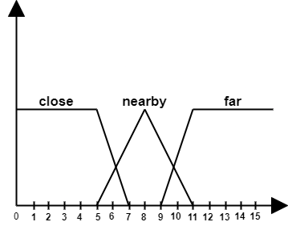
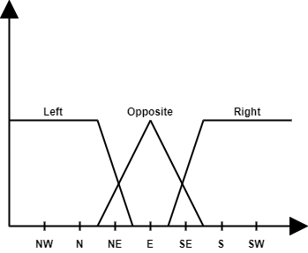
Fuzzy logic module
Fig: Distance to other ship from own ship
Fig: Direction of approach of other ship towards own ship

Slide 8
Fuzzy rules for direction of Movement
The following rules are applied in case a collision is detected.
If other ship approaching from left direction and location is close then direction of ship is -45 degree.
If other ship approaching from left direction and location is nearby then direction of ship is 45 degree.
If other ship approaching from left direction and location is far away then direction of ship is 0 degree.
If other ship approaching from right direction and location is close then direction of ship is 45 degree.

Slide 9
Fuzzy rules for direction of Movement
If other ship approaching from right direction and location is nearby then direction of ship is -45 degree.
If other ship approaching from right direction and location is far away then direction of ship is 0 degree.
If other ship approaching from opposite direction and location is close then direction of ship is 45 or -45 degree(based on one which is close to destination).
If other ship approaching from opposite direction and location is nearby then direction of ship is -45 degree.
If other ship approaching from opposite direction and location is far away then direction of ship is 0 degree.

Slide 10
Heuristic function
Heuristic function is sum of manhattan distance from present location to destination and costs of adjacent moves
The cost of adjacent moves will be updated based on the output(direction) of fuzzy module
At every decision step, own ship will try to move close to destination at same time moving away from grids having more cost indicating chance of collision

Slide 11
Collision Avoidance Algorithm using A*
Generate random trajectories for other ships
Estimated trajectory of own ship using A*
Use trajectory of own ship and other ships to detect chance of collision by checking overlap in safe zones(region around ship with radius 1)
Costs of the cells in the zone of collision are updated using Fuzzy module
Find best next move using A*
Repeat step 2 until reached destination

Slide 12
Time and Space complexity
Time Complexity : O(N*b^d)
Space Complexity : O(b^d)
Here,
N - max number of steps taken by own ship to reach destination
b - branching factor(here it is 3)
d - depth of search tree

Slide 13
Ship moves: break
Breaks were implemented for own ship
In general, decision of the move will be taken by Fuzzy+AI module, but in extreme cases.
This extreme case occurs when our ship has been deviated because of other ship(s) and if it moves along other ship direction.
In water, there won’t be sudden breaks. Hence, the decision of applying break is made 2 grids earlier so as to stop at the correct location.

Slide 14
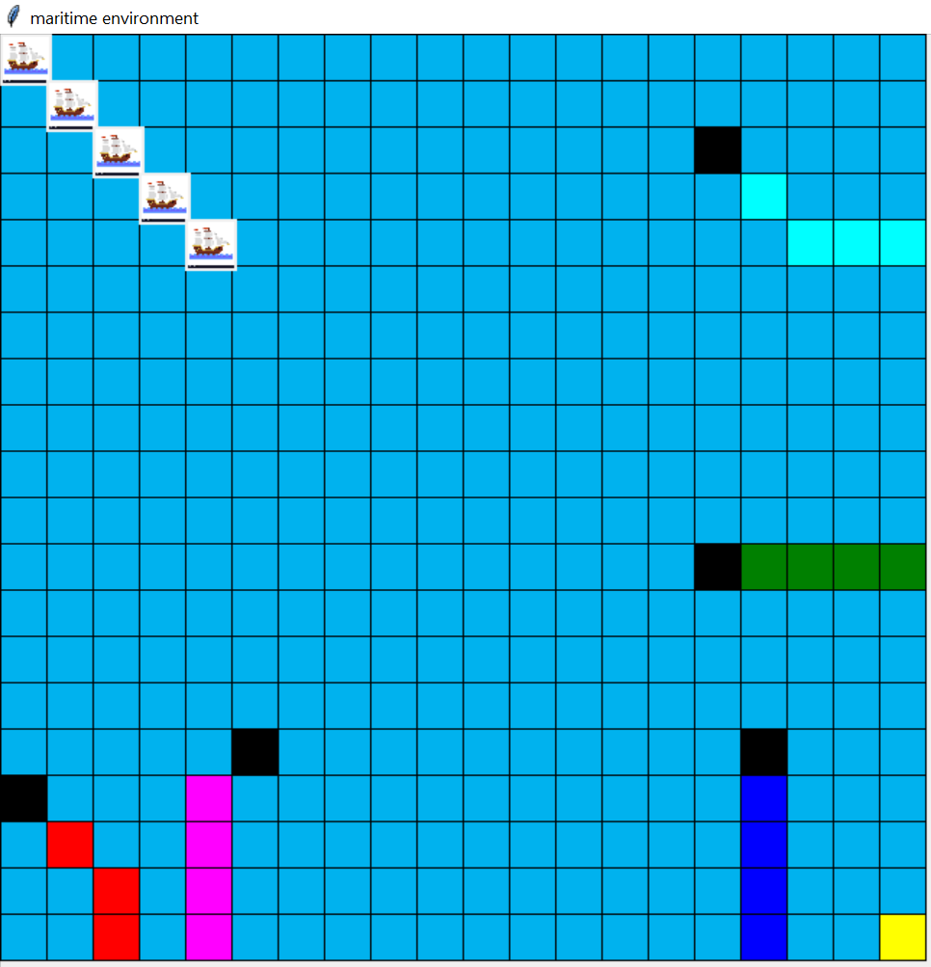
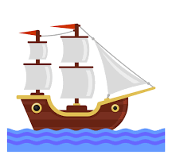
Ship water environment
Ocean water
Own ship
Other ship
Other ship 1 path
Other ship 2 path
Other ship 3 path
Other ship 4 path
Other ship 5 path
Destination

Slide 15
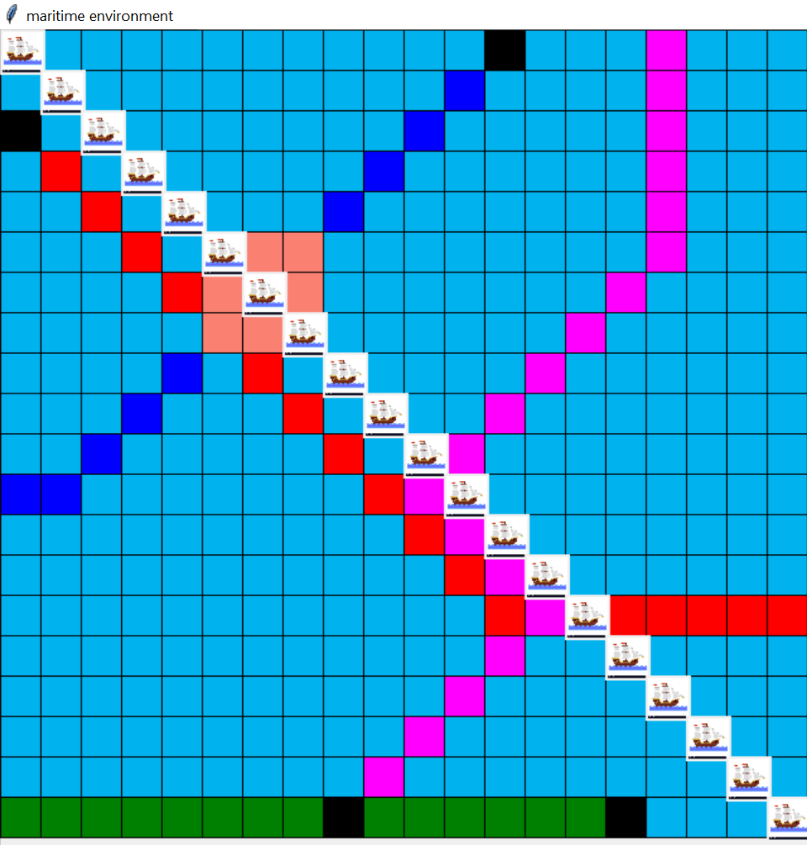
Collision Scenario
This image is observation of using simple A* without any collision avoidance mechanism
Own ship started at left corner and all other ships started at random positions
Her own ship collides with other ship having path in blue colour, at time step 6
The region surrounding the collision was indicated with salmon colour

Slide 16
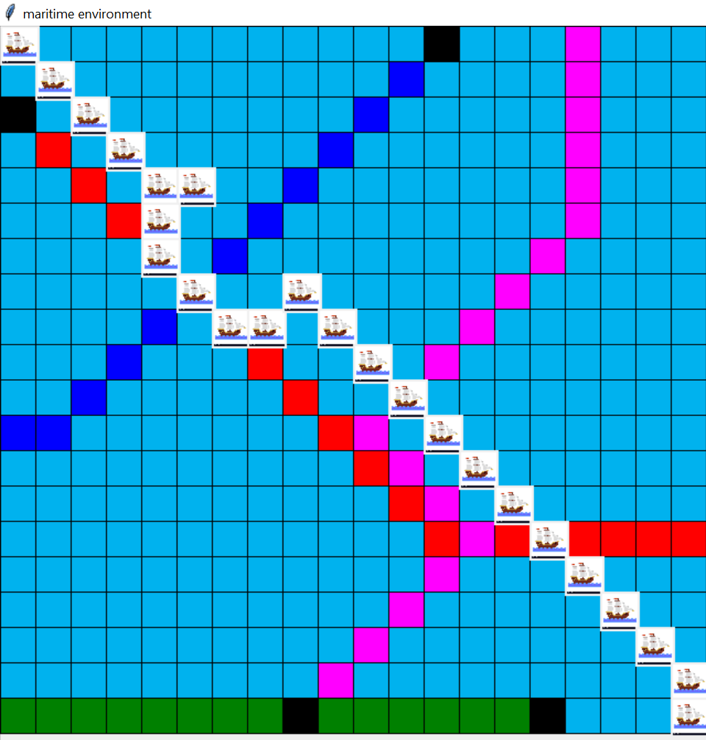
Requirement of smoothing
This image shows the scenario of own ship trajectory using A* with collision avoidance
Here in the path it is visible that some moves of ship are not reliable(Ex: suddenly moving back from present location, grid (4,5) to (4,4))
So to address this problem smoothing was applied

Slide 17
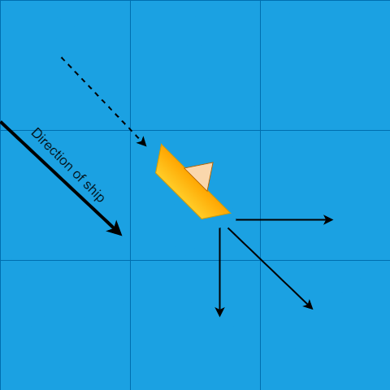
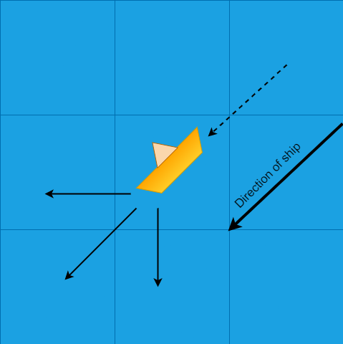
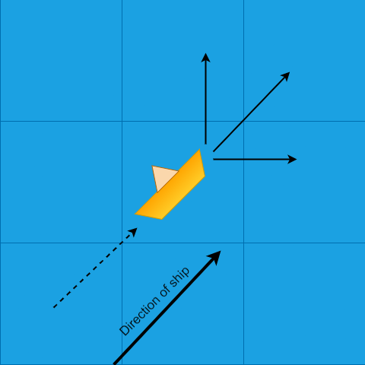
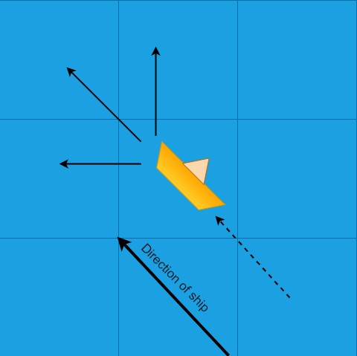
Ship moves for smoothness

Slide 18
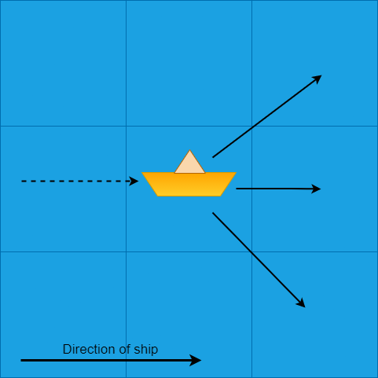
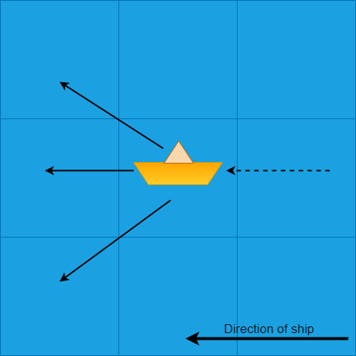
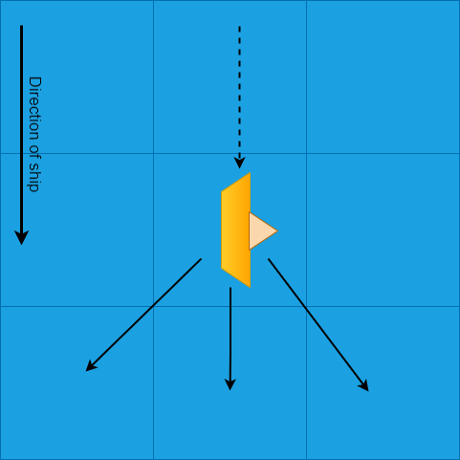
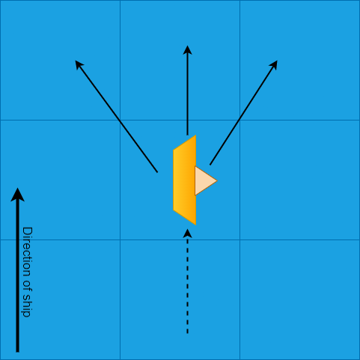
Ship moves for smoothness

Slide 19
Experiments
Board size : 20x20 (can be any size nxn)
Number of other ships : 4,5 (experimented with 4 and 5 other ships, can even have more)
Costs : weighted costs based on the distance from other ships((1/d)*100)
Total steps of own ship : Number of moves + breaks
Here it is purely decision based algorithm so there won’t be any kind of training, decision will be made on the go
Simulations were done for different random paths of other ships

Slide 20
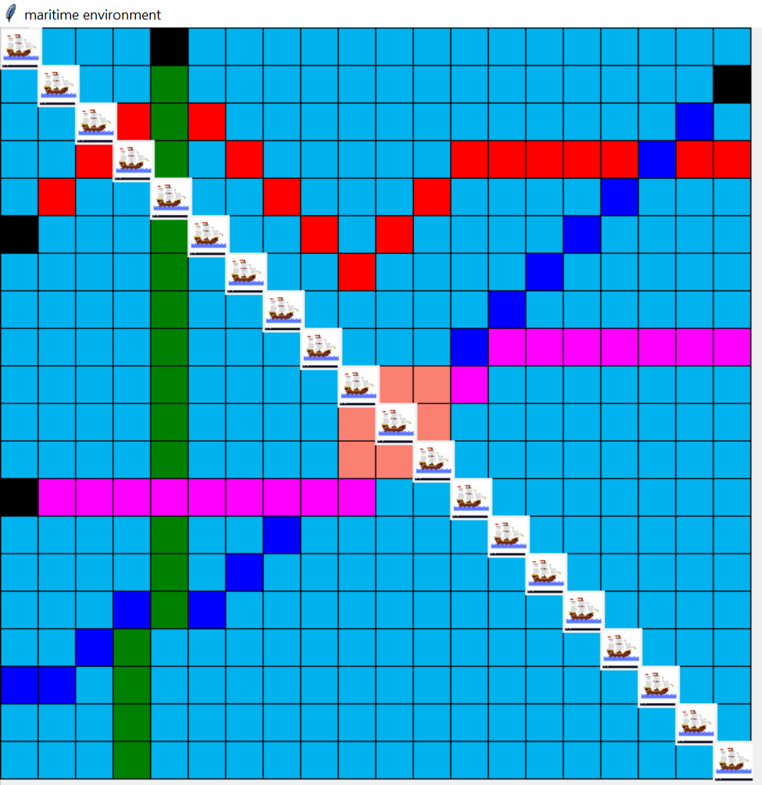
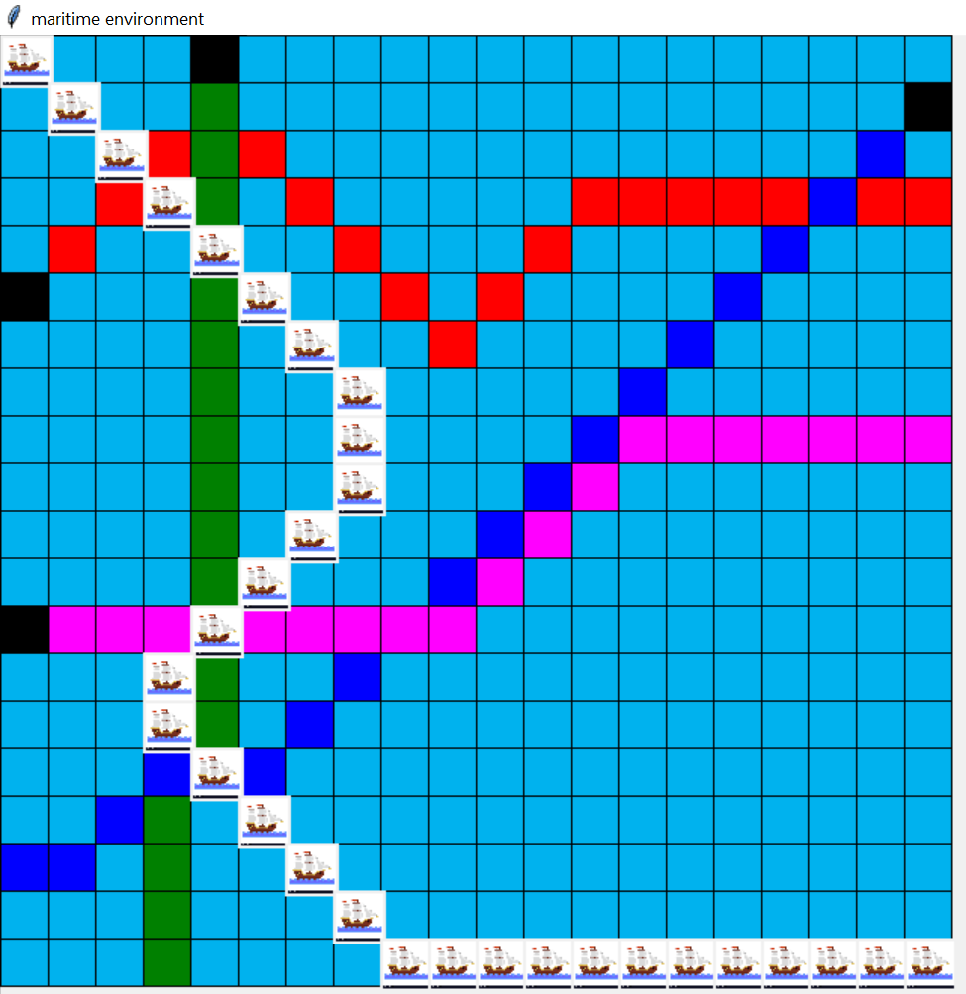
Results
Other Ships: 4
Steps: 30
Time: 0.027s
Breaks: 0
Moves: 30
Fig: Collisions in path found by A*
Fig: Trajectory using collision avoidance algorithm with smoothing

Slide 21
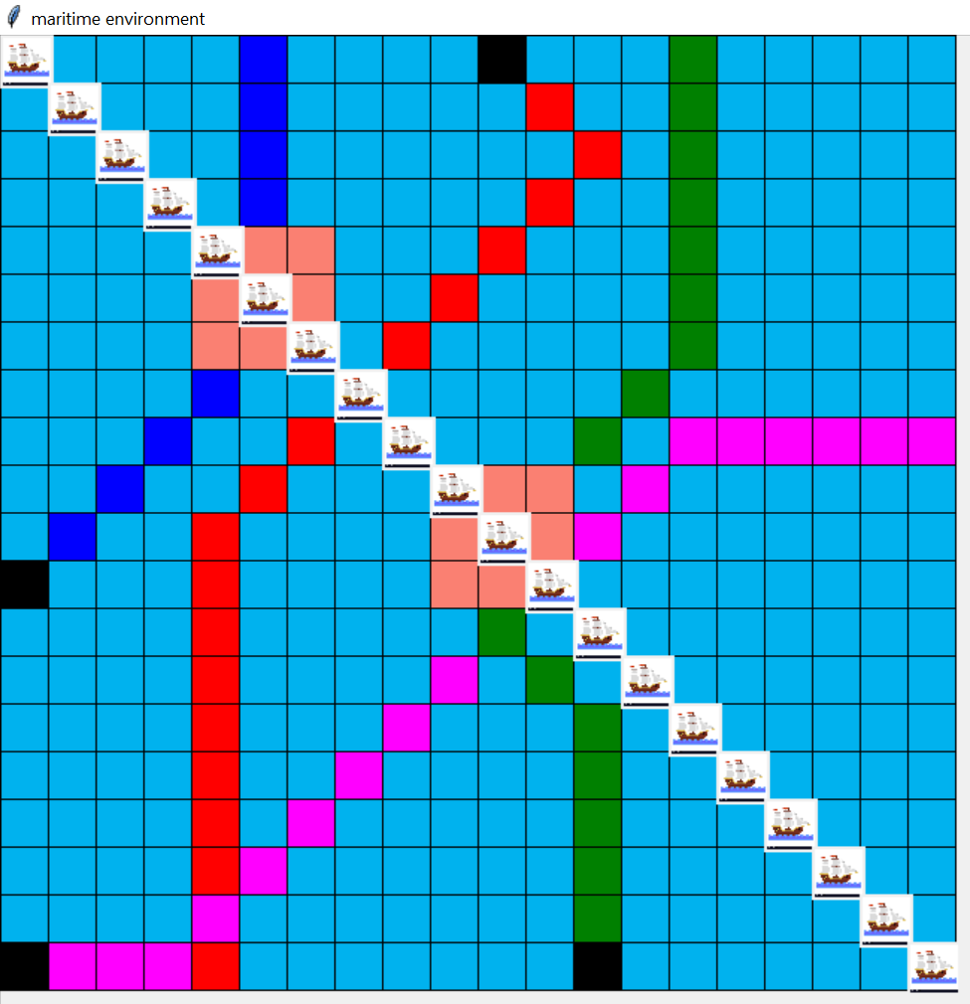
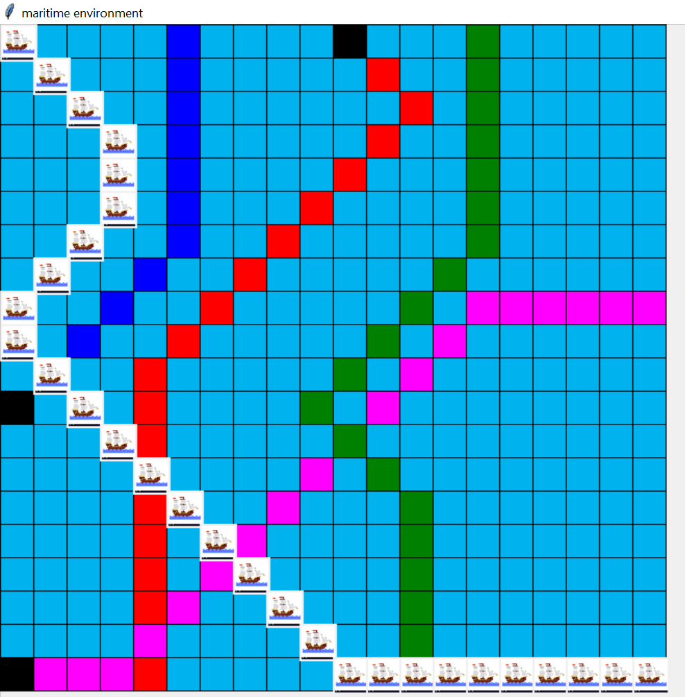
Results
Other Ships: 4
Steps: 31
Time: 0.029s
Breaks: 2
Moves: 29
Fig: Collisions in path found by A*
Fig: Trajectory using collision avoidance algorithm with smoothing

Slide 22
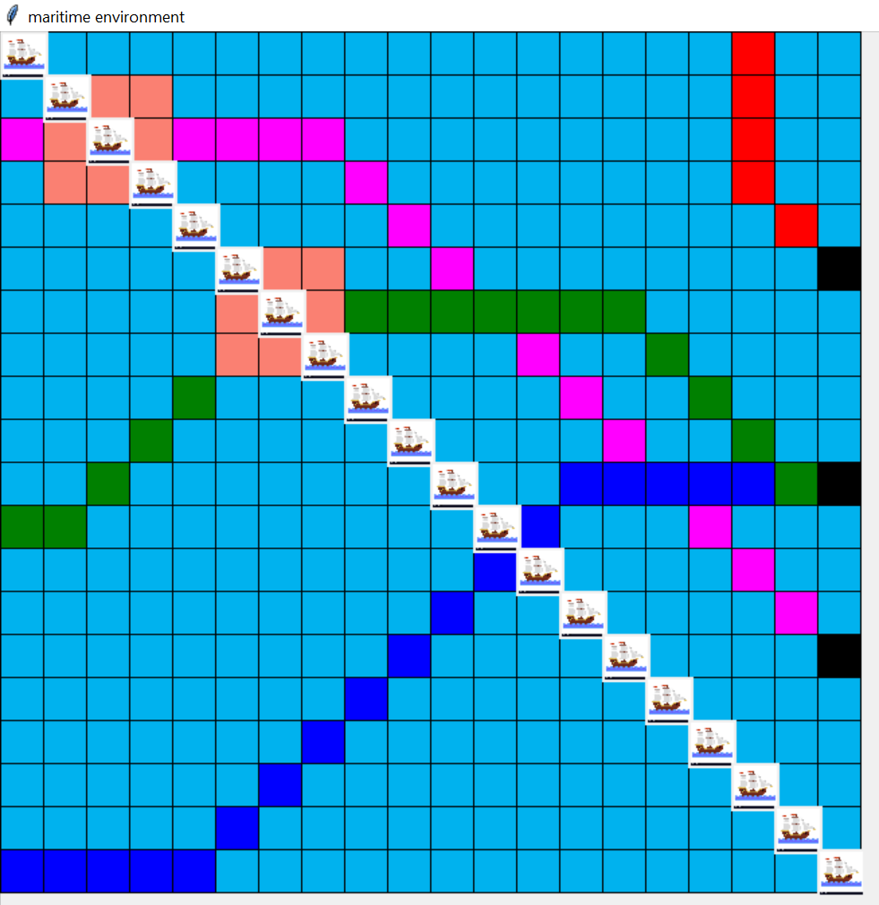
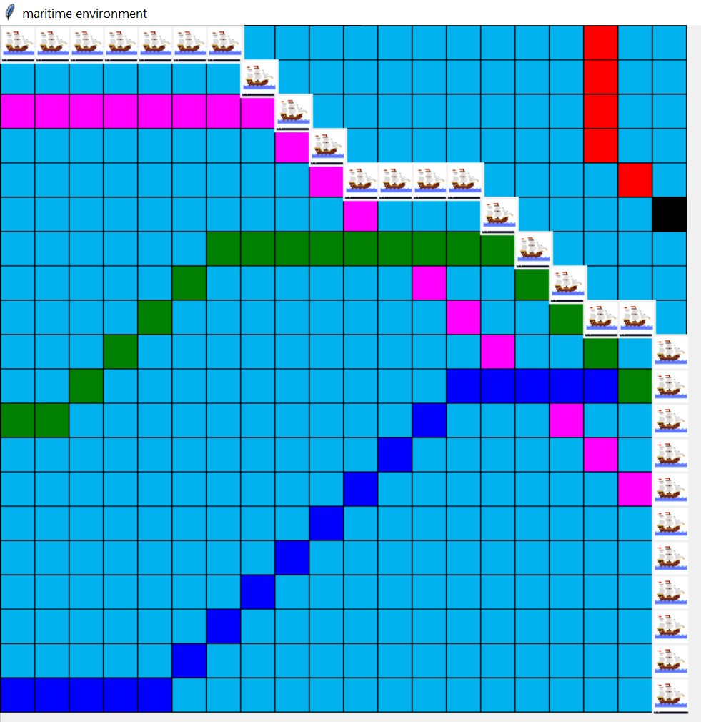
Results
Other Ships: 4
steps: 31
Time: 0.050s
Breaks : 2
moves : 29
Fig: Collisions in path found by A*
Fig: Trajectory using collision avoidance algorithm with smoothing

Slide 23
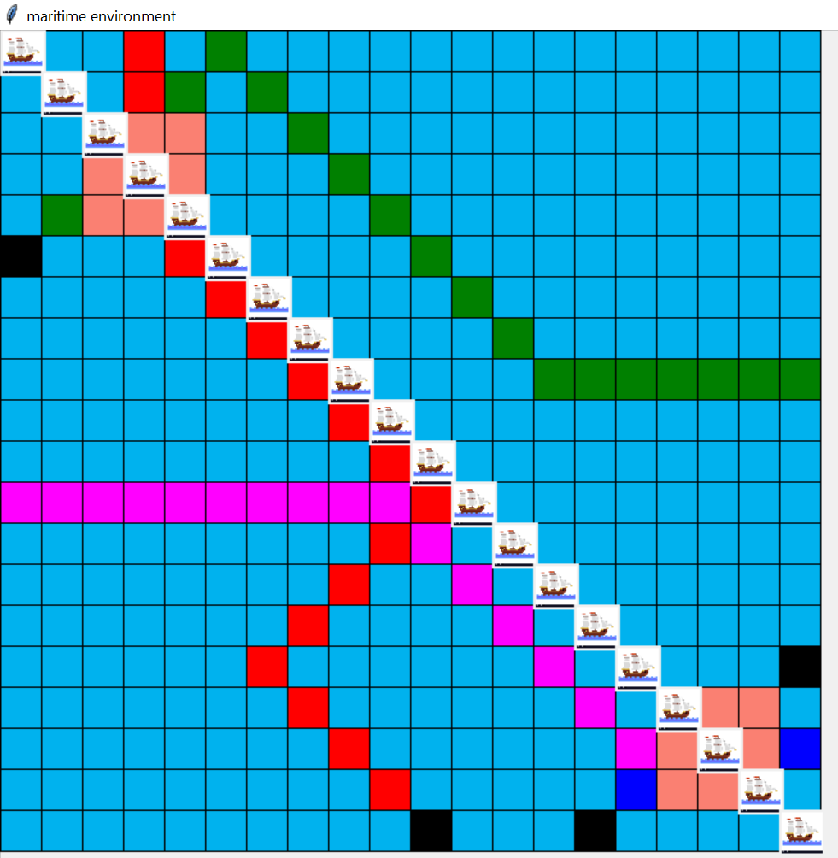
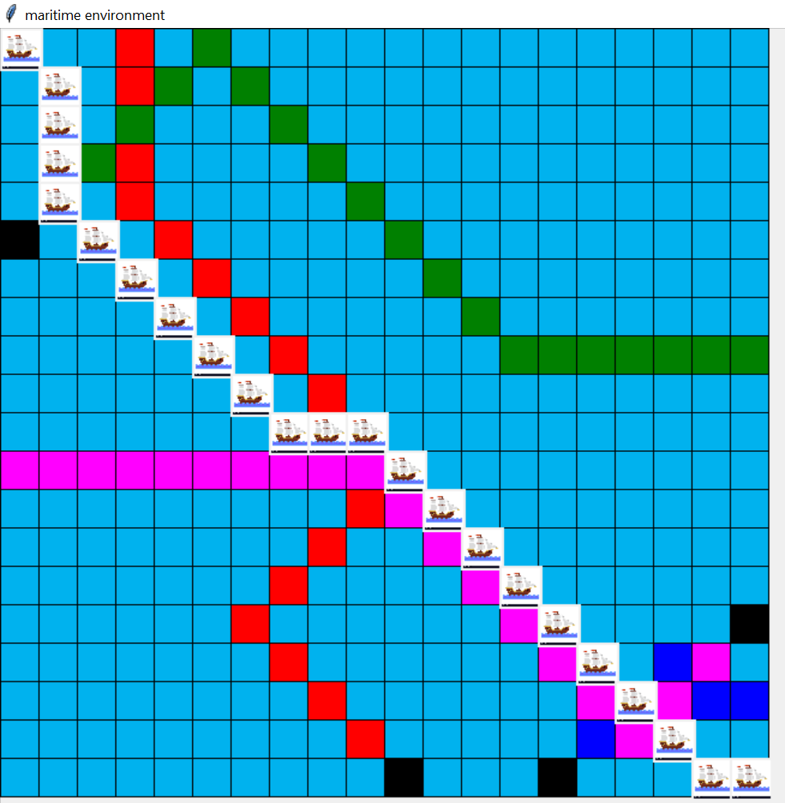
Results
Other Ships: 4
Cost : 23
Time: 0.025s
Breaks : 1
Moves: 22
Fig: Collisions in path found by A*
Fig: Trajectory using collision avoidance algorithm with smoothing

Slide 24
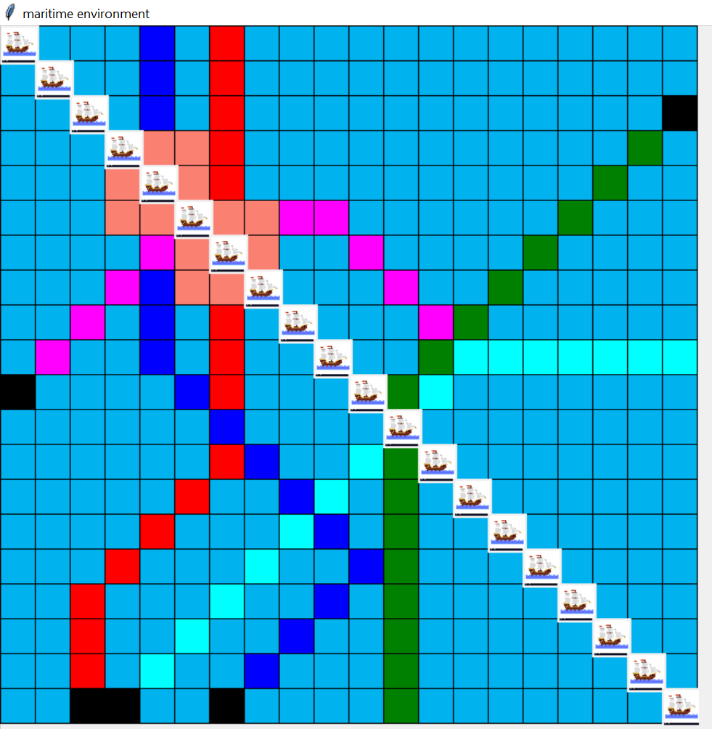
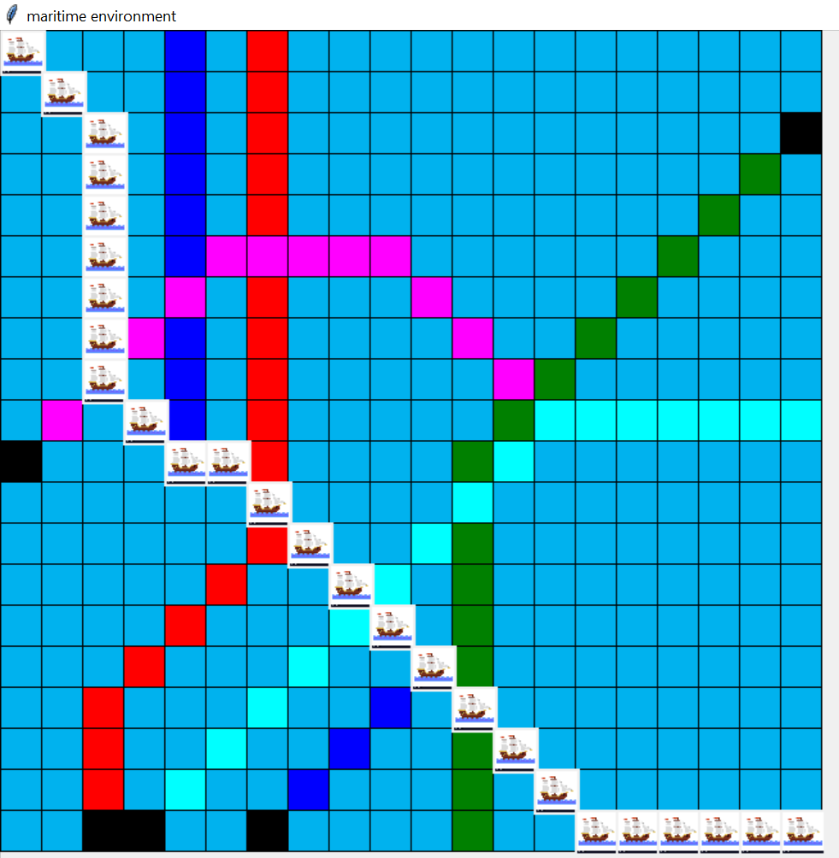
Results
Other Ships: 5
Steps: 27
Time: 0.037s
Breaks : 2
Moves: 25
Fig: Collisions in path found by A*
Fig: Trajectory using collision avoidance algorithm with smoothing

Slide 25
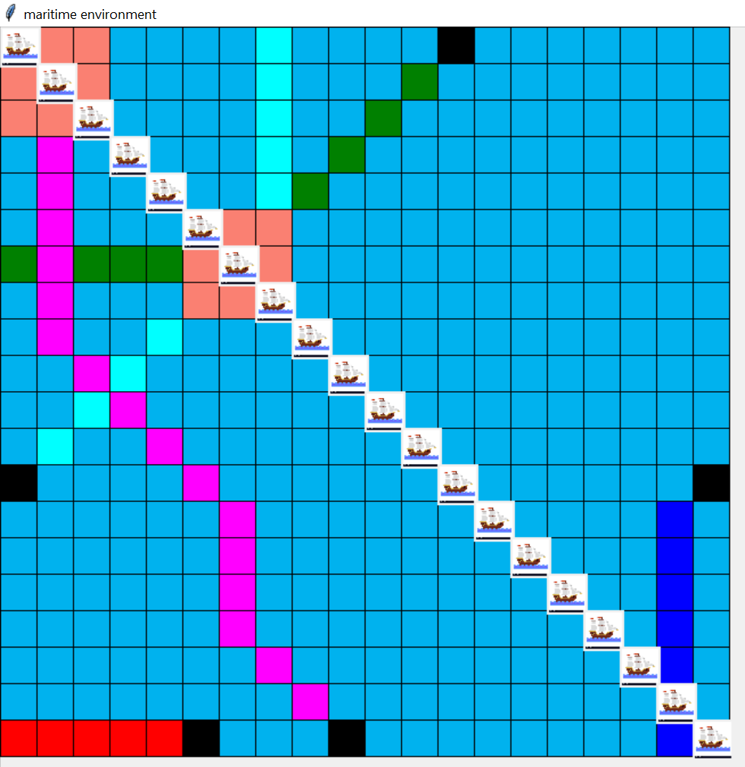
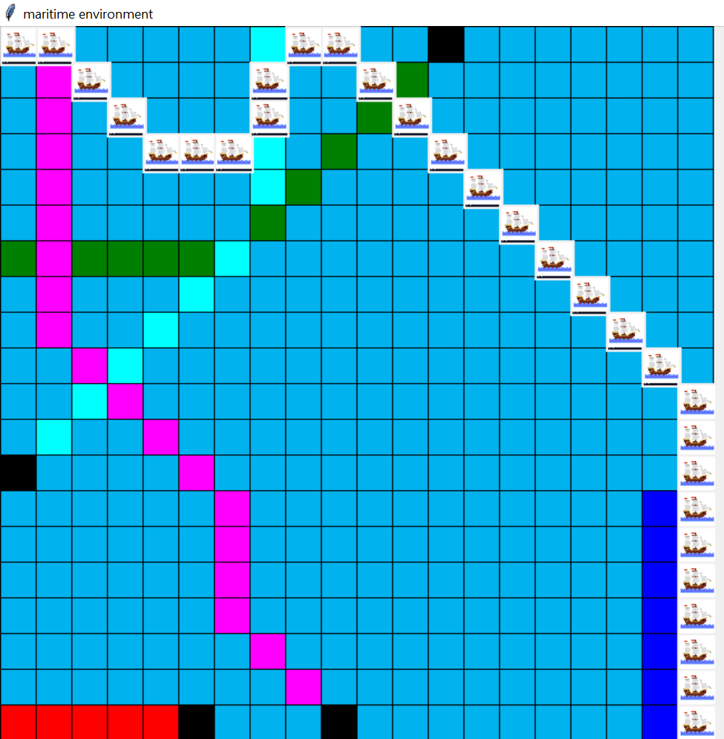
Results
Other Ships: 5
Steps: 31
Time: 0.038s
Breaks : 2
Moves: 29
Fig: Collisions in path found by A*
Fig: Trajectory using collision avoidance algorithm with smoothing

Slide 26
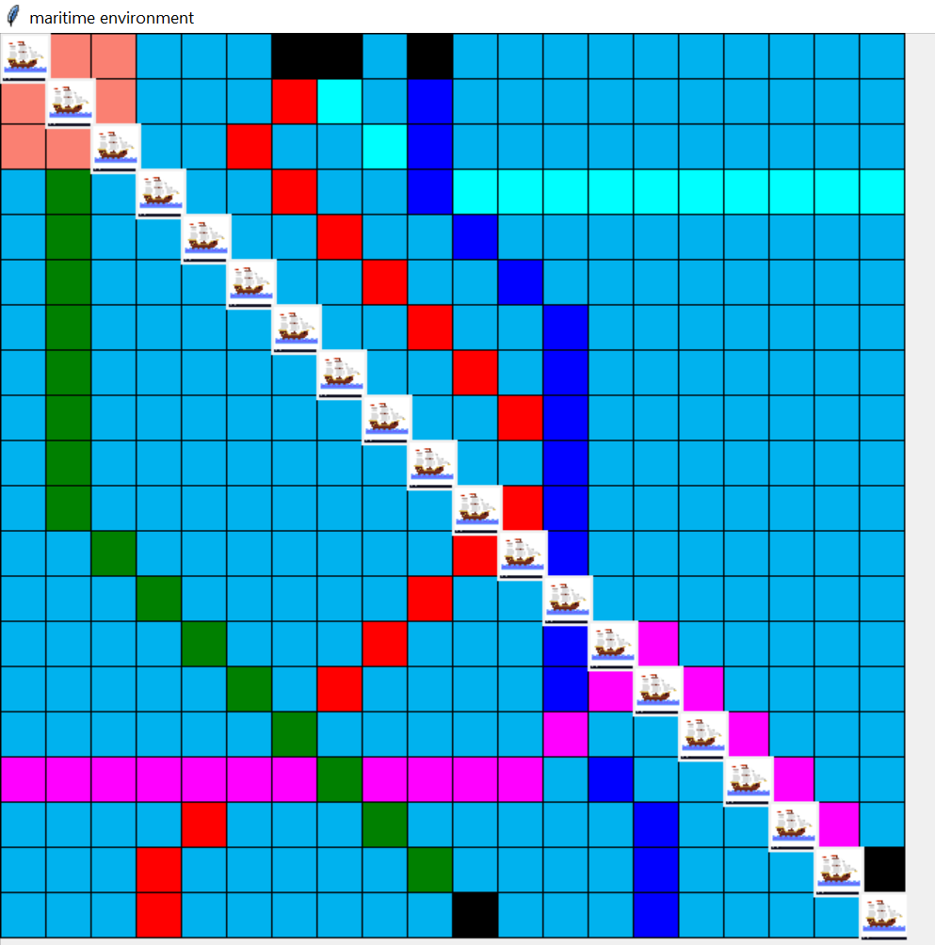
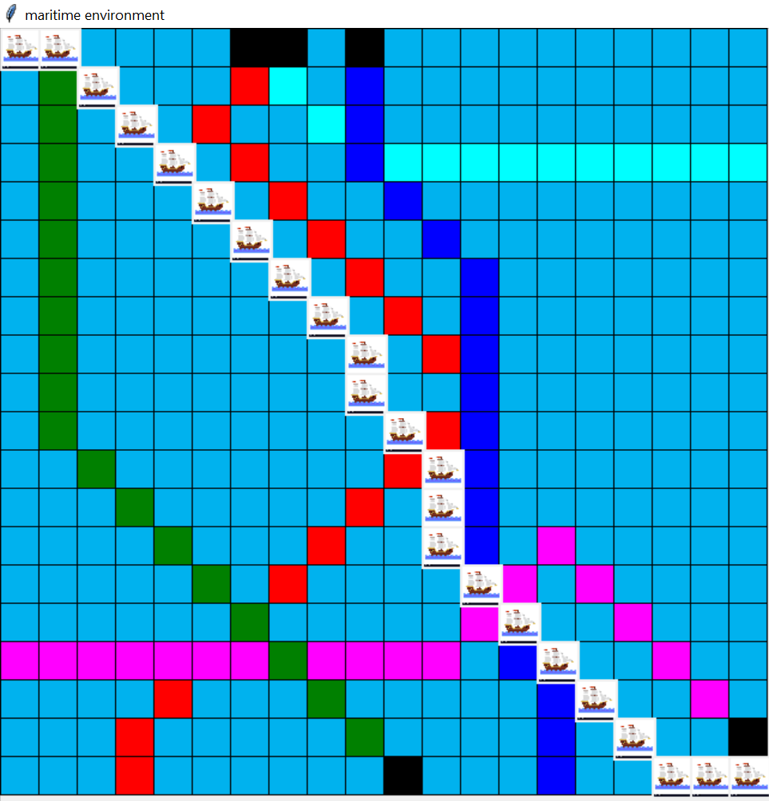
Results
Other Ships: 5
Steps: 24
Time: 0.080s
Breaks : 2
Moves: 22
Fig: Collisions in path found by A*
Fig: Trajectory using collision avoidance algorithm with smoothing

Slide 27
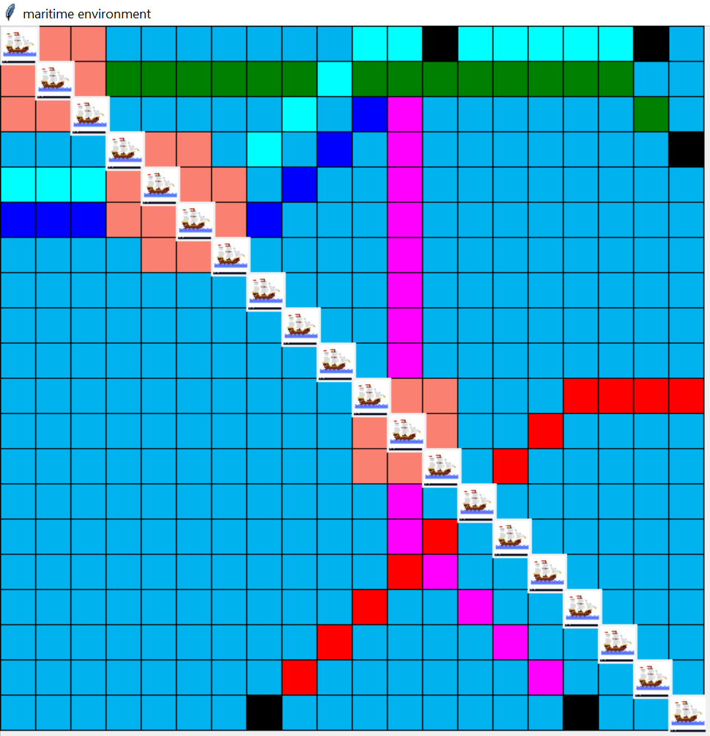
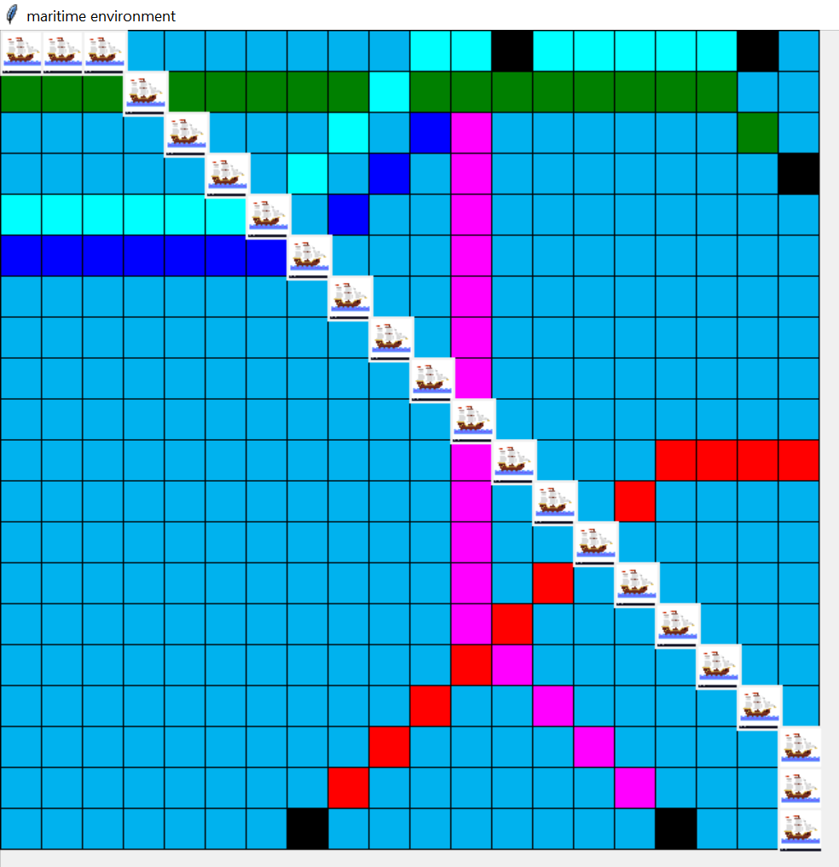
Results
Other Ships: 5
Steps: 22
Time: 0.022s
Breaks : 1
Moves: 21
Fig: Collisions in path found by A*
Fig: Trajectory using collision avoidance algorithm with smoothing

Slide 28
Conclusion and Future Work
A* with dynamic heuristic function with help of fuzzy logic was implemented for ship collision avoidance in congested water environment
Paths of Own ship computed from ship collision avoidance algorithm from different experiments has avoided collision, ensured smoothness and optimality
With smoothness constraint sometimes optimality has to be compromised
Future work can be done by considering more uncertainties and including speed factor

Slide 29
References
Calle, Miguel Angel & Alves, Marcilio. (2011). Ship collision: A brief survey.
Chen L., Negenborn R.R., Lodewijks G. (2016) Path Planning for Autonomous Inland Vessels Using A*BG. In: Paias A., Ruthmair M., Voß S. (eds) Computational Logistics. ICCL 2016.
Vagale, A., Oucheikh, R., Bye, R.T. et al. Path planning and collision avoidance for autonomous surface vehicles I: a review. J Mar Sci Technol (2021)

Slide 30
Tools Used
For GUI : tkinter, termcolor, PIL
Programming Language : Python

Slide 31
Thank you

