Slide 1
StyleSense AI
Personalized Fashion Recommendations & Virtual Try-On
JAPJIT · PRABHSIMRAN · PANSHUL · RATIK · ABHINEET
Minor Project | April 2026
Kotlin + Jetpack Compose
FastAPI + Redis
IDM-VTON Try-On

Slide 2
Why Does Fashion Shopping Feel Broken?
🧠
👗
🌤️
Decision Fatigue
No Try-Before-Buy
Context Blindness
Too many choices, zero personalization — shoppers abandon carts overwhelmed by options.
Can't visualize fit or style match until the item arrives at your door — returns spike.
Ignores local weather, current occasion, and existing wardrobe when suggesting outfits.
"20–35% of online fashion orders are returned — driven by poor fit and zero personalization"

Slide 3
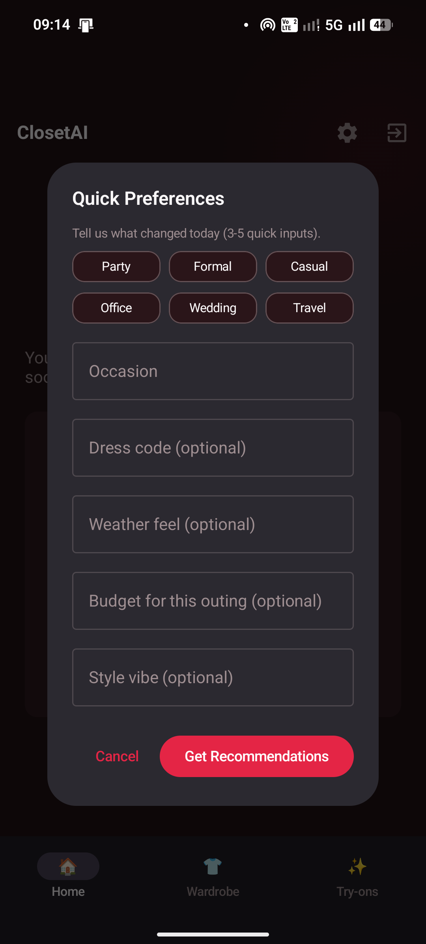
OUR SOLUTION
StyleSense AI: Context-Aware Fashion Intelligence
▸
Profile-driven 10-step onboarding Body type, skin tone, style prefs, budget, occasions
▸
Live Myntra product scraping Real-time catalog via BeautifulSoup + curl_cffi
▸
MatchScorer multi-factor ranking Style · Color · Brand · Weather · Wardrobe · Feedback
▸
Weather-aware suggestions via GPS OpenWeatherMap REST API integration
▸
Wardrobe-compatible recommendations Avoids duplicates, suggests complementary pieces
▸
AI Virtual Try-On (IDM-VTON) Diffusion-based try-on via hosted HuggingFace Space

Slide 4
System Architecture
Android App
FastAPI Backend
• Kotlin + Jetpack Compose
• Python + Uvicorn
• Material 3 UI
• /recommendations
▶
Firebase / Firestore
• Firebase Auth SDK
• /tryon
Auth + DB (direct from App)
• Firestore SDK
• /wardrobe/*
▶
▶
Redis Cache
• Retrofit / OkHttp
• Redis client
▶
In-memory ranked results
• DataStore (local cache)
• Gradio client (HF)
▶
Myntra Scraper
BeautifulSoup + curl_cffi
HuggingFace IDM-VTON
All communication via REST/HTTP · Firebase accessed directly from the Android app
Gradio client → try-on AI
▼
OpenWeatherMap API

Slide 5
Technology Stack
Mobile UI
Auth
Kotlin + Jetpack Compose + Material 3
Firebase Auth (Google Sign-In via Credential Manager)
Database
Backend
Cloud Firestore (NoSQL, realtime sync)
Python FastAPI + Uvicorn (async REST API)
Cache
Scraping
Redis (in-memory fallback for dev)
BeautifulSoup + curl_cffi (TLS bypass)
Weather
Try-On AI
OpenWeatherMap REST API (GPS-based forecast)
HuggingFace IDM-VTON via Gradio Client

Slide 6
MODULE 01
Authentication & Identity
Splash Screen
▸
Google Sign-In via Credential Manager No context switching — in-app auth flow, no external browser
▼
▸
Firebase UID as primary key Used across Firestore collections and Redis keying
Google Sign-In
Android Credential Manager
▼
▸
Persistent session management Token refresh handled automatically; skip sign-in on return
Firebase Auth → UID
Token verified server-side
▸
Zero-knowledge onboarding check Firestore query determines first-time vs. returning user
▼
Route: Onboard / Home
Based on Firestore profile
▸
Screens: Splash, Sign-In Minimal, dark-themed entry point

Slide 7
MODULE 02
10-Step Profile Onboarding
1
2
3
4
5
6
7
8
9
10
Gender
Body
Type
Measure
ments
Skin
Tone
Style
Prefs
Fit
Prefs
Occasions
Budget
Special
Reqs
Categories
All 10 steps persisted to Firestore users/{uid} on completion
▸ Gender, body type & key measurements
▸ Budget range (₹ slider, saved to Firestore)
▸ Skin tone (8-point scale from selfie or manual)
▸ Special requirements — plus-size, petite, maternity
▸ Style archetypes — casual, formal, streetwear …
▸ Preferred categories — tops, bottoms, dresses …
▸ Preferred fit (slim, regular, relaxed, oversized)
▸ No purchase history needed (cold-start solved)
▸ Occasions — daily, office, gym, date night, festival
▸ Profile editable anytime from Settings screen
Cold-Start Solved: No purchase history needed — profile data drives immediate personalization from day one.

Slide 8
MODULE 03
Smart Wardrobe Management
Photo / Pick Image
▸
Camera or gallery image selection Uses Android photo picker & CameraX — no extra permissions
Camera or gallery picker
▼
▸
Backend saves to /uploads dir FastAPI saves file; returns public URL for Firestore storage
POST /wardrobe/upload
Backend saves to /uploads dir
▸
Metadata stored per item Firestore stores URL, category, color, date added
▼
URL stored in Firestore
▸
Wardrobe items feed MatchScorer Existing items influence recommendation ranking weights
users/{uid}/wardrobe/{id}
▼
Wardrobe Grid UI
▸
Prevents duplicate purchases MatchScorer de-ranks items similar to already-owned pieces
LazyVerticalGrid — tap to manage
▸
Screens: Wardrobe Grid, Add Item Full CRUD — add, view, delete wardrobe items

Slide 9
MODULE 04
MatchScorer Recommendation Engine
User Profile (Firestore) + Context (Occasion, Weather) + Wardrobe Items
▼
Myntra Scraper
BeautifulSoup + curl_cffi → 200 raw candidates → Redis Cache (TTL 10 min)
▼
MatchScorer — Multi-Factor Ranking
Style Match
Color Harmony
Brand Pref
Weather Fit
Wardrobe Compat
Feedback Weight
▼
Ranked + Paginated Results → Android App
Redis caches ranked list; re-ranks only when feedback version changes — no re-scraping

Slide 10
MODULE 05
AI Virtual Try-On
User Selfie + Garment URL
▸
IDM-VTON: diffusion-based try-on (2023) State-of-art virtual garment fitting — no mesh or 3D model needed
▼
POST /tryon
▸
No GPU needed on our side Inference runs on hosted HuggingFace free-tier Space
FastAPI endpoint
▼
▸
Returns Base64 image No extra file hosting required — sent directly as response body
Download garment image
Backend fetches from URL
▼
▸
Try-on history saved locally Android DataStore keeps last 20 try-on results for offline view
Gradio Client → HF Space
IDM-VTON inference
▼
▸
Screens: Try-On Select + Result One-tap flow: pick garment, see yourself wearing it
Base64 image response
▸
Latency: 20–60s on HF free tier Handled gracefully with loading state + progress indicator
▼
Display + Save to History
DataStore (local)

Slide 11
MODULE 06
Like/Dislike Feedback Loop
User Sees
Recommendations
Swipe
Like / Dislike
POST /recommendations
/feedback
▶
▶
▲
▼
Updated Ranking
Sent to App
Re-rank Applied
(No re-scraping)
Stored in Redis
Keyed by UID
◀
◀
Key Insight:
"No re-training. No re-scraping. Pure re-ranking — instant personalization from user feedback."

Slide 12
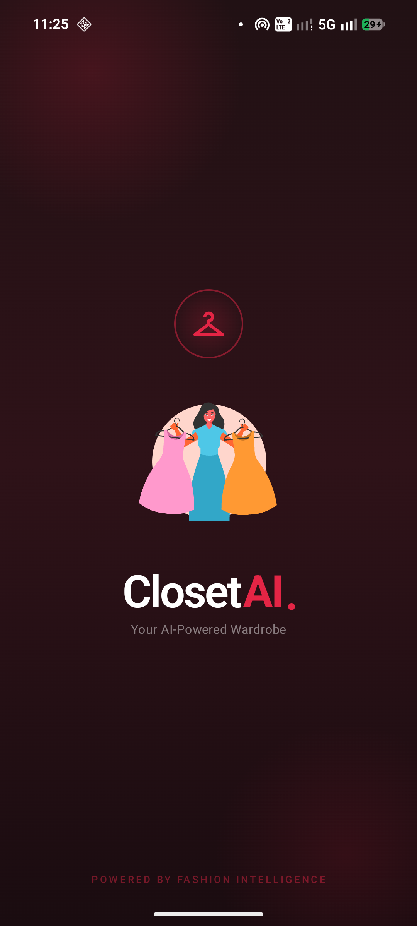
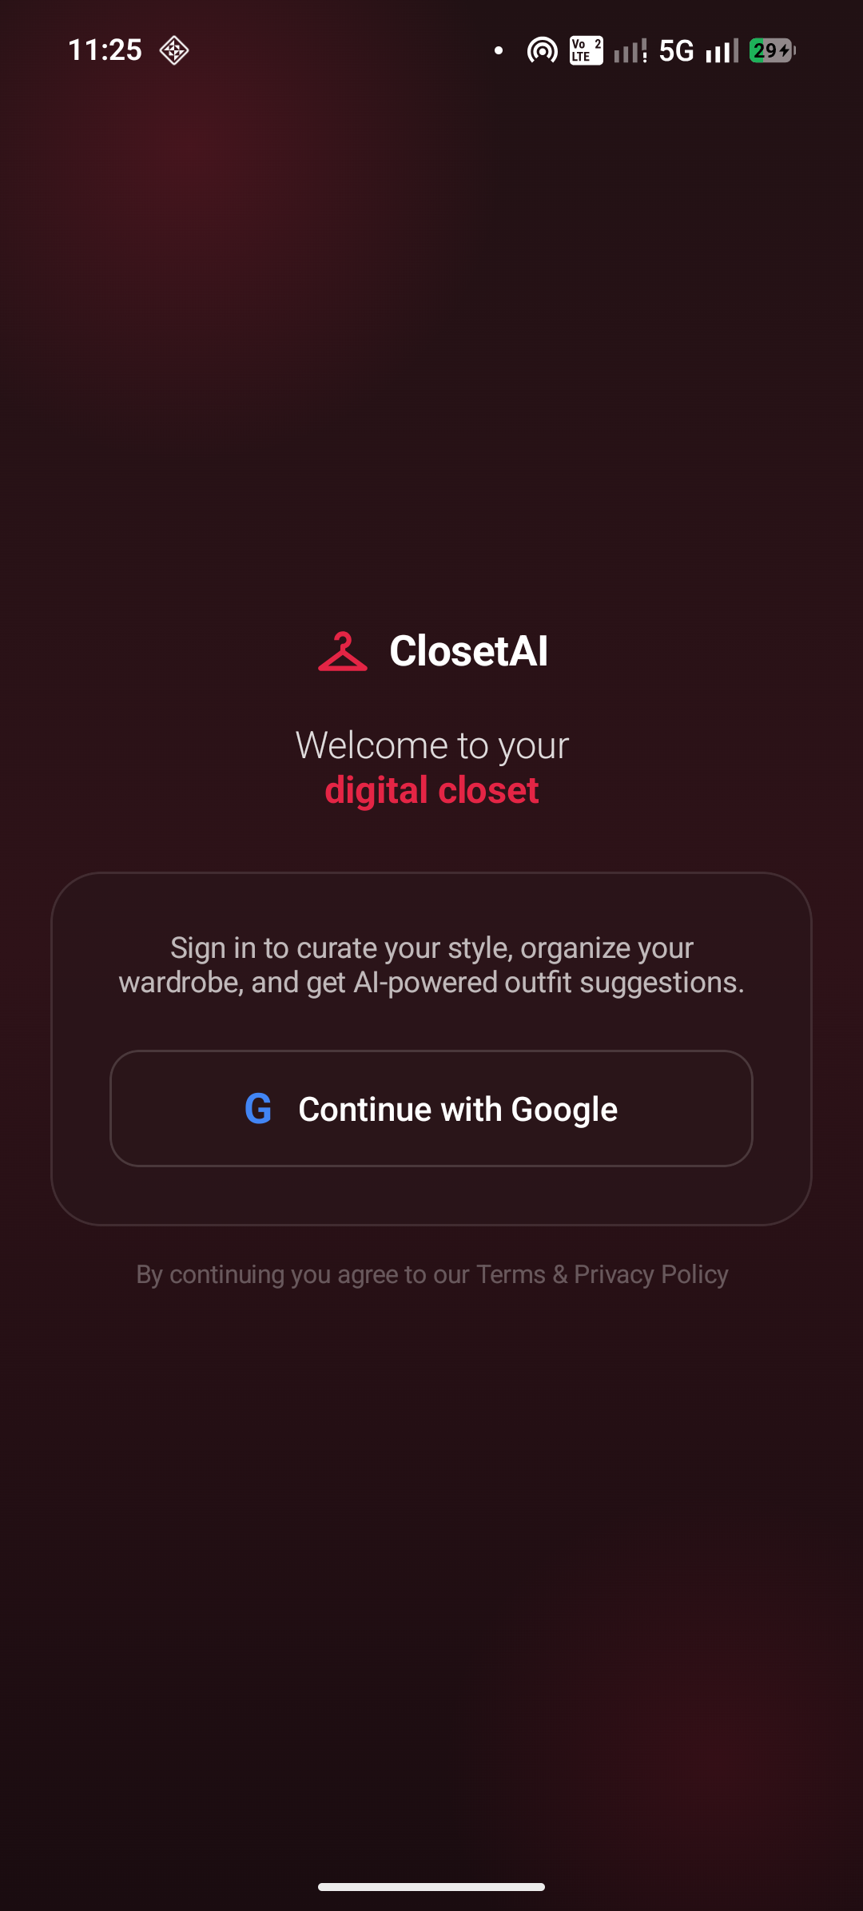
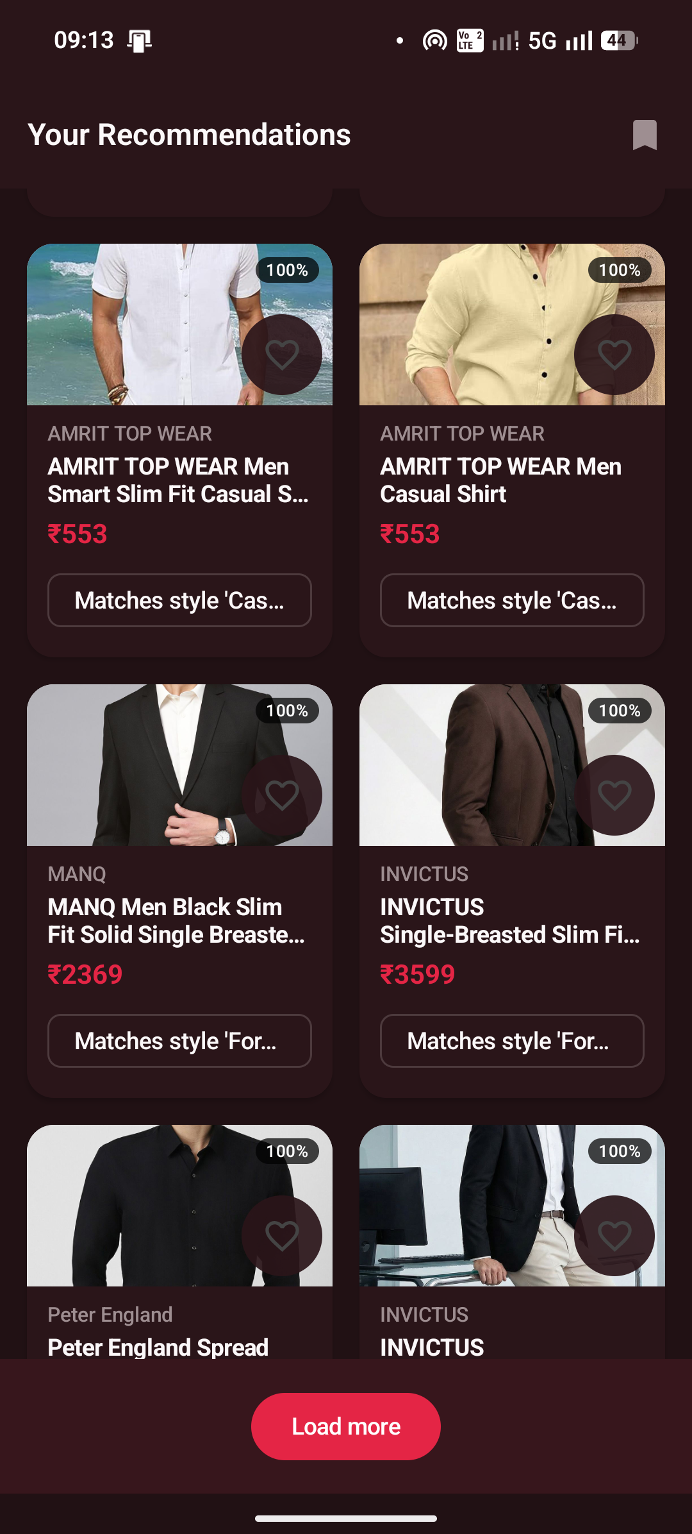
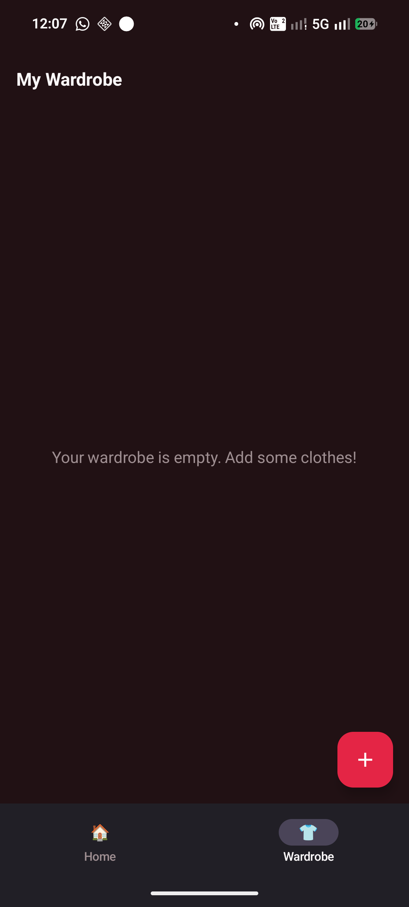
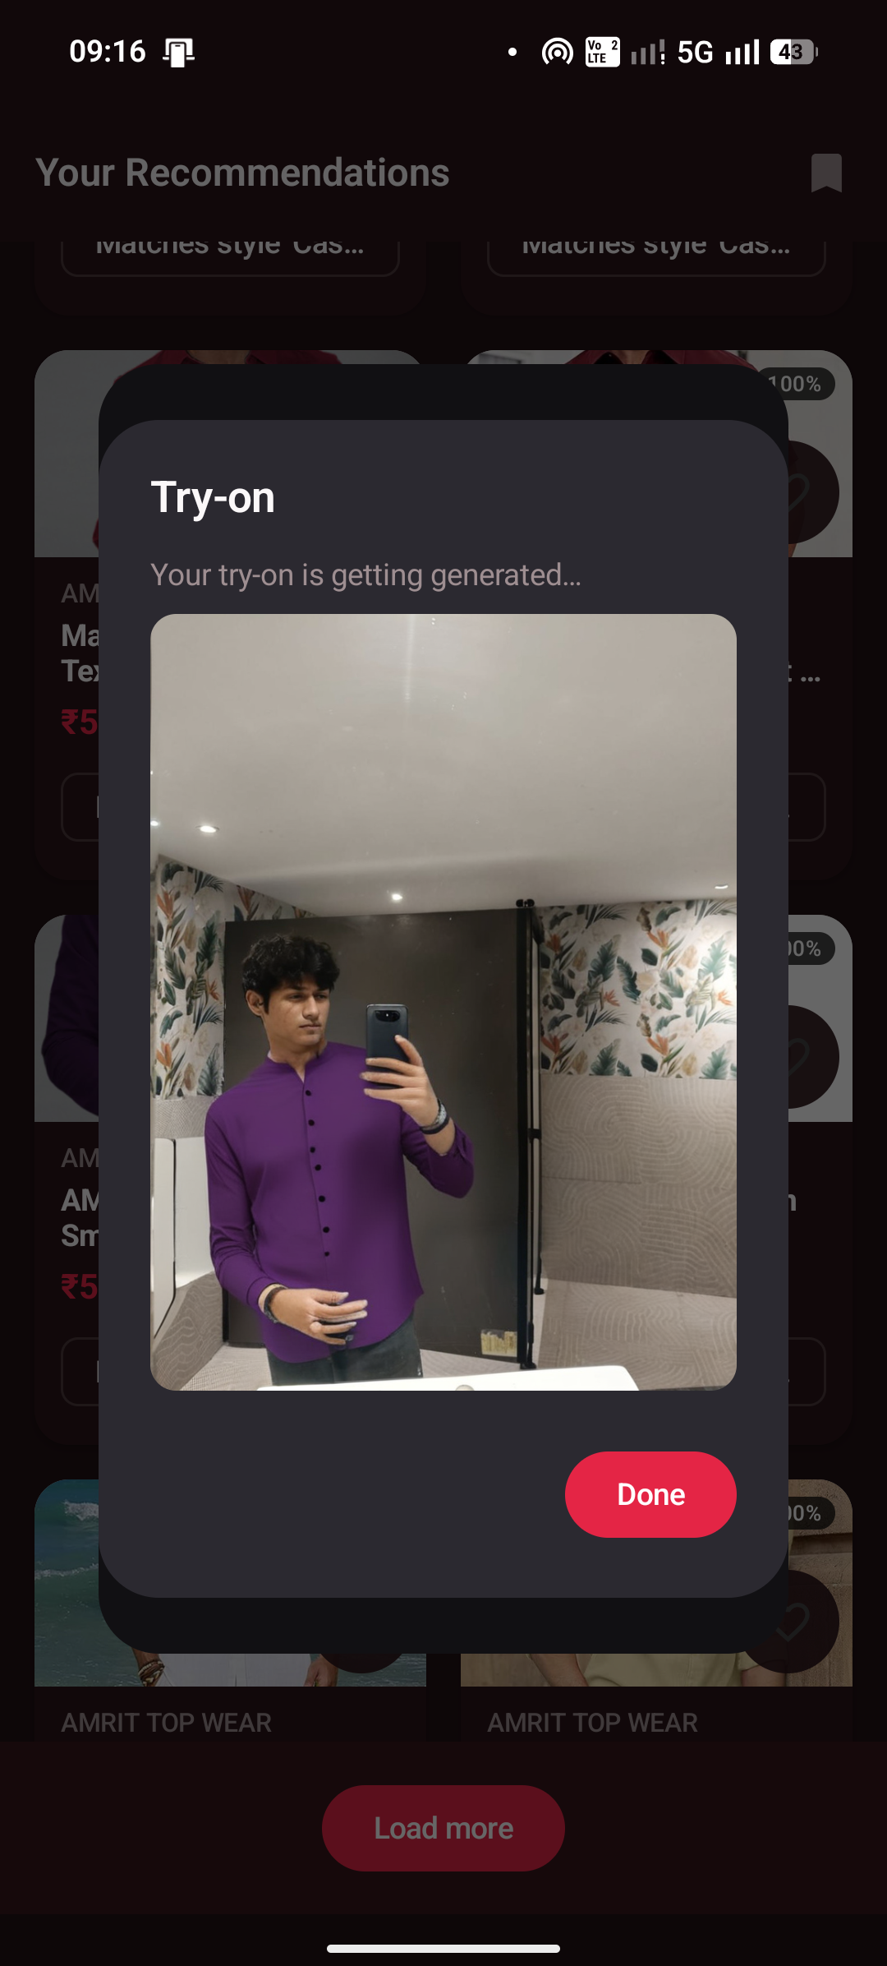
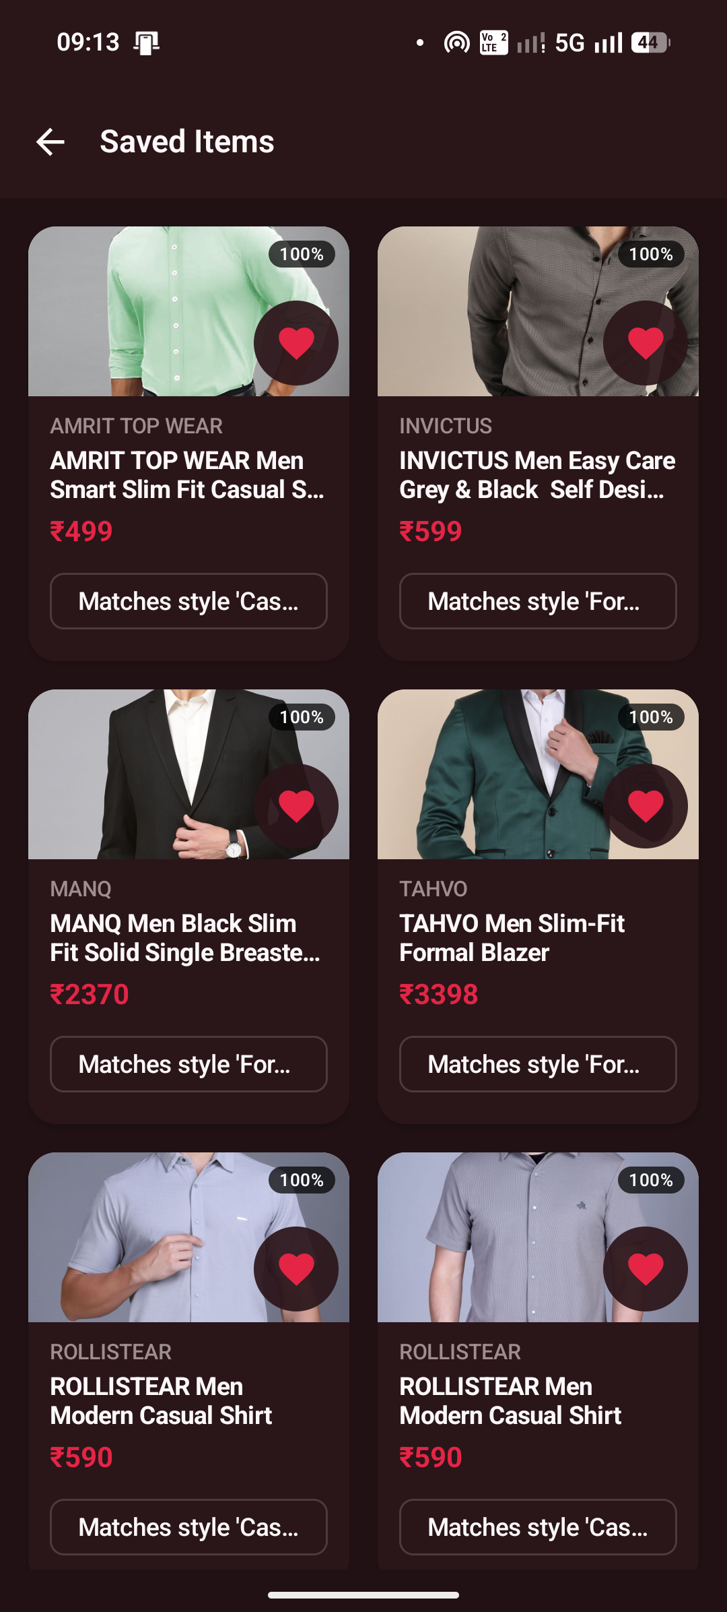
App Screens
Splash Screen
Sign-In
Recommendations
Wardrobe Grid
Try-On Result
Saved Items
Built with Jetpack Compose + Material 3 · Dark-mode first design

Slide 13
How We Compare
System | Body-Type Aware | Weather Aware | Wardrobe Aware | Virtual Try-On | Live Catalog
Myntra | ~ | ✗ | ✗ | Limited | ✓
ASOS | Size guide | ✗ | ✗ | ✗ | ✓
Stitch Fix | ✓ | ✗ | ~ | ✗ | ✗
H&M Style Quiz | ~ | ✗ | ✗ | ✗ | ✗
Google Lens | ✗ | ✗ | ✗ | ✗ | ✗
StyleSense AI | ✓ | ✓ | ✓ | ✓ | ✓

Slide 14
Future Directions
🛒
🧠
Multi-Store Scraping
ML-Based Ranking
Expand beyond Myntra to AJIO, Amazon Fashion, and Meesho for broader catalog coverage and price comparison.
Replace rule-based MatchScorer with a learned ranking model (e.g. LightGBM/NCF) as interaction data grows.
👥
📱
Social Features
On-Device Try-On
Share curated outfits, follow stylists, collaborative wishlists, and community-sourced style boards.
Distilled IDM-VTON model for offline/real-time try-on — no server round-trip, instant results.

Slide 15
Thank You
Questions?
JAPJIT · PRABHSIMRAN · PANSHUL · RATIK · ABHINEET
Minor Project | April 2026
github.com/your-org/stylesense-ai

