Slide 1

Centralized Log Management with Elastic Stack
RICH
2019/6/09

Slide 2
Outline
Problem Statement
Elastic Stack
Log Management Service
Architecture Design
Implementation Details
Advanced Design
Querying Data
Data Backup/Restore
Management & Monitoring Tools

Slide 3
Problem Statement
Context
In Microservices architecture, an application consists of multiple services and service instances that are running on multiple machines.
Each service instance generates writes information about what it is doing to a log file.
Problem
How to query information related to system operation from the data efficiently.
How to troubleshoot bugs from multiple log files
Solution
Build a log management service with Elastic Stack, because it is a mature and complete open source tool.

Slide 4
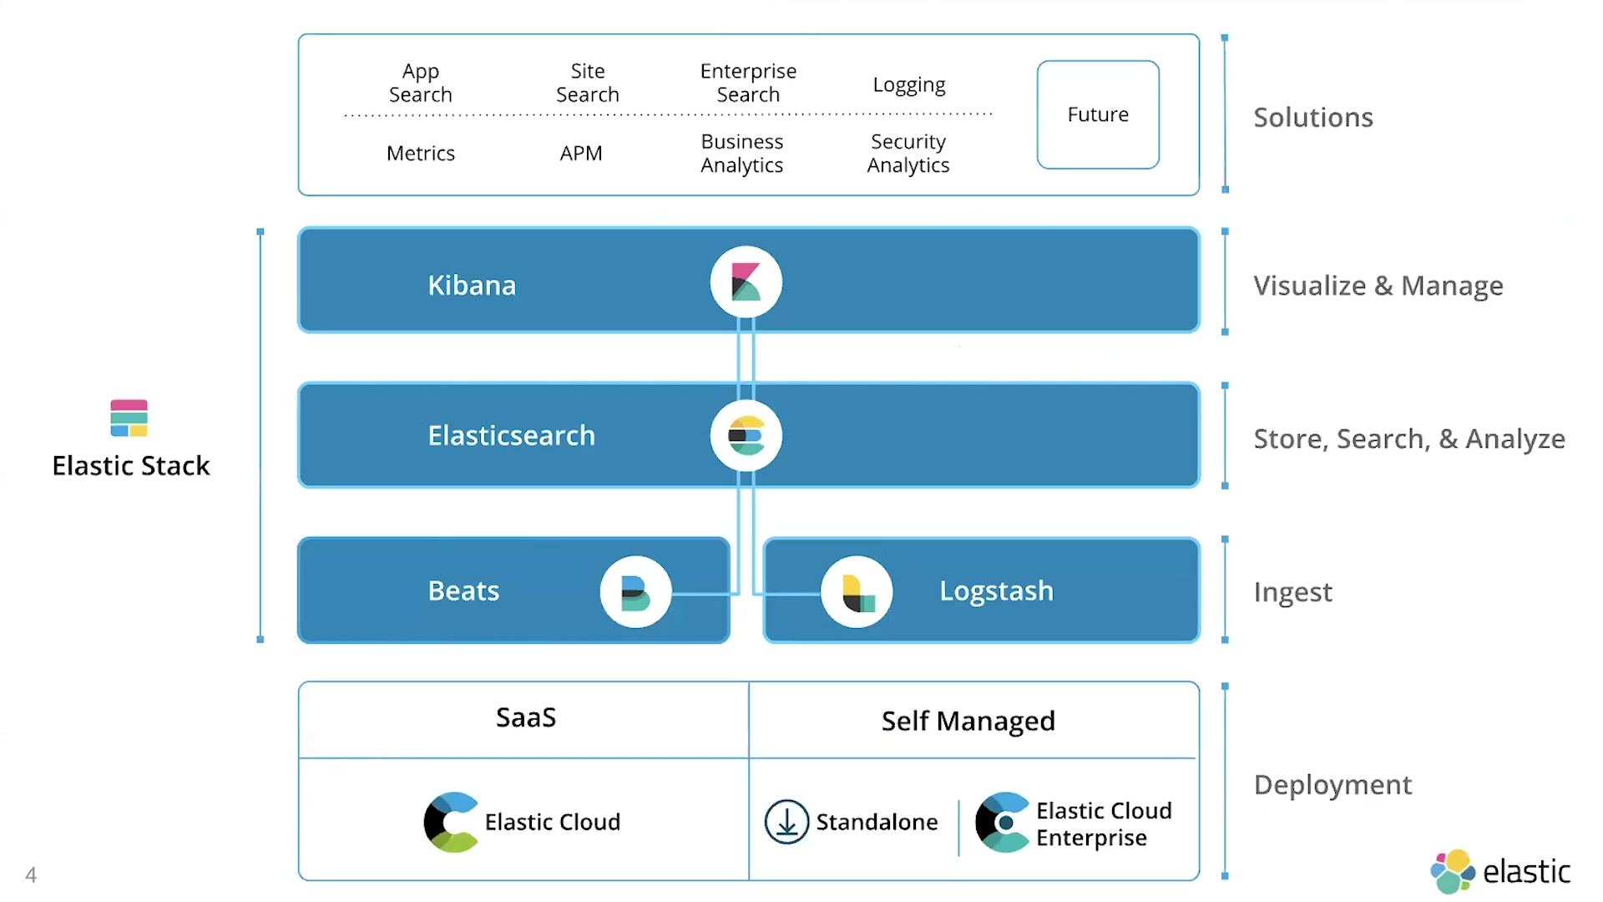
What is the ELK Stack?
The ELK Stack is a collection
of multiple open-source products, all developed, managed and maintained by Elastic.
ref

Slide 5
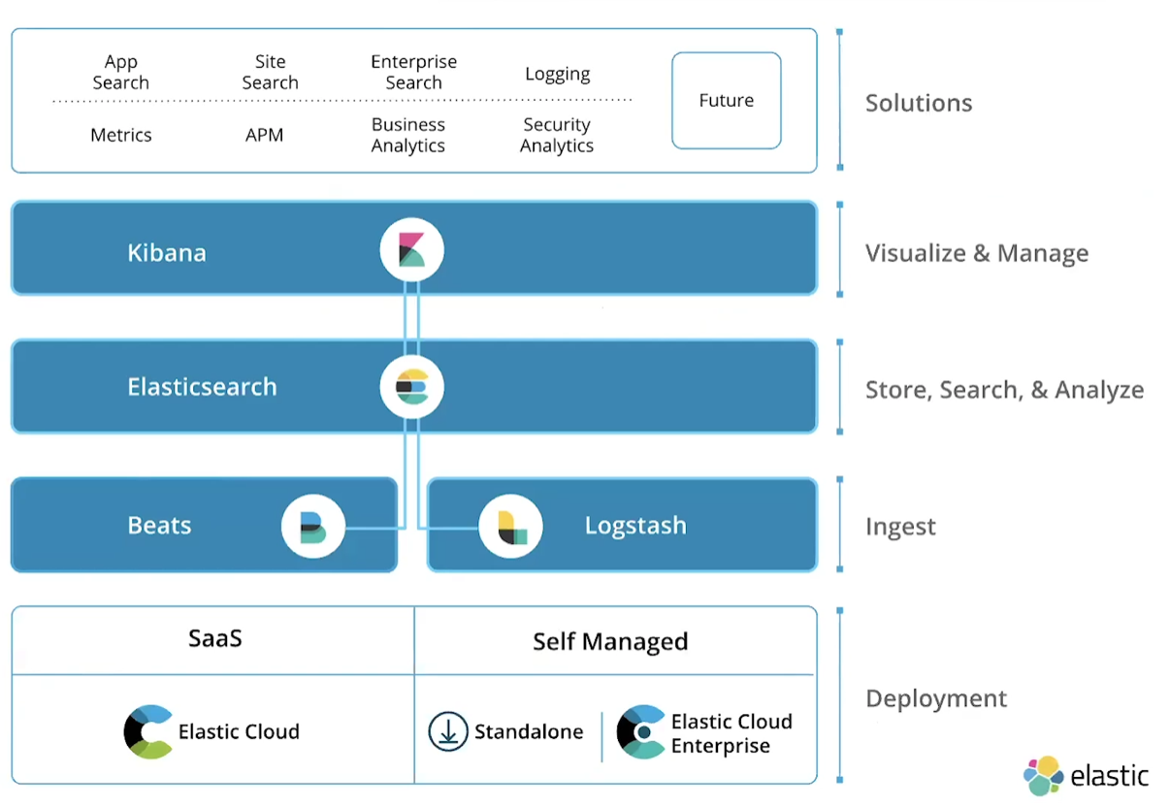
What is the ELK Stack?
However, we only need to use the following modules for this solution.
Beats: agents to ship log data
Logstash: processing log data
Elasticsearch: storing log data
Kibana: UI for visualizing

Slide 6
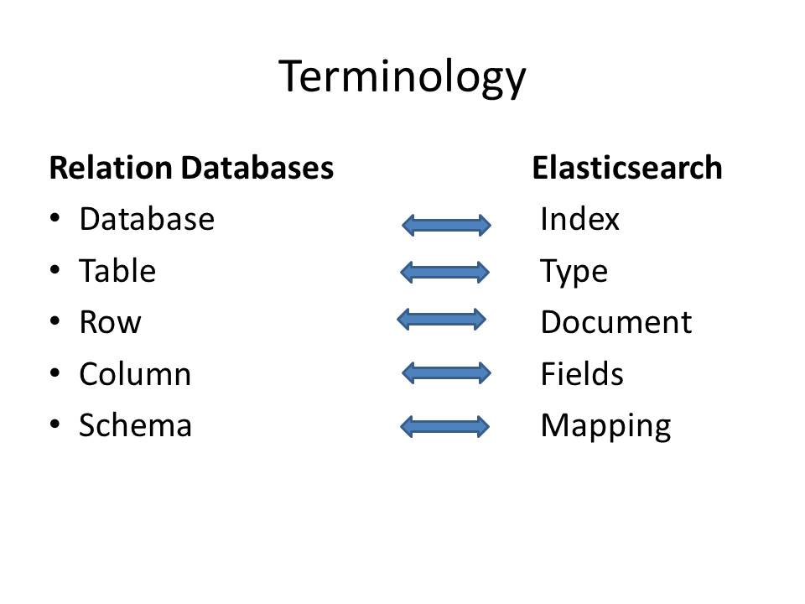
Elasticsearch Basic Concepts
Index
An index contains one or multiple types
An Elasticsearch index is an independent chunk of document and stored on the disk in the same set of files
Type
A type can be thought of as a table in a RDB
A type has one or more documents
Document
A document is normally a JSON
representation of your data

Slide 7
Elasticsearch Basic Concepts
Cluster
A cluster has one or more nodes. Clusters are identified by their names. (default cluster name= elasticsearch)
Node
A node is an instance of Elasticsearch
Multiple nodes can join the same cluster. With a cluster of multiple nodes, the same data can be spread across multiple servers.
Shard
An index can be divided into shards.
There are two types of shards
primary
replica

Slide 8
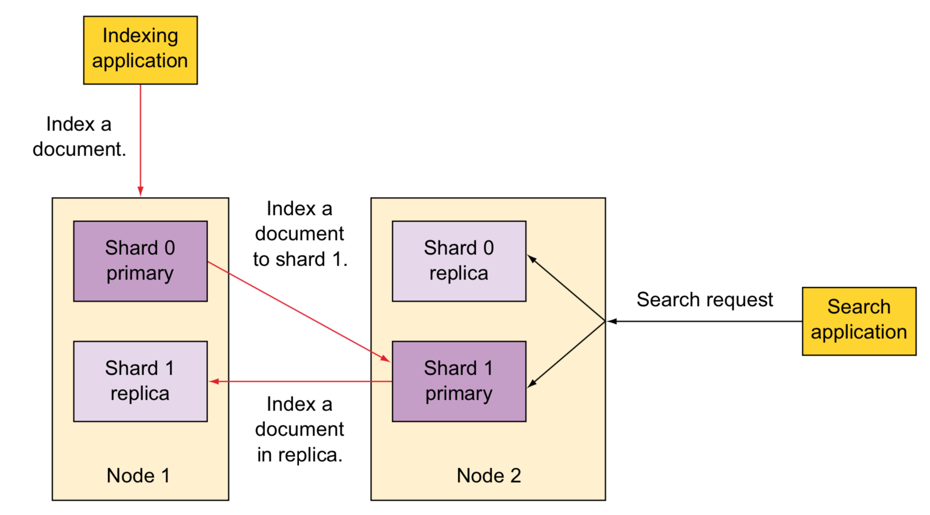
Elasticsearch Basic Concepts
Node types
Master node: in charge of cluster management
Data node: Data nodes hold data and perform CRUD, search, and aggregations.
Ingest node: for pre-processing documents before indexing
Machine learning node
Each document, when indexed, is first added
to the primary shard and then to one or more
replica shards
ref Elasticsearch in action 2015

Slide 9
Elasticsearch Basic Concepts
Minimum master nodes
We can specify a property that Elasticsearch evaluates to find out the minimum number of nodes that are needed as master eligible
Split Brain Problem
To avoid this problem, we can use discovery.zen.minimum_master_nodes
setting for cluster setup.
The value of this setting can be derived as: ( Total number of nodes / 2 ) + 1
For example: If we have 4 nodes, so we should keep this value to 3
discovery.zen.minimum_master_nodes=3

Slide 10
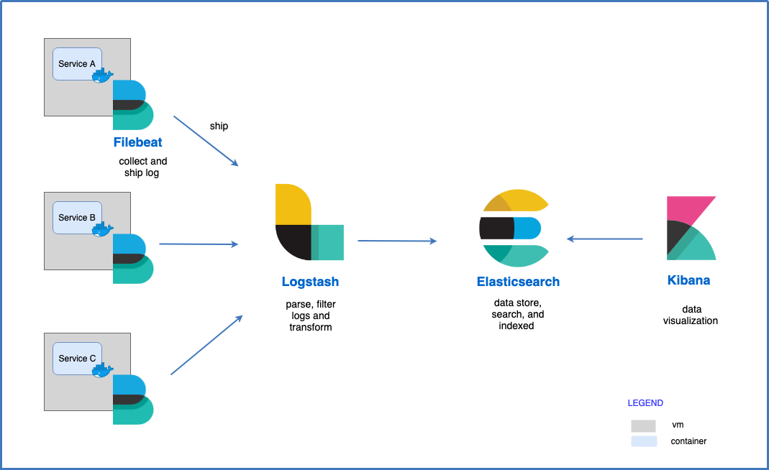
Log Management Architecture Design
Data processing flow:
Filebeat will ship all the
logs to Logstash
2. Logstash transform data format
and output to Elasticsearch
3. view logs on Kibana and
query by specific field
1
2
3

Slide 11
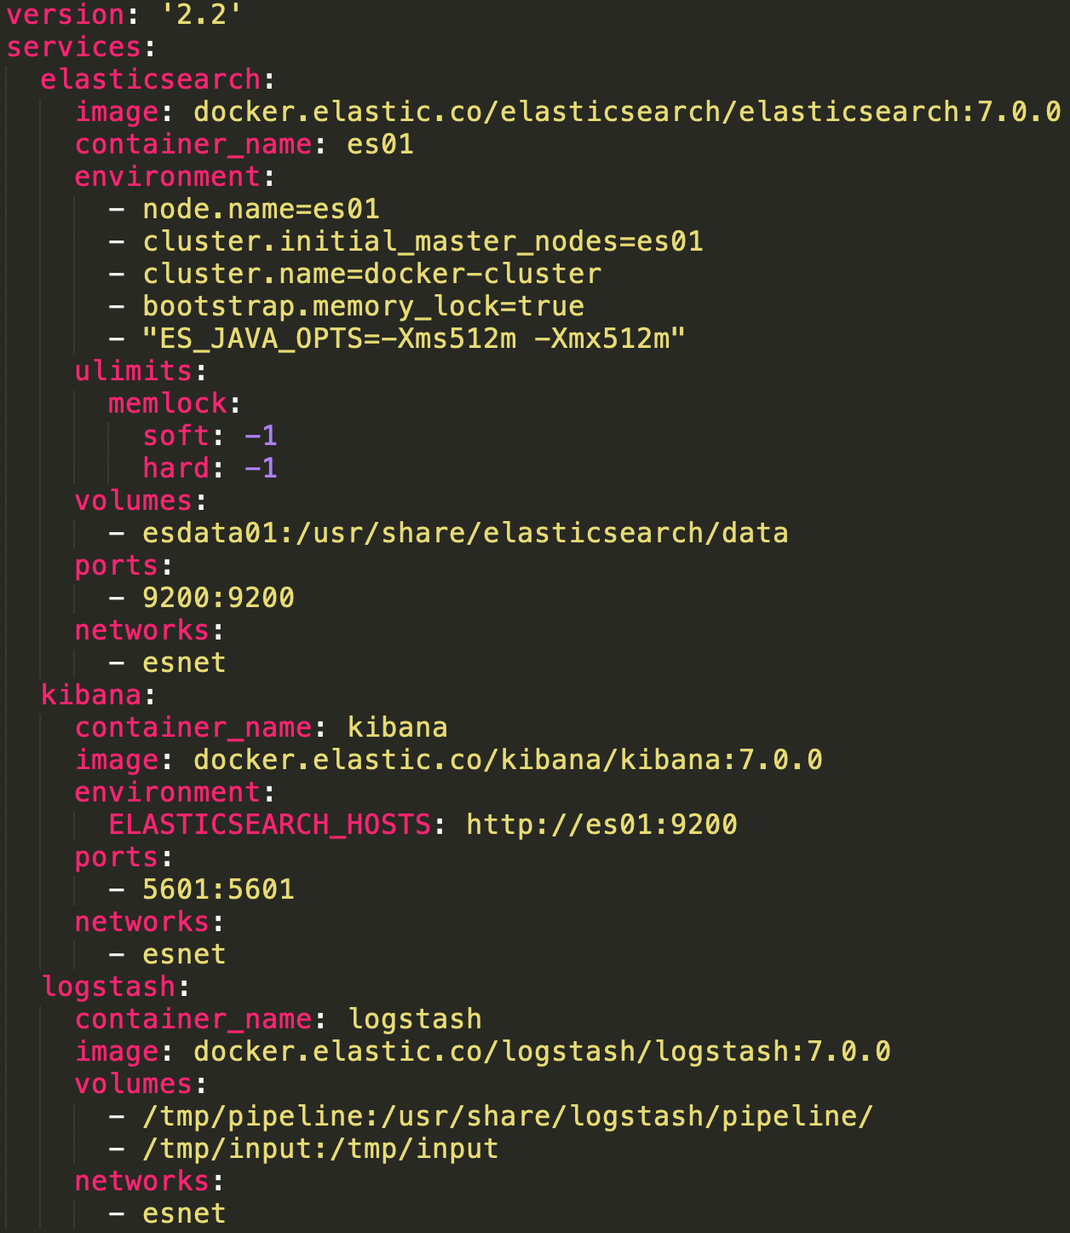
Implementation Details
Installing Elastic Stack using
Docker Compose

Slide 12
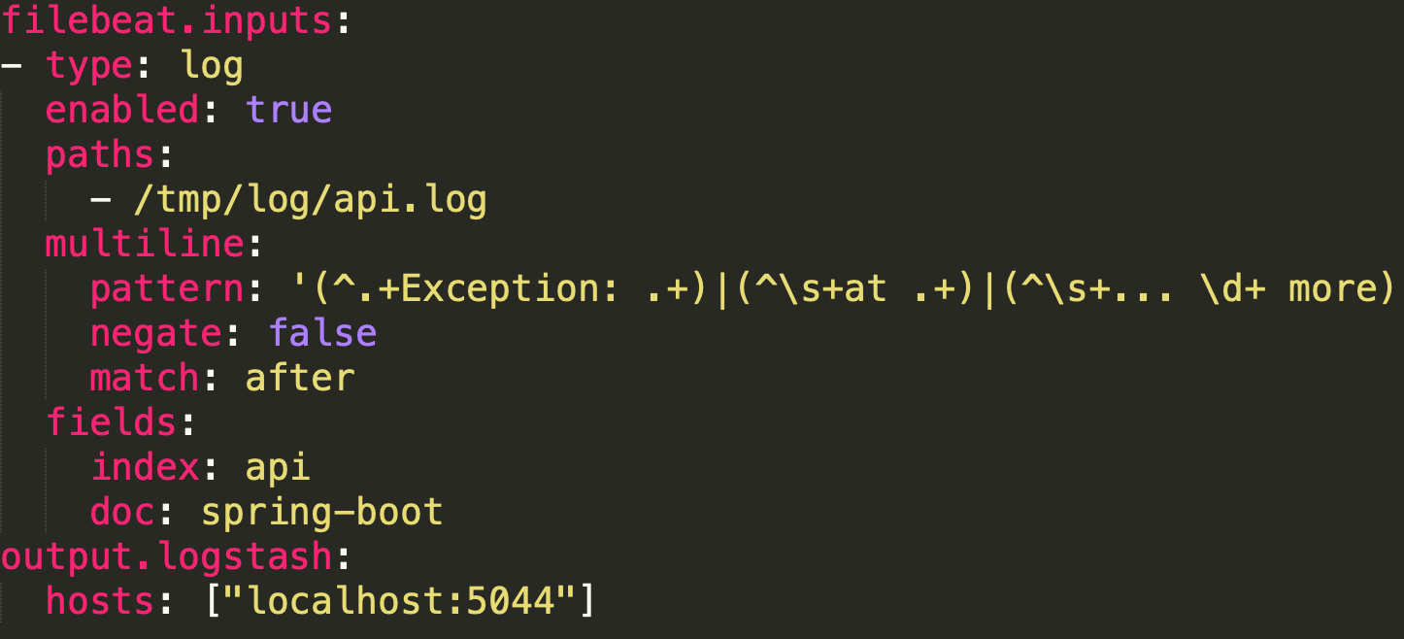
Implementation Details
Filebeat
is a lightweight log data shipper for local files
monitors all the logs in the log directory and forwards to Logstash
configuration:
Because Java stack traces
consist of multiple lines, so we need
consolidate these lines into a single
event in Filebeat
Logstash output sends events directly
to Logstash by TCP

Slide 13
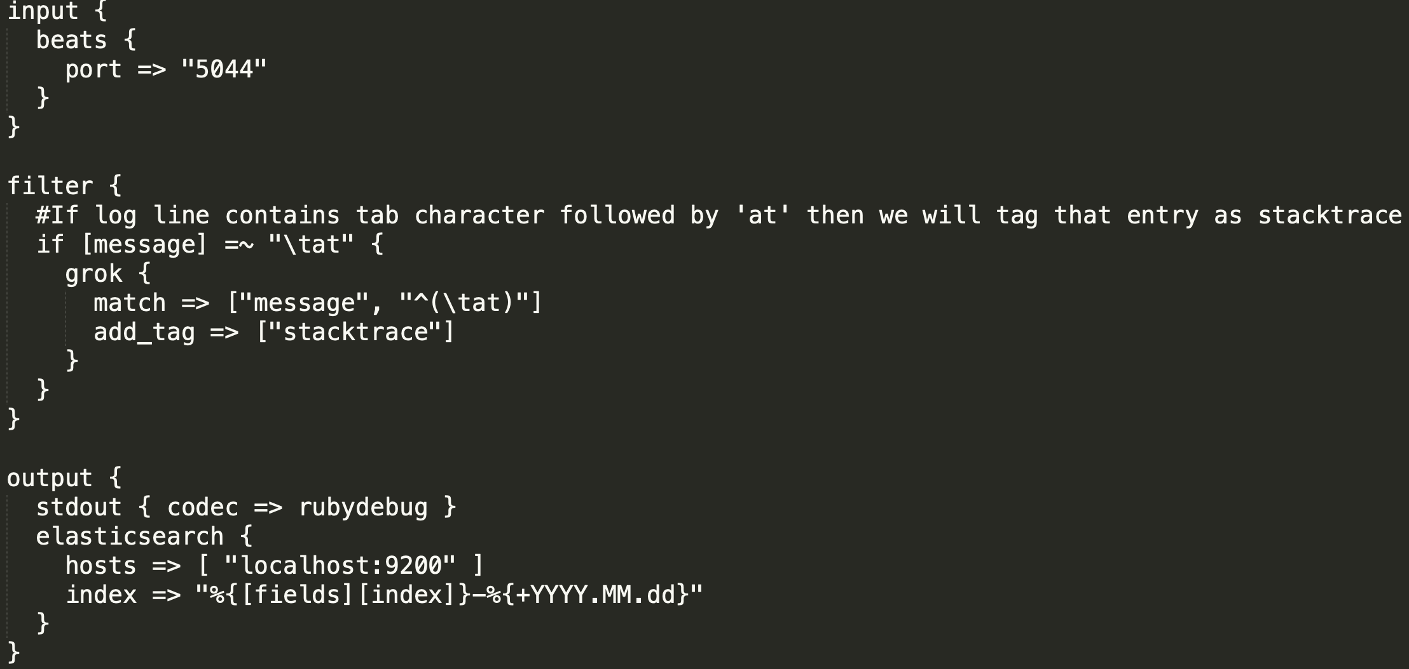
Implementation Details
Logstash
An open source, server-side data processing pipeline that ingests data from a multitude of sources, transforms it, and then sends it to your favorite “stash.”
configuration:
1. input
The Logstash event
processing pipeline has
three stages:
2. filters
(optional)
3. outputs

Slide 14
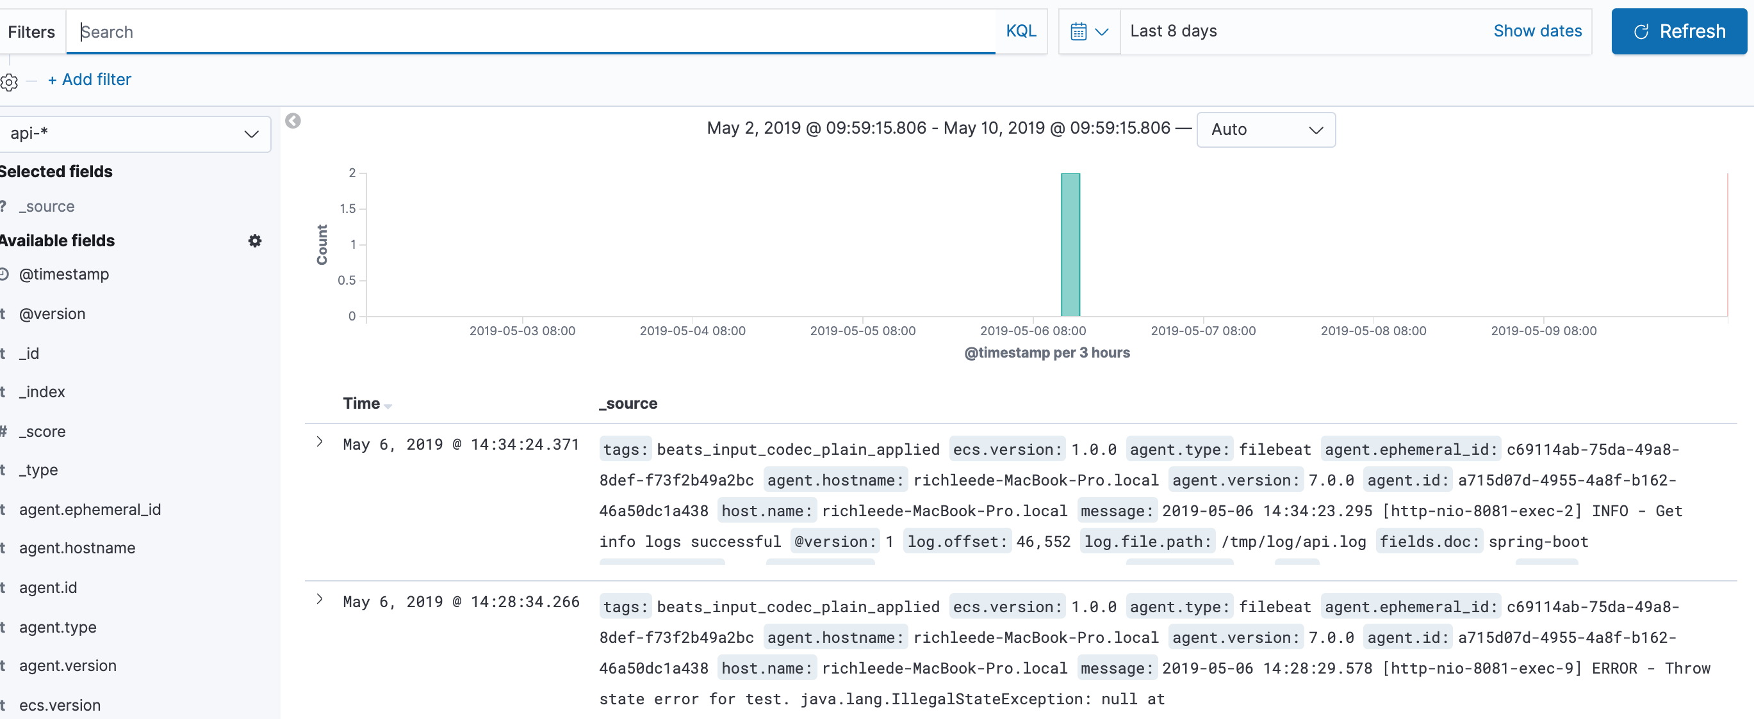
Implementation Details
Kibana
The Discover page allows you to perform different types of searches on the log data.
log data

Slide 15
Advanced Design for Large Amounts of Logs
Context:
When the service increases, the amount of data in the log will become larger
Following a production incident, logs can suddenly surge
Problem:
The receiving end (Logstash or Elasticsearch) will be the main bottleneck.
Suddenly surge logs will overwhelm your logging infrastructure.
Solution:
To protect Logstash and Elasticsearch against such data bursts, users deploy buffering mechanisms to act as message brokers.

Slide 16

Advanced Design for Large Amounts of Logs
Apache Kafka is a Publish-Subscribe messaging system, originated at Linkedin in 2009, open sourced in 2011. Apache Kafka has some characteristics such as:
Kafka was designed to be distributed inherently. This makes Kakfa be very easy to scale out.
High throughput, high performance
Guarantee the fault-tolerant in term of machine failure.

Slide 17
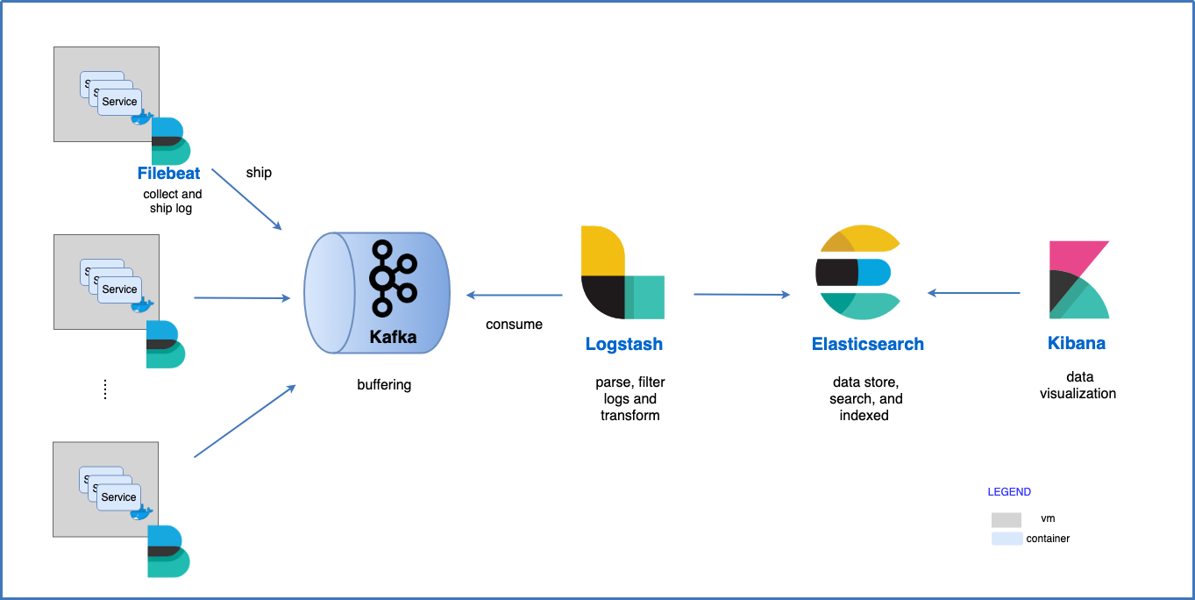
Advanced Design for Large Amounts of Logs
Apache Kafka is the most common broker solution deployed together the ELK Stack.
Usually, Kafka is deployed between the shipper and the indexer, acting as an entrypoint for the data being collected

Slide 18
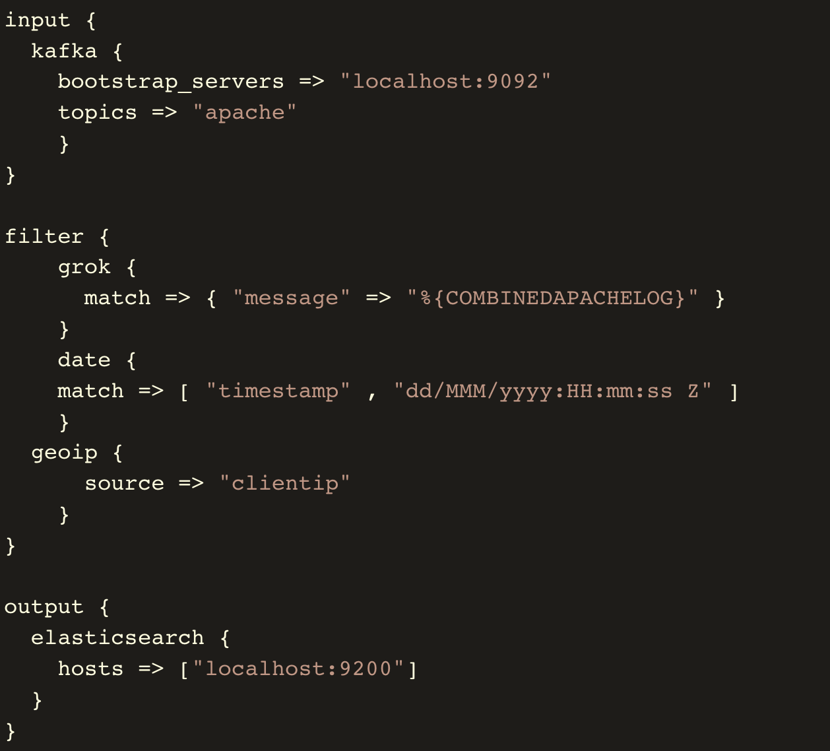
Advanced Design for Large Amounts of Logs
Logstash config: aggregates the data from the Kafka topic, processes it and ships to Elasticsearch.
Logstash Kafka input plugin to define
the Kafka host and the topic we want Logstash to pull from.

Slide 19
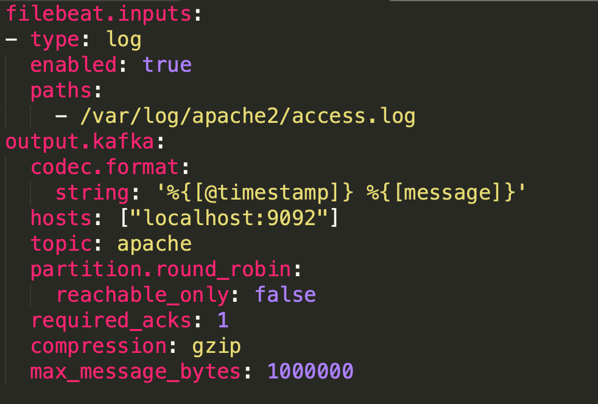
Advanced Design for Large Amounts of Logs
Filebeat config: collects logs and forwards them to a Kafka topic.
forward the data to Kafka server
and the relevant topic

Slide 20
Querying Data
Elasticsearch Query DSL
Get mapping field of index
Get document by id
URI Search
curl -XGET 'http://localhost:9200/api-2019.05.06?pretty'
curl -XGET 'http://localhost:9200/api-2019.05.06/_doc/sxXZi2oB-PgPWl1Y9Cl1?pretty=true'
curl -XGET 'http://localhost:9200/api-2019.05.06 \
/_search?q=message:ERROR&from=0&size=10&sort=@timestamp:desc&pretty’

Slide 21
Querying Data
Elasticsearch Query DSL
Request Body Search
Count query
curl -H "Content-Type: application/json" \
-XGET 'http://localhost:9200/api-2019.05.06/_search?pretty' -d \
'{
"query" : {
"match" : { "message": "ERROR"}
}
}'
curl -H "Content-Type: application/json" \
-XGET 'http://localhost:9200/api-2019.05.06/_doc/_count?pretty' -d \
'{
"query" : {
"term" : {"message" : "ERROR"}
}
}'

Slide 22
Querying Data
Elasticsearch Query DSL
Validate DSL
result:
curl -H "Content-Type: application/json" \
-XGET 'http://localhost:9200/api-2019.05.06/_doc/_validate/query?pretty' -d \
'{
"query" : {
"term" : {"message" : "ERROR"}
}
}'
{
"_shards" : {
"total" : 1,
"successful" : 1,
"failed" : 0
},
"valid" : true
}

Slide 23
Querying Data
Kibana
is the front end for Elasticsearch and provides visualizations for data, that can be used to search, view, and analyze data.
Kibana User Interface
Discover
Visualize
Dashboard
Kibana Query Language (KQL)
Release from version 6.3
If a default field is not set these terms will be matched against all fields

Slide 24
Querying Data
Kibana Query Language (KQL)
Match query
message:"info”
Token analyzer query
message:"info error"
Multiple values query
message:(info or error)
Wildcard query
container.name: *api
Field exist querie
fields.doc:*

Slide 25
Backing Up Data
Backup Snapshot
Using the snapshot API to back up the cluster.
The current state and data in the cluster are saved in a shared repository.
The first snapshot is a complete copy of the data, but all subsequent snapshots are incremental backups
There are several options to choose from for a repository:
Shared filesystem such as NAS
Azure Cloud
Amazon S3
HDFS

Slide 26
Backing Up Data
Performing a cluster backup entails executing three steps:
Define a repository (Instruct Elasticsearch on how you want the repository structured)
Confirm the existence of the repository
Execute the backup
Backup/restore example:
Step1: Defining a new repository
curl -XPUT 'localhost:9200/_snapshot/foo_backup' -d
'{
“type” : “fs”, //shared file system type
"settings" : {
"location" : "/usr/share/elasticsearch/data/backups/foo_backup"
}
}'

Slide 27
Backing Up Data
Step2: Check the repository existence
Step3: Create a snapshot of particular index (api-2019.05.23)
Step4: Monitoring snapshot progress
curl -XGET 'localhost:9200/_snapshot/foo_backup?pretty'
curl -XPUT 'localhost:9200/_snapshot/foo_backup/snapshot_api-2019.05.23' -d '
{
"indices" : "api-2019.05.23” //Comma-separated list of index names to snapshot
}'
curl -XGET 'localhost:9200/_snapshot/foo_backup/snapshot_api-2019.05.23/_status'

Slide 28
Backing Up Data
Step5: Retrieving information on the state of a given snapshot
response:
curl -XGET 'localhost:9200/_snapshot/foo_backup/snapshot_api-2019.05.23'
{
"snapshots": [
{
"snapshot": "napshot_api-2019.05.23",
"uuid": "knM5TEZrRxKhIqvpPQO74w",
"version_id": 7000099,
"version": "7.0.0",
"indices": [“api-2019.05.23"],
"include_global_state": true,
"state": "SUCCESS",
"start_time": "2019-05-24T06:30:11.737Z",
"start_time_in_millis": 1558679411737,
"end_time": "2019-05-24T06:30:11.791Z",
"end_time_in_millis": 1558679411791,
"duration_in_millis": 54,
"failures": [],
"shards": {
"total": 1,
"failed": 0,
"successful": 1
}
}
]
}

Slide 29
Backing Up Data
Step6: Restoring from a snapshot
The default action is to restore all the indices present in the snapshot
or set wait_for_completion flag=true (executes in the foreground)
curl -XPOST 'localhost:9200/_snapshot/foo_backup/snapshot_2/_restore'
curl -XGET 'localhost:9200/_snapshot/foo_backup/snapshot_api-2019.05.23'?wait_for_completion=true

Slide 30
Housekeeping Strategy
Time-based indices
Index name pattern: <index_name>.yyyy.MM.dd
faster and reduces to remove documents and reduces memory CPU and overhead (delete by index directly)
large amounts of bulk deletions can result in large Lucene index segments
Cron Job: delete the index seven days before every AM 2:oo
For example: if housekeeping is 7 days and today is 2019/06/08, then delete 6/01 index
Indices: [
“api-2019.06.01”, (deleted)
“api-2019.06.02”,
“api-2019.06.03”,
“api-2019.06.04”,
“api-2019.06.05”,
“api-2019.06.06”,
“api-2019.06.07”,
“api-2019.06.08”
]
keep 7 days

Slide 31
Management & Monitoring Tools
Elasticsearch Admin GUI Tools:
ElasticHQ : as a monitoring and management platform for Elasticsearch clusters.
Cerebro: is a elasticsearch web admin tool built using Scala, Play Framework, AngularJS and Bootstrap.
ElasticHQ | Cerebro
Apache Software License | MIT License
Can monitor and manage many clusters at the same time | Observe the index shards allocation
Monitor and manage clusters, nodes, indices, aliases, and shards | Manage cluster settings, aliases and index templates
Easy-to-Use Querying capabilities | Create snapshot
Saves monitored clusters

Slide 32
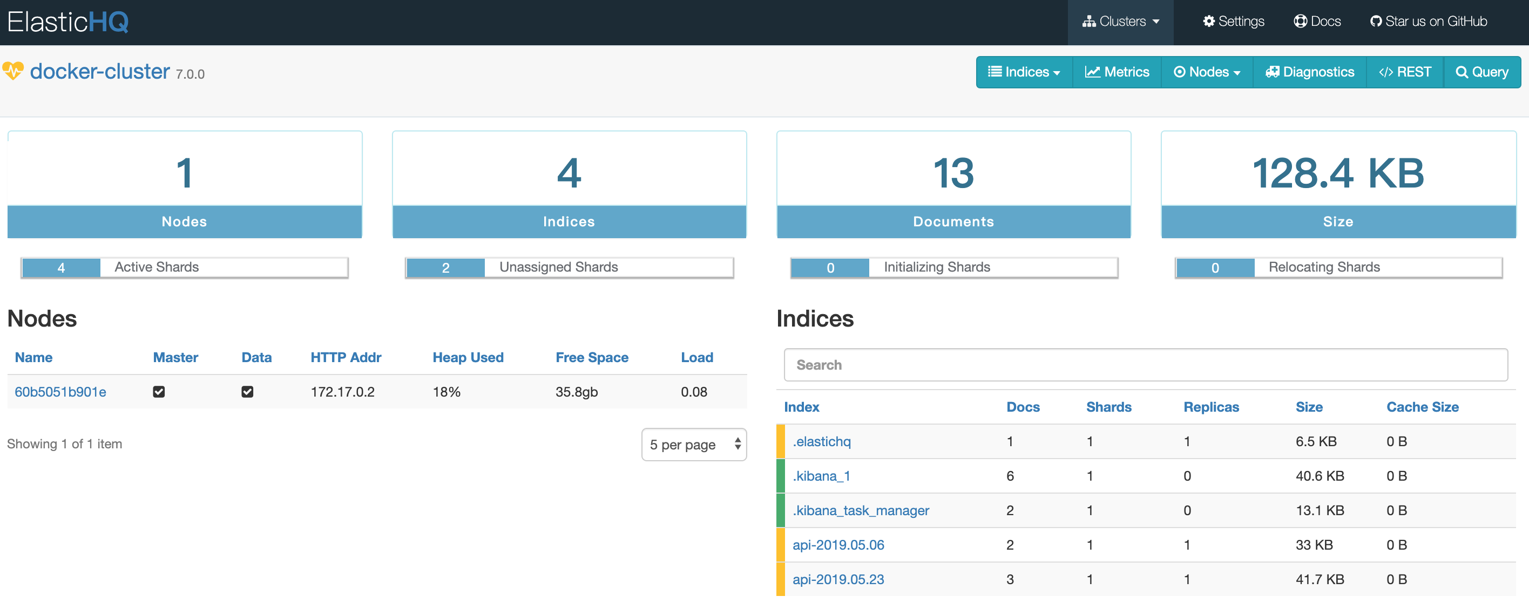
Management & Monitoring Tools
ElasticHQ

Slide 33
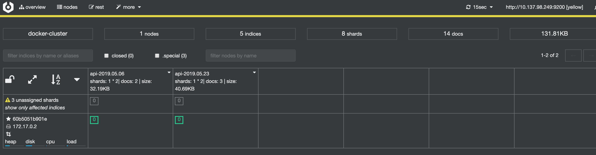

Management & Monitoring Tools
Cerebro

Slide 34
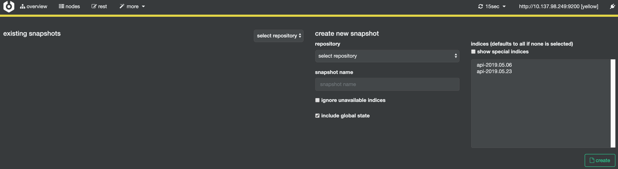
Management & Monitoring Tools
Cerebro (snapshot management)

