Slide 1

Bangladesh Army University of Science & Technology (BAUST), Saidpur
Project Name: Airline Reservation
Course Code : CSE2200
Course Title : Software Development Project II
Submitted By :
Submitted To :
Student Name : Husne Ara Kabir Rifat
ID : 180201056
Batch : 8th
Level : 2 Term : II
Section :B
Teacher Name : MD. Toukir Ahmed
Designation : Lecturer
Bangladesh Army University of Science & Technology (BAUST),Saidpur Cantonment, Saidpur, Nilphamari

Slide 2

Outlines
1. Introduction
Objectives
Development Tools
Requirement Analysis
Login
Menu bar
Add Flight
Add customer
Flight ticket
Search customer
Book ticket
Ticket Report
User creation
Future Work

Slide 3
Introduction
Airline reservation System is a computerized system used to store and retrieve information and conduct transactions related to air travel. The project is aimed at exposing the relevance and importance of Airline Reservation Systems. It is projected towards enhancing the relationship between customers and airline agencies through the use of ARSs, and thereby making it convenient for the customers to book the flights as when they require such that they can utilize this software to make reservations.

Slide 4
Objectives
1.Customer
2.Ticket
3.Flight
4.User
Airline reservation
Page

Slide 5
Development Tools
1. NetBeans 8.2 for JAVA
2. Xampp-control
Database
My SQL

Slide 6
Requirement Analysis
Hardware Requirements:
PC with dual core or more processor
8GB RAM or above
180 GB Hard disk or above
Net connectivity
Software Requirements:
NetBeans IDE 8.2
Microsoft word document
Microsoft Excel Worksheet
Operating System Windows

Slide 7
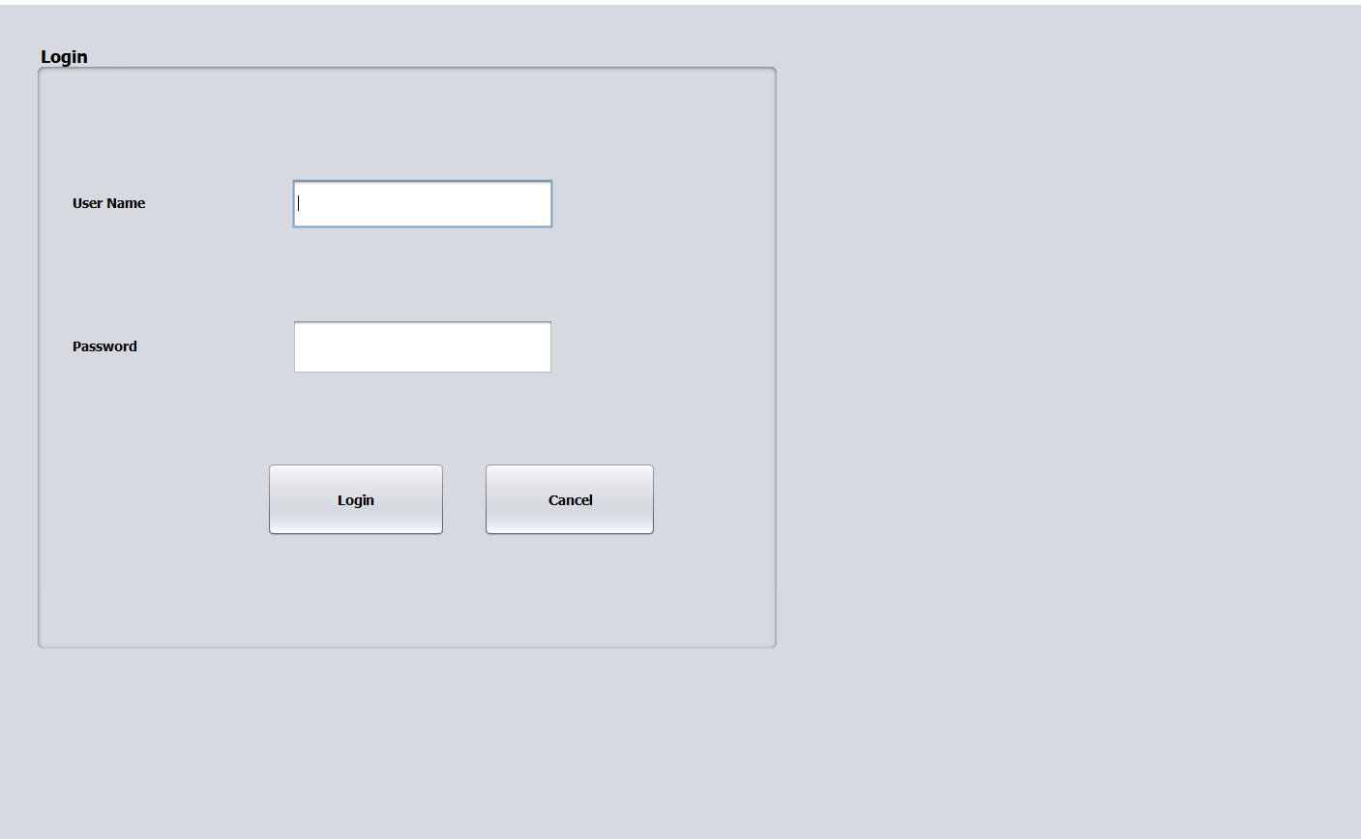
Login

Slide 8
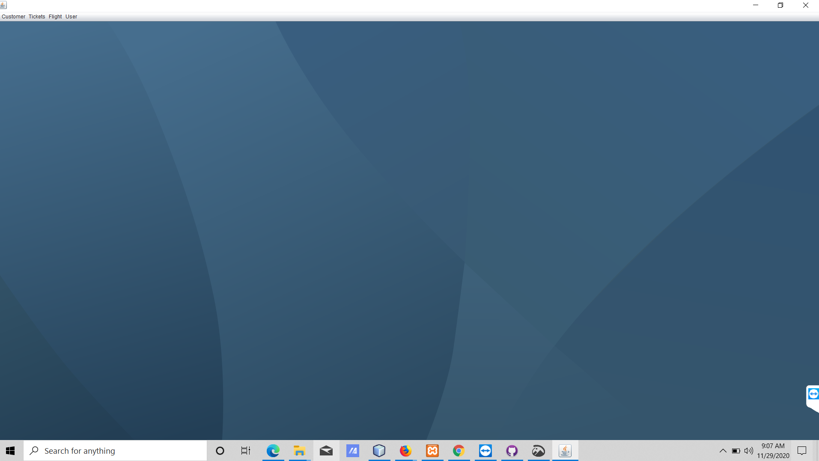
Menu Bar

Slide 9
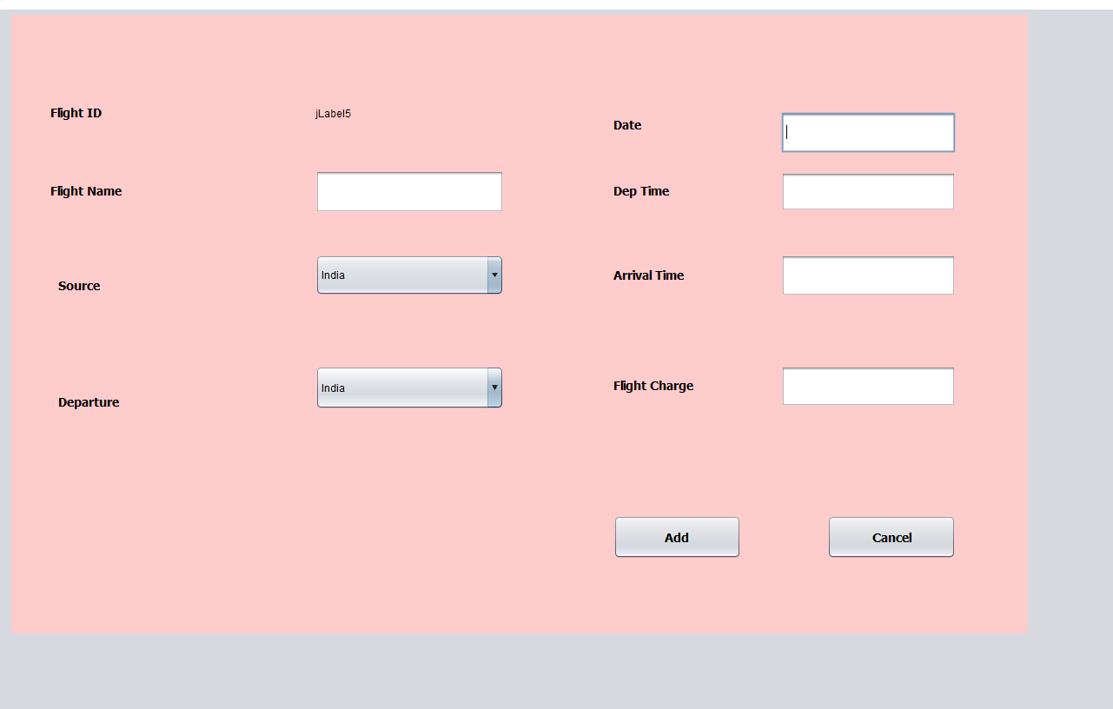
Add Flight

Slide 10
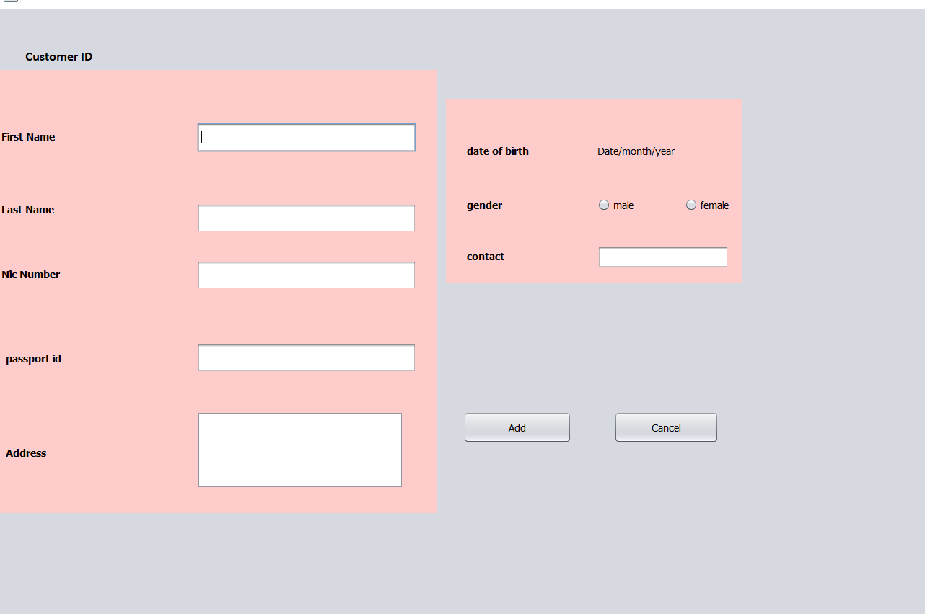
Add Customer

Slide 11
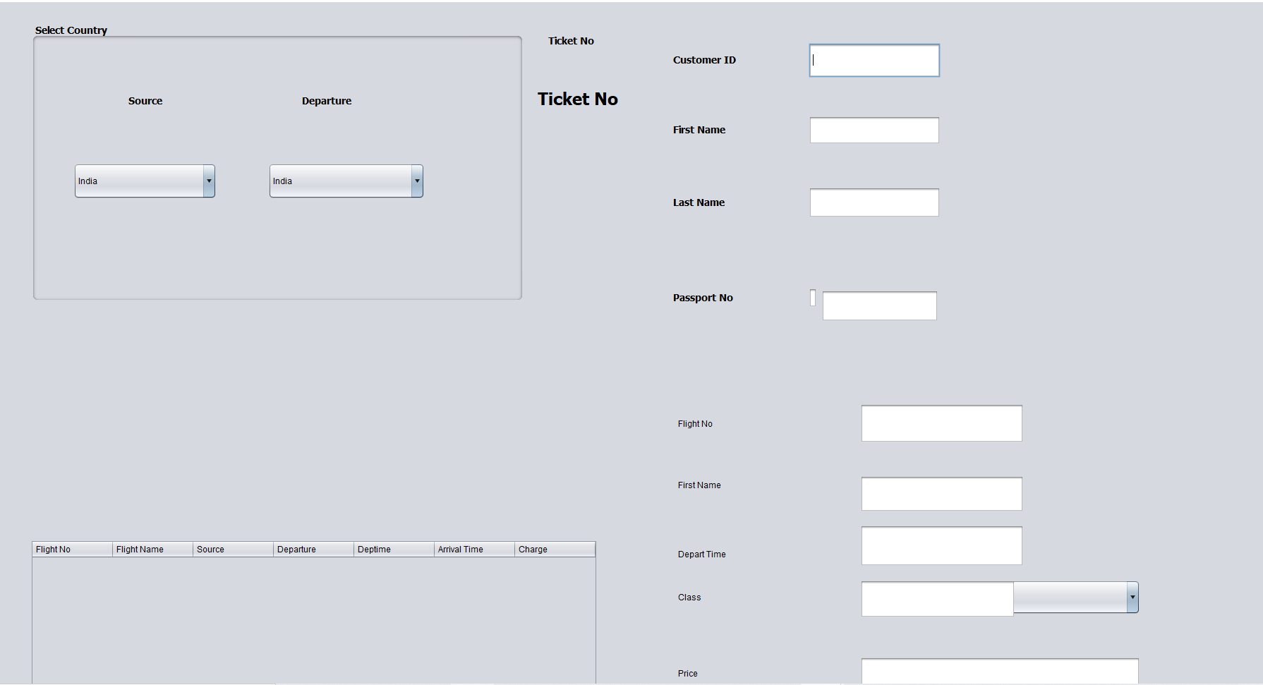
Book Ticket

Slide 12
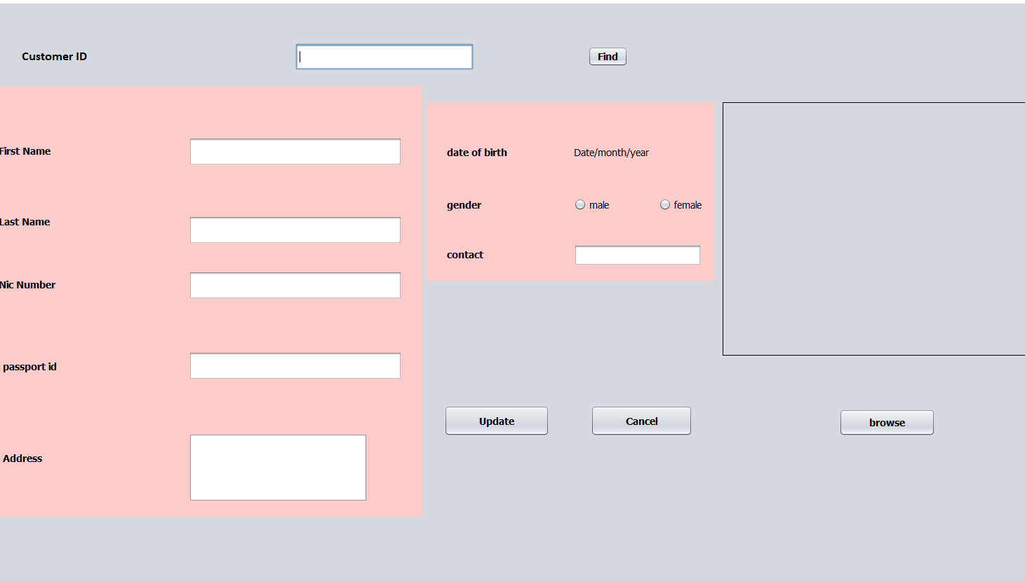
Search Customer

Slide 13
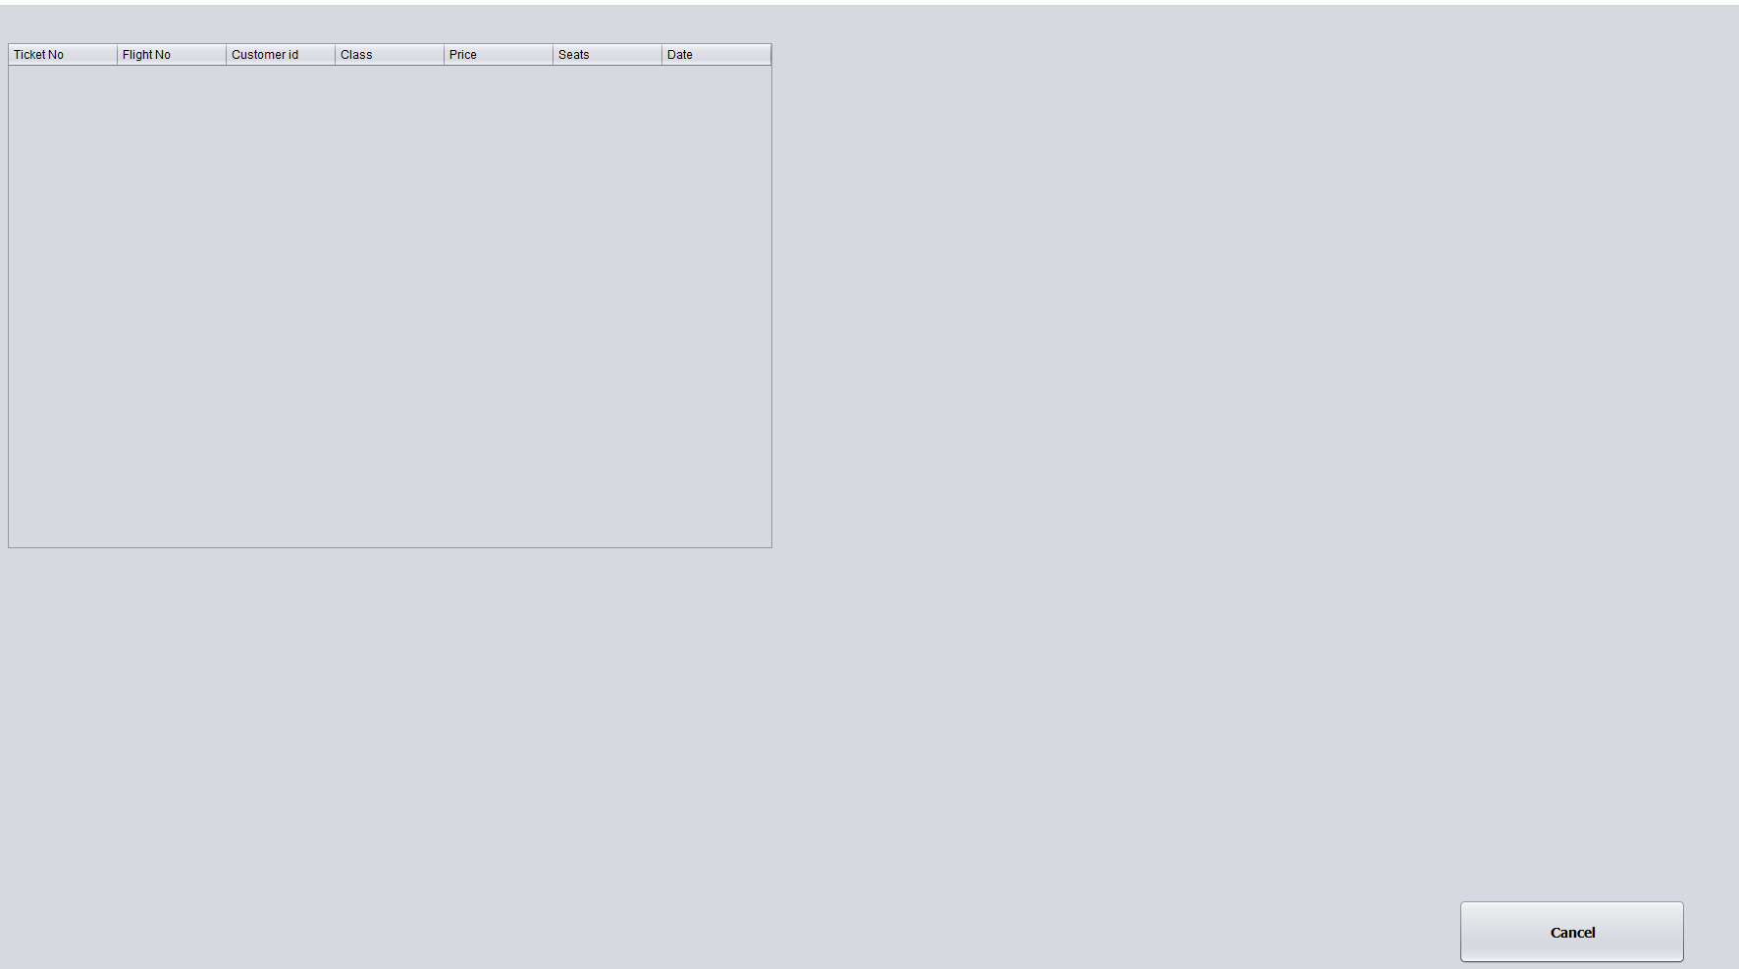
Ticket Report

Slide 14
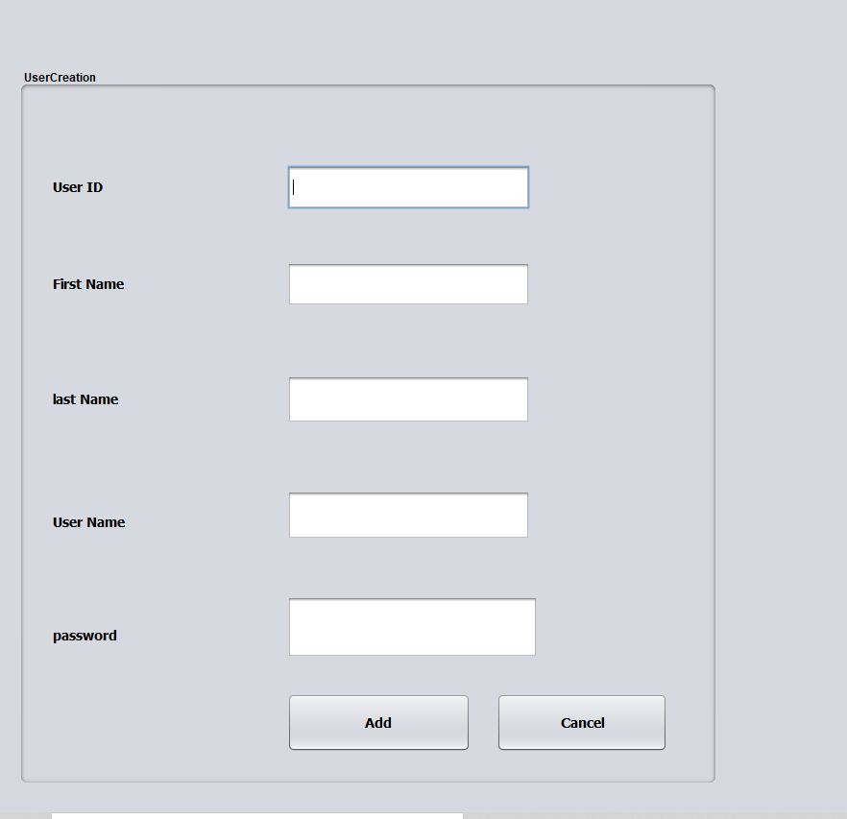
User Creation

Slide 15
GitHub Link: https://github.com/RIFAT-56/Airline-Reservation

Slide 16
Future Work
I haven’t finish my work yet.The work of the database is still pending also some code.Hopefully after these works are over we will get a best Airline Reservation System.
Since Android app in the future that everyone can use and enjoy
Thank you !!

