Slide 1
IIT Search Engine
A Domain-Specific Information Retrieval System
Rifat Al Maruf
BSSE1705
⌕
1
→
→
Institute of Information Technology
University of Dhaka
SPL-1 Project Proposal
A Java-based search engine for indexing, searching and ranking information from an IIT-focused document collection.
Notes:
Project identity: a Java information retrieval system for an IIT document corpus. The core retrieval algorithms are implemented manually.

Slide 2
Problem & Motivation
IIT information can be spread across PDFs, notices, academic documents and other files.
Scattered documents
Manual lookup
Focused retrieval
The collection grows across files and folders.
→
Browsing folders and opening files takes time.
→
A query should return the relevant documents.
Need: fast and focused retrieval from an IIT-specific document collection.
Target users
IIT students
Teachers
Academic / administrative users
02
Notes:
Problem: scattered IIT documents become hard to search manually as the corpus grows. The intended users are students, teachers, and academic or administrative staff.

Slide 3
How the Search Engine Works
INDEX THE COLLECTION
IIT documents
Text extraction
Text preprocessing
Inverted / positional index
→
→
→
PDFs, notices and academic files
Read usable text from each file
Tokenize, normalize and filter
Term → document occurrence + position
index lookup
SEARCH THE INDEX
↓
Top-K results
TF-IDF ranking
Process & match
User query
←
←
←
Ranked documents with snippets
Score and order matched documents
Keyword, phrase or logical query
Keywords or a multi-word phrase
Preprocessing and indexing happen before a query; matching retrieves candidates from the stored index.
03
Notes:
Two connected stages. The document pipeline creates a stored inverted and positional index. The query pipeline uses that index for matching, then applies TF-IDF ranking and returns Top-K results with snippets.

Slide 4
Core Algorithms & Technology
Core search algorithms / data structures
Technology / tools
Text preprocessing
Inverted index
Java • Java File I/O
Tokenization; normalization and filtering
Map terms to documents containing them
IntelliJ IDEA
Git • GitHub
Positional index
Query processing
Store positions for phrase-aware retrieval
Keyword, multi-word, phrase and logical queries
Core information-retrieval algorithms and data structures will be implemented manually.
TF-IDF ranking
Top-K selection
Score the relevance of matched documents
Return the highest-ranked results
No Lucene, Elasticsearch or Solr for the search-engine core.
04
Notes:
Explain the manual Java implementation. The index stores both document occurrences and term positions, enabling phrase queries. Query processing, TF-IDF and Top-K result selection remain in the approved scope.

Slide 5
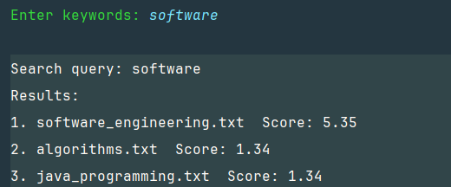
From Implementation to Final Outcome
Logical build order
01
Document collection
→
02
Extraction / preprocessing
→
03
Index construction
↓
06
Evaluation
←
05
Ranking / result generation
←
04
Query processing
Expected outcome
Prototype v0.1 — Sample Search Run
Working IIT search engine
Search over an IIT-specific document corpus
Indexed retrieval
Search the stored index instead of scanning every file; return ranked Top-K results and snippets
Measurable performance
Indexing time, query time, index size and corpus statistics
Evaluate: indexing time • query time • index size • corpus statistics
05
Notes:
The boxes show technical implementation order rather than a calendar. The final system indexes an IIT-focused corpus and returns ranked Top-K results and snippets. Evaluate indexing and query time, index size and corpus statistics.

