Slide 1

Python Kids
Chapter 1

Slide 2
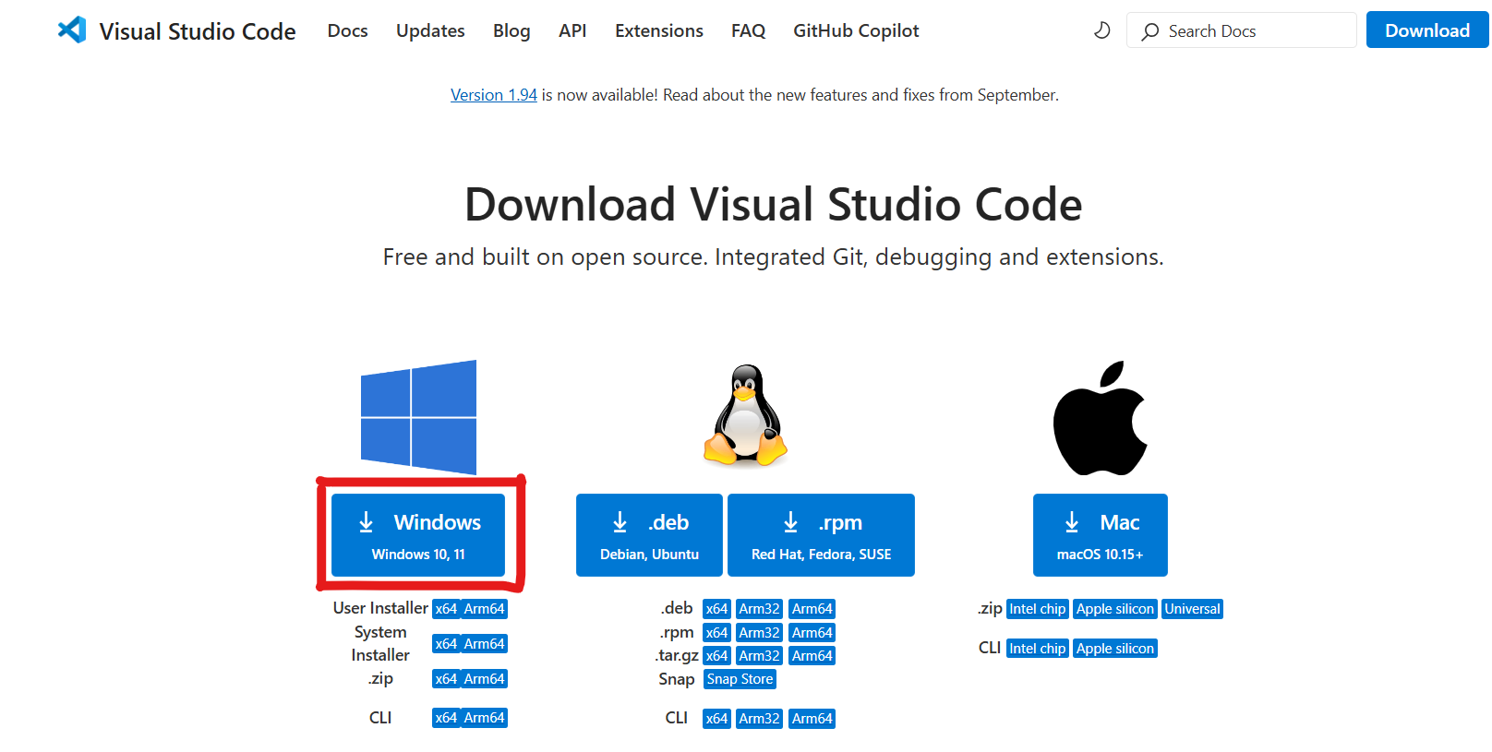
Visual Studio Code
https://code.visualstudio.com/Download
Install

Slide 3
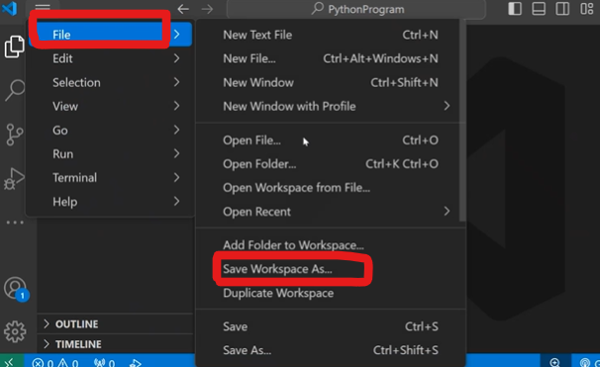
Python install in Visual Studio Code
Save as workspace your folder

Slide 4
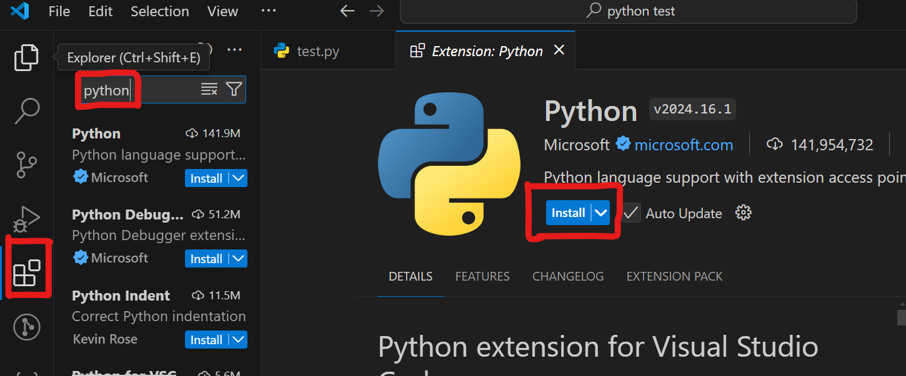
Install the Python extension
On VS Code's side-panel, click on its Extensions icon (looks like 4-cubes). On the Search bar that appears, search the string Python to locate and install this plugin:
Python (by Microsoft)

Slide 5
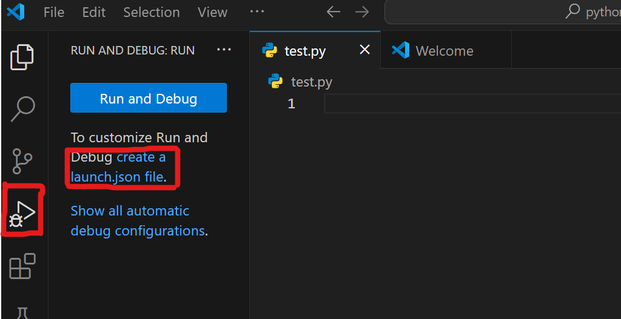
Debugging Python Scripts in Visual Studio Code
Step 1:

Slide 6
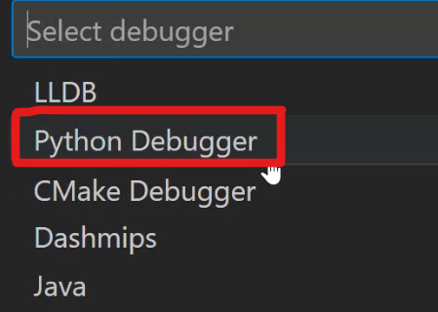
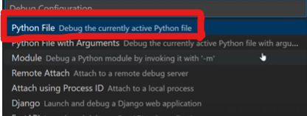
Debugging Python Scripts in Visual Studio Code
Step 2:
Step 3:

Slide 7
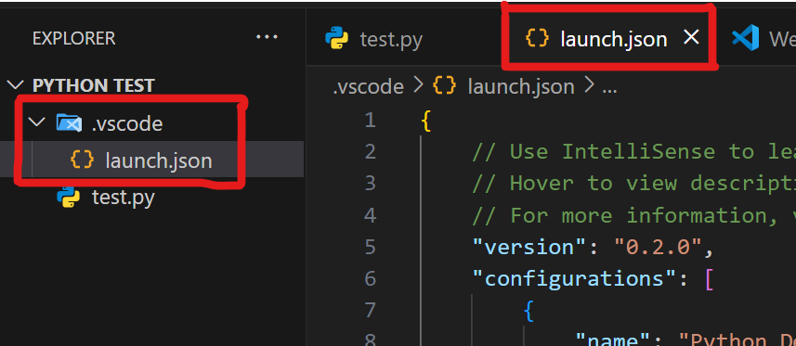
Debugging Python Scripts in Visual Studio Code
Step 3:
launch.json
{
"version": "0.2.0",
"configurations": [
{
"name": "Python: Current File",
"type": "python",
"request": "launch",
"program": "${file}",
"console": "integratedTerminal",
"justMyCode": true,
"cwd": "${fileDirname}"
} ] }

Slide 8
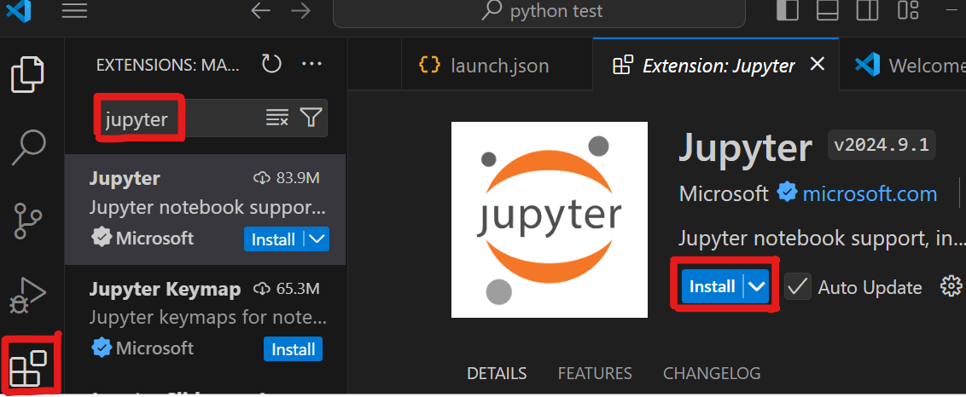
Install the Jupyter extensions

Slide 9
Let’s write some program in visual studio code

Slide 10
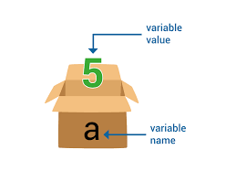
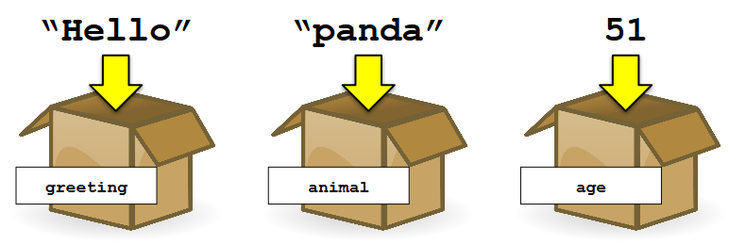
Variable
Container for storing data.
Example: fred = 100
print(fred)

Slide 11
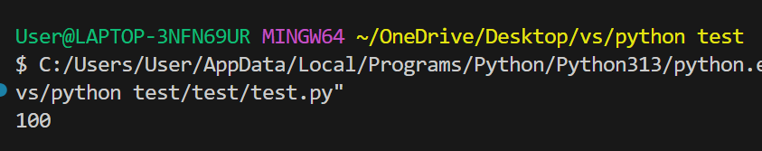
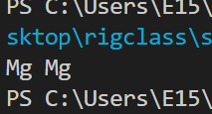
Write program with variable
Apple = 100
print(Apple)
name = "Mg Mg"
print(name)

Slide 12
String
We often term any text as a string in a programming language.
Every letter, symbol, and number can be considered a string.
If you boil down to it, your name can also be considered a string. The same can be said about your address or any other group of text.
fred = "Why do gorillas have big nostrils? Big fingers!!“
Print(fred)

Slide 13
Assignment 1
Create a variable called city and assign it the name of your favorite city as a string.
Create a variable called year and assign it the current year as an integer.
Print both variables.

Slide 14
List
an ordered sequence of elements
E.g.,
the list contains the words representing the first few numbers
['zero', 'one', 'two', 'three', 'four', 'five']
•put numbers or booleans in the list, or nothing
[1, 2, 3, 4, 5]
[True, False, True, True, False]

Slide 15
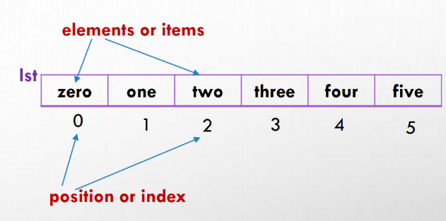
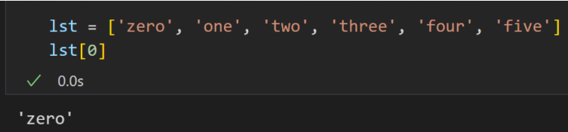
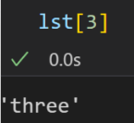
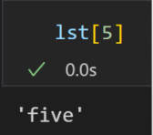
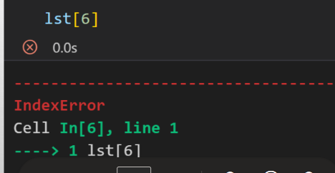
Accessing elements
• Fetch a single element from the list

Slide 16
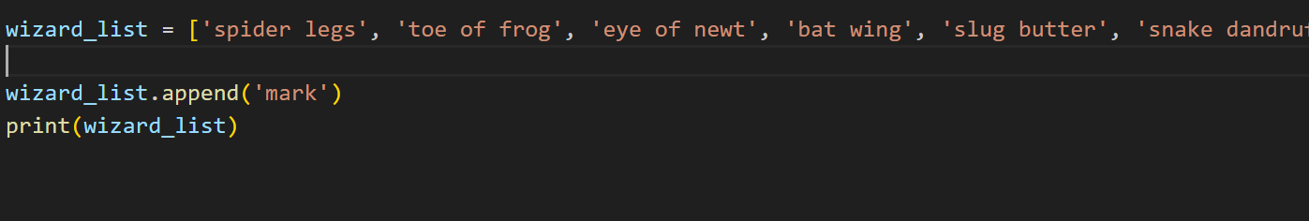
Adding Items to Lists
Example:
wizard_list.append('bear burp')
print(wizard_list)

Slide 17
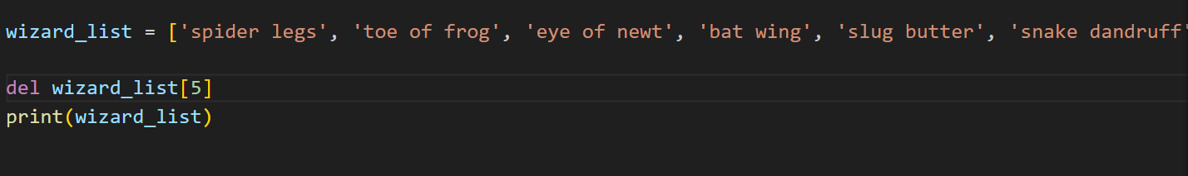
Removing Items From Lists
del wizard_list[5]
print(wizard_list)
Example:

Slide 18
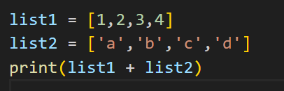
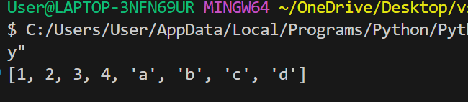
Arithmetic in Lists
>>> list1 = [1, 2, 3, 4]
>>> list2 = ['I', 'tripped', 'over', 'and', 'hit', 'the', 'floor'] >>> print(list1 + list2)
[1, 2, 3, 4, 'I', 'tripped', 'over', 'and', 'hit', 'the', 'floor']
Example:

Slide 19
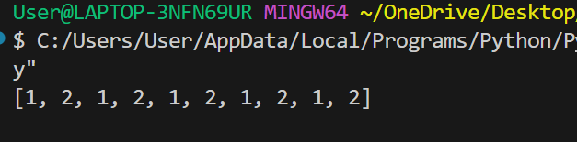

Arithmetic in Lists

Slide 20
Assignment 2
Create a list called fruits that contains at least five different fruit names as strings.
Print the entire list.Print the first and last elements of the list using indexing.
Change the second fruit in the list to "Mango" and print the updated list.
Add a new fruit to the end of the list using .append().

Slide 21
Tuples
Tuples are like lists, but the difference is that the former uses parentheses.
>>> fibs = (0, 1, 1, 2, 3)
>>> print(fibs[3])
2
Example:

Slide 22
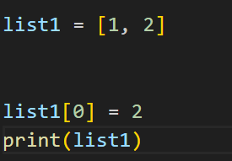
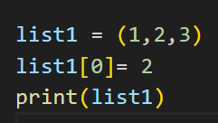
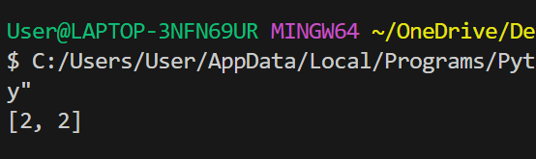
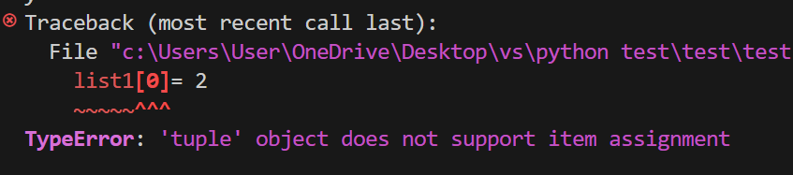
Different Between Tuples and List
List
Can change value
Tuples
Cannot change value

Slide 23
Dictionary
A dictionary in Python is a collection of key-value pairs. It is used to store data in an unordered, changeable, and indexed manner, making it efficient for lookups and modifications.
student = {
"name": "Alice",
"age": 20,
"grade": "A",
"city": "New York"
}
print(student)

Slide 24
Key Features of a Dictionary
✅ Unordered → Items are not stored in a specific order. ✅ Key-Value Pairs → Each item consists of a key and a value. ✅ Mutable → You can modify, add, or remove elements. ✅ Unique Keys → Each key in a dictionary must be unique.

Slide 25
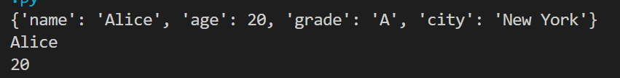
Accessing Dictionary
Use the key inside square brackets [ ] or the .get() method.
student = {
"name": "Alice",
"age": 20,
"grade": "A",
"city": "New York"
}
print(student)
print(student["name"])
print(student.get("age"))

Slide 26
Modifying a Dictionary
can update values, add new keys, or remove elements.
student["age"] = 21 # Updating value
student["subject"] = "Math" # Adding new key-value pair
print(student)
del student["city"] # Removing a key

Slide 27
Thanks!
Realistic Infotech Group
IT Training & Services
No.79/A, First Floor
Corner of Insein Road and Damaryon Street
Quarter (9), Hlaing Township
Near Thukha Bus Station
09256675642, 09953933826
http://www.rig-info.com

