Slide 1

Python Kids
Python Basic

Slide 2
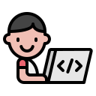
Introduction
writing computer programs.
• teaching the computer to do new things .
There are different languages for humans to speak to one another.
There are different programming languages for humans to speak to computers.

Slide 3
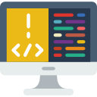
What is Programming?
The term programming means to create (or develop) software, which is also called a program.
In basic terms, software contains the instructions that tell a computer—or a computerized device—what to do.
Software developers create software with the help of powerful tools called programming languages.

Slide 4
Algorithm
An algorithm is a basic formula or a step-by-step instruction that you can use to complete any task or solve any problem.
A programmer will use it to tell a machine or computer how it should perform a specific task.
Example: your mother or grandmother may use a recipe to prepare a dish. This recipe is an example of an algorithm.
** Did you know that your morning routine is also an algorithm? **

Slide 5
Why Algorithm Matter in Coding?
Algorithms are essential in coding because they tell the computer exactly what to do, step by step.
If you’re writing code for a game, the algorithm might describe how characters move, how points are scored, or how levels change.
Just like in real life, algorithms help solve problems, but in coding, they allow the computer to solve them for you!

Slide 6
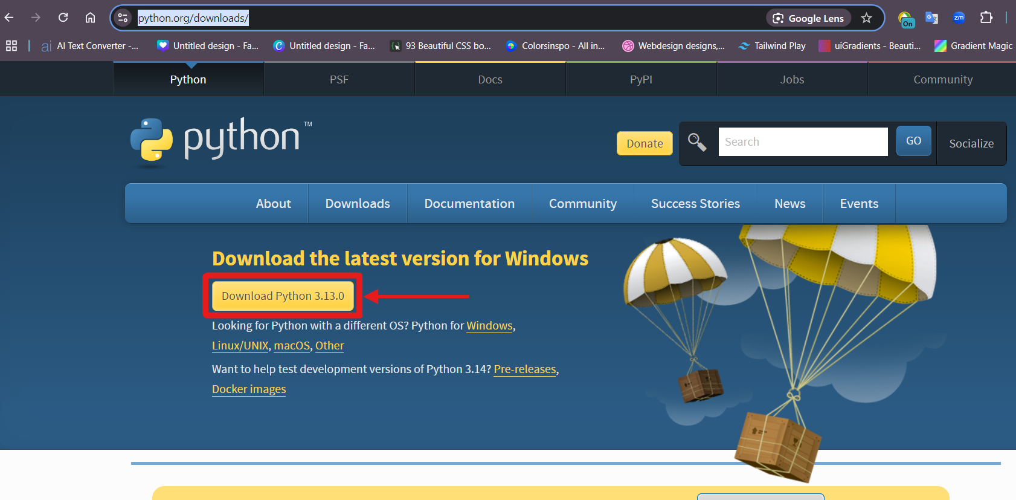
Requirement
https://www.python.org/downloads/
Download

Slide 7
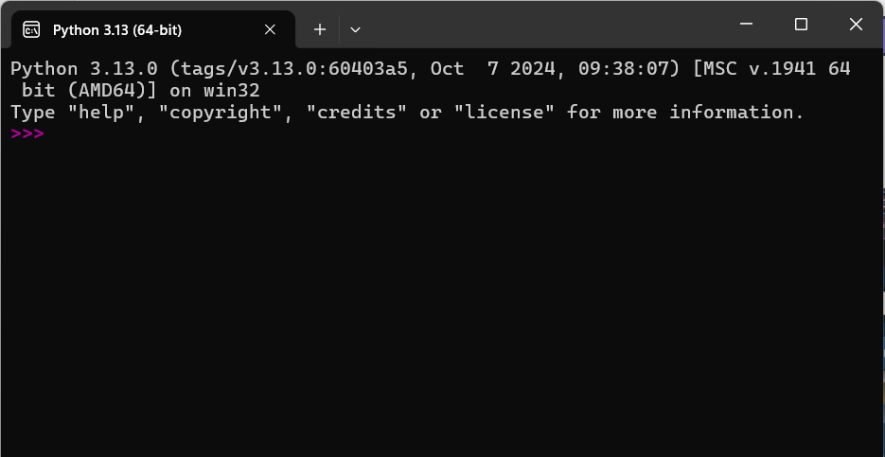
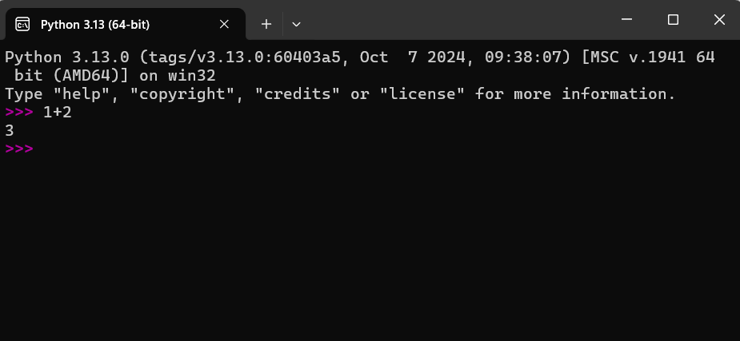
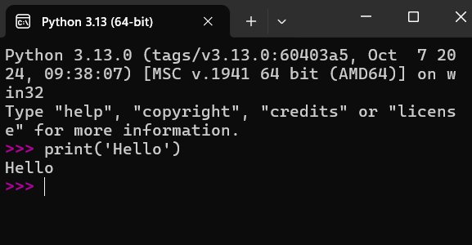
Let’s Start
Expressions and statements

Slide 8
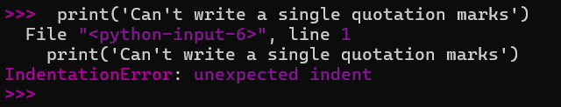

Error syntax
True Syntax

Slide 9
Operator
Math Operator
Operator | Description | Example
+ | addition | 1 + 2
- | Subtraction | 2 - 1
* | multiplication | 1 * 2
/ | Division | 2 / 1

Slide 10



Write program with Math Operator

Slide 11

Truth and Falsity
either something is true or it is not
boolean named after the English mathematician George Boole (1815–1864)
1. True
2. False
How can we use these?
Comparison

Slide 12
Operator
Comparison Operator
Operator | Description | Example
== | Equal | 1 == 1
< | Less than | 1 < 2
> | greater than | 2 > 1
<= | Less than or equal | 1 <= 2
>= | Greater than or equal | 2 >= 1
!= | Not equal | 2 != 1

Slide 13




Write program with Comparison Operator

Slide 14
The type of things
>>> type('Hello!’)
<class 'str'>
>>> type(25)
<class 'int'>
>>> type( 1 + 2 * 3)
<class 'int'>
>>> type(True)
<class 'bool'>
Three types of data
1. strings
2. integers
3. Booleans

Slide 15
Thanks!
Realistic Infotech Group
IT Training & Services
No.79/A, First Floor
Corner of Insein Road and Damaryon Street
Quarter (9), Hlaing Township
Near Thukha Bus Station
09256675642, 09953933826
http://www.rig-info.com

